Slide 1
Mechanical Condition Monitoring
Vibration Analysis
Lecture 2

Slide 2
Outline
Maintenance Strategies
Condition Monitoring Techniques
Characteristics of a Vibration Signal
Overall Vibration Criteria
Fault Diagnostics of rotating components

Slide 3
Objectives
Maintenance is the management, control, execution and quality of those activities which will ensure that optimum levels of availability and overall performance of plant are achieved, in order to meet business objectives - The British Department of Trade & Industry (DTI) (Rao, B.K.N.).
Maintenance activities can be characterised as:
a) general purpose, b) essential and c) critical

Slide 4
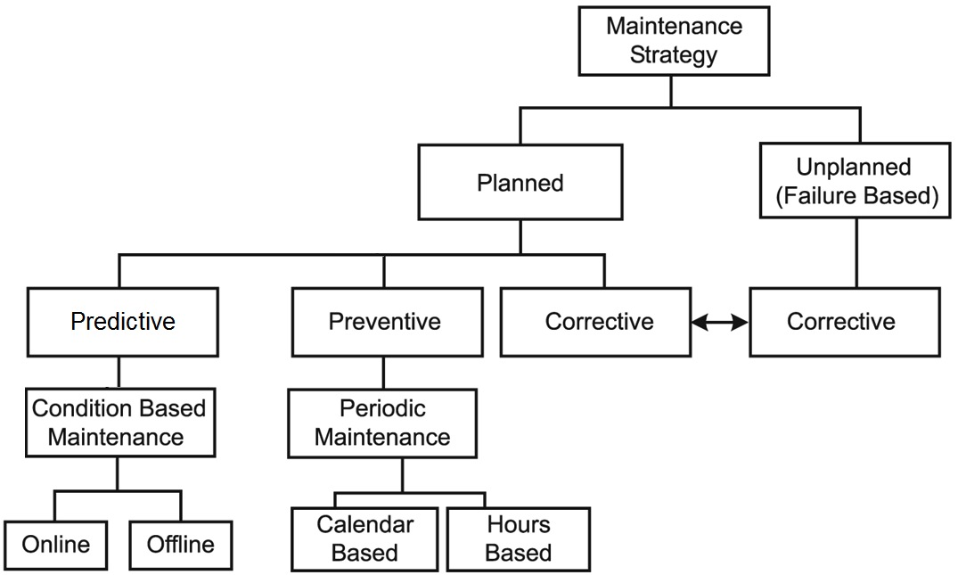
Maintenance Strategies
There are essentially three main approaches to maintenance of structures and machines:
Run-to failure maintenance
Preventive maintenance
Predictive maintenance

Slide 5
General Purpose Machines
Failure does not affect plant safety
Not critical to plant production
Machine has an installed spare or can operate on demand
These machines require low to moderate expenditure, expertise and time to repair
Secondary damage does not occur or is minimal

Slide 6
Essential Equipment
Machines whose failure can affect plant safety
Machines that are essential for plant operation and where shutdown will curtail a unit operation or part of the process
Machines that may or may not have an installed spare available
Shut-down is possible but may affect production process
High power and speed might not be running continuously
Some machines that demand time-based maintenance
These machines require moderate expenditure, expertise and time to repair

Slide 7
Critical Equipment
Machines whose failure can affect plant safety
Machines that are essential for plant operation and where a shut-down will curtail the production process
Machines which do not have spare parts
Machines that have high capital cost, are very expensive to repair, or take a long time to repair

Slide 8
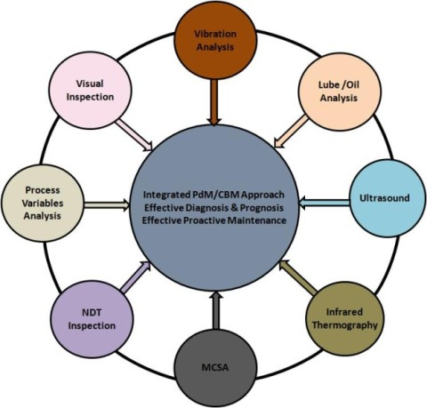
Condition Monitoring Techniques
Condition monitoring attempts to detect symptoms of eminent failure and approximates time of a functional failure.
It utilises a combination of techniques to obtain the actual operating condition of the machines based on collected data.
It can operate online or offline

Slide 9
Condition Monitoring Techniques
The specific techniques used depend on the type and operation of the machines:
Vibration monitoring – this is the most commonly used and effective technique to detect internal defects in rotating machinery.
Acoustic emission monitoring – this involves detection and location of cracks in bearings, structures, pressure vessels and pipelines.
Oil analysis – lubrication oil is analysed and the occurrence of certain microscopic particles in it can be connected to the condition of bearings and gears.
Particle analysis – worn machinery components, whether in reciprocating machinery, gearboxes or hydraulic systems, release debris. Collection and analysis of this debris provides vital information on the deterioration of these components.
Ultrasonic monitoring – this is used to measure thickness of corrosion or crack on pipelines, offshore structures, pressure vessels.

Slide 10
Vibration Monitoring
All rotating machines produce vibrations that are a function of the machine operating conditions and machine dynamics.
When a machine has a defect, the energy level of the specific component increases

Slide 11
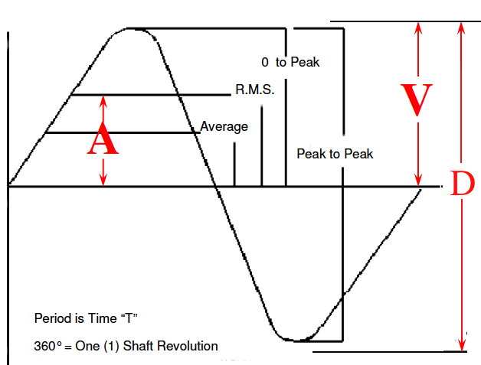
Characteristics of a Measured Vibration Signal
Frequency: its relation to the natural frequency, rotation frequency, and defect frequencies
RMS Velocity
P to P velocity
Displacement
Acceleration
Phase
Bandwidth
= Frequency Span / Analyzer Lines

Slide 12
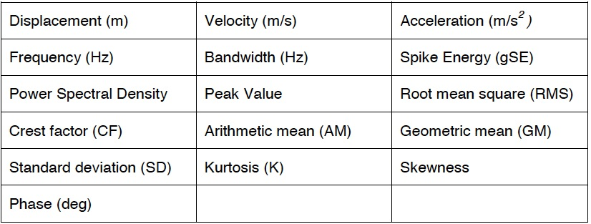
Characteristics of a Measured Vibration Signal
Some useful parameters characterizing vibration:

Slide 13
Information contained in a time waveform
Heavy Spot
Amplitude
+
0
Time
360 degrees
-
Rotation
1 revolution
3600 rpm = 3600 cycles per minute
60 Hz = 60 cycles per second
1 order = one times turning speed

Slide 14
Information contained in a time waveform
Amplitude
+
0
Time
-
1000 rpm
1 revolution
4 blades = vibration occurs 4 times per revolution
4 x 1000 rpm = vibration occurs at 4000 cycles per minute

Slide 15
Information contained in a time waveform
Amplitude
+
12 tooth
gear
0
Time
-
1000 rpm
1 revolution
12 teeth are meshing every revolution of the gear
12 x 1000 rpm = vibration occurs at 12,000 cycles per minute
frequency= 12,000 cpm = 200 Hz

Slide 16
Vibration Profiles
Vibration data recorded from machines is usually extremely complex as there are many sources of vibration.
Each source generates its own profile which will essentially be added together to give the composite profile.
Time-domain plots are useful in the overall analysis of machine trains to study operating condition changes but time-domain data are difficult to use.

Slide 17
Information contained in a time waveform
+
0
Time
-
+
0
Time
-
+
0
Time
-

Slide 18
Information contained in a system time waveform
+
0
Time

Slide 19
Complex/system time waveform

Slide 20
Time domain to frequency domain
Time-domain data may be broken down into their frequency components using a Fast Fourier Transform (FFT).
Frequency-domain data are required for equipment operating at more than one running speed and all rotating applications.
Time
1x
Frequency
Time
Frequency
4x
Time
12x
Frequency

Slide 21
Time domain to frequency domain
Amplitude
Frequency
Time
Amplitude
Amplitude
Frequency
Time
Amplitude
Time

Slide 22
Vibration Analysis Technique
Comparative analysis directly compares two or more data sets in order to detect changes in operating condition of machine.
It is limited to direct comparison of time-or frequency-domain signature generated by machine.
Comparison may be to machine baseline or industry standards.
Baseline must be updated after maintenance.
Key to using vibration analysis for predictive maintenance is the ability to differentiate between normal and abnormal vibration profiles.
Many vibrations are normal for rotating or moving machinery, e.g. normal rotation of shafts and other rotors, contact with bearings, gear-mesh etc.
Specific problems with machinery generate abnormal, yet identifiable, vibrations, e.g. loose bolts, misaligned shafts, worn bearings, leaks and incipient metal fatigue.

Slide 23
Vibration Profiles of Rotating Machines
A rotating machine has one or more machine elements that turn with a shaft –e.g. rolling-element bearings, impellers and other rotors.
In a perfectly balanced machine, all rotors run on their true centreline and forces are equal.
In industrial machinery, rotors imbalance will generally be present due to uneven weight distribution or due to the imbalance between generated lift and gravity.
Pumps, fans, compressors will be subject to imbalance caused by turbulent or unbalanced media flow.
Combination of these forces with stiffness of rotor-support system will determine the vibration level.

Slide 24
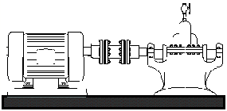
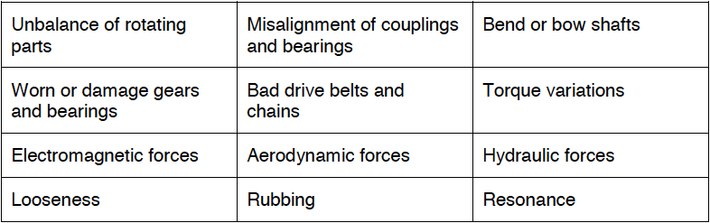
Machinery Fault Detection Using Vibration

Slide 25
Machine Failure Mode Analysis
General Failure Modes
Machine-Train Component Failure Modes
  -Bearing Failures
  -Gear Failures
  -Shaft Failure

Slide 26
Overall Vibration Criteria
The overall level is a single number
Calculation of the unfiltered amplitude of a vibration waveform.
In the analysis of the majority of machinery vibration signatures, the absolute level of spectrum components is not as valid an indicator of machine problems as is the rate of increase in level of the components.
The most common amplitude unit is Velocity.
Displacement may be used when relative motion or slow speed is a consideration.
Acceleration is often used in gearbox and high speed machinery as well as bearing troubleshooting.

Slide 27
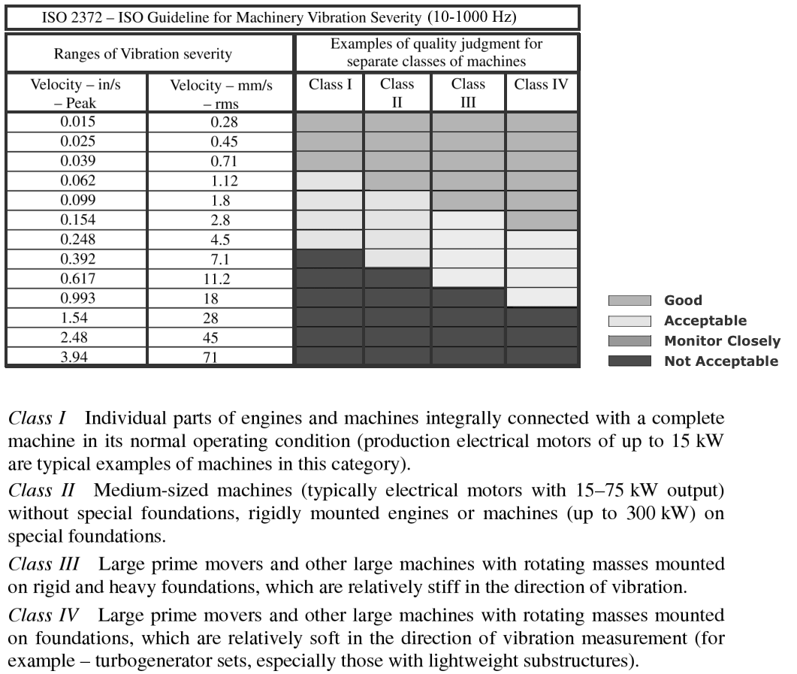
ISO Standard 2372
The ISO standard 2372 provides vibration amplitude acceptance guidelines for rotating machinery operating between (10-1000 Hz)
Limited in the high frequency range

Slide 28
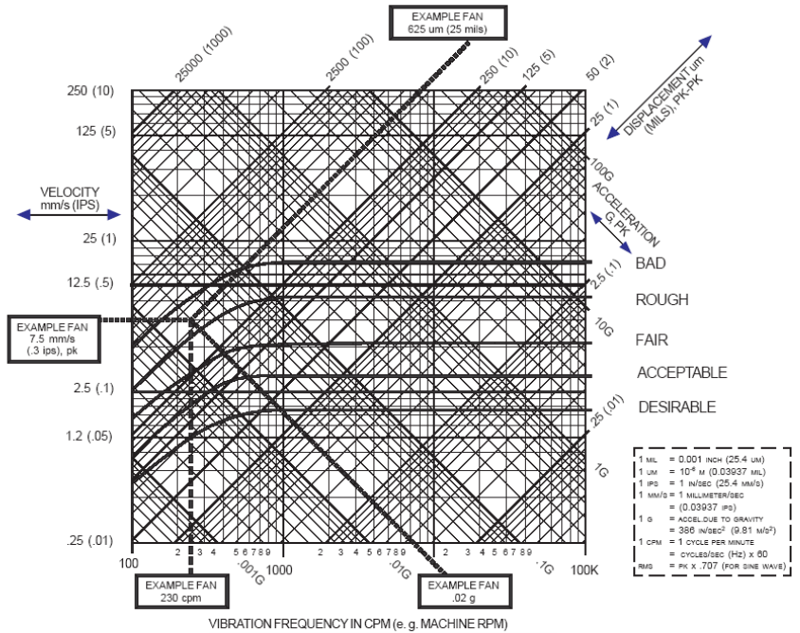
Commercial Standards
DLI Machinery Severity Chart

Slide 29
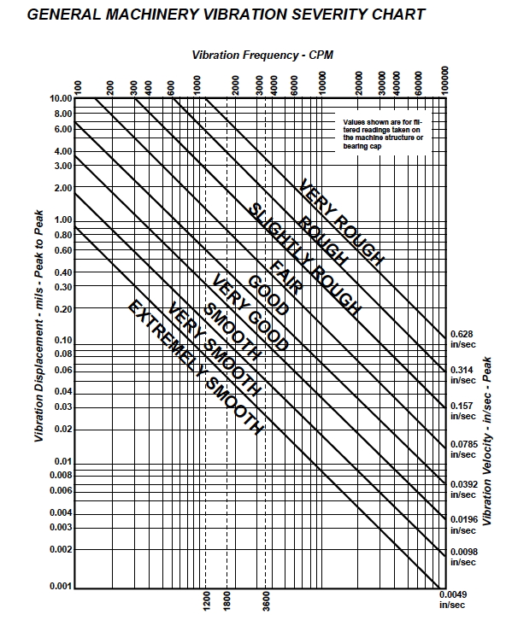
Overall Vibration Criteria

Slide 30
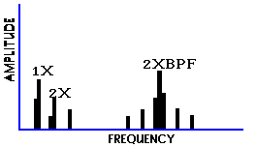
Machine Failure Mode Analysis
Which frequencies exist?
what are their relationships to the fundamental exciting frequencies?
What are the amplitudes of each peak?
How do the peaks relate to each other?
If there are significant peaks, what are their source?

Slide 31
Machine Failure Mode Analysis
Frequency Regions
Synchronous: rotational frequency and its harmonics
N x RPM
where N is an integer
Sub synchronous: <1 x RPM
Non-synchronous:
F x RPM
where F is >1 x RPM but not an integer

Slide 32
Machine Failure Mode Analysis
Causes of Sub-synchronous Frequencies
Another component in the machine
Another machine
Belt drives
Hydraulic instability
Oil whirl, oil whip
Rubs
rotor, shaft, wheel
Cage
fundamental train - rolling element bearings.

Slide 33
Machine Failure Mode Analysis
Synchronous Frequency Causes
Imbalance
Pitch line run-out
Misalignment
Bent shaft
Looseness
Blade / vane pass
Recips
Gears
Slot / Rotor Bar pass

Slide 34
Machine Failure Mode Analysis
Non – synchronous Frequency Causes
Another machine
Belt multiples
Bearings.
Resonance
Electrical
Chains
Compressor surge
Detonation
Sliding surfaces
Lube pumps
Centrifugal clutches
U-joints

Slide 35
Machine Failure Mode Analysis
Critical Speeds
Critical speeds result due to the natural vibrating frequencies of the machine-train they are functions of the mass and stiffness of the machine.
When the running speed coincides with one of the critical speeds excessive vibration occurs which is generally undesirable.
Best way to confirm a critical-speed problem is to change running speed - amplitude of vibration components (1x, 2x, 3x running speed) will immediately drop if problem is due to critical-speed.

Slide 36
Machine Failure Mode Analysis
Looseness
Balance means that all forces generated by rotating element of machine-train are in equilibrium. Any change in state of equilibrium creates an imbalance.
Imbalance is one of most common condition monitoring problems. All machines exhibit some level of imbalance.
Dominant frequency component is at running speed (1x) of shaft. Harmonics (2x, 3x, etc...) may be observed in multi-plane imbalance.

Slide 37
Machine Failure Mode Analysis
Looseness
Mechanical looseness (e.g. poor bolting to foundations) can be present in vertical and horizontal planes and can create a variety of patterns in vibration signature.
In some cases only 1x frequency is excited but generally full and half multiples of the running speed are present in spectra (0.5x, 1x, 1.5x, 2x etc.)

Slide 38
Machine Failure Mode Analysis
Misalignment
Misalignment is virtually always present in machine trains.
Three types of misalignment: internal, offset and angular.
All three types excite 1x frequency as they create an apparent imbalance in machine.
Internal and offset also excite 2x frequency as shaft creates two high-spots.

Slide 39
Machine Failure Mode Analysis
Modulations
These are frequency components that appear in vibration signal but cannot be attributed to any specific physical cause or forcing function.
They can be viewed as “ghost” or artificial frequencies
They can result in significant machine-train damage.
Ghosts are caused when two or more frequencies combine to produce another frequency component.
Not an absolute indication of problem within machine-train but increased amplitude can amplify defects.

Slide 40
Machine Failure Mode Analysis
Modulation example
Consider 10-tooth pinion gear rotating at 10 rpm whilst driving 20-tooth bullgear with an output speed of 5 rpm.
Gear generates frequency components at 5, 10 and 100rpm (i.e. 10 teeth x 10rpm).
This set can generate ghost frequencies at 15rpm (10+5), 110rpm (100+10), 95rpm (100-5) etc.

Slide 41
Machine Failure Mode Analysis
Process instability is normally associated with bladed or vaned machinery such as fans and pumps.
Process instability creates an unbalanced condition within the machine which generally excites the fundamental (1x) frequency and the blade-pass/vane-pass frequency components.

Slide 42
Diagnosing Unbalance
Vibration frequency equals rotor speed.
Vibration predominantly RADIAL in direction.
Stable vibration phase measurement.
Vibration increases as square of speed.
Vibration phase shifts in direct proportion to measurement direction.
90⁰
90⁰

Slide 43
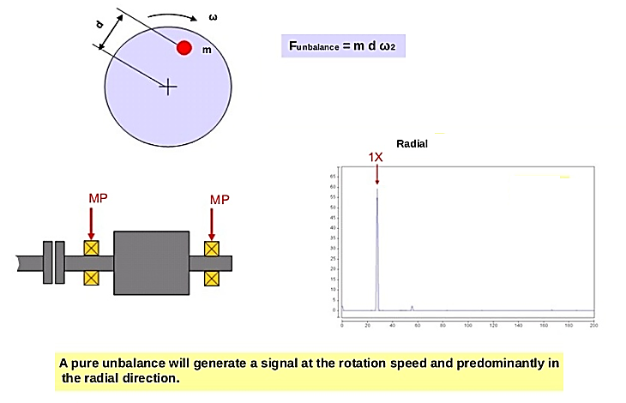
Unbalance

Slide 44
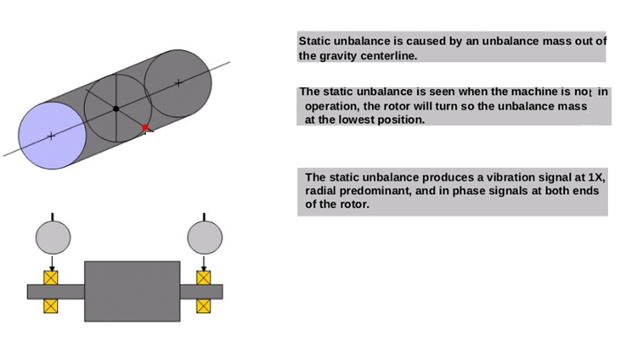
Static Unbalance

Slide 45
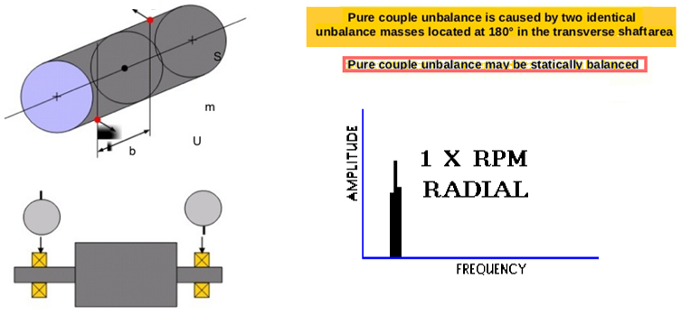
Pure Couple Unbalance
180⁰ out of phase on the same shaft
1X RPM always present and normally dominates
Amplitude varies with square of increasing speed
Can cause high axial as well as radial amplitudes
Balancing requires Correction in two planes at 180º

Slide 46
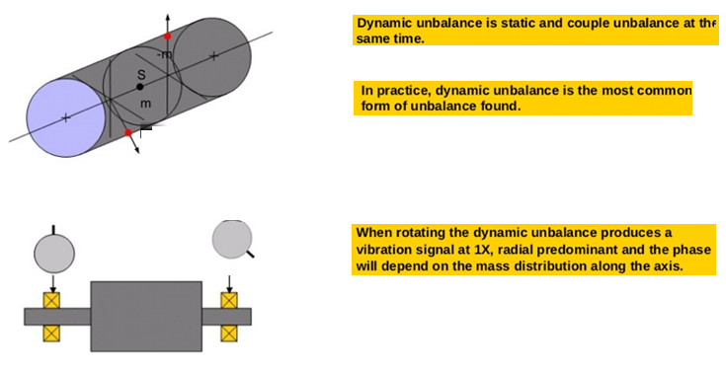
Dynamic Unbalance

Slide 47
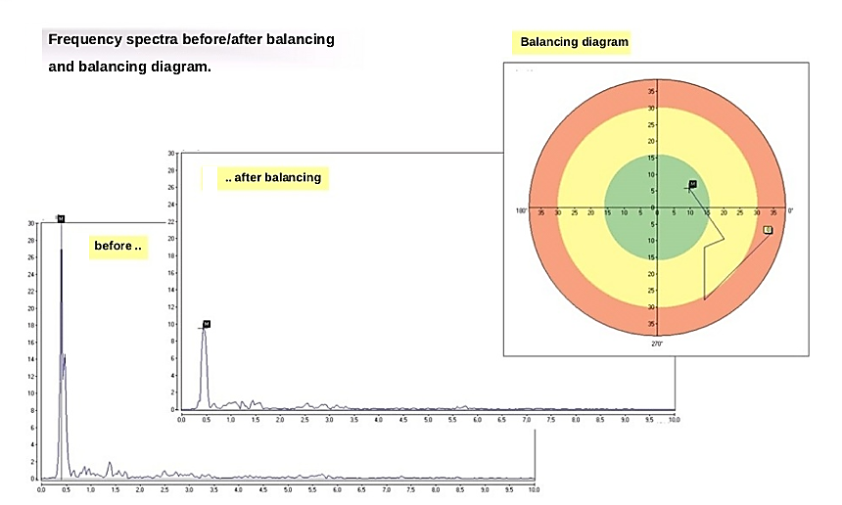
Balancing

Slide 48
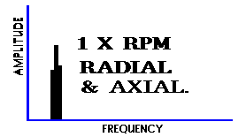
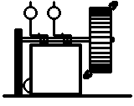
Overhung Rotor Unbalance
1X RPM present in radial and axial directions
Axial readings tend to be in-phase but radial readings might be unsteady
Overhung rotors often have both force and couple unbalance each of which may require correction
Notes:
An overhung rotor is one that has the driven rotor placed outboard of the bearings. Overhung rotors can cause interesting vibration symptoms and can be difficult to balance.
This configuration is often found in machines such as fans, blowers and pumps. Because the planes where the balance correction weights are to be attached are outside the supporting bearings , these rotors will not respond to normal single plane and two plane balancing techniques.
Overhung rotors can cause high axial vibration at 1 x rpm.
A large couple unbalance may be generated as well as the force unbalance.
For pure unbalance of an overhung rotor, the axial phase at bearing 1 will approximately equal that at bearing 2 (=/- 30 degs)
Normally overhung rotor unbalance can be corrected by first taking care of the force unbalance component which will leave the remainder as couple unbalance with phase differences approaching 180 degrees.
Because the unbalance planes are outside the support bearings, even a static unbalance will cause a couple unbalance which will be proportional to the distance of the unbalance plane from the rotor center of gravity.
The analysis 1 manual gives details about how to approach balancing an overhung rotor. This can be found in Chapter 6.014

Slide 49
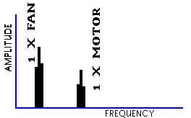
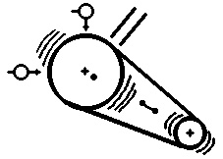
Eccentric Rotor
Largest vibration at 1X RPM in the direction of the centerline of the rotors
Comparative phase readings differ by 0⁰ or 180⁰
Attempts to balance will cause a decrease in amplitude in one direction but an increase may occur in the other direction
Notes:
Eccentricity is defined as “the distance of the geometric center of a revolving body from it’s axis of rotation”
This results in more weight being on one side of the rotating centerline than the other and causes the shaft to wobble in an irregular orbit. This is inherently unstable and can be the source of troublesome vibration.
Sometimes it is possible to Balance out some of the effect of eccentricity, but much of the displaced motion still remains.
Today with the emphasis on higher rotor speeds it is even more important that eccentricity is minimized.
In the example shown the highest vibration will be in the direction of belt tension and it will be at 1 x rpm.
In an eccentric gear the highest amplitude will be in line with the centers of the two gears, it will be at a frequency of 1 x rpm and will appear to be unbalance of the gear.
Eccentric electric motor rotors will produce a rotating variable air gap between the rotor and stator which induces pulsating vibration between 2x line frequency and it’s closest running speed harmonic as well as generating pole pass frequency sidebands around 2 x line frequency.
Eccentric pump impellers can result in unequal hydraulic forces distributed between the rotating impeller and stationary diffuser vanes.
Attempts to balance eccentric rotors may decrease the vibration in one direction but increase it in another direction.
Eccentricity may cause significantly higher amplitudes in one direction than in the other, as does resonance, wiped bearings and sometimes looseness.

Slide 50
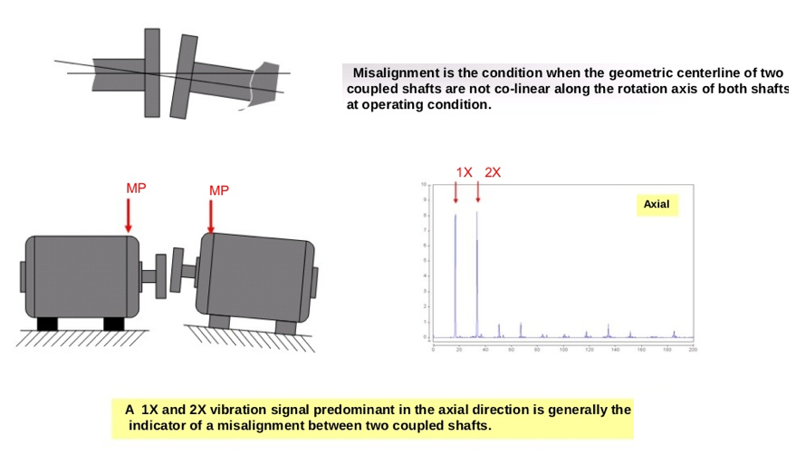
Misalignment

Slide 51
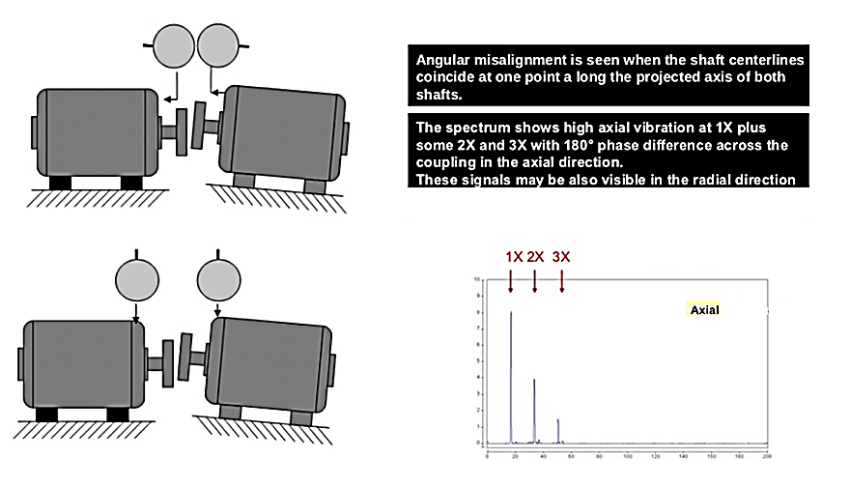
Angular Misalignment

Slide 52
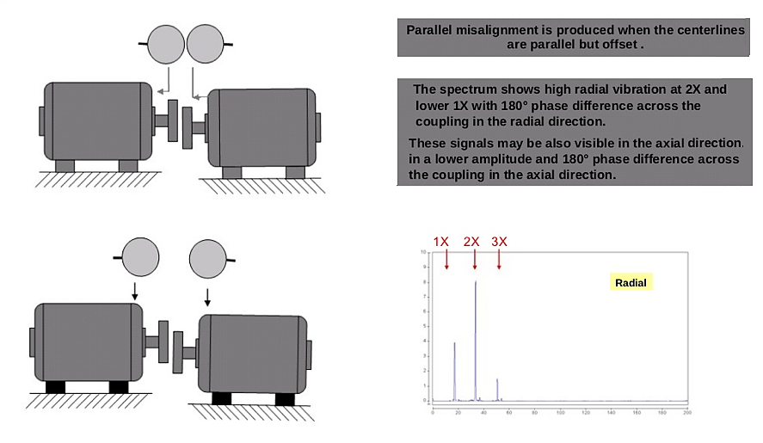
Parallel Misalignment

Slide 53

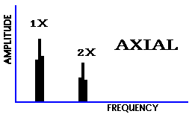
Bent Shaft
Bent shaft problems cause high axial vibration
1X RPM dominant if bend is near shaft center
2X RPM dominant if bend is near shaft ends
Phase difference in the axial direction will tend towards 180⁰ difference
Notes:
Bent Shaft
A bowed or bent shaft can generate excessive vibration in a machine, depending on the
amount and location of the bend. Like eccentric shafts, the effects can sometimes be
decreased by balancing. However, more often than not, it is not possible to achieve a
satisfactory balance in a shaft which as any noticeable bend. Analysts are sometimes
successful in removing the bend by various techniques sometimes involving thermal
treatments. In these cases, however, one must be careful not to introduce residual stresses
which might later lead to shaft fatigue.
Bent shafts exhibit the following characteristics:
1. High axial vibration is generated by the rocking motion induced by the bent shaft. Dominant vibration normally is at 1x RPM if bent near the shaft center, but a higher than normal 2x RPM component can also be produced, particularly if bent near the coupling.
2. Axial phase change between two bearings on the same component (motor, fan,
pump, etc....) will approach 180º, dependent on the amount of the bend (as shown in
Figure 6.03A). In addition, if one makes several measurements on the same bearing at
various points in the axial direction, he will normally find that phase differences
approaching 180º occur between that measured on the left and right hand side of the
bearing, and also between the upper and lower sides of the same bearing.
3. Amplitudes of 1x RPM and 2x RPM will normally be steady, assuming that 2x
RPM is not located close to twice line frequency (7200 CPM) which might induce a
beat of the 2x RPM component with 2x line frequency if there is high electromagnetic
vibration present.
4. Please note the axial phase measurements on 4 points of a bearing housing pictured on Figure 6.03B. If the shaft is bowed through or very near a bearing, you get a
twisting motion by the bearing housing itself which will result in significantly
different phase readings on this bearing housing in the axial direction as pictured in
Drawing A of Figure 6.03B. Drawing B of this figure shows the axial phase which
results from a true, straight shaft.
5. When much run-out is present at the rotating mass, it appears as unbalance.
When run-out at the coupling occurs, it appears as misalignment.
6. In bent shafts, amplitudes can vary with the square of speed and preload. If
unbalance is more of a problem than bow, vibration will decrease abruptly if operating
below the first critical speed. However, if the rotor is brought above its first critical
speed, unbalance amplitude will change only a small amount, whereas if the dominant
problem is a bent shaft, the amplitude will again drop significantly as the speed is
dropped towards the first critical speed.
7. If a rotor is located between bearings and should operate at or close to its
fundamental natural frequency, it will appear to be a "bent" shaft and will display
these symptoms (see Figure 6.05E in Section 6.05 on "Resonant Vibration").
However, this is only temporary. when the machine is stopped or at another non-
resonant speed, it will then "straighten out".
8. When electric motors have problems such as shorted lamination, they will
thermally induce a bend as the machine heats up, with the resultant vibration
getting higher and higher as the rotor heats. This again will introduce bent shaft
symptoms (see Figure 6.12F in Section 6.12 on "Electrical Vibration"). In this case,
the shaft again will straighten when allowed to come back to room temperature if the
plastic limit of the shaft material has not been exceeded. This will be covered later in
the electrical problems section 6.12.

Slide 54
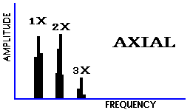
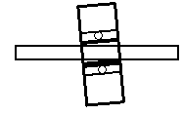
Misaligned Bearing
Vibration symptoms similar to angular misalignment
Attempts to realign coupling or balance the rotor will not alleviate the problem.
Will cause a twisting motion with approximately 180⁰ phase shift side to side or top to bottom

Slide 55
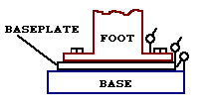
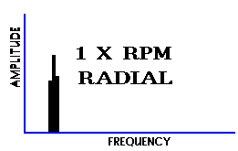
Looseness – Example 1
Caused by structural looseness of machine feet
Distortion of the base will cause “soft foot” problems
Phase analysis will reveal approximately 180⁰ phase shift in the vertical direction between the baseplate components of the machine

Slide 56
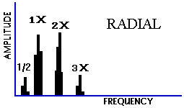
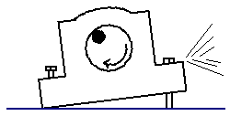
Looseness – Example 2
Caused by loose pillowblock bolts
Can cause 0.5, 1, 2 and 3X RPM
Sometimes caused by cracked frame structure or bearing block

Slide 57
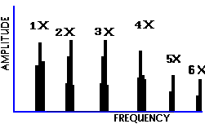
SLEEVE BEARING- WEAR / CLEARANCE
Later stages of sleeve bearing wear will give a large family of harmonics of running speed
A minor unbalance or misalignment will cause high amplitudes when excessive bearing clearances are present

Slide 58
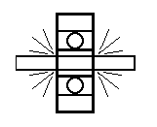
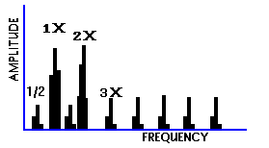
Looseness
Phase is often unstable
Will have many harmonics
Can be caused by a loose bearing liner, excessive bearing clearance or a loose impeller on a shaft

Slide 59
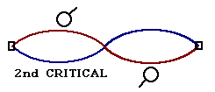
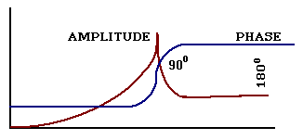
RESONANCE
Resonance occurs when the Forcing Frequency coincides with a Natural Frequency
180⁰ phase change occurs when shaft speed passes through resonance
High amplitudes of vibration will be present when a system is in resonance

Slide 60
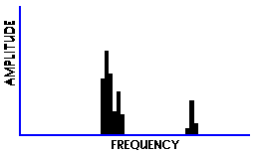
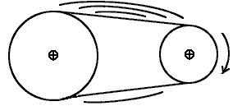
Belt Problems
RESONANCE
1X RPM
RADIAL
BELT RESONANCE
High amplitudes can be present if the belt natural frequency coincides with driver or driven RPM
Belt natural frequency can be changed by altering the belt tension

Slide 61
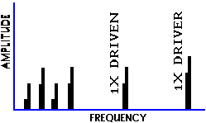
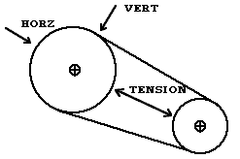
Belt Problems
WORN, LOOSE, OR MISMATCHED BELTS
BELT FREQUENCY
HARMONICS
Often 2X RPM is dominant
Amplitudes are normally unsteady, sometimes pulsing with either driver or driven RPM
Wear or misalignment in timing belt drives will give high amplitudes at the timing belt frequency
Belt frequencies are below the RPM of either the driver or the driven

Slide 62
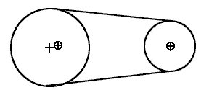
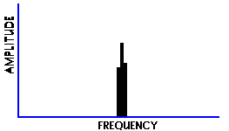
Belt Problems
ECCENTRIC PULLEYS
1X RPM OF
ECCENTRIC
PULLEY
RADIAL
Eccentric or unbalanced pulleys will give a high 1X RPM of the pulley
The amplitude will be highest in line with the belts
Beware of trying to balance eccentric pulleys

Slide 63
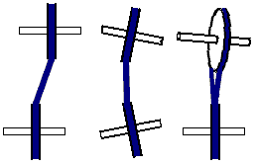
Belt Problems
BELT/PULLEY MISALIGNMENT
1X DRIVER
OR DRIVEN
Pulley misalignment will produce high axial vibration at 1X RPM
Often the highest amplitude on the motor will be at the fan RPM

Slide 64
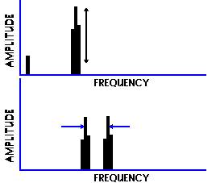
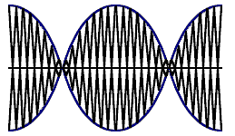
Beat Vibration
WIDEBAND SPECTRUM
F1 F2
A beat is the result of two closely spaced frequencies going into and out of phase
The wideband spectrum will show one peak pulsating up and down
The difference between the peaks is the beat frequency which itself will be present in the wideband spectrum

Slide 65
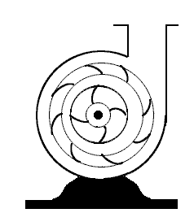
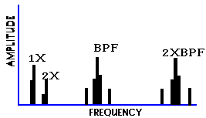
Hydraulic & Aerodynamic Forces
BPF = BLADE PASS FREQUENCY
If gap between vanes and casing is not equal, Blade Pass Frequency may have high amplitude
High BPF may be present if impeller wear ring seizes on shaft
Eccentric rotor can cause amplitude at BPF to be excessive

Slide 66
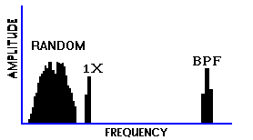
Hydraulic & Aerodynamic Forces
FLOW TURBULENCE
Flow turbulence often occurs in blowers due to variations in pressure or velocity of air in ducts
Random low frequency vibration will be generated, possibly in the 50 - 2000 CPM range

Slide 67
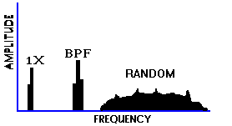
Hydraulic & Aerodynamic Forces
CAVITATION
Cavitation will generate random, high frequency broadband energy superimposed with BPF harmonics
Normally indicates inadequate suction pressure
Erosion of impeller vanes and pump casings may occur if left unchecked
Sounds like gravel passing through pump

Slide 68
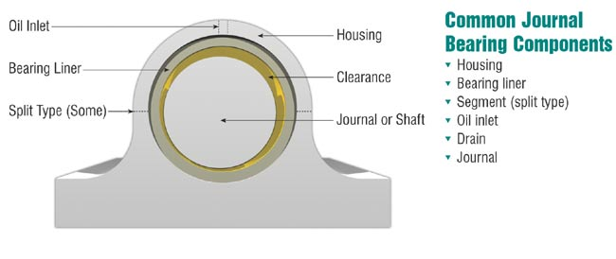
Fluid Bearings
Fluid bearings are bearings which solely support the bearing's loads on a thin layer of liquid or gas.
Frequently used in high load, high speed or high precision applications where rolling-element bearings have short life or high noise and vibration. Also used increasingly to reduce cost.
Bearing rotation sucks the fluid on to the inner surface of the bearing, forming a lubricating wedge under or around the shaft.

Slide 69
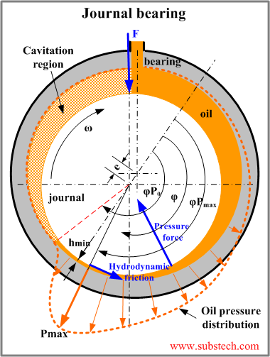
Fluid Bearings
Lubricating-film instability (OIL WHIRL) is dominant failure mode for fluid bearings.
Typically caused by eccentric rotation of shaft resulting from imbalance, misalignment or other machine-related problem or improperly designed bearing.
Rotor is prevented from creating a stable lubricating wedge on which to ride. Oil film can drive the shaft ahead of it in whirling path with the bearing clearance.

Slide 70
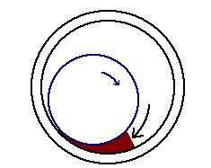
Fluid Bearings
Oil whirl is easy to recognise by its unusual vibration frequency of between 40% and 48% of shaft speed.
Vibration amplitudes are sometimes severe
Whirl is inherently unstable, since it increases centrifugal forces therefore increasing whirl forces
Oil whip can occur when oil whirl frequency coincides with and becomes locked to a natural frequency of system.
Left uncorrected, oil whip may cause destructive vibration resulting in catastrophic failure - often in a relatively short period of time.

Slide 71

Oil Whip Instability
oil whip
oil whirl
Oil whip may occur if a machine is operated at 2X the rotor critical frequency.
When the rotor drives up to 2X critical, whirl is close to critical and excessive vibration will stop the oil film from supporting the shaft.
Whirl speed will lock onto rotor critical. If the speed is increased the whip frequency will not increase.

Slide 72
Failure Mode Analysis - Conclusion
Predictive maintenance using vibration analysis is based on the following:
All common machinery problems and failure modes have distinct vibration frequency components that can be isolated and identified.
Frequency-domain signature is generally used because it contains discrete peaks, each representing specific vibration source.
There is a cause for each frequency component.
When the machine signature is compared over time, it will repeat until some event changes the vibration pattern.

Slide 73
Failure Mode Analysis - Conclusion
Several failure-mode charts available but 60 to 70% of the total vibration energy is contained in the frequency component corresponding to the running speed of the machine.
Many common causes of failure in machinery components can be identified by understanding relationship to running speed of shaft.
Common machine-train failure modes include critical speeds, imbalance, mechanical looseness, misalignment, modulations and process instability.

Slide 74
Predefined Spectrum Analysis Bands
1xRPM - BALANCE
1.8
2xRPM - ALIGNMENT
1.5
1.2
3-5xRPM - LOOSENESS
0.9
ANTI-FRICTION BEARINGS & GEARMESH
0.6
0.3
5-25xRPM
25-65xRPM
5000
10000
15000
20000
Frequency (Hz)

Slide 75
Frequency Band Alarming and Trending
Sub-
Har
monic
1X
2X
Bearing
Bearing
Gears
Bearing
Amplitude
1x
2x
25-60 x
Trend of
Balance
Trend of Bearings
Alarm
.5
in/sec
Alarm
Warning
.1
Warning
in/sec
Time
(Days)
Time
(Days)

Slide 76
Mechanical Condition Monitoring
Rolling Element Bearing
Lecture 3

Slide 77
Outline
Bearing Basics
Bearing types
Bearing failure causes
Bearing life expectancy
Vibration Profile
Demodulation
Examples

Slide 78
Purpose of a bearing
To provide low friction rotation of machine parts
To support and locate rotating equipment
Resistance to motion which occurs when one object slides or rubs against another object.
If not controlled, friction will result in:
  Heat generation
  Increased wear
  Increased noise
  Loss of power

Slide 79

Roles of a bearing
Reduce friction
Transmit loads
Support the shaft
Locate the shaft

Slide 80

Bearing components

Slide 81


Types of static bearing loads

Slide 82


Types of rolling elements
Point and line contact

Slide 83

Types of ball bearings

Slide 84


Types of roller bearings
Load carrying capacity is expressed as the ‘basic dynamic load rating’ or ‘C’ in catalogues

Slide 85

Contact angle
The lower the contact angle, the higher the radial load capacity
The higher the contact angle, the higher the thrust load capacity

Slide 86

Bearings and contact angles
As the contact angle increases, radial load capacity decreases; while the axial load (i.e. thrust) capacity increases.

Slide 87
Bearing life expectancy
Based upon five assumptions:
The bearing is defect free.
The correct bearing type and size is selected for the application.
Dimensions of the bearing mating parts are correct.
The bearing will be mounted without damage.
Good lubrication in the correct quantity will always be available to the bearing.

Slide 88

Causes of bearings’ failure
Four predominant causes of premature bearing failure:
Improper loading
16% Poor Installation
36% Poor Lubrication
14% Contamination
34% Fatigue

Slide 89
Operational damage mode causes
Static vibration
Operational misalignment
Ineffective sealing
Ineffective or inadequate lubrication
Passage of electric current through the bearing
Excessive loading

Slide 90

Loading patterns: Inner Ring Rotation

Slide 91

Loading patterns: Outer Ring Rotation

Slide 92

Load Zones:
Thrust load, Radial load, & combined loads

Slide 93

Bearing damage analysis

Slide 94


Fatigue: subsurface fatigue
Repeated stress changes
Material structural changes
Micro-cracks under the surface
Crack propagation
Flaking, spalling, and peeling

Slide 95

Fatigue: subsurface fatigue
Hydrogen Embrittlement

Slide 96


Fatigue: surface initiated fatigue
Surface distress
Reduced lubrication regime
Sliding motion
Burnishing, glazing
Asperity micro-cracks
Asperity micro-spalls

Slide 97



Wear: abrasive wear
Progressive removal of material
Ingress of dirt particles
Accelerating process
Dull surfaces

Slide 98

Wear: adhesive wear
Low loads
Accelerations
Smearing / skidding / galling
Material transfer / friction heat
Tempering / re-hardening
With stress concentrations and cracking or flaking

Slide 99



Corrosion: moisture corrosion
Oxidation / rust
Chemical reaction
Corrosion pits / flaking
Etching (water/oil mixture)

Slide 100

Corrosion: frictional corrosion - fretting
Micro-movement between mating surfaces
Oxidation of asperities
Powdery rust / loss of material
Occurs in fit interfaces
Transmitting loads

Slide 101


Corrosion: frictional corrosion - false brinelling
Rolling element / raceway
Micro movements / elastic deformations
Vibrations
Corrosion / wear / shiny / red depressions
Stationary: rolling element pitch
Rotating: parallel flutes

Slide 102

Electrical erosion: excessive voltage
High current / sparking
Localized heating in very short Interval / melting / welding
Craters up to 100 μm

Slide 103

Electrical erosion: current leakage
Low current intensity
Shallow craters closely positioned
Development of flutes on raceways & rollers, parallel to rolling axis
Dark gray discoloration

Slide 104

Plastic deformation: overload
Static or shock loads
Plastic deformations
Depressions in rolling element distance
Handling damages

Slide 105

Plastic deformation: indentation from debris
Localized overloading
Over-rolling of particles dents
Soft / hardened steel / hard mineral

Slide 106

Plastic deformation: indentation from handling
Localized overloading
Over-rolling of particles dents
Soft / hardened steel / hard mineral

Slide 107

Fracture: forced fracture
Stress concentration > tensile strength
Impact / overstressing

Slide 108

Fracture: fatigue fracture
Rings and cages - Crack initiation / propagation
Exceeding fatigue strength under bending
Finally forced fracture

Slide 109

Fracture: thermal cracking
High sliding and /or insufficient lubrication
High friction heat
Cracks at right angle to sliding direction

Slide 110

Bearing Life
Any extra loading (e.g. misalignment, unbalance, resonance) reduces life by a cubed function:
$$L_{10}=\left(\frac{\text{16,667}}{\text{RPM}}\right)×{\left(\frac{Rated Load }{Actual Load}\right)}^{3}$$
10% extra loading cuts life by 1/3
20% extra loading cuts life by half

Slide 111
Bearing Life, L10
It is the life expectancy for 90% of the population
Full load life is estimated at 1,000,000 revolutions at 3600 RPM, this is only 4.6 hours
Guidelines:
  Under a light load, L10< 6%
  Under a normal load, 6% <L10< 12%
  Under a heavy load, L10 >12%

Slide 112
The Detection Technologies
Vibration analysis and acoustic emission
Oil and wear particle analysis
Infrared thermography
Each technology has its applications and should be used where appropriate. Under many circumstances, they are complementary.

Slide 113
Vibration Sources
Vibration can be due to 4 sources:
Forced vibration due to unbalance, misalignment, blade and vane pass, gear mesh, looseness, impacts, resonance, etc…
Resonance response due to impacts
Stress waves or shock pulses
Frictional vibration

Slide 114
Vibration Profile
In the vibration profile of a rolling element bearing three distinct frequencies can be found: natural, rotational, and defect
Natural frequencies (resonance) are generated by impacts of internal parts of rolling element bearing. They are present in a new bearing.
For a proper design, the natural frequencies are well above maximum frequency range and so rarely observed in predictive maintenance.

Slide 115


Rotational Frequencies
Four rotational frequencies are associated with rolling element bearings
Fundamental train frequency
Ball/roller spin
Ball-pass outer-race
Ball-pass inner-race

Slide 116


Rotational Frequencies
Fundamental train frequency (FTF)
The bearing cage generates FTF as it rotates around races. Some friction exists between rolling elements and races, even with perfect lubrication.
Where f_{t} is the relative speed between outer and inner race.
116

Slide 117
Rotational Frequencies
Ball-pass outer race (BPFO)
Balls or rollers passing outer race generate ball-pass outer-race frequency (BPFO):
Where n is the number of rollers
117

Slide 118
Rotational Frequencies
Ball-pass inner race (BPFI)
Balls or rollers passing outer race generate ball-pass inner-race frequency (BPFI):
Where n is the number of rollers
118

Slide 119
Rotational Frequencies
Ball-pass outer race (BPFO)
Ball-spin frequency - Each of balls or rollers rotates around own axis as it rolls around races. Speed of rotation (BSF) determined by geometry of bearing
Where β is the contact angle
119

Slide 120

Defect Frequencies
Rolling element bearing defect frequencies are the same as the as their rotational frequencies, except BSF.
For a defect on inner race: BPFI amplitude increases as balls/rollers contact defect.
For a defect on outer race: BPFO amplitude increases as balls/rollers contact defect.

Slide 121

Defect Frequencies
When one or more of balls or rollers have defects, the defect impacts both the inner and outer race each time one revolution of the rolling-element is made. Therefore detection frequency is 2xBSF rather than 1 x BSF

Slide 122

Example 1

Slide 123

Example 2

Slide 124
Basic Frequency Spectrum Patterns
Vibration measurements display either of four basic spectrum (FFT) patterns:
Harmonics
Sidebands - Due to Amplitude Modulation or Frequency Modulation
Mounds/Haystacks - Random vibration occurring in a frequency range
Raised Noise Floor - White noise or large random events

Slide 125
Demodulation
Demodulating (Envelope) the Signal or Determination of the Peaks of the Repetitive Fault Frequency.
Spanning the band for the station frequency (540-1600 kHz) and picking off the broadcasted signal.
Incorporating a high-pass or band-pass filtering
Eliminating any high amplitude signals associated with 1 x and multiples up to about 10 x
Inclusion of only the fault frequencies exciting inherent resonance
Intensifying and drawing out repetitive components of the fault
Converting to frequency for display of the pattern
Amplitudes will show up as a distinctive “saw-tooth” or “comb” harmonic pattern of the actual bearing fault

Slide 126

Amplitude Modulation
Amplitude Modulation (AM)
One frequency (carrier) is getting louder and softer at another frequency (the modulating frequency)
AM is mono. Mono is ‘one’, which implies one sideband on each side of the carrier.

Slide 127




Signal Processing
The raw signal includes low frequency running speed harmonics
These are removed by band-pass filtering
Then envelope detection is applied
Finally the result is displayed in the frequency domain:

Slide 128
Mechanical Condition Monitoring
Fault Diagnostics of Gears
Lecture 4

Slide 129
Outline
Gear Basics
Gear types
Gear Meshing
Vibration Profiles

Slide 130


Gears Types

Slide 131

Gears Types

Slide 132
Gears
Gearboxes contribute significantly to damage incidents and maintenance costs.
Gearboxes comprise about 60% of mechanical faults in rotating machinery and about 30% of maintenance costs in aircraft industry due to gearboxes.
Fault detection in helicopter gearboxes is one of THE most difficult problems in rotating machinery diagnostics

Slide 133

Gear Meshing

Slide 134
Basic Gear Relations
RPM1 x T1 = RPM2 x T2
1700 RPM
51 TEETH
31 TEETH
20 TEETH
If 8959 RPM - HOW MANY TEETH ARE ON THIS GEAR?

Slide 135
Gears
All gear sets create a frequency component referred to as gear-mesh.
Fundamental gear-mesh frequency is equal to number of gear teeth times running speed of shaft.
In addition, all gear sets create a series of sidebands or modulations that are visible on both sides of primary gear-mesh frequency.

Slide 136
Gear Meshing (GMF)
Amplitude
+
12 tooth
gear
0
Time
-
1000 rpm
1 revolution
12 teeth are meshing every revolution of the gear
12 x 1000 rpm = vibration occurs at 12,000 cycles per minute
GMF = 12,000 RPM = 200 Hz

Slide 137

Normal Vibration Profile - E.g. GMF calculation

Slide 138
Normal Vibration Profile - Example GMF calculation
Input shaft speed = 3,585 RPM
Intermediate shaft speed = (3,585 RPM) [(26 T)/101 T] = 923 RPM
Output shaft speed= 923 x 31T/97T=295 RPM
High-speed gear mesh:
3,585 RPM x 26T = 93,210 CPM (1,553.5 Hz)
Low-speed gear mesh:
922.87 RPM x 31 T = 28,609 CPM (476.8 Hz)

Slide 139

Normal Vibration Profile
Normal profile of undamaged gear set shows 1X and 2X and gear mesh frequency GMF
GMF commonly will have sidebands of running speed
All peaks are of low amplitude and no natural frequencies are present

Slide 140

Normal Vibration Profile – GMF Frequency
GMF Sidebands occur in pairs, one below and one above the gear-mesh frequency, and amplitudes are the same.
Any deviation from this profile indicates a gear problem.

Slide 141

Normal Vibration Profile – Effect of Load
Energy and vibration profiles of gear sets change with load.
Gear Mesh Frequencies are often sensitive to load
High GMF amplitudes do not necessarily indicate a problem
When the gear is fully loaded, profiles exhibit amplitudes as shown before.
When gear is unloaded, same profiles are present, but amplitude increases dramatically.
Difference is due to gear-tooth roughness. More looseness is present on the non-power side of the gear.
Around the GMF Frequency

Slide 142

Fault Diagnostics
If the gear set develops problems, the amplitude of the gear-mesh frequency and symmetry of the sidebands changes
When a gear set becomes worn the spacing between the sidebands becomes erratic and symmetry of amplitudes alters.
Around the GMF Frequency

Slide 143

Fault Diagnostics - Chipped/Broken tooth
TIME WAVEFORM
A cracked or broken tooth will generate a high amplitude at 1X RPM of the gear
It will excite the gear natural frequency which will be sidebanded by the running speed fundamental
Best detected using the time waveform
Time interval between impacts will be the reciprocal of the 1X RPM

Slide 144
Fault Diagnostics - Chipped/Broken tooth Effect on GMF
The profile shown signifies the effect of a chipped or broken tooth in the gear set.
As the gear rotates, the space left by the chipped or broken tooth increases the mechanical clearance between pinion and bullgear
Result is low-amplitude sidebands to left of gear-mesh frequency (lower freq), and
Sidebands to the right of the mesh frequency have higher amplitude

Slide 145


Slide 146

Fault Diagnostics – Tooth Wear
Wear is indicated by excitation of natural frequencies along with sidebands of 1X RPM of the bad gear
Sidebands are a better wear indicator than the GMF
GMF may not change in amplitude when wear occurs

Slide 147

Fault Diagnostics – Misalignment of Gears
Gear misalignment almost always excites second order or higher harmonics with sidebands of running speed
Small amplitude at 1X GMF but higher levels at 2X
and 3X GMF

Slide 148


Slide 149

Fault Diagnostics – Eccentricity and Backlash
Fairly high amplitude sidebands around GMF suggest eccentricity, backlash or non parallel shafts
The problem gear will modulate the sidebands
Incorrect backlash normally excites gear natural frequency

Slide 150


Slide 151
Gear Hunting Problem
Is the phenomenon in which two teeth - one on each gear - that are damaged contact one another at a particular frequency.
During the normal rotation of these gears, those two teeth will enter the mesh area simultaneously and contact one another. This is a relatively low frequency - lower than the RPM of either gears.
It is determined by the common factors of the number of teeth on each gear.
Hunting Tooth Frequency – FHT:

Slide 152
Gear Hunting frequency - FHT
To calculate the common factors of each gear (CF), list all the multiplication possibilities for each tooth number and compare.
Example
The numbers that appear in each column are: 1, 2, 3, 4, 6 and 12. The highest common factor is 12 in this example
24 Tooth Gear | 1 x 24 2 x 12 3 x 8 4 x 6 | 84 Tooth Gear | 1 x 84 2 x 42 3 x 28 4 x 21 6 x 14 7 x 12

Slide 153

Hunting Tooth Symptoms
Amplitude peaks at 1 x FHT and possibly 2 x FHT.
Sidebands of FHT around 1x rpm (of each shaft).
Sidebands of FHT around 1x GMF and harmonics.

