Slide 1
Marion Kelt Research and Open Access Librarian
Parallel lines: a look at some common issues in the development, repurposing and use of online IL training resources.

Slide 2
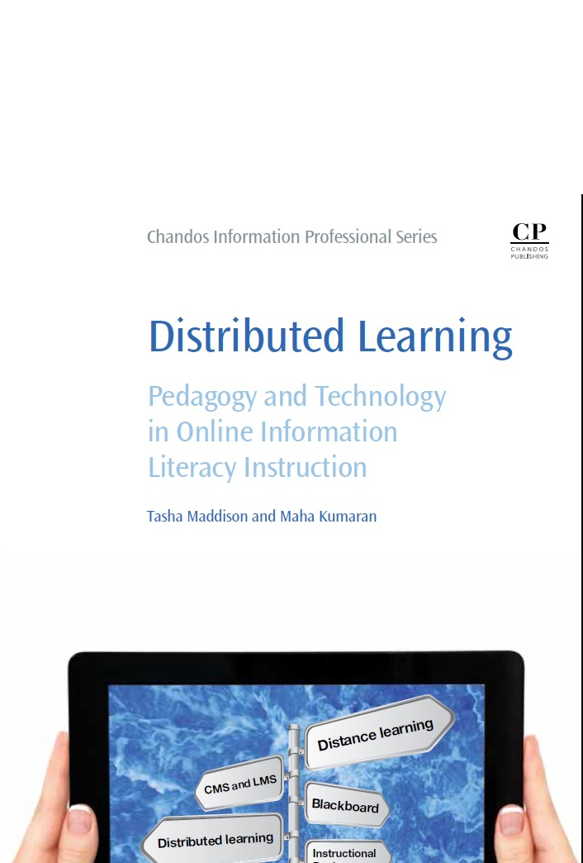
Presentation Summary
October 15th!
This presentation is based on a chapter from
Distributed Learning: Pedagogy and Technology in Online Information Literacy Instruction edited by Tasha Maddison and Maha Kumaran, Chandos, 2016

Slide 3
The interpretation is based on my own experience with SMILE, SMIRK and PILOT
The issues identified are the results of a lit review
Warning!

Slide 4
The eight pillars of pain (issues identified)
Market scan or literature review
Planning: design and project management
IL frameworks
Development software
Hardware and delivery methods
Testing and piloting
Teaching: timetabling and delivery
Futureproofing

Slide 5
Market scan or literature review
It may not be possible to go through all eight stages. It helps to adopt a structured approach!
Is a market scan necessary? Yes!
Did we do it? No!
Even if you are adapting an OER it is worth finding out what resources exist and the best delivery methods.
It is always worth learning from others. It can save time in the long run.

Slide 6
Planning
Define target users
Decide on style
Look and feel
Navigation
Develop content
Accessibility
Write project plan
Stage of course, mode of study, language and IT skills? Broadband?
Set up style guide (useful for teams!)
Are all graphics necessary? Clear font, scrolling, institutional marketing?
Clear menus, location signposts, platform agnostic, flash player? Test on variety of devices!
Build from scratch or adapt OERs (or both?). Create storyboard. Copyright?
Consult specialists at all stages. If none in institution, use external organisations. Build in from start!
With timeline (Gantt chart), build in time for revision!

Slide 7
IL frameworks
Professional
ACRL framework
Institutional
National Information Literacy Framework Scotland
GCU 21st Century Graduate Attributes
Graduate
National
Vitae Researcher Development Framework
SCONUL 7 Pillars
BPS Future of Undergraduate Psychology in the UK report
CBI graduate attributes

Slide 8
Development and software
How do you present your course?
simple HTML web pages
presentation software like iSpring, Xerte or Articulate
What about gamification?
Do you use plugins? Flash player? Camtasia?
How interactive does the resource need to be?
quizzes?
interactive games?
Mobile device compatibility is a must!
what type? tabletop or online? single user or groups?
consider browser issues, VLE/LMS, and technical limitations
what looks good on PC, may not work at all on a smartphone!

Slide 9
Hardware and delivery methods
Closed or open? How accessible do you want to be?
institutional VLE (LMS) like Moodle or Blackboard
open web site
Do you REALLY need a login? Users are easily deterred!
Shared server - not a good idea. Think of peaks in user demand

Slide 10
Testing and piloting
Decide what you are testing!
Feedback
User testing in labs
Focus groups
Surveys
Implement changes fast
Allow time in project plan for:
usability, IL skills developed, or both!
keep detailed notes
select range of differently abled users with various language skills.
test on as many different devices as possible
good for qualitative feedback
keep them short! Check institutional policy. Consider paper surveys!
or inform users why
pilot phase, inevitable delays, and revision

Slide 11
Teaching
Wide uptake follows adoption into institutional policy. This forces formal timetabling.
Module structure: - long thin - short fat?
Online only, hybrid or face to face. Hybrid best (Williams)
How to assess? - quizzes -automatic grading?
What are you assessing? - IL skills - usability

Slide 12
Futureproofing
No easy answers!
Copyright?
Licensing issues?
Speed of developments
Fashion
How open is your OER?
Presentation systems?

Slide 13
Key texts from mini-review
ACRL. Information Literacy Competency Standards for Higher Education. (2000). <http://www.ala.org/acrl/standards/informationliteracycompetency> Accessed 18.09.15.
Crawford, J. & Irving, C. National Information Literacy Framework Scotland blog. Framework levels. (2013). <http://www.therightinformation.org/temp-use-highereducation/> Accessed 03.09.15.
Crawford, N. & Broertjes, A., (2010). Evaluation of a university online Information Literacy unit. Australian Library Journal 59(4), 187-196.
Stubbings, R. & Franklin, G., (2004). A critical analysis of the INFORMS project at Loughborough University. JeLit 1(1), 31-41.
Thomas, J. & Gosling, C., (2009). An evaluation of the use of "Guides at the side" Web-based Learning activities to equip students in health sciences and nursing with information literacy skills. New Review of Academic Librarianship 15(2), 173-186.
Vitae. Vitae Researcher Development Framework. (2011). <http://www.vitae.ac.uk/researchers/428241/Researcher-Development-Framework.html> Accessed 11.03.13.
Yang, S., (2009). Information literacy online tutorials: an introduction to rational and technological tools in tutorial creation. The Electronic Library 27(4), 684-693.

Slide 14
Thank you
Contact details and links:
Slides on edShare@GCU https://edshare.gcu.ac.uk
Email: m.kelt@gcu.ac.uk

