Slide 1
Marion Kelt
Copyright and your thesis

Slide 2
Presentation Summary
Planning your research
IPR
Making your research available
What is third party content? - permissions
Open Access
Open Educational Resources
Creative Commons
Questions

Slide 3
Introduction
Copyright is a form of intellectual property that protects original literary, dramatic, musical and artistic works, as well as layouts or typographical arrangements of published work, sound recordings, film and broadcast.
There is no formal registration procedure for copyright; a work is protected as soon as it is in a permanent or fixed form.
More than one person can own copyright on a resource.
Infringement of copyright occurs when someone takes either all of a work, or a substantial part of it, without permission.
Soetendorp, R., Meletti, B. Education. http://copyrightuser.org/ Available under a CC-BY 3.0 License

Slide 4
Planning your research
It is best to think about copyright when planning your research and before data collection or fieldwork. A little time spent now can save a lot of work later!
The lines between copyright and wider ethical issues sometimes are not clear. GCU has guidance on research ethics. This will help you decide how best to use the data you collect.
We also have an Assistant Head (Information Compliance) who can help you with Data Protection Issues.
For example if you take photographs where the subject is identifiable. You would own the copyright to the photo, but you still need to get the subject’s permission before you use it.

Slide 5
Intellectual Property Rights (IPR)
Intellectual property refers to ideas. Copyright applies to the tangible form of those ideas.
At GCU you own the IPR and copyright of your thesis and the rights to publish and distribute it.
There may be exceptions:
If you have been sponsored to complete your research, the sponsoring body may require you to transfer or assign copyright to them.
This may also be the case if you have been awarded a research grant.
Check the small print and discuss this with your supervisor.
In any case you will always retain the IPR of your work.

Slide 6
How will your thesis be made available to readers?
When you have completed your viva examination and made any revisions requested by the examiners, you will be asked to deposit two copies of your thesis with the university library. Your thesis will then be available for consultation within our Archive Centre.
GCU is a member of EThOS (Electronic Thesis Online Service), which is the UK's national thesis service run by the British Library. Your thesis can be digitised via this service and made available freely on the internet.
Your rights are outlined on the Deposit Agreement form. All theses can be requested under FOI (Freedom of Information) and EIR (Environmental Information Regulations) unless you specify a relevant exemption.

Slide 7
What is Open Access? How does it affect me?
Open Access is the immediate, online availability of scholarly literature, free of charge.
It vastly increases the potential scholarly audience for your work.
Theses are digitised and added to EThOS on demand.
Users of EThOS are allowed to reuse material from a thesis in the same way as they would from any other source. This means:
Providing a full citation
Making fair use of the material

Slide 8
What are the advantages of Open Access publication?
There are a number of advantages in making your thesis available:
Raising the visibility and reach of your research. This is particularly relevant to theses.
Providing a stable and long term URL that you can use to promote your work to potential employers and grant providers.
Ensuring long term preservation and access to your research.
Satisfying the funding requirements of research bodies. For example RCUK expect a thesis to be available open access within 12 months of award. Contact the library if this is the case.
Protecting against plagiarism by making a reference copy publicly available.

Slide 9
Are there any issues with Open Access publication?
Making your thesis open access can be problematic if:
It includes third party content.
You intend to publish the content in a book or academic journal.
It contains sensitive information which may affect the commercial operations of a company or the university.
It contains information which was obtained under a confidentiality agreement.
It endangers the physical, mental health or safety of an individual.

Slide 10
Third party content and open access
Third party content is content that you may use in your thesis which comes from other sources. It could be:
Quotations
Data
Images, Charts or Graphs
You need to use judgement over whether your use falls under what is considered “fair” in copyright law.
Substantial use will require permission from the copyright owner unless there is a clear statement on the original work saying it can be reused.
More information on the Copyright User website.

Slide 11
Other issues with Open Access publication
Intent to publish:
You should check your agreement with the publisher, they may wish to place an embargo on your thesis.
A standard embargo applies for up to three years from the date of award.
Commercially sensitive, confidentiality or endangerment:
This should be dealt with when planning your research.
Your thesis can be embargoed, redacted or restricted as necessary.

Slide 12
How do I get permissions? - identify the owner.
First you need to identify who owns the work you want to use. Is it the author, photographer or publisher?
Material on a website may have a section on copyright or terms and conditions of use.
The time it takes for rights owners to respond will vary.
Some rights owners may ask for a fee - you should never pay this.
Never assume that the owner has granted permission if they don’t respond.
It is best to start this process as early as possible.
More help available from copyright@gcu.ac.uk

Slide 13
What if I can’t get permissions?
If the material is essential to the argument of your work then you should include it regardless of whether you have obtained permission or not.
If your thesis is digitised this material will be redacted before your work is put online.
Any redaction will be clearly identified on a coversheet added to the online version.

Slide 14
Using your own published work in your thesis
If you have published work as part of your research then you may wish to include it in your thesis.
This should be included as an appendix and prefixed by a contents page listing the works included.
The published works will be redacted from a digitised version.
If you are completing a PhD by Previous Published Works you should include full reference to your published works on the contents page.
The published works will be redacted from a digitised version; only your overview will be made available.

Slide 15
Using Open Educational Resources (OERs)
Open Educational Resources (OERs) are:
Digital educational materials such as images, audio, video, animations, content modules, and other digital resources.
To guarantee you stay legal when reusing content follow these three simple steps:
Reuse only licensed content e.g. Creative Commons;
Adhere to the terms of the licence;
Cite the content you use.

Slide 16
Why use Open Educational Resources (OERs)?
OERs are made available under a licence. Follow the terms of the licence and you don’t need to worry about copyright.
Use existing resources and develop them in ways that suit your needs.
Develop high quality resources on your own or with a small team of staff.
Save time and duplication of effort.
Build on best practice by experts in your subject area.
Use resources which you may not have the software, equipment or facilities to create yourself.
Find OERs using a Google Creative Commons search.
Use edShare to license and share your own OERs.

Slide 17
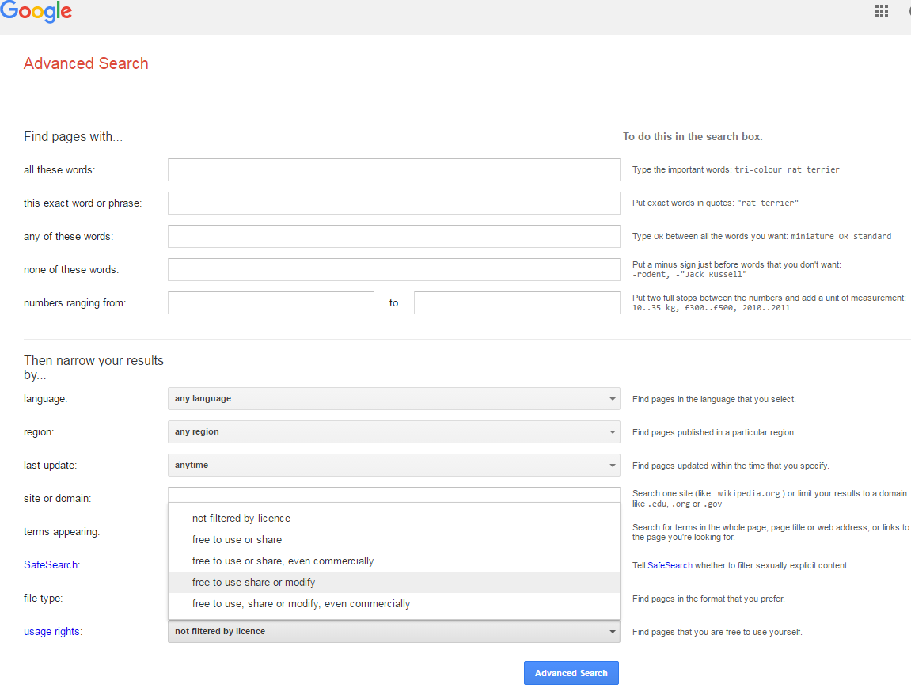

Slide 18
What is Creative Commons (CC)?
It is a way of licensing material to reserve some of the rights such as reproduction or adaptation, rather than copyright which protects all potential uses of the work under copyright law.
Many items are now being made available under CC licence which allows the creator to specify how they are reused by others. For example, you may prevent commercial use.
You can search for CC licensed material using a Google advanced search.
If you want to use CC licensed material in your thesis, you should ensure you comply with the terms of the licence.
Even where material is in the public domain (which means free from any copyright protection) you must acknowledge the source in the interests of academic integrity.

Slide 19
Thank you
Contact details and links:
http://gcu.ac.uk/library/servicesforstaff/copyright/
More detail and examples available at the Copyrightuser.org website copyright@gcu.ac.uk
Presentation based on a booklet entitled Copyright and your thesis by Dr Jane Secker, LSE

