Slide 1
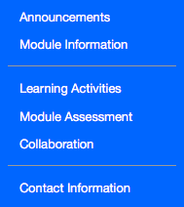
Recommended Module Structure
The recommended GCULearn Structure for modules has three main sections
Section 1 provides: information on the module itself including the module handbook and any other relevant information and Announcements - any general whole module updates/information when the module is running.
Section 2 focuses on: modules learning, teaching and assessment activities. The Learning Activities button should include all the learning activities, content and resources. The Module Assessment button should include information and guidance on module assessments and all assignments. The Collaboration button will link to synchronous Collaborate Sessions. If appropriate you can create another button(s) here for regular learning activities such as “labs”.
Section 3 provides: contact information for the module teaching team and any other relevant support staff.

Slide 2
Suggested Menu Section Content Items
Section | Suggested content
Announcements | Welcome to the module, new announcements, weekly updates,
Module information | Module handbook, module calendar
Learning Materials | Activities, case studies, resources, podcasts, screencasts, reading lists
Assessment | Summary of all module assessments including dates, marks, submission details
Collaboration | Synchronous webinars , discussion areas, wikis, blogs
Contact Information | Module teaching staff, programme admin staff, any other relevant support staff

