Slide 1
Marion Kelt
Finding free to use material (OERs)

Slide 2
Finding free to use material - Presentation Summary
What are OERs?
Why should I use them?
How do I find them?
How to cite them right
Questions

Slide 3
Introduction
One of my favourite sayings about the world of work is
“If you want to know the best way to do a thing, as a lazy person!”
So here I am …

Slide 4
Using Open Educational Resources (OERs)
Open Educational Resources (OERs) are:
Digital educational materials such as images, audio, video, animations, content modules, and other digital resources.
To guarantee you stay legal when reusing content follow these three simple steps:
Reuse only licensed content e.g. Creative Commons;
Adhere to the terms of the licence;
Cite the content you use.

Slide 5
Why use Open Educational Resources (OERs)?
OERs are made available under a licence. Follow the terms of this licence and you don’t need to worry about copyright.
Use existing resources and develop them in ways that suit your needs.
Develop high quality resources on your own or with a small team of staff.
Save time and duplication of effort.
Build on best practice by experts in your subject area.
Use resources which you may not have the software, equipment or facilities to create yourself.
Find OERs using a Google Creative Commons search.
Use edShare to license and share your own OERs.

Slide 6
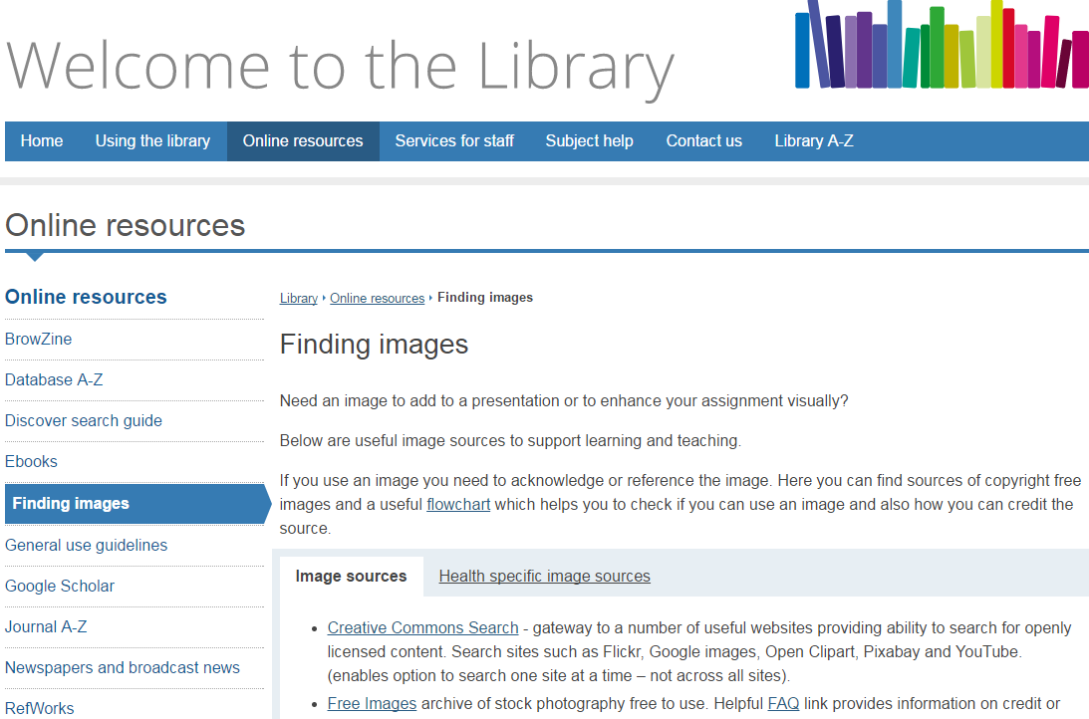
How do I find them?
We have a list of resources on the library web pages

Slide 7
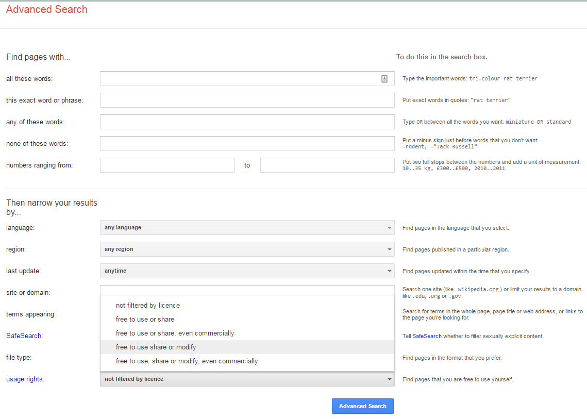
Google advanced search

Slide 8
Finding images
Creative Commons Search - gateway to a useful websites allowing you to search for openly licensed content. Search Flickr, Google images, Open Clipart, Pixabay and YouTube one site at a time.
Free Images archive of free to use stock photography. The FAQs give information on credit or attribution.
Freepik is a search for high quality photos, vectors, icons, illustrations and PSD files.
Moving Image Gateway (BUFVC) access to moving image and sound materials across a wide range of subject areas. Sign in using your domain username and password.
New York Metropolitan Museum of Art 375,000 images under CC0 licence which can be freely remixed and reused. Also covers the New York Public Library and theRijksmuseum.
Open Clipart free clipart made available under CC0 - no credits necessary!
Scran covers images and media from museums, galleries, and archives.
Luminous Lint is a website on photography.
VADS is a visual art collection, contents are freely available and copyright cleared for use in learning, teaching and research in the UK.
WorldImages provided by the California State University IMAGE Project. free to use for education.

Slide 9
Medical images
Anatomy.tv is a useful image databank providing 3D anatomical pictures, allows rotation of images and removal of layers to expose underlying structures. Includes useful guide and tutorials.
Centre for Bioscience imagebank contains freely available images contributed by academics, researchers, learned societies, industry and individuals with rights cleared for educational purposes.
e-Anatomy is an anatomical database providing more than 3,000 images of the human body. It provides cross-sectional, gross, and radiological anatomy derived from various types of medical imaging, including magnetic resonance imaging (MRI) and computed tomography (CT) scans.

Slide 10
Other resources
Creative Commons (CC) search searches CC licensed content select image, music or video sites. Check the licence applied to each resource to see what you can and cannot do with it.
Mobygratis free music for non-profit filmmakers.
Morguefile photographs. Enter your search terms and select Free Photos from the drop-down search, or browse by selecting Free Photos at top left of the page.
Musopen royalty and copyright free music for use in educational resources.
Open music archive out of copyright and public domain music.
Stonewashed free music.
Xpert OER repository from the University of Nottingham. Select a resource to download it together with a built-in attribution statement.

Slide 11
Licensing
When you find a resource, always read the terms of the license! Sometimes indexing is not up to scratch. If no licence, read terms and conditions!
A frequently used system is Creative Commons licensing (CC).
This system uses “building blocks” which allow producers to specify what use can be made of their resources.
Don’t just assume you can do whatever you want if it is tagged CC! Read the rest of the licence!
A full explanation is available on their web site at https://creativecommons.org/licenses/

Slide 12
The CC building blocks
CC-BY lets you distribute, remix, tweak, and build upon a work, even commercially, as long as you credit the creator.
CC-BY-SA lets you distribute, remix, tweak, and build upon a work, even commercially, as long as you credit the creator and license your new creations under identical terms.
CC-BY-ND allows redistribution, commercial and non-commercial, as long as the content is passed along unchanged and you credit the creator.
CC-BY-NC lets you distribute, remix, tweak, and build upon a work non-commercially, as long as you credit the creator.
CC0 - Public domain licence

Slide 13
YouTube
When searching YouTube, use the filters to specify Creative Commons.
Check the conditions before you use an item.
Best to link out to YouTube site or use the GCULearn building block.

Slide 14
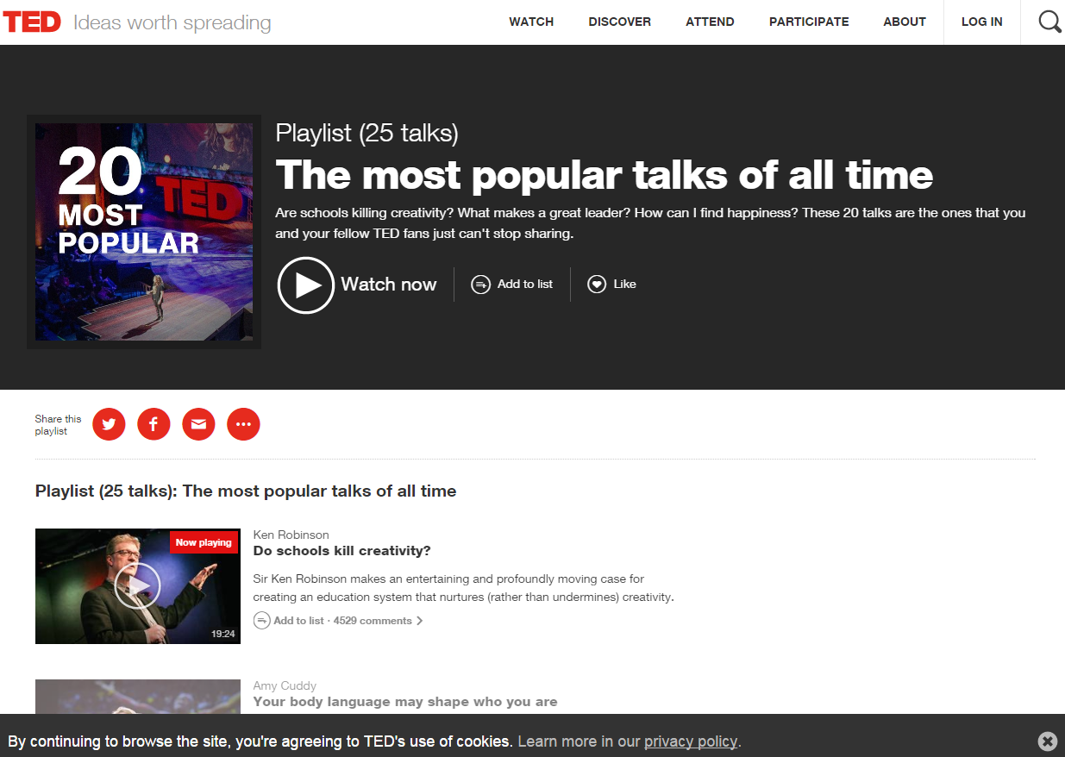
Ted Talks

Slide 15
What is sufficient acknowledgement?
Sufficient acknowledgement is required to appropriately credit the original creator of a work.
It also allows a user to easily locate the work in its full form, either online or in print.
Always cite the original source:
Use a standard citation system for academic works (e.g. Harvard).
For other resources use this basic citation format, providing as much information as possible: Type of content: Title by Author. Link.

Slide 16
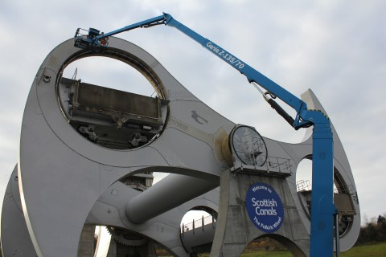
Example 1 - Photograph
Image: The Falkirk wheel gets an MOT by Angela Finlay. https://www.scottishcanals.co.uk/media-centre/galleries/the-falkirk-wheel-gets-an-mot.
Notes:
Why do this? If I have found this photo on the web and want to illustrate my talk on the maintenance of the Falkirk Wheel, this referencing format allows me to acknowledge the photographer’s work and the student to view the photo in its original context.

Slide 17
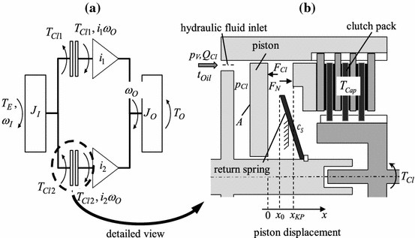
Example 2 - Diagram
Schematic diagram of a double clutch (a) and detailed cylinder model. In: WURM, A., BESTLE, D. 2015. Robust design optimization for improving automotive shift quality. Optimization and Engineering [online]. [viewed 13 April 2016]. Available from: http://dx.doi.org/10.1007/s11081-015-9290-1.
Notes:
Why do this? If I have found this diagram in a text and want to illustrate my talk on engineering design, this referencing format allows me to acknowledge the authors’ work and the student to view the full text.

Slide 18
Example 3 - Quote
“Environmental assessment is the process of assessing, or measuring, the change or consequence to environmental factors when making plans, such as those for an engineering construction project, or decisions, such as deciding whether to go forward with a new, tax-funded project.”
JAIN, R. et al. 2012. Handbook of Environmental Engineering Assessment [online]. Boston: Butterworth-Heinemann. [viewed 13 April 2016]. Available from: http://dx.doi.org/ B978-0-12-388444-2.00001-4.
Notes:
It is useful to add definitions, this format allows the student to view the whole ebook online.

Slide 19
Copying and using longer broadcast, video, or audio recordings
Box of Broadcasts is an off-air recording and media archive service. Covers terrestrial and freeview channels. This includes movies broadcast on these channels! Only available in the UK.
Content played during a lecture cannot be recorded.

Slide 20
Copying and using extracts of newspapers
The Newspaper Licensing Agency (NLA) licence permits you to make copies of newspaper content for teaching purposes. This includes UK national and regional newspapers and newspaper websites.
The library subscribes to a number of current and archive newspaper services, including the Newsstand database which provides full text online access to over 1300 news publications.
Visit the library newspapers web page for more information.

Slide 21
Questions?

Slide 22
Thank you
Contact details and links:
http://gcu.ac.uk/library/servicesforstaff/copyright/
m.kelt@gcu.ac.uk
copyright@gcu.ac.uk

