Slide 1
How do we flip the classroom?
CCIS Software Engineering workshop on Implementing the Flipped Classroom
Jim Paterson, L&T Lead, CCIS

Slide 2
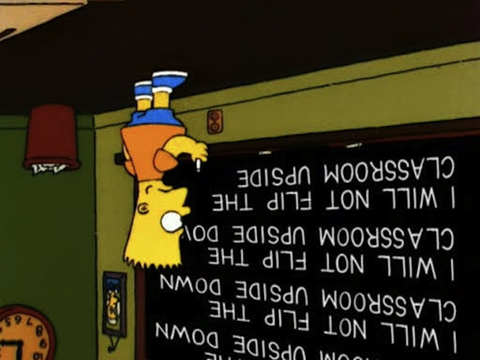
Contents
Motivation
Terminology
Implementation
Impact
Challenges

Slide 3
Motivation

Slide 4
What is the flipped classroom?
Popularised by chemistry teachers Jon Bergman and Aaron Sams (Bergman & Sams 2012)
Driven by a simple question:
“What is best for the students in my classroom?”
In a flipped approach, the conventional notion of classroom-based learning is inverted
Students are introduced to the learning material before class
Classroom time used to deepen understanding
Discussion with peers and problem-solving activities facilitated by teachers

Slide 5
Why now?
New delivery models in Computing @ GCU
ALC
Learning materials need to be online, significant development effort achieved and ongoing on this
Classroom sessions with ALC Associate Lecturers
GLA
Work-based learning
Limited time spent on campus, need to make best use for students of the sessions here
Development of online learning materials offers alternatives to the traditional lecture-based approach

Slide 6
Terminology

Slide 7
Peer Instruction and Just in Time Teaching
Techniques used in the flipped classroom, predate the common usage of that term
Described by Harvard Physics professor Eric Mazur in the late 1990s
Mazur developed a model of ‘peer instruction’ in which he provided material for students to prepare and reflect on before class
Used class time to encourage deeper cognitive thinking via peer interaction and instructor challenge
He called this “just in time teaching” (Crouch and Mazur 2001)

Slide 8
Peer Instruction (PI)
Promotes classroom interaction to engage students and address difficult aspects of the material
Typically structured around questions related to these aspects
Provides opportunities for students to discuss concepts in class with peers
Typically requires students to work collaboratively either in pairs or in
larger groups
In principle no limit to class size – has been used with 100s of students in a class
PI allows students to learn from each other
Gives real-time feedback

Slide 9
Just in Time Teaching (JiTT)
For PI to be most effective, students need to come to class with some basic understanding of the material
JiTT structures students’ reading before class
Delivers learning content, for example recorded lectures, online materials
Provides feedback - for example, online quizzes provide feedback to students and to instructor
Instructor can tailor the PI questions to target student difficulties
Together, PI and JiTT help students and instructors monitor learning as it happens

Slide 10
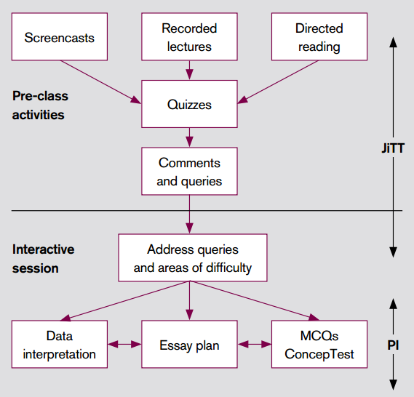
PI and JiTT activities
From: Just-in-time Teaching and Peer Instruction in the Flipped Classroom to Enhance Student Learning, Natalie Rowley and Jon Green

Slide 11
Implementation

Slide 12
Implementing PI
Session structured around short, conceptual multiple-choice questions (ConcepTests)
After a brief presentation by the instructor, the focus shifts from the instructor to the student
After 1–2 minutes of thinking, students commit to an individual answer
Depending on results, instructor may ask students to turn to their neighbours and discuss their answers
Students talk in pairs or small groups and are encouraged to find someone with a different answer
The teaching staff circulates throughout the room to encourage productive discussions and guide student thinking
After several minutes students answer the same ConcepTest again

Slide 13
Implementing PI
From: Just-in-time Teaching and Peer Instruction in the Flipped Classroom to Enhance Student Learning, Natalie Rowley and Jon Green

Slide 14
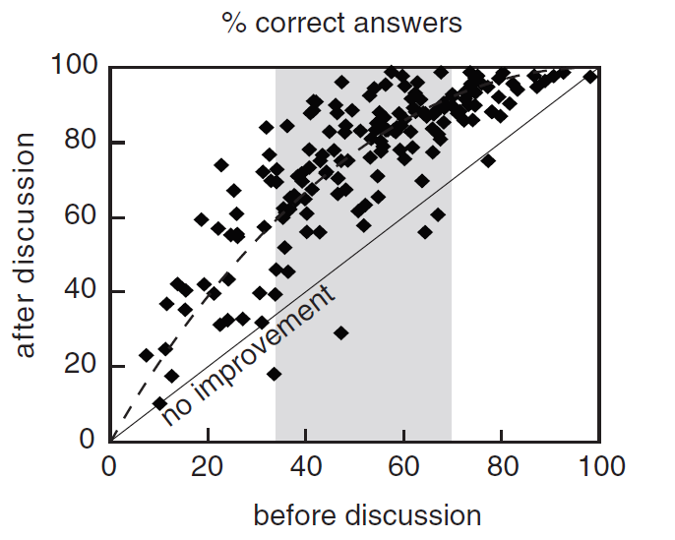
When is discussion most effective?
From Watkins & Mazur, justifies that discussion has most effect when 30-70% correct

Slide 15
Implementing PI - questions
There are different types of question format which can be used in PI, for example:
questions on general theories and definitions
application of concepts in varying contexts
questions which inter-relate different ideas
“predict the outcome” questions on demonstrations
questions for which there is a ‘correct’ answer
questions that stimulate discussion amongst students where there is no definitive answer

Slide 16
Implementing JiTT
Students are expected to engage in advance with preparatory material that delivers the content that would traditionally be presented in lectures or in support of lectures, for example:
Online content prepared by lecturer (e.g. ALC material)
Recorded lectures
Screencasts
Video courses (e.g. Lynda, Pluralsight)
Directed reading
Also expected to engage with assignments in advance that direct the content classroom session

Slide 17
Implementing JiTT
Quality of student discussion and learning in a PI classroom depends on the quality of the ConcepTests
Questions must require higher-level thinking about a concept
Questions must challenge students but allow them to reason to the answer with their existing knowledge.
To choose the best ConcepTests, instructors need to gauge what concepts are causing student difficulties and what level of question is appropriate for their class
By assigning JiTT assignments before class, instructors receive important feedback on their students’ knowledge and understanding of the material
Learn what difficulties students have, what topics students are most apprehensive about, and what concepts students understand well

Slide 18
Impact

Slide 19
Impact of flipping
Bergmann and Sams claim that flipping:
Speaks the language of the students
Helps busy students
Helps struggling students
Helps students of all abilities to excel
Allows students to pause and rewind their teacher
Increases student-teacher interaction
Allows teachers to know their students better
Increases student-student interaction
Allows for real differentiation
Changes classroom management

Slide 20
Evidence for impact
Quite a lot of literature available on these techniques across a wide range of subjects (see for example Bishop & Verleger, 2013)
Focus here on evidence relating to their use in our own discipline
Summarising findings from a selection of papers published in Computer Science Education journals/proceedings
Findings relate to:
Student perceptions of value
Fail rates
Student evaluations

Slide 21
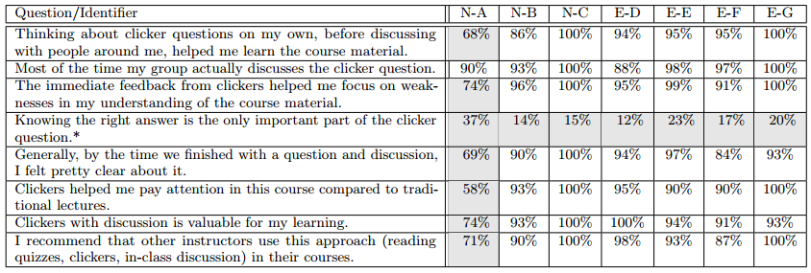
Student perception of value
Multi-institutional study of PI by Porter et al. (2016), key findings:
a supermajority of students in all studied classes liked and would recommend PI
successful PI implementation requires that the instructor’s motivations for using PI are clear to students

Slide 22
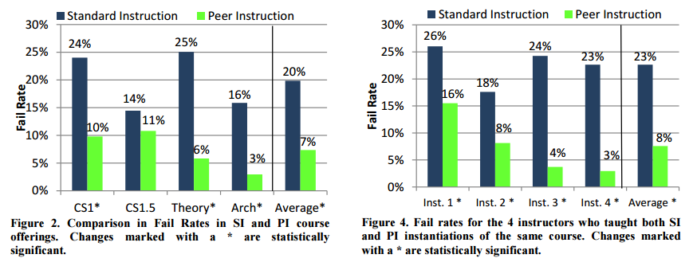
Impact on fail rates
Earlier study by Porter et al. (2010), key findings:
course fail rates are reduced 25-81%
“within-instructor” fail rates reduced by 40-87%

Slide 23
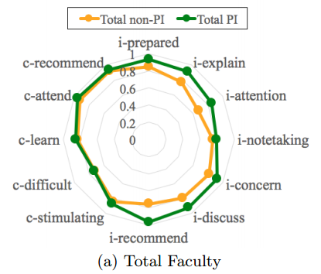
Impact on student evaluations
Liao et al. (2017), key findings:
students value PI on course evaluations
PI classes receive higher scores and have better scalability than non-PI classes

Slide 24
Challenges and barriers to adoption

Slide 25
Student barriers
Engagement, motivation, self-discipline
Approach will not work if students are not prepared in advance of class
Understanding of the approach, expectations
Students need to know why we flip, how it works, and what they are expected to do
Quality of preparatory content
Difficult to motivate students to engage if learning materials are not carefully designed
For example, many students will find it difficult to concentrate if these consist simply of recordings of hour-long lectures

Slide 26
Instructor barriers
Unfamiliarity with the approach
Time (and support) to prepare learning materials, JiTT assignments
Time to design questions for PI sessions
Classroom facilities, e.g. clickers
Fear of student resistance/disengagement
Organisational resistance
…

Slide 27
Useful resources
http://www.peerinstruction4cs.org/
https://www.heacademy.ac.uk/enhancement/starter-tools/flipped-learning-0
https://intranet.birmingham.ac.uk/staff/teaching-academy/documents/public/eip-dec15/rowley.pdf
http://flglobal.org/communityhome/

Slide 28
References
Watkins, J & Mazur, E. (2010) ‘Just-in-Time Teaching and Peer Instruction’, in Simkins, S.P. & Maier, M.H. (Eds.) Just-in-Time Teaching: Across the Disciplines, Across the Academy. Virginia, USA: Stylus Publishing, LLC.
Bergmann, J. and Sams, A., 2012. Flip your classroom: Reach every student in every class every day. International Society for Technology in Education.
Bishop, J.L. and Verleger, M.A., 2013, June. The flipped classroom: A survey of the research. In ASEE National Conference Proceedings, Atlanta, GA (Vol. 30, No. 9, pp. 1-18).
Liao, S.N., Griswold, W.G. and Porter, L., 2017, March. Impact of Class Size on Student Evaluations for Traditional and Peer Instruction Classrooms. In Proceedings of the 2017 ACM SIGCSE Technical Symposium on Computer Science Education (pp. 375-380). ACM.
Porter, L., Bailey Lee, C. and Simon, B., 2013, March. Halving fail rates using peer instruction: a study of four computer science courses. In Proceeding of the 44th ACM technical symposium on Computer science education (pp. 177-182). ACM.
Porter, L., Bouvier, D., Cutts, Q., Grissom, S., Lee, C., McCartney, R., Zingaro, D. and Simon, B., 2016. A multi-institutional study of peer instruction in introductory computing. ACM Inroads, 7(2), pp.76-81.

Slide 29
Thank you.

