Slide 1
Marion Kelt, Research and Open Access Librarian
Adding permalinks using Discover
m.kelt@gcu.ac.uk @mugpunter7
This work is licensed under a Creative Commons Attribution 4.0 International License.

Slide 2

What is a permalink?
When you are adding resources to your modules, you may want to add links to our electronic resources to make it easy for your students to find and use them.
The best way to do this is to add a permalink. This is a permanent link which does not expire when you close your browser session.
We have updated our library system so there are a few minor changes on how to do this, so I’m here to show you how simple it is.

Slide 3
One simple search …
Usually you will have an exact article or book title to use, but this will also work with a keyword search.
Top tip! Enter your title in the search box on the library home page, Discover will then find the exact item for you.

Slide 4
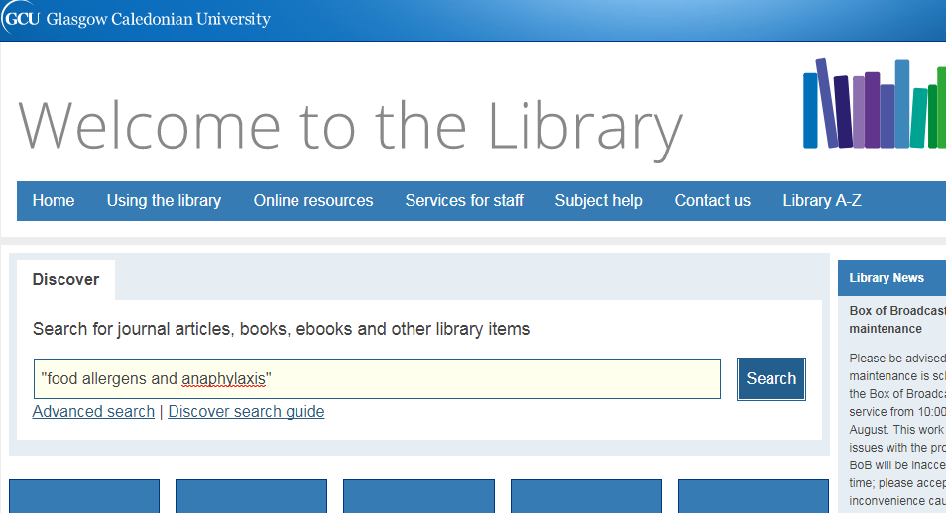
Find the electronic resource

Slide 5
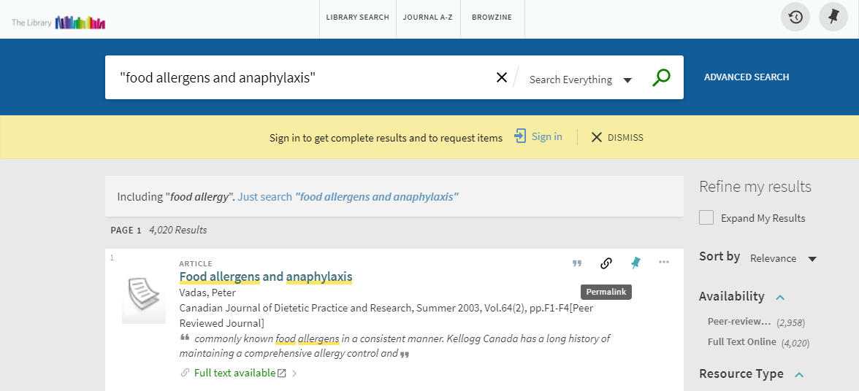
Click the permalink icon

Slide 6
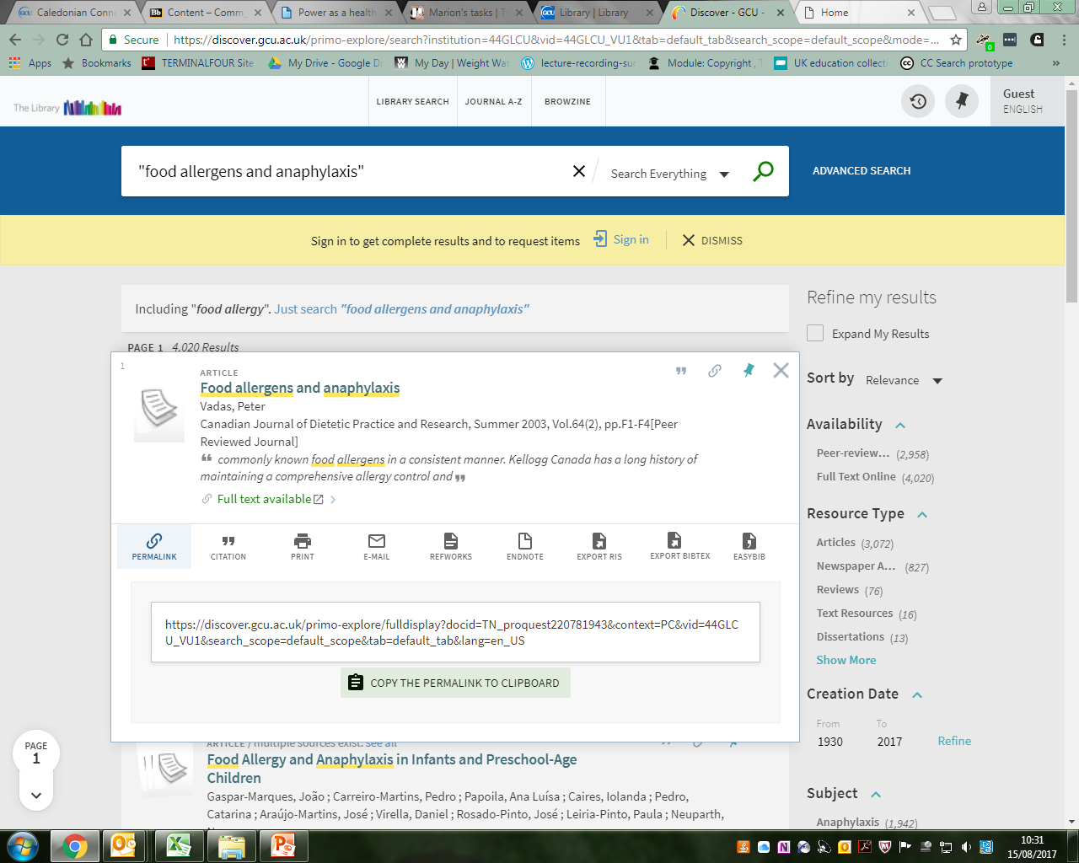
Copy the permalink

Slide 7
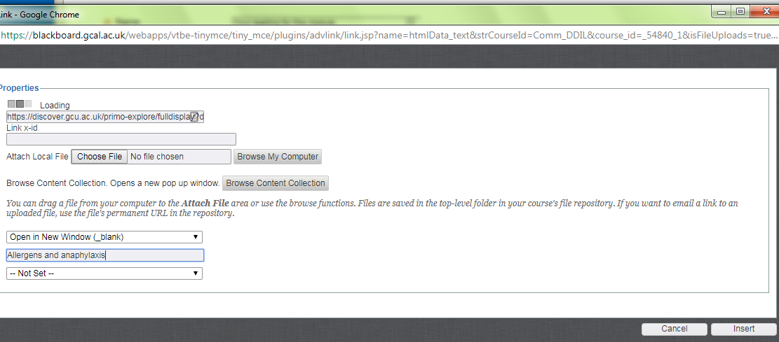
Add link to GCULearn

Slide 8

What if we don’t have it in stock?
If we have a paper copy
  We can scan it for you and send you a link to use
  See the Scanning page in the staff services menu on library web site
If not in stock
  Fill in details on the scanning form and we will follow it up for you

Slide 9

Happy linking!
Easy!
If you need some more help, contact your librarian. They will be happy to help.

Slide 10
Thank you.
m.kelt@gcu.ac.uk @mugpunter7

