Slide 1
Medical Ultrasound: Fundamental Physics & Safety Implications

Slide 2
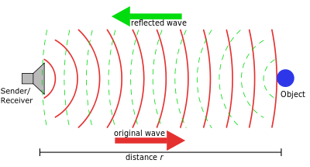
Basic Principle of Ultrasound
Waves of sound are sent into the body and ‘bounce’ off structures
The returning echoes are then collected & used to produce an image

Slide 3
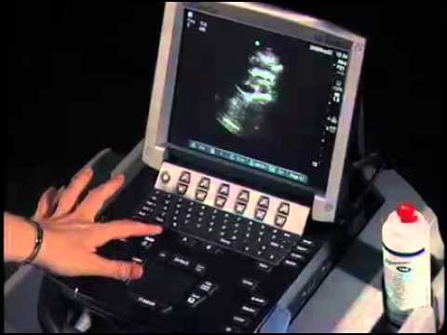
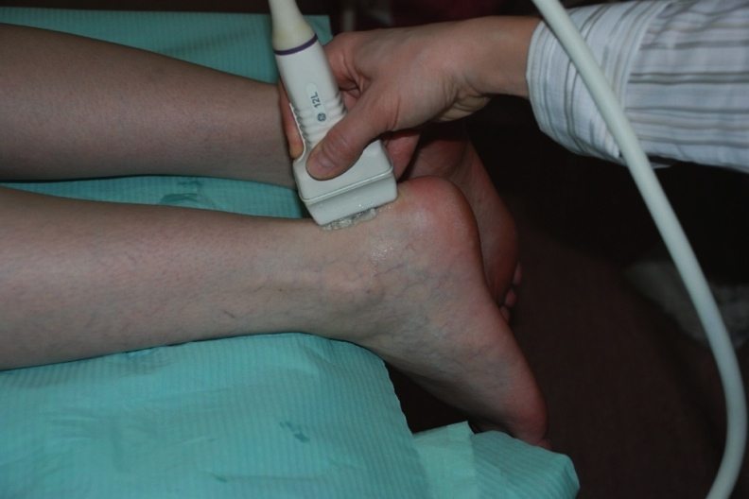
Basic Principle of Ultrasound
Sound waves are produced within the transducer (Piezoelectric effect)
Returning sound is captured by the transducer, changed to electrical signal and passed to the processing unit for display on the monitor.
Sound propagates into tissue when the transducer is applied to the patient. Coupling gel is required to combat air between interfaces.

Slide 4
Piezoelectric Effect
An electric current is briefly passed over the layer of crystals present within the transducer
The current physically alters the shape of the crystal
Once the current is switched off , the crystal snaps back to it’s normal shape producing a sound wave
This cycle is repeated to produce continuous scanning

Slide 5
Piezoelectric Effect
Electrical charge applied – compression of crystals
Electrical charge off – rarefaction of crystals
Normal crystal
Sound wave emitted

Slide 6
Acoustic impedance (z)
Refers to the resistance offered by the tissue to the travelling sound wave
Determines how much sound is transmitted forward and how much is reflected back
Determined by the density of the tissue (p) and the speed of sound (c) within that tissue type
Z= pc
Original sound wave
(reflected sound)
Interface between tissue
(transmitted sound)
The amount of sound allowed to pass through a border of two differing tissue types will depend on how closely matched the impedance values are – i.e. the greater the mismatch the less sound throughput

Slide 7
Sound propagation
The more alike the neighbouring tissues are the more sound is transmitted
This is known as the intensity reflection co-efficient (R)
Determines the ratio of energy reflected – where 0 = complete transmission and 1 = complete reflection
Tissue borders | Intensity reflection coefficient (R) | Sound reflected - percentage
Soft tissue/ water | 0.002 | 0.2
Fat/muscle | 0.0108 | 1.08
Bone/muscle | 0.412 | 41.2
Bone/fat | 0.49 | 49.0
Air/soft tissue | 0.999 | 99.9

Slide 8
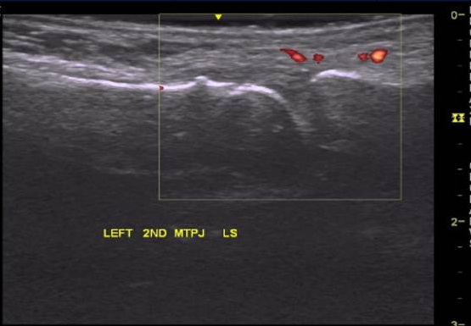
Reflection
When a large amount of sound is reflected this produces a brighter echo and appears hyper echoic on screen
Trade off -there is very little imaging capability past this strong reflector
E.g. acoustic shadow posterior to bone

Slide 9
Reflection
The strength of the sound reflected back to the transducer will also depend on the type of interface it meets
A smooth surface will return a stronger echo (specular reflection)
An irregular surface will cause the beam to scatter into more, smaller echoes -therefore reducing the overall strength (diffuse reflection)

Slide 10
Attenuation
The process by which a sound beam will lose it’s intensity
Reflection is one of the main methods of attenuation
A beam is attenuated on it’s way in to the body but also on it’s return path back to the transducer
Directly proportional to frequency – i.e. higher frequencies attenuate more therefore cannot travel as far. Not generally a problem for superficial MSK scanning.
Reflection
Forming of echo
Absorption
Transformation of sound energy into heat energy – stored within tissue
Scattering
Form of reflection where the majority of the echoes are not returned to the transducer –spread throughout the organ

Slide 11
Attenuation
Refraction
Change of beam pathway – occurs at tissue borders where there is a mismatch in speed of sound causing a change in wavelength
Divergence
The widening of the beam from origin – results in a loss of intensity
i
Tissue 1
Tissue 2
r
Wider beam at the far field than the near field
Snell’s law – formula that expresses the angles of incidence (i) and refraction (r)
sinθi = c1
Sinθr c2

Slide 12
Image generation
Returning echoes are received by the piezoelectric crystal within the transducer
Crystal again is vibrated– this time converts the vibration to an electrical signal
The processing unit within the machine recognises the position of each crystal – i.e. this will allow the computer to plot the echo on the screen depending on where on the transducer it was received and the strength of returning signal

Slide 13
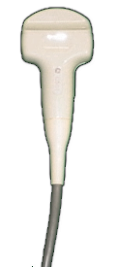
Image generation
The area of interest lies within the left field. As this is detected by crystals towards the left of the transducer this has been correctly plotted on the screen

Slide 14
Image generation
The system must additionally plot the correct depth an echo has returned from
The time taken for a returning echo to be detected will determine how far it has travelled
E.g. a longer time will translate to a greater depth displayed on screen

Slide 15
Image generation
Time for pulse and receive 2X seconds
Time for pulse and receive X seconds

Slide 16
Image generation
The system plots every echo this way
Bases it’s calculations on several assumptions
Path of an echo is straight – original or returning
The speed of sound (1540 m/s)and attenuation is constant through all tissue
All echoes have originated from the centre of the beam
Returning echoes – time taken for these to be detected is directly proportional to the distance travelled

Slide 17
Image generation
These assumptions can lead to false appearances being displayed on the image
These are known as artefacts
Common artefacts include
Acoustic shadow
Acoustic enhancement
Reverberation
Edge shadow
Mirror image

Slide 18
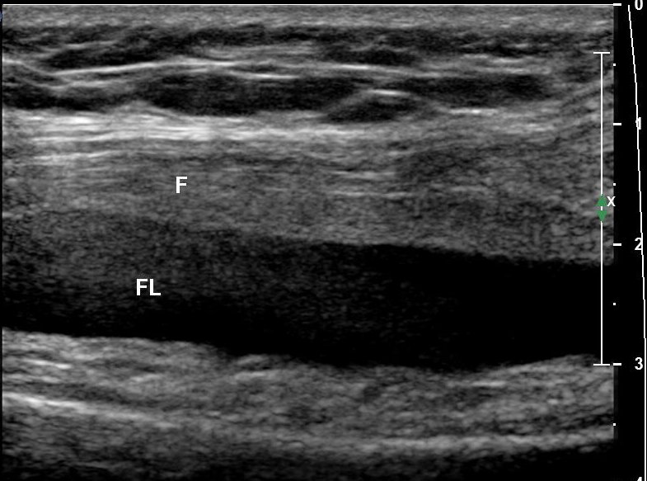
Image display
Each echo is displayed as a grey scale
Level of grey determined by the amplitude of the echo received
Strong echo = white
No echo = black
Approximately 64 grey scales available on most scanners – can alter manually

Slide 19
Image display
The ability of the ultrasound machine to distinguish different structures and display these correctly is known as resolution
Several types are important in MSK Ultrasound imaging:
Spatial
Axial
Lateral
Spatial resolution – the ability to distinguish two structures which lie very close together
Axial
Lateral

Slide 20
Resolution
Axial resolution
Determined by pulse length – i.e. short pulse length = greater axial resolution
Affected by the frequency – higher frequencies have shorter wavelengths and pulse lengths
Lateral resolution
Determined by the beam width – i.e. beam must be narrow enough to ‘see between’ two structures and register them separately
Affected by the use of focus

Slide 21
Resolution
Axial
Lateral

Slide 22
Resolution
Sector width – the narrower the section the faster the whole area can be imaged = more times (increased frame rate) and better temporal resolution
Temporal resolution
Ability of the machine to correctly distinguish two separate actions occurring at separate times and display them accordingly – i.e. the number of times a section of tissue is scanned and displayed
Faster the update (frame rate) = higher temporal resolution – REAL TIME
Focal zones – more focal zones require longer sweeps and thus have lower temporal resolutions
3 zones – requires 3 sweeps
1 zone – 1 sweep

Slide 23
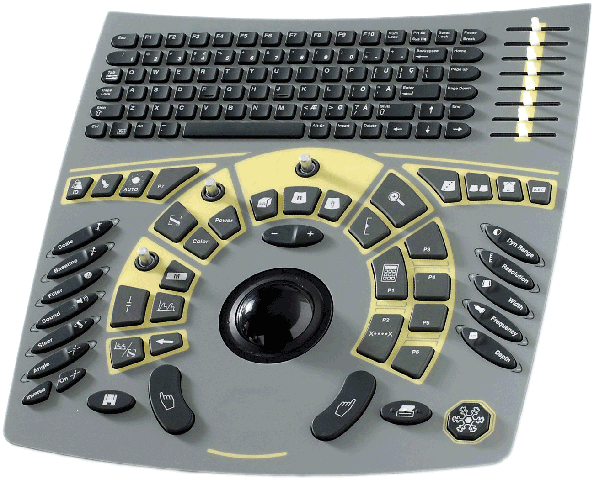
Knobology
Typical machine – important controls to increase image quality/ detail
TGC – used to alter amplitude of echoes at different levels of the image – e.g. gradual slope useful to even out echoes from deep structures with those superficially. Differs from overall gain which amplifies all echoes equally
Also known as contrast – alters the number of grey scales available for the computer to use for display
Sector width – alters the number of scan lines in an image
Frequency – alters the resonant frequency employed – higher for more superficial structures = better detail
Depth – distance able to be imaged

Slide 24
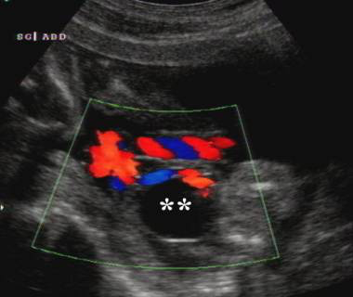
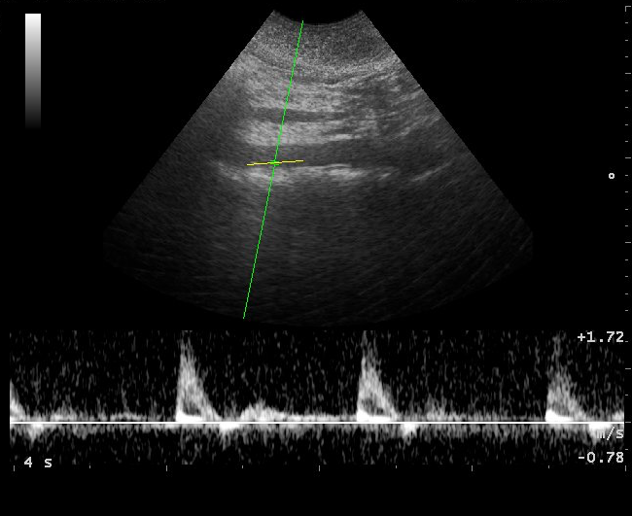
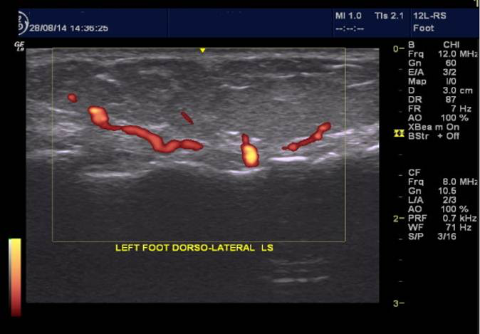
Doppler imaging
Colour – demonstrates the presence and direction of flow. Dependent on incident angle of beam.
Spectral – allows calculations of velocity and pulsatility to be calculated. Dependent on incident angle of beam.
Power – demonstrates the presence of flow; gives no indication of direction. More sensitive for low flow. Not angle dependent and used widely in MSK field.
colour
spectral
power

Slide 25
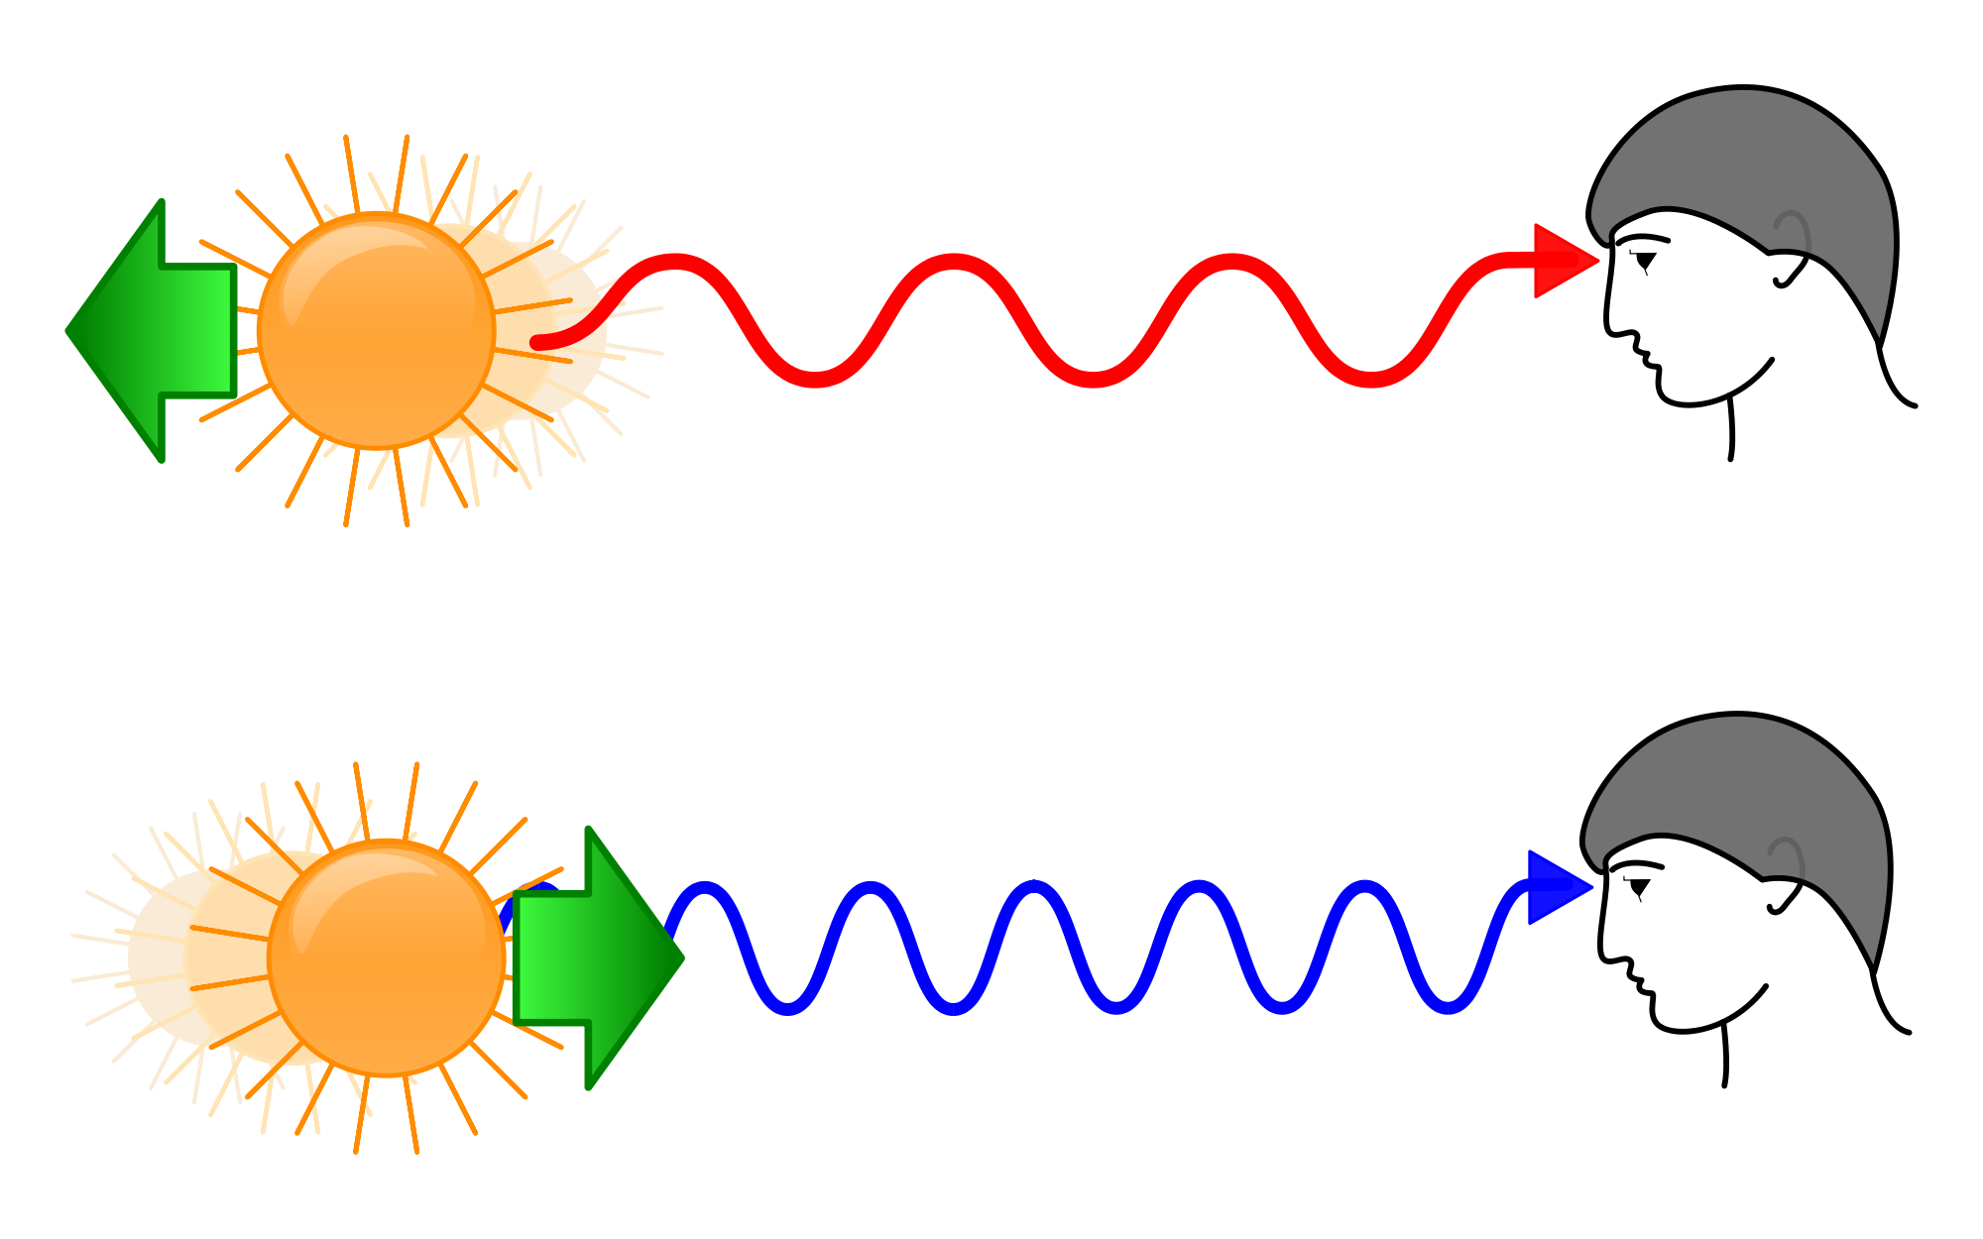
Doppler imaging
Frequency of a sound wave is changed when it encounters a moving object
Increases when object moves closer to the wave
Decreases when object moves further from the wave
Proportional to the velocity of the moving target – Doppler shift
Doppler shift equation

Slide 26
ALARA
As Low As Reasonably Achievable
Means use the least amount of ultrasound to gain a diagnostic image
Overarching principle of imaging – in ultrasound this translates to
Lowest output power
Shortest scanning time possible
Use of supplementary imaging techniques (e.g. Doppler) increases the output power.

Slide 27
Bio-effects of ultrasound
No evidenced adverse effects of ultrasound in human subjects
Theoretical effects fall into two categories
Mechanical
Stable cavitation
Non-stable cavitation
Thermal
Cavitation –
the creation of an empty space within tissue

Slide 28
Mechanical bioeffects
Stable cavitation
Tiny gas bubbles in tissue
Pressure of the sound wave will cause a transient change in their size
Considered relatively safe
Gas bubble shrinks during peak positive pressure
Compression
Rarefaction
Gas bubble swells during peak negative pressure

Slide 29
Mechanical bioeffects
Average intensity beam
High intensity beam
Unstable cavitation
When there is high enough intensity within the wave to cause the gas bubbles to burst and collapse
Will cause damage to surrounding material – i.e. causes an ‘empty space’ to appear where the gas bubble once occupied
Proven cases in rodent lung
Normal oscillation – stable cavitation
Gas bubble bursts and destroys the surrounding tissue – creates a hole

Slide 30
Thermal bioeffects
The heating of tissue through which a sound wave passes – process of absorption
Highest risk of heating within tissue with high absorption coefficient e.g. bone
Also affected by higher frequencies and screening times

Slide 31
Safety
Ultrasound operators are responsible for minimising the risk of bioeffects
Manufacturers are required to display information on the live image that will help operators make informed decisions – safety indices
Thermal Index (TI)
Mechanical Index (MI)

Slide 32
TI
Determines the ratio of the power produced to the power estimated to raise the temperature of surrounding tissue by 1°C
TI = W
W deg
i.e. TI = overall power
power needed to raise
temp by 1°C

Slide 33
MI
Estimates the potential for cavitation by the formula below
MI = PNP
√f
i.e. the peak negative pressure divided by the square root of operating frequency

Slide 34
Safe limits
TI Level | Concern
TI > 1 | Risk of increased tissue temperature
TI > 3 | Significant risk of increased tissue temperature
The British Medical Ultrasound Society (BMUS) have previously released recommendations on MI and TI values
(Adapted from Gibbs et al, 2010)
MI Level | Concern
MI > 0.3 | Possible risk of slight damage to the neonatal intestine/lung tissue
MI > 0.7 | Theoretical risk of cavitation. Risk of cavitation in conjunction with contrast agent

Slide 35
Controlling acoustic output
The TI and MI values can be controlled by
Non- Stationary Probe – if specific tissue is continually interrogated this can cause localised heating.
Frequency – higher frequency will cause increase in TI due to higher absorption
Focus – As the intensity is highest at the focus, the site and number of focus points along a beam will affect the MI/TI values

Slide 36
Indicative reading
British Medical Ultrasound Society (2009) Guidelines for the safe use of diagnostic ultrasound equipment https://www.bmus.org/static/uploads/resources/BMUS-Safety-Guidelines-2009-revision-FINAL-Nov-2009.pdf
Gibbs, V., Cole, D. and Sassano, A. (2009). Ultrasound physics and technology. Edinburgh: Churchill Livingstone/Elsevier.
Kremkau, F., Forsberg, F. and Kremkau, F. (2011). Sonography principles and instruments. St. Louis, Mo.: Elsevier/Saunders.

