Slide 1
Medical Ultrasound: Ergonomics

Slide 2
Ergonomics- Definition
“Ergonomics (or human factors) is the scientific discipline concerned with the understanding of interactions among humans and other elements of a system, and the profession that applies theory, principles, data and methods to design in order to optimize human well-being and overall system performance”.
(International Ergonomics Association, 2014)

Slide 3
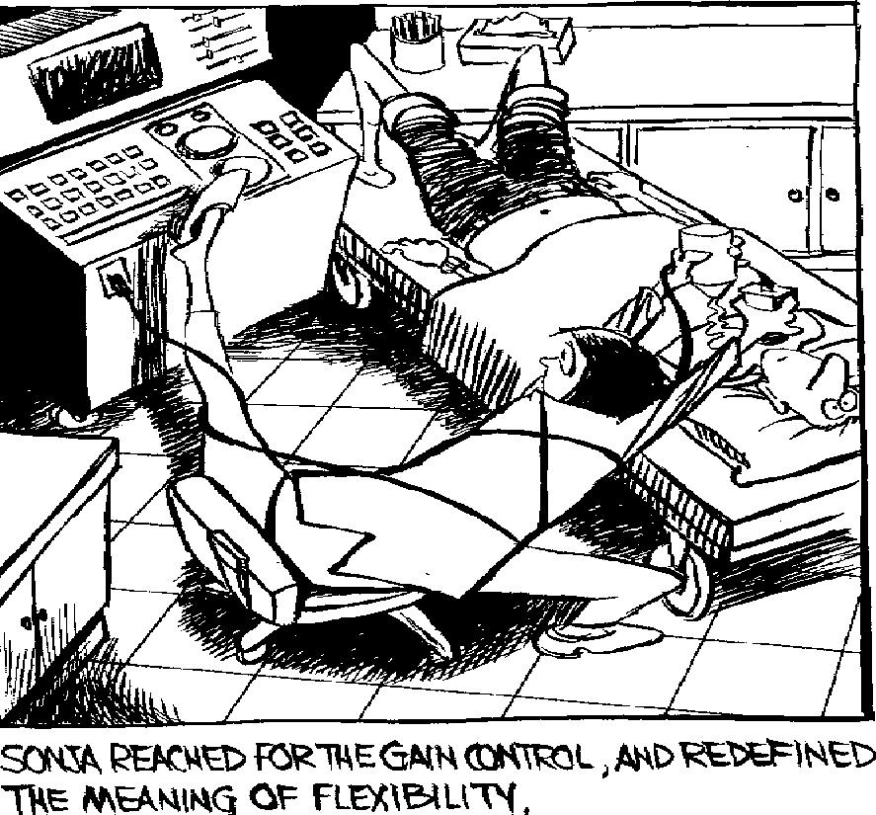
Ultrasound
Ultrasound practitioners are generally considered predisposed to Work-Related Musculoskeletal Disorders (WRMSD) due to repetitive upper limb movements and static postures.
Diagnostic ultrasound presents multiple ergonomic concerns, including:
Type and use of Equipment
Scanning environment
Work load
Practitioner/patient factors

Slide 4
Risks
Poor ultrasound practice ergonomics can lead to:
Work-related Musculoskeletal Disorders (WRMSD)
Absenteeism through ill health
A significant economic burden

Slide 5
Ultrasound WRMSD
WRMSD’s range in severity from pain and tingling to loss of function; acute, chronic and irreversible damage may lead to episodes of sickness from employment which carries a significant financial and social burden
(Murphy & Coffin, 2002)
Between 80-90% of sonographers scan in pain
(Baker 2001; Evans et al, 2010)
Anatomical regions commonly affected by WRMSD include:
Shoulder
Neck
Wrist
Back
Hand/fingers
Upper arm

Slide 6
WRMSD-Scanning risks
Repetitive micro movements
Poor scanning posture
Sub standard equipment
Inefficient transducer grip
Excessive or sustained reaching
Application of force/pressure

Slide 7
Work load risks
Increased referrals
Government waiting time targets
Staff shortages
Insufficient rest periods/breaks
Repetitive examination lists

Slide 8
Practitioner risks
Aging workforce
Inappropriate environment/equipment set-up
Inappropriate moving & handling techniques

Slide 9
Client risks
Increasingly obese population
Displacement of adipose tissue in obese patients often requires increased probe pressure and stretching (HSE, 2012), this can elevate muscle fatigue and may lead to injury.

Slide 10
Risk reduction of WRMSD in Ultrasound
Regular Health & Safety risk assessments
Appropriate equipment
Safe working environment
Moving and handling training
Education of risks of occupational injury
Appropriate equipment and ancillaries
Training and support.
Employers have a duty of care to provide regular health and safety risk assessments and an appropriate working environment for ultrasound practice. (SCoR & BMUS, 2015).

Slide 11
Ultrasound Equipment
Ultrasound equipment specifications vary, however scanners should be:
Mobile - Multidirectional wheels (scanner or cart)
With the following credentials:
Monitor- Fully adjustable height with swivel screen
Transducer- Lightweight, flexible cables
Console- Height adjustable with side tilt
Operator controls- Well lit, Intuitive, logically arranged

Slide 12
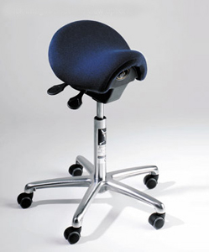
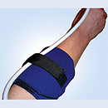
Ancillary equipment
Essential
Table - height adjustable
Ultrasound table/couches should be height adjustable ideally by electronic control to allow operator to adjust appropriately throughout examination and in response to altered patient positions
Seat – ergonomically designed/adjustable
Ergonomically designed chairs help relieve and prevent postural
stress (Bambach, 2013)
Desirable
Arm/cable support
Arm supports can be placed between the patient and practitioner
to provide arm rest to reduce muscle loading in examinations (HSE,2012)
Sagging cables should be positioned in cable supports to reduce wrist torqueing (SoR, 2006)
Anti-fatigue mat
(Rothband, 2014 )

Slide 13
Scanning Environment
Appropriate floor area to allow access around couch/flexible set-up
Black out blinds/windowless
Adjustable lighting
Air conditioning for ventilation and room cooling

Slide 14
Good work practices
Appropriate work list scheduling
Adequate staffing levels
Apply due ergonomic consideration
Adjust work environment prior to each scan (table height, chair height, patient position, lighting).

Slide 15
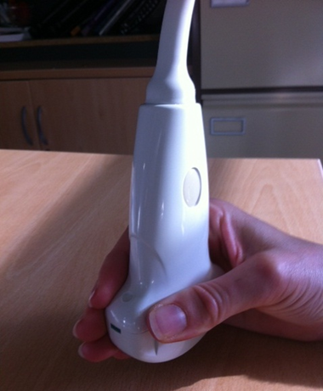
Transducer Grip
Employ the power grip
The pinch grip is a common and natural approach to hold the US transducer however takes 4 to 5 more muscle and tendon force than the power grip and utilises only 25% of hand strength (Soundergonomics, 2014).
Power grip
Pinch Grip

Slide 16
Posture
Avoid or minimize twisting of the spine
Maintain an upright position
Avoid overreaching and unnatural positions
Limit arm abduction to less than 30˚
Scan with neutral wrist position

Slide 17
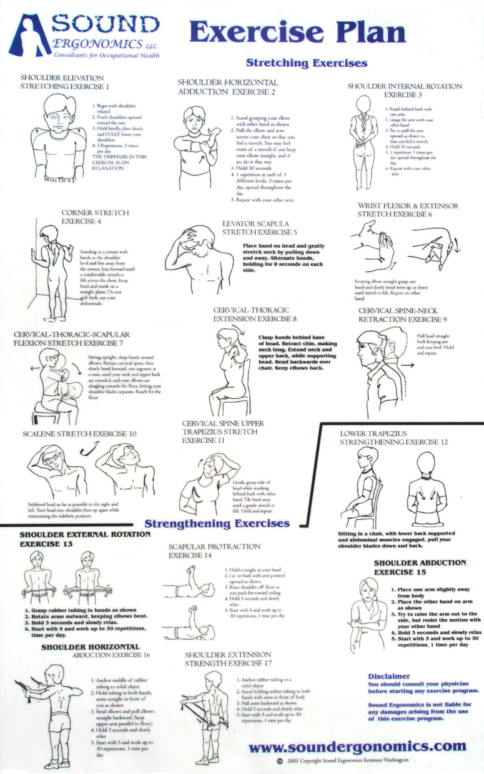
Move and stretch
Rotate tasks
Take regular mini breaks
Stretch

Slide 18
References
Baker, J.P., & Murphey, S.L., 2001. Minimizing workplace Injuries among Sonographers. Innovation in Ultrasound –Ergonomics Nov 2001 23-24
Bambach, 2013, The Bambach saddle seat. [online] Available at: http://www.bambach.co.uk/
Evans, K., Roll, S.C. and Baker, J., 2009, Work-Related Musculoskeletal Disorders (WRMSD)Among Registered Diagnostic Medical Sonographers and Vascular Technologists A Representative Sample. Journal of Diagnostic Medical Sonography Vol. 25, 287-299
GE, 2014, Ultrasound. [online] Available at: http://www3.gehealthcare.com/en/Products/Categories/Ultrasound
Health and Safety Executive, 2012, Risk management of Musculoskeletal disorders in sonography work. Date: 23 March 2012
International Ergonomics Association, 2014 [online] Available at: http://www.iea.cc/whats/index.html
Murphey, S,L. & Coffin, C,T., 2002, Ergonomics and Sonographer Well-being in Practice [online] Available at: http://www.soundergo.com/pdf/ErgSonWellBeing.pdf
Rothband, 2014, Cable support [online] Available at: http://rothband.com/product_info.php?cPath=109&products_id=234
Society of Radiographers, 2006, Industry standards for the prevention of work-related musculoskeletal disordered in sonography [online] Available at: http://www.sor.org/system/files/documentlibrary/public/sor_industrystandards_prevention_musculoskeletal.pdf
www.soundergonomics.com
Society and College of Radiographers and British medical Ultrasound Society, 2015, Guidelines for Professional Ultrasound practice [online]
Available: https://www.bmus.org/static/uploads/resources/GUIDELINES_FOR_PROFESSIONAL_ULTRASOUND_PRACTICE.pdf

