Slide 1
Medical Ultrasound: Artefacts

Slide 2
What are artefacts?
Artefacts are errors in images.
They are normally caused by physical processes that affect the ultrasound beam and that in some way alter the basic assumptions the operator makes about the beam:
Sound waves travel in straight lines.
Reflections occur from structures along the central axis of the beam.
Sound travels directly to the reflector and back.
Intensity of reflection corresponds to the reflector scattering strength
Ultrasound waves travel at exactly 1540 m/sec.

Slide 3
What are artefacts?
These assumptions do not always hold true. There are numerous cases of exceptions to these assumptions.
Some of these artefacts may actually provide useful information or allow for novel interpretations
The majority of artefacts present potential pitfalls that degrade the image and may confuse the practitioner if not considered.

Slide 4
Ultrasound beam assumptions
The basic assumptions made in producing an ultrasound image are:
Sound waves travel in straight lines.

Slide 5
Ultrasound beam assumptions
The basic assumptions made in producing an ultrasound image are:
Sound travels directly to the reflector and back.
The time taken for this round trip (time of flight) is used to calculate the depth of the object, assuming that the speed of sound in tissue is constant at 1540 m/sec.

Slide 6
Ultrasound beam assumptions
The basic assumptions made in producing an ultrasound image are:
Reflections occur from structures along the central axis of the beam.
Intensity of reflection relates to the acoustic properties and size of the reflector.

Slide 7
Ultrasound beam assumptions
These assumptions do not always hold true.
When the sound beam does not behave in the assumed manner, artefacts may occur.

Slide 8
The role of artefacts
Some artefacts help to identify certain structures (the good).
The majority are potential pitfalls that may confuse the examiner if not considered (the bad and the ugly).
Advancing technology of Ultrasound equipment reduces the risk of pitfalls, but awareness is essential to help avoid misinterpretation.

Slide 9
Common artefacts
THE GOOD
Shadowing (reflective & refractive)
Enhancement
Comet tail
THE UGLY
Motion artefact
Aliasing
Electrical noise
THE BAD
Reverberation
Anisotropy
Beam width

Slide 10
The good: Acoustic Shadowing
The amount of the ultrasound beam reflected from the boundary between two tissues depends of their acoustic impedance. The soft tissues have similar acoustic impedance, and most of the ultrasound will carry on through the second medium.

Slide 11
The good: Acoustic Shadowing
At a highly reflective interface (structures of high acoustic impedance: calcifications, bone, air), almost all of the energy of an ultrasound beam will be reflected.
The resulting image shows an anechoic area that extends deep from the hyper-reflective object.

Slide 12
Acoustic shadow: shoulder: ACJ over the supraspinatus muscle

Slide 13
Acoustic shadow: calcifications in the synovial tissue of the suprapatellar recess

Slide 14
Acoustic shadow: air bubbles in subcutaneous tissue after injection of anestetic

Slide 15
Acoustic shadowing: sesamoid bone

Slide 16
The good: Refractive shadowing
…or critical angle shadowing relates to the objects with highly curved surfaces. The shadow appears at the lateral margins of the object. Due to refraction and reflection none of the sound beam returns to the transducer.

Slide 17
Refractive shadowing: Achilles tendon

Slide 18
Achilles longitudinal tear

Slide 19
Refractive shadowing
Can be helpful in identifying oblique interfaces (i.e. in tendon rupture), but also can cause confusion and difficulty in the assessment of the oval structure borders. Refractive shadowing is reduced in spatial compound imaging.

Slide 20
Spatial compound imaging
In spatial compound imaging the sound beam is steered out of axis. Signal processing renders the steered frames into a final image.
A clearer delineation of borders is obtained even when they are orientated at unfavorable angles.

Slide 21
The good: Posterior Acoustic Enhancement
…is related to the false assumption that all tissues attenuate sound equally.
When the sound beam encounters the structure that does not attenuate the sound beam as much as surrounding tissues (simple fluid), more sound is available to image the structures at deeper levels.
It results in the impression of increased echogenicity of the deeper structures.

Slide 22
Enhancement: Baker’s cyst

Slide 23
Enhancement: suprapatellar bursa

Slide 24
Enhancement and refractile shadowing: Baker’s cyst

Slide 25
The good: Comet tail artefact
…appears when the sound beam encounters metal or glass.
Is formed of bands of increased echogenicity which cross tissue boundaries, including those of high acoustic impedance (as a bone).
The intensity of the bands decreases with the distance from the object giving the appearance of the tail of a comet.

Slide 26
Reverberations: plantar fascia injection

Slide 27
Reverberations: tibio-talar joint injection
Notes:
Need to arrow image

Slide 28
How does the comet tail artefact appear?
The ultrasound beam bounces back and forth between the anterior and posterior surface of the metal or glass object and then returns to the receiver (reverberation).
The periodicity of the bands within the comet tail is equal to the thickness of the object.

Slide 29
The bad: Reverberation
The same artefact appears when the sound beam is reflected from strong reflector such as a bone/tissue interface.
In this situation the effect is more confusing creating the objects below the bone.

Slide 30
Reverberation: PIP joint

Slide 31
Reverberation: MCP joint

Slide 32
The bad: Mirror artefact
Sound can bounce off a strong, smooth reflector such as the bone or diaphragm.
The surface acts as mirror and reflects the pulse to another tissue interface (type of reverberation artefact).
The ultrasound system believes the second interface is beyond the first surface, and this is where it appears on the scan.

Slide 33
The bad: Mirror artefact
Bone acts as a mirror, what is beneath is a reflection and not a true structure

Slide 34
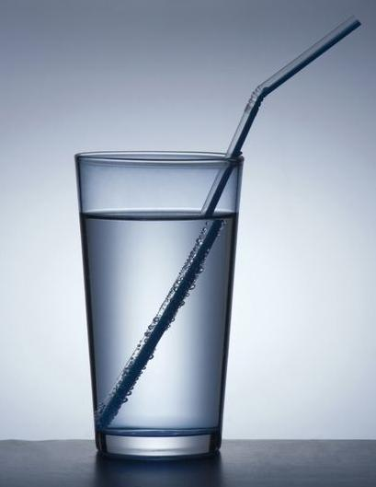
The bad: Refraction
Due to refraction the real structures appear in false locations.
Occurs at interfaces between structures that change the velocity of sound.
The sound beam is bent at the interface in proportion to the difference in velocity of sound transmission.

Slide 35
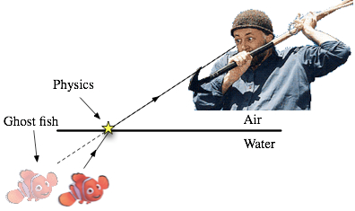
The bad: Refraction
Imaged location
True location

Slide 36
The bad: Anisotropy
Variation of the ultrasound interactions with the fibrillar tissues (anisotropic reflectors), showing different echogenicity of tissue depending of the angle of the ultrasound beam.

Slide 37
The bad: Anisotropy
On screen
On screen

Slide 38
The bad: Anisotropy
Anisotropic reflectors are common in musculoskeletal ultrasound.
The strongest anisotropic reflectors are tendons. Muscles, ligaments and nerves have less pronounced anisotropic features.
Anisotropy can help to differentiate tissues (i.e. tendon from surrounding fat), and intra-tendinous damage (abnormal tendon does not express anisotropic features).
The incident sound beam should ALWAYS be perpendicular to the examined tendon.

Slide 39
Anisotropy: extensor tendons wrist

Slide 40
Anisotropy: rotator cuff

Slide 41
Anisotropy: extensor tendon over MTP joint

Slide 42
The bad: Beam Width artefact
Ultrasound images comprise a volume of tissue (width of the transducer = width of the sound beam).
The appearance of the structure under examination may be smaller than the width of sound beam therefore the image produced becomes a combination of the echoes from the object and the surrounding tissues (volume averaging).
The effect can be loss of posterior shadowing from small calcifications or demonstration of echoes within simple cysts.

Slide 43
The bad: Beam Width artefact
Small calcifications may not show the acoustic shadow.

Slide 44
Beam width artefact: loose body in the CMC joint

Slide 45
The ugly: Motion artefact
The image displayed on the ultrasound machine is an average of several data acquisitions. When movement occurs the image can become blurred.
Movements affect the assessment of the tissue vascularity while using Color and Power Doppler (color noise).

Slide 46
The ugly: Motion artefact

Slide 47
Motion artefact: Psoriatic arthritis

Slide 48
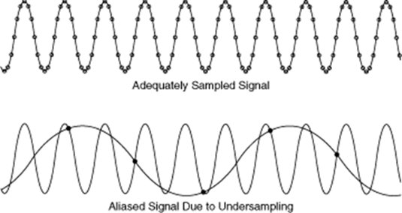
Doppler artefact - Aliasing
Most common Doppler artefact affecting colour and spectral applications
Aliasing occurs due to estimation errors of Doppler signals from under sampling
Low sampling frequency (low PRF) prevent appropriate signal capture

Slide 49
Fundamentals of Aliasing
The maximum Doppler shift (therefore maximum velocity determined) is determined by the Nyquist limit which equals ½ the Pulse Repetition Frequency (PRF).
To adequately display, Doppler signals must be sampled at least twice
System has upper limit of PRF (determined by time for returning echos/depth of sample area)
This affects the Maximum Fd which can be detected
Remember equation - V = Fd c
2 Ft cosØ
Nyquist limit occurs when max Fd has been reached
Fd = PRF
2

Slide 50
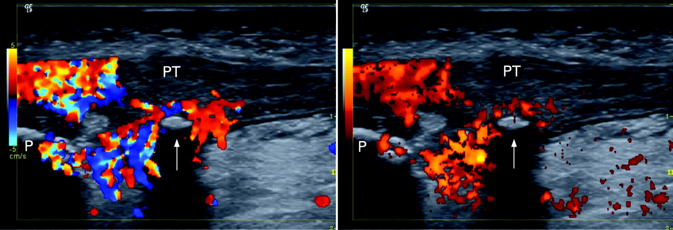
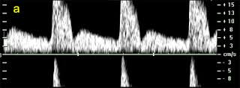
Aliasing
Colour Doppler- as the signal is aliased (becomes indistinguishable) from one colour to the next, it appears as a mosaic of the very bright hues
Spectral Doppler- Spectral wraparound is
demonstrated where signals are
displayed both above and below the
baseline.

Slide 51
Therefore..
Aliasing is affected by PRF AND Depth
Increased depth = reduced PRF = Reduced Max Fd = Aliasing
It is not always possible to eliminate aliasing
and aliasing can be useful!
Avoid aliasing by:
1. Increasing the PRF
2. Reducing the transducer frequency
3. Shifting the baseline
4. Reducing the depth of sample volumee

Slide 52
The ugly: Electrical noise
Electromagnetic interference from high-voltage transformers or other equipment can degrade images.
The distortion appears i.e. in the proximity of MRI scanners, mobile telephones, radio transmitters.

