Slide 1
Foot and Ankle Pathology in Rheumatic Diseases

Slide 2
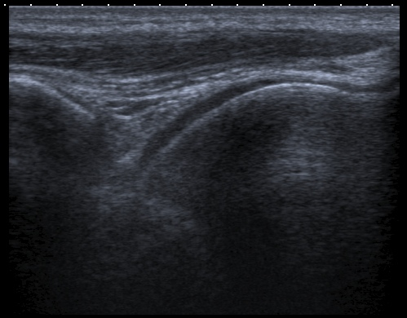
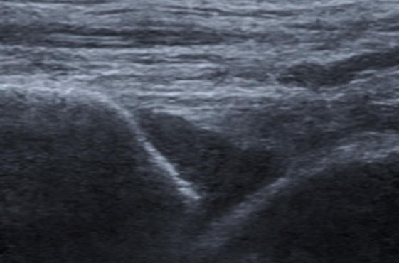
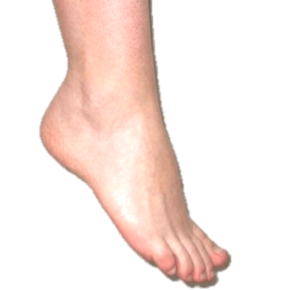
Ankle Joint Effusion
A compressible, displaceable, hypoechoic or anechoic intra-capsular area, which does not exhibit Doppler Signal (Wakefield et al, 2005)
Normal
Joint Effusion
tibialis anterior tendon/muscle
joint capsule
tibia
talus
Synovial Effusion
Longitudinal Axis

Slide 3
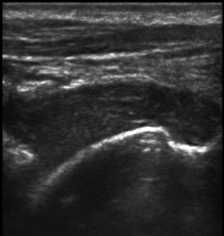
Ankle Joint Synovitis (Synovial Hypertrophy) An abnormal non-displaceable, poorly compressible hypoechoic intra-capsular area which may exhibit Power Doppler signal (Wakefield et al, 2005)
Normal
Synovitis (Synovial Hypertrophy)
tibialis anterior tendon/muscle
joint capsule
tibia
talus
Synovial Hypertrophy
Longitudinal Axis

Slide 4
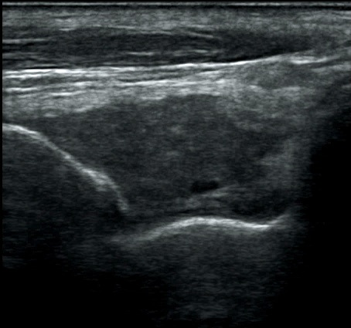
Ankle Joint Synovitis (Synovial Hypertrophy) An abnormal non-displaceable, poorly compressible hypoechoic intra-capsular area which may exhibit Power Doppler signal (Wakefield et al, 2005)
Normal
Synovitis (Synovial Hypertrophy)
tibialis anterior tendon/muscle
joint capsule
tibia
talus
Synovial Hypertrophy
Longitudinal Axis

Slide 5
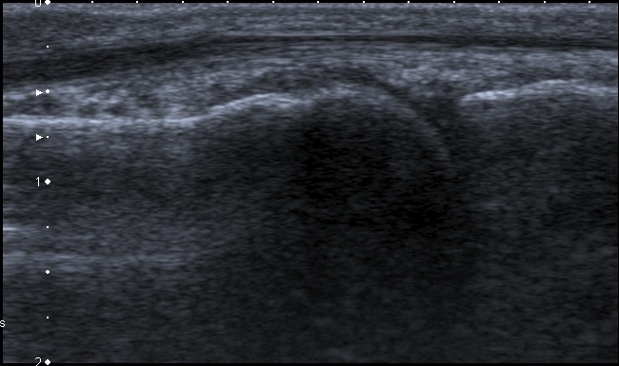
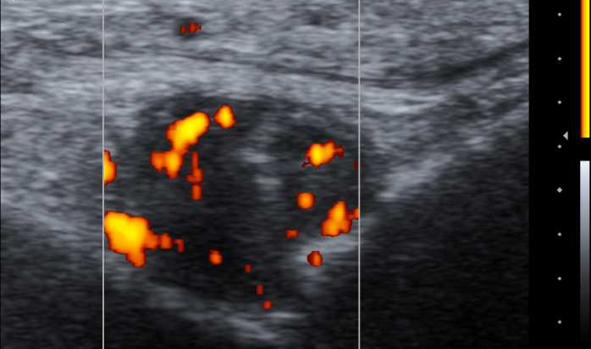
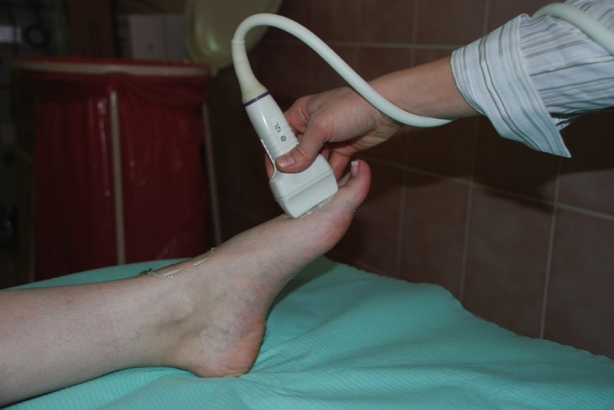
2nd MTP Joint Synovitis (Power Doppler Signal) Active Power/Colour Doppler Signal seen in the synovium of joint capsules indicating haemodynamic active synovitis (Naredo, 2007)
Normal
Extensor tendon
Joint capsule
Synovitis (Power Doppler Active)
Proximal phalanx
Metatarsal head
Synovitis
Longitudinal Axis

Slide 6
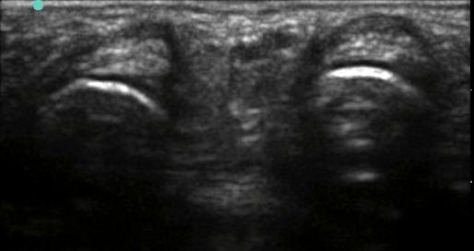
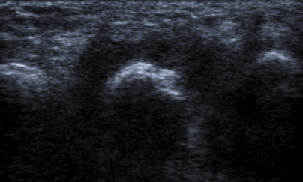
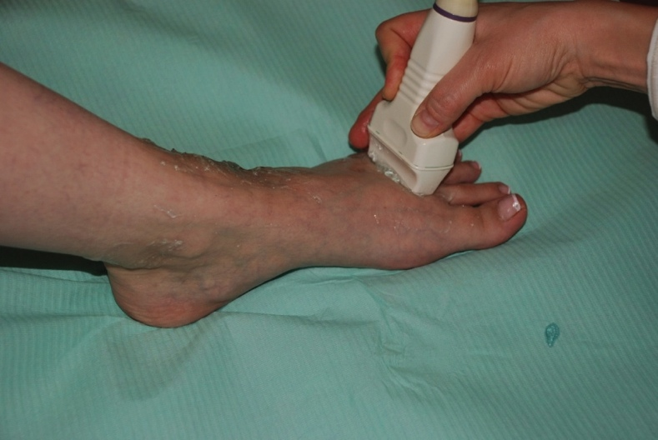
MTP Joint Synovitis (B-Mode Changes)
Normal
Synovitis
(Synovial Hypertrophy)
Extensor tendon
Extensor tendon
Joint capsule
Joint capsule
Metatarsal head
Metatarsal head
Extensor tendon
Synovial Hypertrophy
Transverse Axis

Slide 7
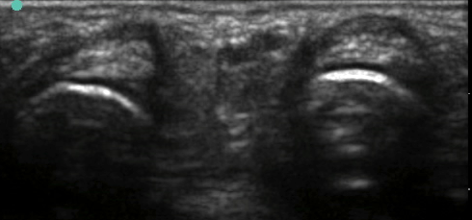
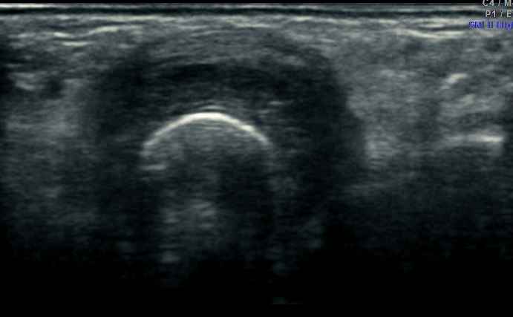
MTP Joint Synovitis (B-Mode Changes)
Normal
Synovitis (Synovial Hypertrophy in B-Mode)
Extensor tendon
Synovial Hypertrophy
Transverse Axis

Slide 8
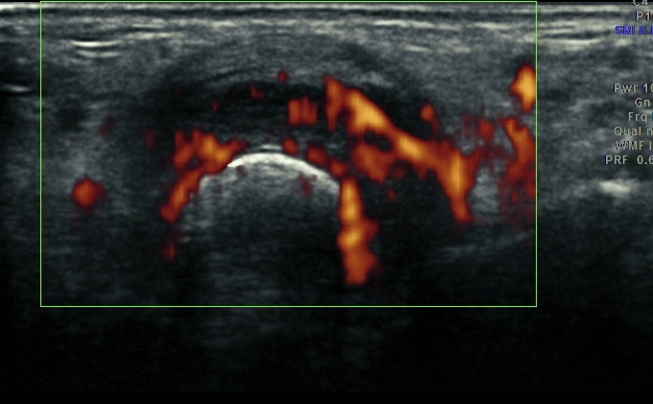
MTP Joint Synovitis (Power Doppler)
Normal
Synovitis
(Power Doppler Active)
Transverse Axis

Slide 9
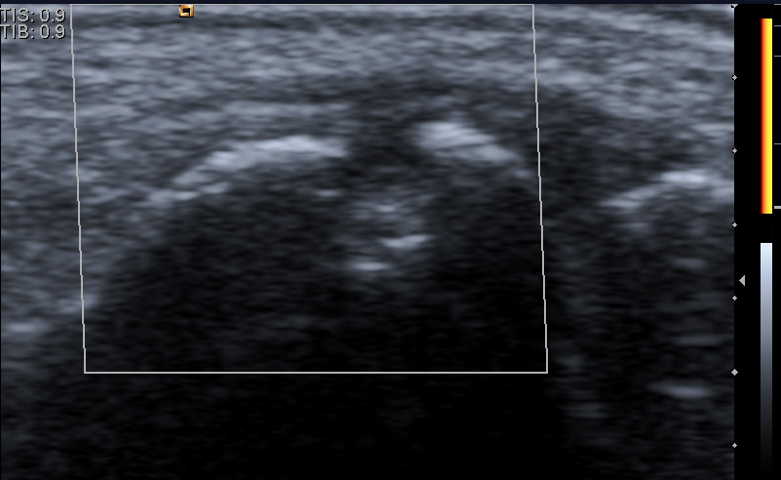
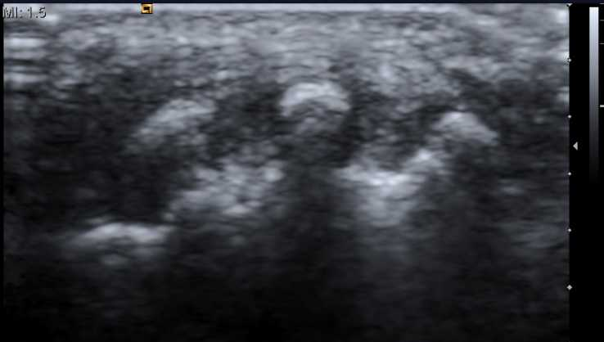
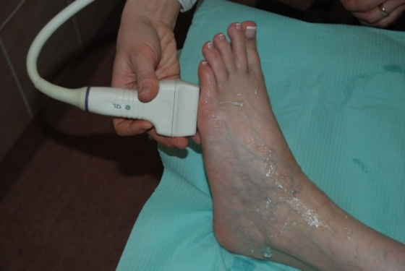
Bone/Joint Erosions (B-Mode Changes) An intra-articular discontinuity of the bone surface that is visible in 2 perpendicular planes (Wakefield et al, 2005)
Erosions confirmed in
Erosions of 5th MTP Joint (shown in 2 planes)
Proximal phalanx
Metatarsal head
Metatarsal head
Longitudinal Axis
Transverse Axis
Normal
Proximal phalanx
Metatarsal head
Longitudinal Axis

Slide 10
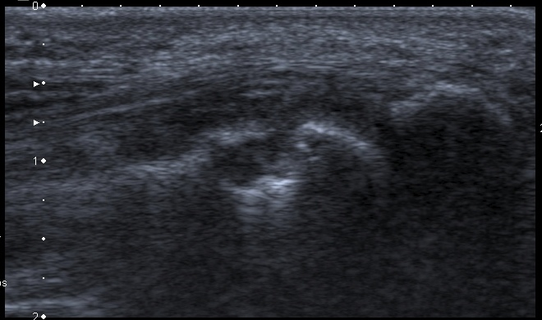
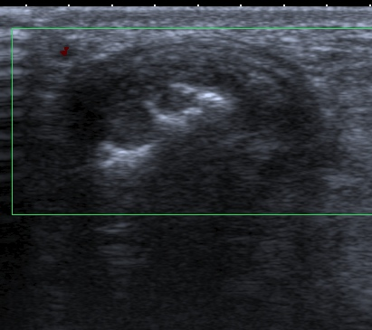
5th MTP Synovitis and Erosions
Proximal phalanx
Proximal phalanx
Metatarsal head
Metatarsal head
Longitudinal Axis
Longitudinal Axis
Proximal phalanx
Metatarsal head
Metatarsal head
Longitudinal Axis
Transverse Axis

Slide 11
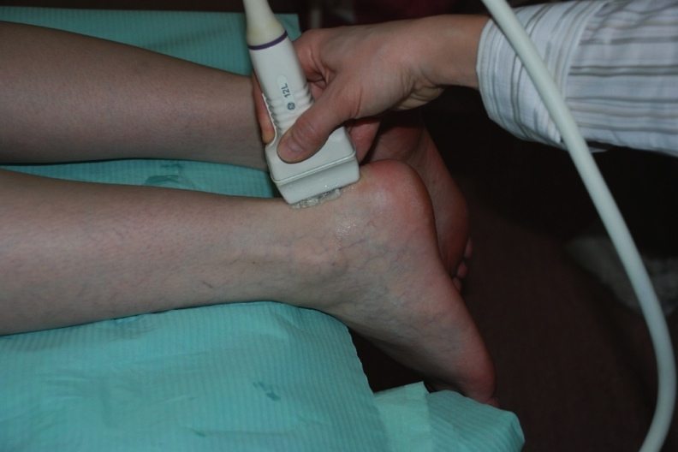
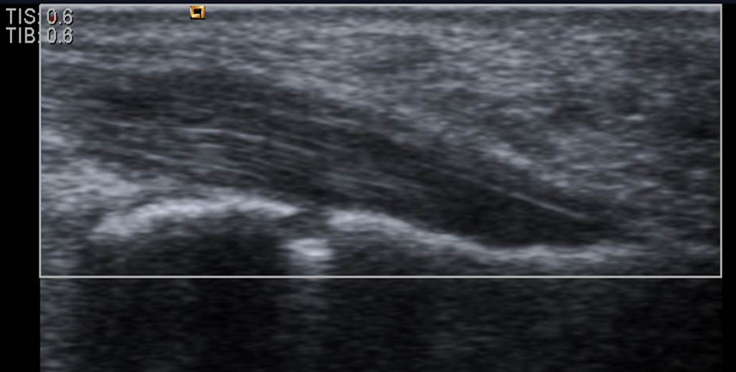
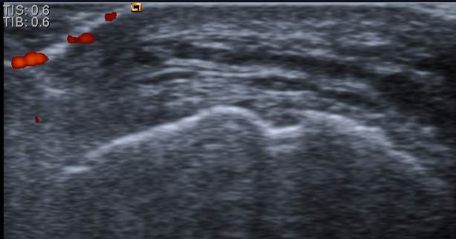
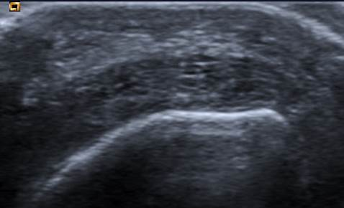
Bone Erosions (B-Mode Changes)
Erosions confirmed in
Erosions of calcaneal bone (shown in 2 planes)
Calcaneum
Calcaneum
Longitudinal Axis
Transverse Axis
Normal
(Normal anatomical step down contours exist in calcaneum in 1 plane only)
Calcaneum
Calcaneum
Longitudinal Axis
Transverse Axis

Slide 12
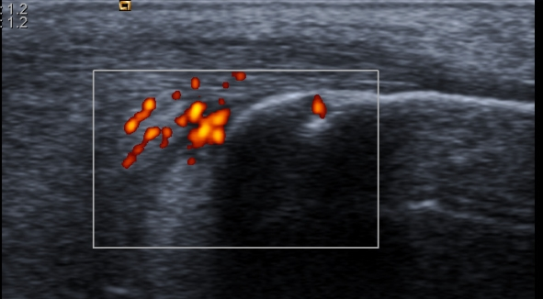
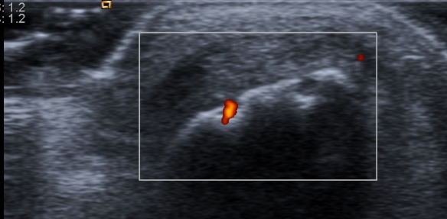
Bone Erosions (Power Doppler Active)
Erosions confirmed in
Active Erosions of calcaneal bone (shown in 2 planes)
Calcaneum
Calcaneum
Longitudinal Axis
Transverse Axis
Normal
Calcaneum
Calcaneum

Slide 13
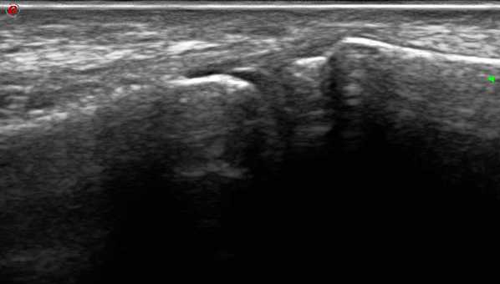
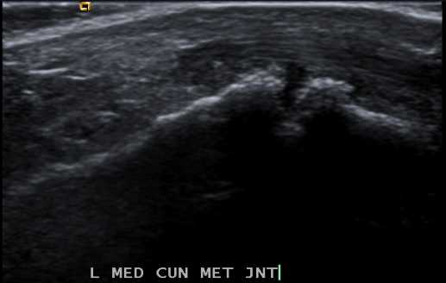
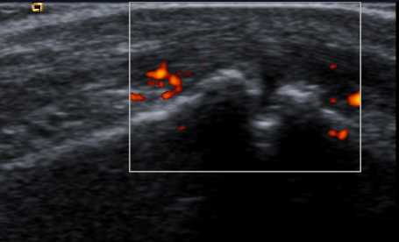
Osteoarthritic (OA) Degenerative Joint Disease Joint Space Narrowing, Degradation of cartilage, irregular bone surfaces (visible in one plane), osteophytic growths and Power Doppler signal in inflammatory OA
Normal Tarsometatarsal Joint
Tarsometatarsal Joint Inflammatory OA (B-Mode & Power Doppler Signal)
Medial Cuneiform
1st Metatarsal
Medial Cuneiform
1st Metatarsal
Medial Cuneiform
1st Metatarsal

Slide 14
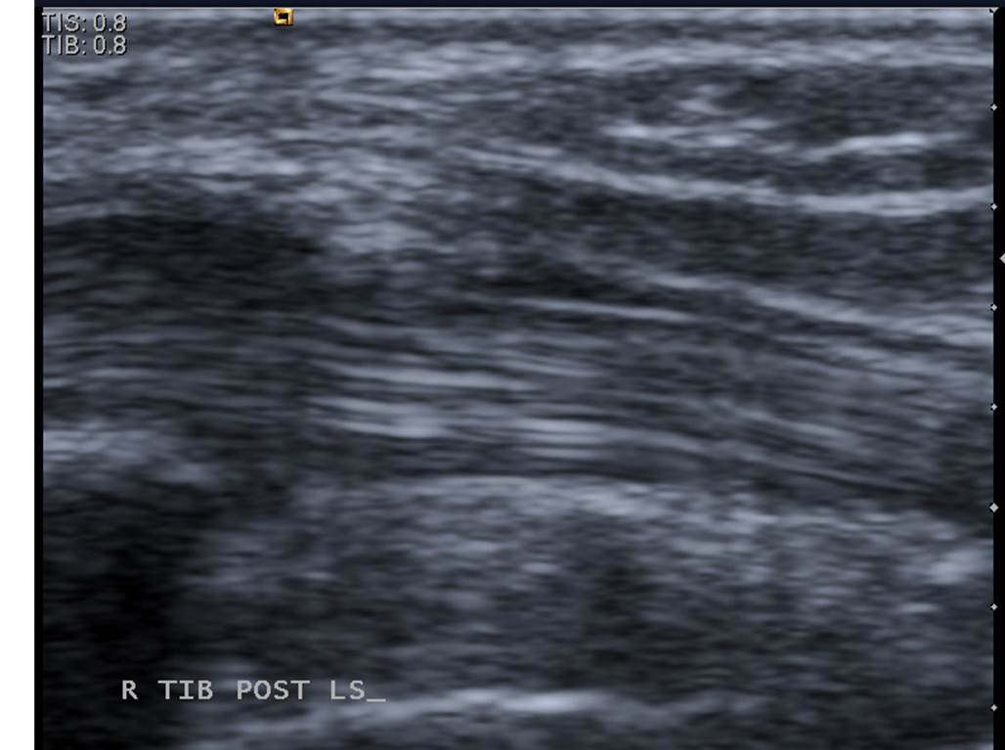
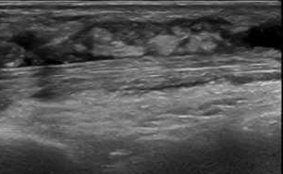
Tibialis Posterior Tendon Tenosynovitis Hypoechoic or anechoic thickening in the tendon with or without fluid within the tendon sheath, in 2 planes and may exhibit Doppler Signal (Wakefield et al, 2005)
Normal
Tenosynovitis
(Synovial Hypertrophy)
Synovial Sheath
Tibialis Posterior Tendon
Synovial Hypertrophy
Tibialis Posterior Tendon
Longitudinal Axis

Slide 15
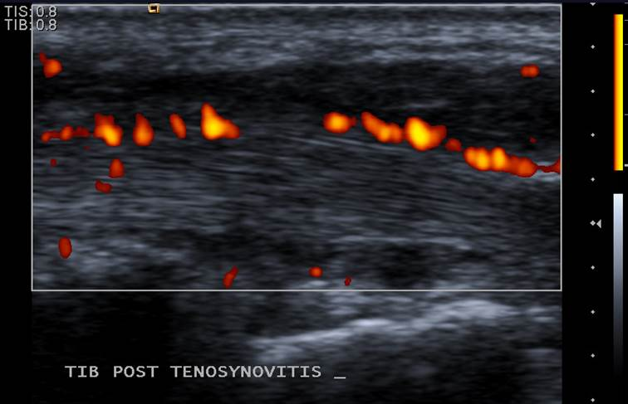
Tibialis Posterior Tendon Tenosynovitis (Longitudinal Axis)
Normal
Tenosynovitis (Power Doppler)
Synovial Sheath
Tibialis Posterior Tendon
Synovial Hypertrophy with Power Doppler
Tibialis Posterior Tendon with stenosing Power Doppler Signal
Synovial Hypertrophy with Power Doppler

Slide 16
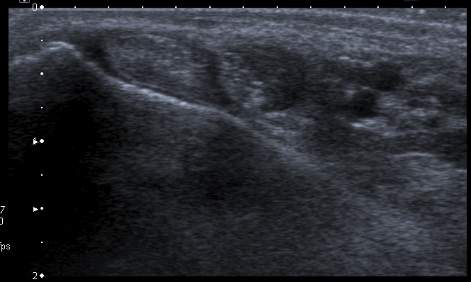
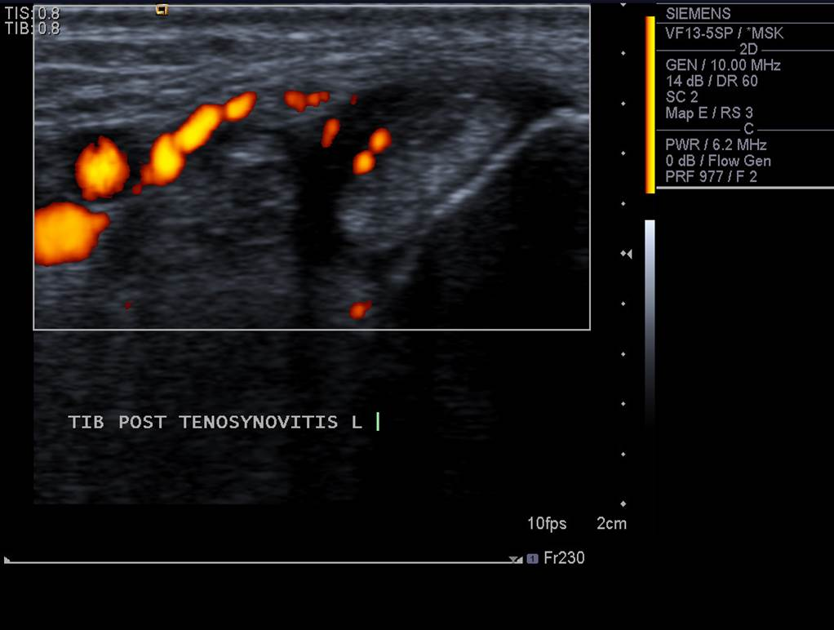
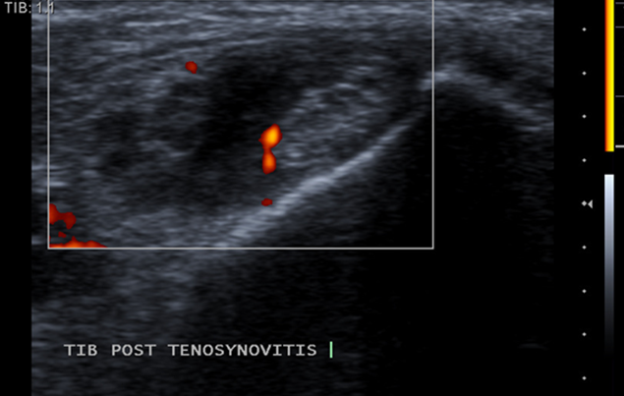
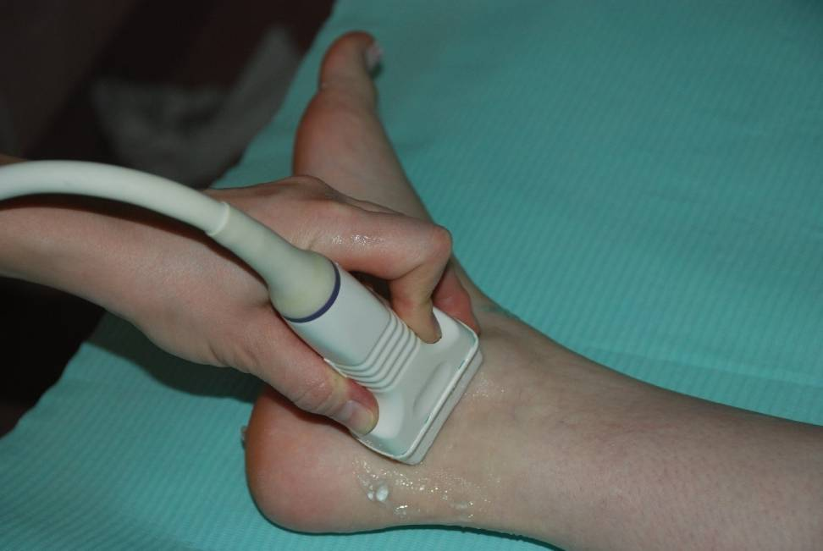
Tibialis Posterior Tendon Tenosynovitis (Transverse Axis)
Normal
Tenosynovitis (Doppler in Tendon Sheath)
Flexor Digitorium longus
Tibialis Posterior
Tibial Nerve and Vessels
Medial Malleolus

Slide 17
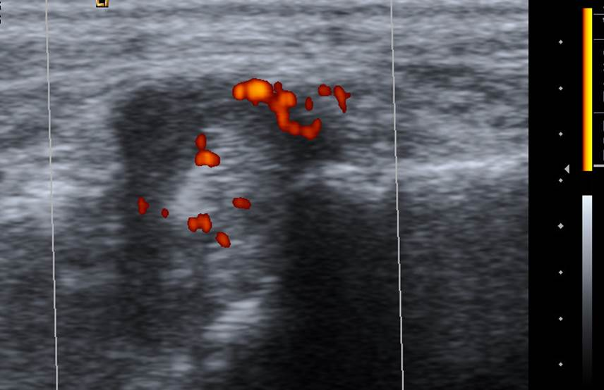
Tibialis Posterior Tendon Tenosynovitis (Transverse Axis)
Normal
Tenosynovitis (Power Doppler in sheath & stenosing into tendon body)
Flexor Digitorium longus
Tibialis Posterior
Tibial Nerve and Vessels
Medial Malleolus

Slide 18
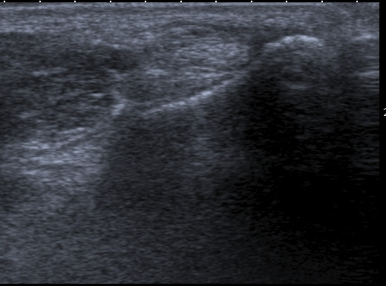
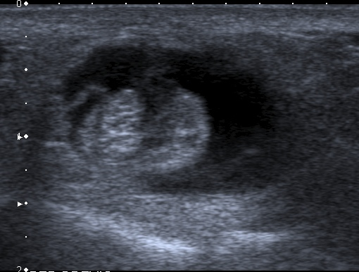
Peroneal Tendon Tenosynovitis (Transverse Axis: B-mode Changes)
Tenosynovitis
(Synovial Hypertrophy)
Normal
P. Longus
P. Brevis
Lateral Malleolus
P. Brevis
P. Longus

Slide 19
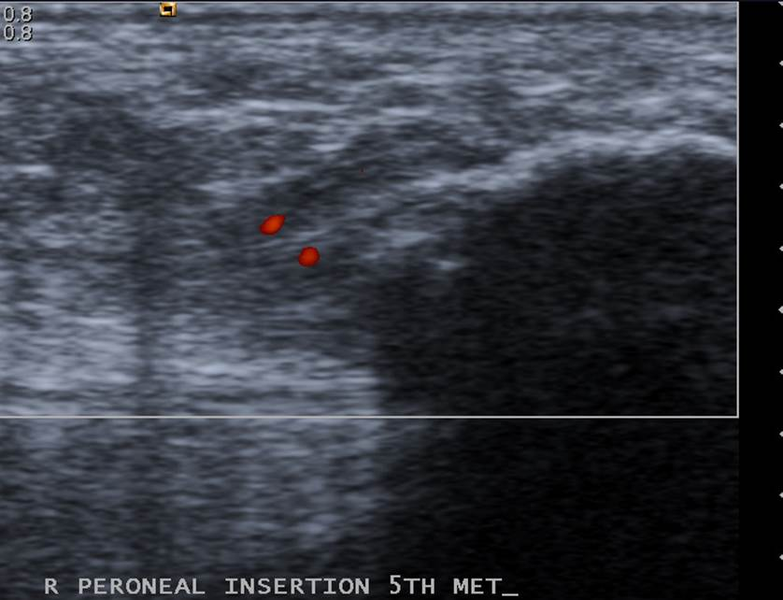
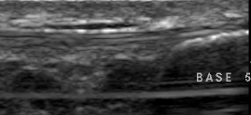
Peroneal Tendon Enthesitis (Longitudinal Axis)
Tendon Enthesitis (Power Doppler & Thickening at Insertion)
Normal
Peroneus Brevis
Styloid Process
Styloid Process
Peroneus Brevis

Slide 20
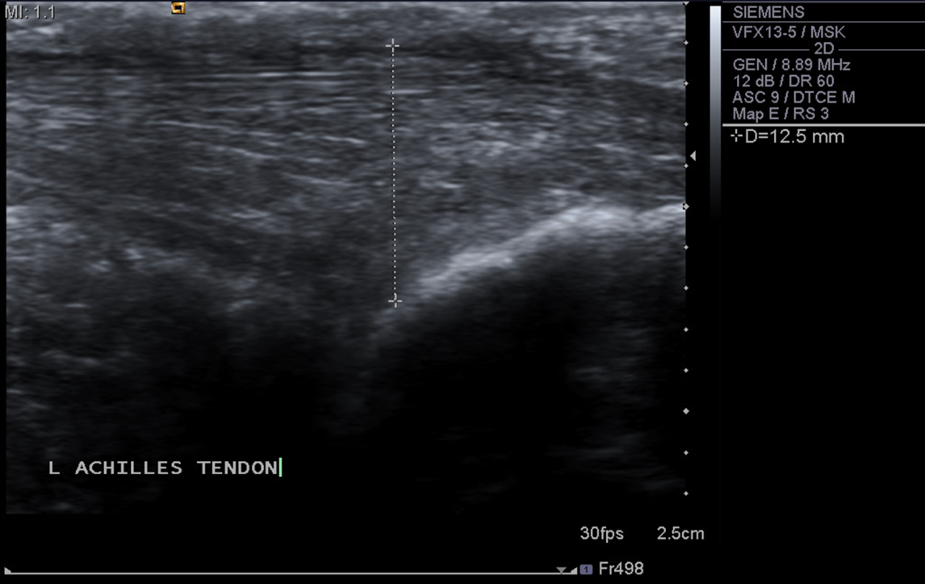
Achilles Enthesopathy: Thickening <5.29mm (Balint et al, 2002) (Longitudinal Axis)
Normal
Achilles tendon
Retrocalcaneal bursa
Calcaneum
Calcaneum
Achilles Enthesopathy (12.5mm)

Slide 21
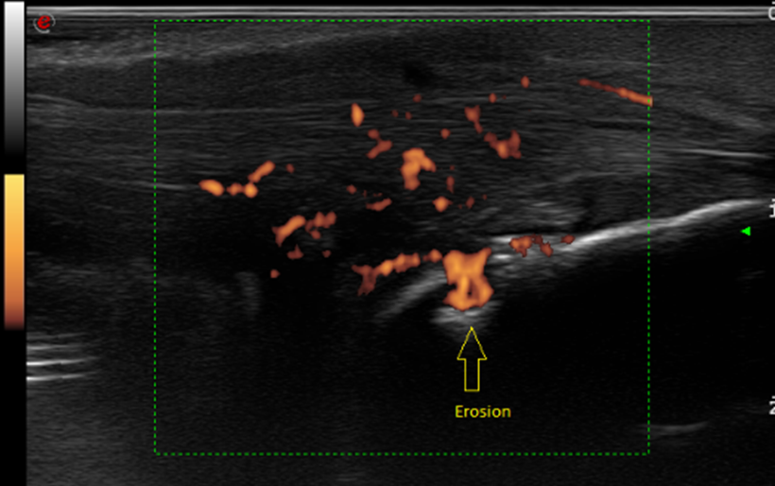
Achilles Enthesitis & Erosions: Power Doppler Active (Longitudinal Axis)
Normal
Achilles tendon
Retrocalcaneal bursa
Calcaneum
Achilles Enthesitis Longitudinal Axis

Slide 22
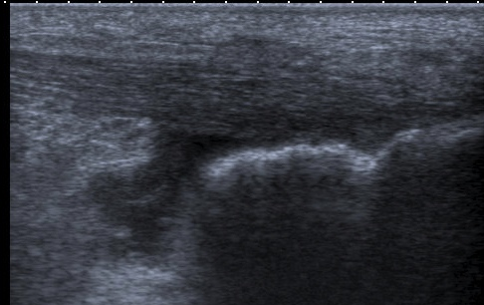
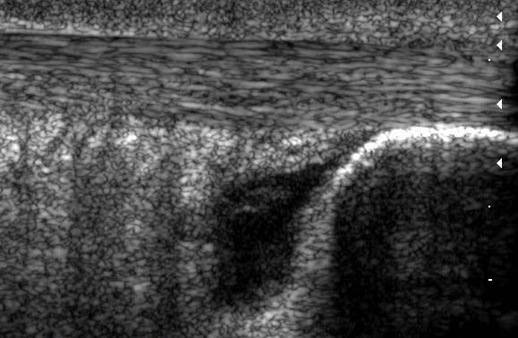
Retrocalcaneal Bursae (Longitudinal) A well circumscribed, localised anechoic/ hypoechoic area at the site of an anatomical bursa (synovial fluid-filled sac >2mm) compressible with transducer (van Holsbeeck & Introcaso, 1991; Balint et al, 2002)
Normal
Achilles tendon
Retrocalcaneal bursa
Calcaneum
Retrocalcaneal Bursae
Retrocalcaneal Bursae
Retrocalcaneal Bursae

Slide 23
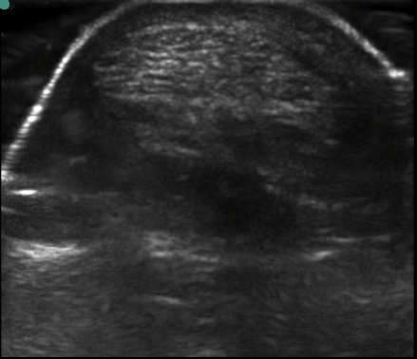
Retrocalcaneal Bursae (Transverse) A well circumscribed, localised anechoic/ hypoechoic area at the site of an anatomical bursa (synovial fluid-filled sac >2mm) compressible with transducer (van Holsbeeck & Introcaso, 1991; Balint et al, 2002)
Achilles tendon
Retrocalcaneal Bursae (RCB)
Achilles tendon
Retrocalcaneal Bursae
Normal

Slide 24
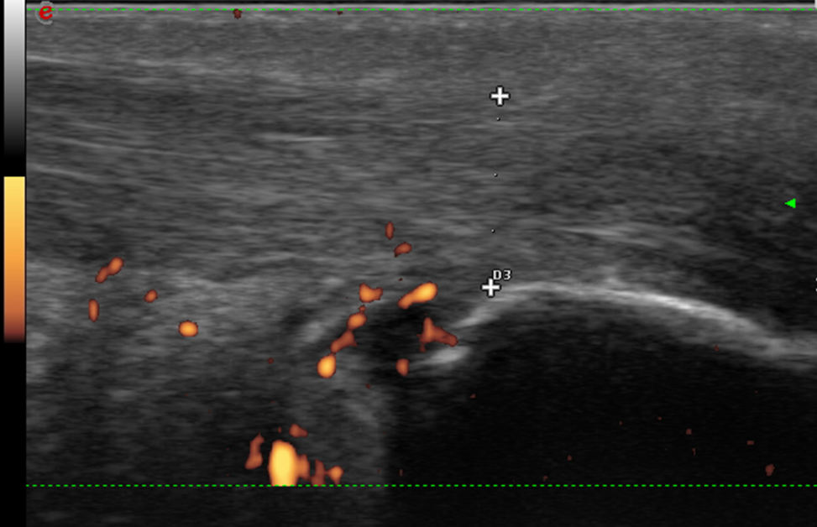
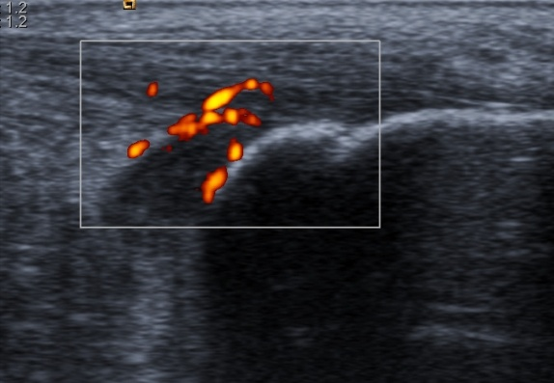
Retrocalcaneal Bursitis (Longitudinal) A well circumscribed, localised anechoic/hypoechoic area at site of anatomical bursa (synovial fluid-filled sac >2mm) compressible with transducer with Power Doppler (van Holsbeeck & Introcaso, 1991; Balint et al, 2002)
Achilles tendon
Retrocalcaneal bursa
Calcaneum

Slide 25
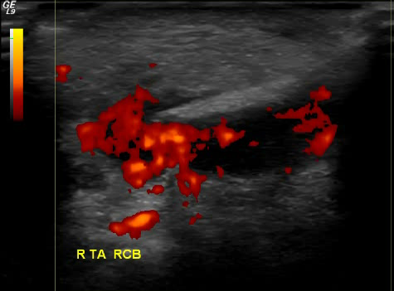
Retrocalcaneal Bursitis (Transverse) A well circumscribed, localised anechoic/hypoechoic area at site of anatomical bursa (synovial fluid-filled sac >2mm) compressible with transducer with PDS (van Holsbeeck & Introcaso, 1991; Balint et al, 2002)
Achilles tendon
Retrocalcaneal Bursitis (RCB)
Achilles tendon
Normal
RCB

Slide 26
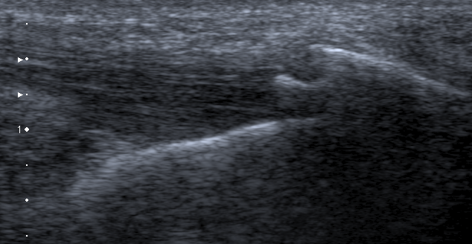
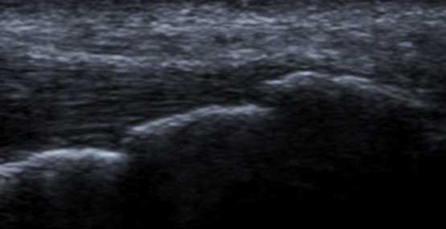
Calcaneal Enthesophytes Longitudinal Axis
A step-up bony prominence at the end of normal bone contour (Balint et al, 2002)
Normal
Calcaneal Enthesophytes
Calcaneum
Calcaneum
Calcaneum

Slide 27
Achilles Tendon Mid-Portion Tendinopathy
Achilles tendon
Retrocalcaneal bursa
Calcaneum
Achilles tendon
Achilles tendon
Longitudinal Axis
Transverse Axis

Slide 28
Achilles Tendon Mid-Portion Tendinopathy with Neovascularisation
Achilles tendon
Retrocalcaneal bursa
Calcaneum
Achilles tendon
Achilles tendon
Longitudinal Axis
Transverse Axis

Slide 29
Plantar Fasciitis (measurement >4.4mm (Balint et al, 2002)
(Longitudinal Axis)
Plantar Fascia
Calcaneum
Normal
Plantar Fascia
Calcaneum
Plantar Fasciitis

Slide 30
Plantar Fasciitis (Longitudinal Axis)
Normal
Plantar Fascia
Calcaneum
Calcifications
Plantar Fasciitis
Plantar Fasciitis
Calcaneum
Calcaneum
Plantar Fasciitis with Calcifications
Plantar Fasciitis with Power Doppler

Slide 31
Intermetatarsal Bursae Bursae can be seen by a compressible anechoic area usually between structures
Extensor tendon
Extensor tendon
Joint capsule
Joint capsule
Metatarsal head
Metatarsal head
Transverse Axis
Bursae
Metatarsal head
Metatarsal head
Transverse Axis

Slide 32
Intermetatarsal Bursitis
Longitudinal Axis
Bursitis
Bursitis
Transverse Axis

Slide 33
Morton’s Neuroma (Plantar Digital Neuritis) Longitudinal Axis
Non compressible with transducer
Attached to a nerve
Between structures (Intermetatarsal space)
Measures >2mm
Neuroma

Slide 34
Adventitious Bursae & Bursitis
Plantar MTP Joints (Longitudinal Axis)
Bursae
Proximal phalanx
Metatarsal head
Normal
Plantar MTP Bursae
Bursitis
Plantar MTP Bursitis

Slide 35
References
Balint PV, Kane D, Wilson H, McInnes IB, Sturrock RD. Ultrasonography of entheseal insertions in the lower limb in spondyloarthropathy. Annals of the Rheumatic Diseases 2002;61(10):905-10.
Naredo, E., Collado, P., Cruz, A., Palop, M.J., Cabero, F., Richi, P., Carmona, L. and Crespo, M. (2007), Longitudinal power Doppler ultrasonographic assessment of joint inflammatory activity in early rheumatoid arthritis: predictive value in disease activity and radiologic progression. Arthritis and rheumatism, vol. 57, no.1, pp. 116–24.
van Holsbeeck M, Introcaso J. Sonography of bursae. In: van Holsbeeck M, Introcaso J, eds. Musculoskeletal ultrasound. St Louis: Mosby Year Book, 1991:91–121
Szkudlarek M, Narvestad E, Klarlund M et al. Ultrasonography of the metatarsophalangeal joints in rheumatoid arthritis, compared with magnetic resonance imaging, conventional radiography and clinical examination. Arthritis Rheum 2004; 50: 2103–2112.
Wakefield, R.J., Balint, P. V, Szkudlarek, M., Filippucci, E., Backhaus, M., D’Agostino, M.-A., Sanchez, E.N., Iagnocco, A., Schmidt, W. a, Bruyn, G. a W., Bruyn, G., Kane, D., O’Connor, P.J., Manger, B., Joshua, F., Koski, J., Grassi, W., Lassere, M.N.D., Swen, N., Kainberger, F., Klauser, A., Ostergaard, M., Brown, A.K., Machold, K.P. and Conaghan, P.G. (2005), Musculoskeletal ultrasound including definitions for ultrasonographic pathology. The Journal of rheumatology, vol. 32, no. 12, pp. 2485–7.

