Slide 1
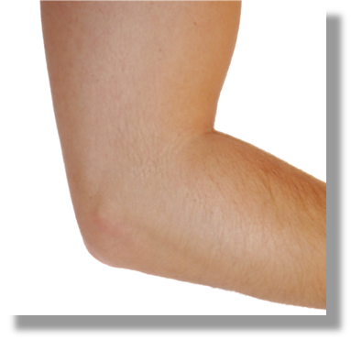
Ultrasound of the Elbow: Pathology in Rheumatic Diseases

Slide 2
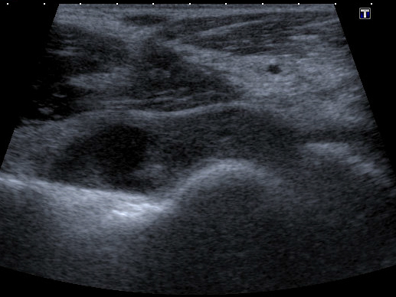
Elbow - anterior
Synovial hypertrophy
Longitudinal
Synovial hypertrophy
Transverse

Slide 3
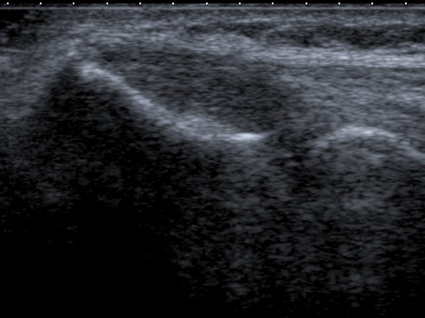
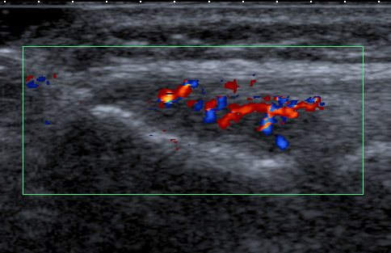
Elbow - lateral
Lateral epicondylitis
Longitudinal
Lateral epicondylitis
Longitudinal

Slide 4
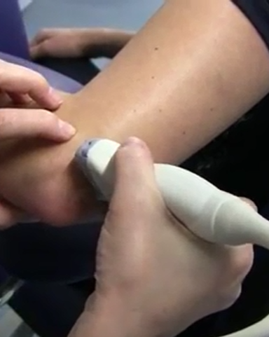
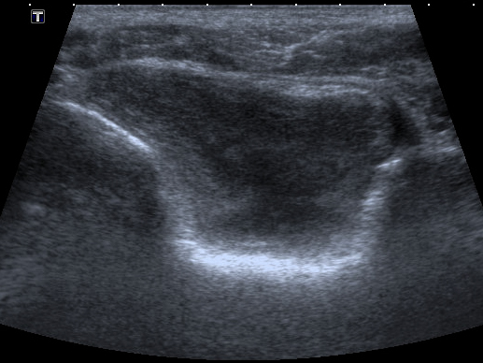
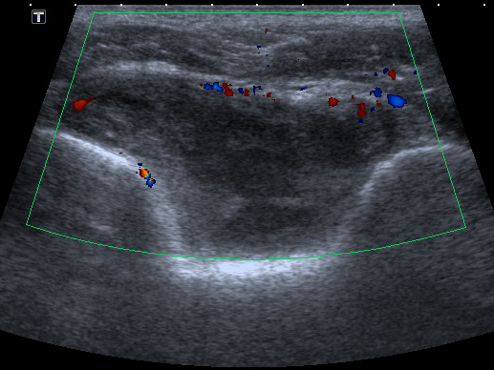
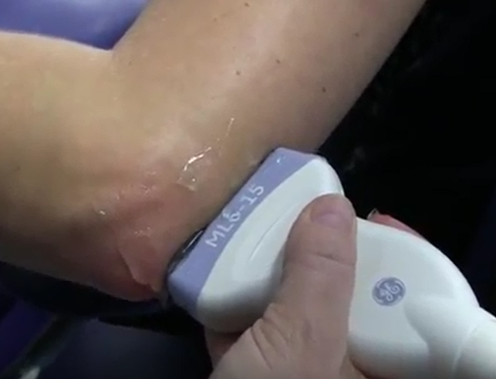
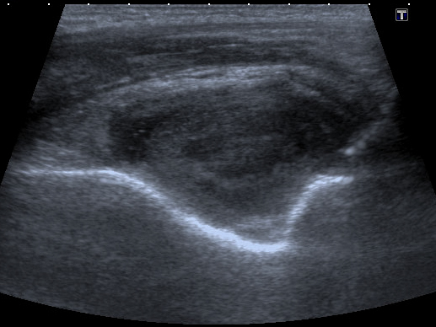
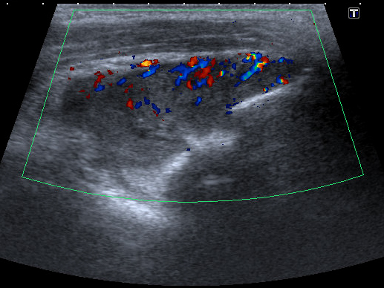
Elbow - posterior
Synovitis
Transverse
Synovitis
Longitudinal

