Slide 1
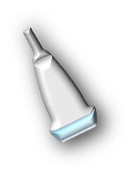
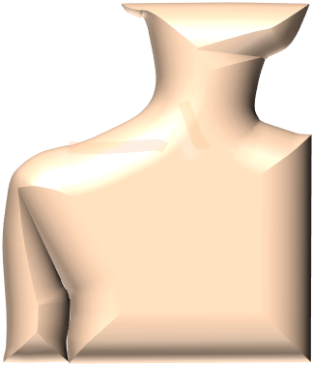
Ultrasound of the Shoulder: Pathology in Rheumatic Diseases

Slide 2
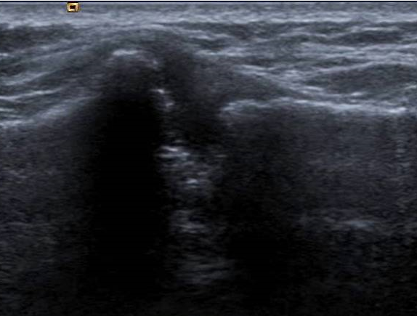
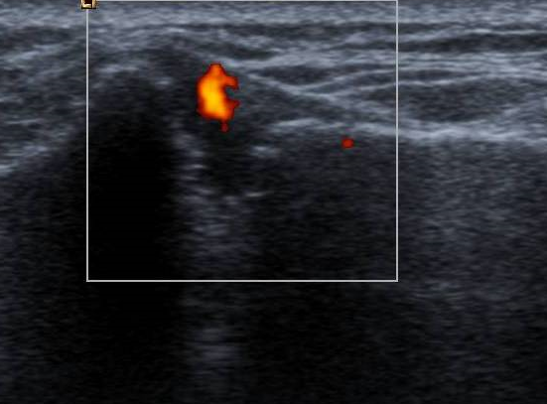
Shoulder - ACJ
Inflammatory arthritis

Slide 3
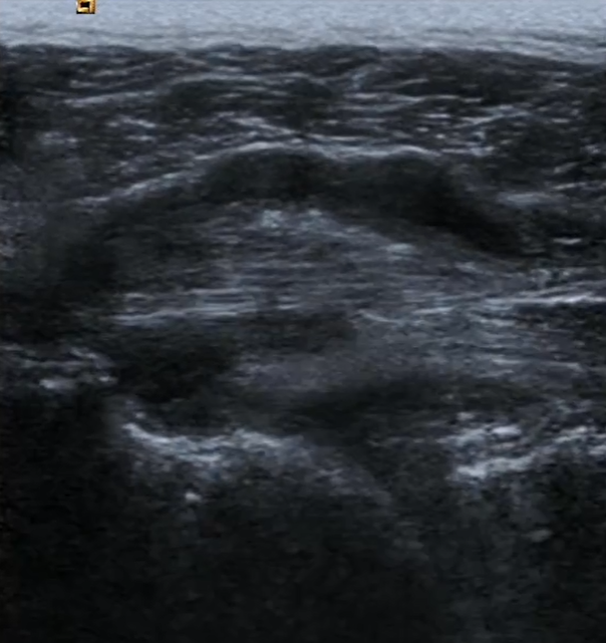
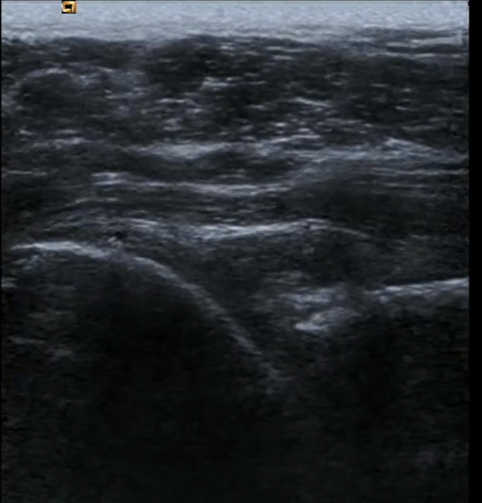
Shoulder - posterior
Partial infraspinatus tendon tear with
Glenohumeral Effusion
Compression

Slide 4
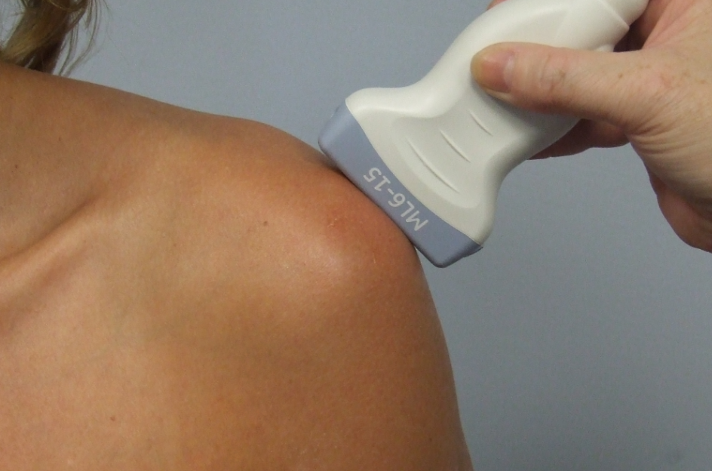
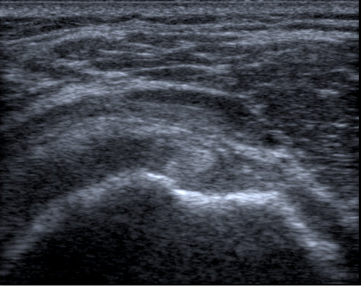
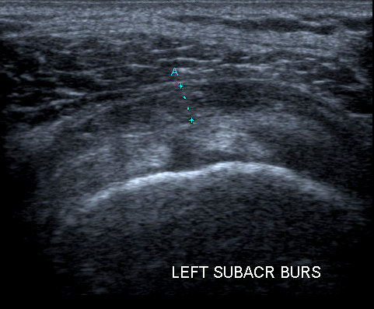
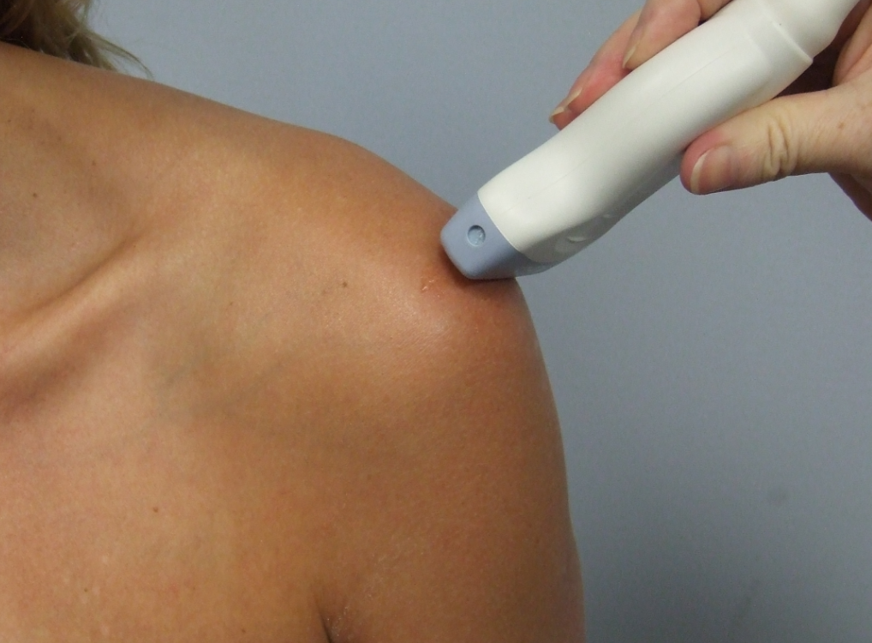
Shoulder -anterior
Sub acromial bursitis
Longitudinal
Sub acromial bursitis
Transverse

Slide 5
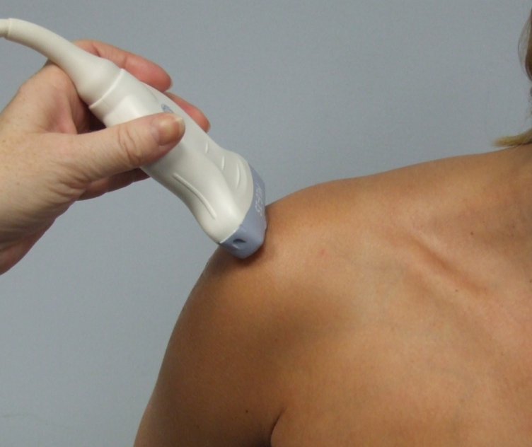
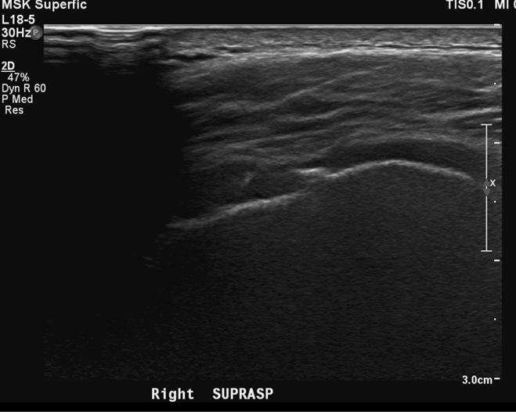
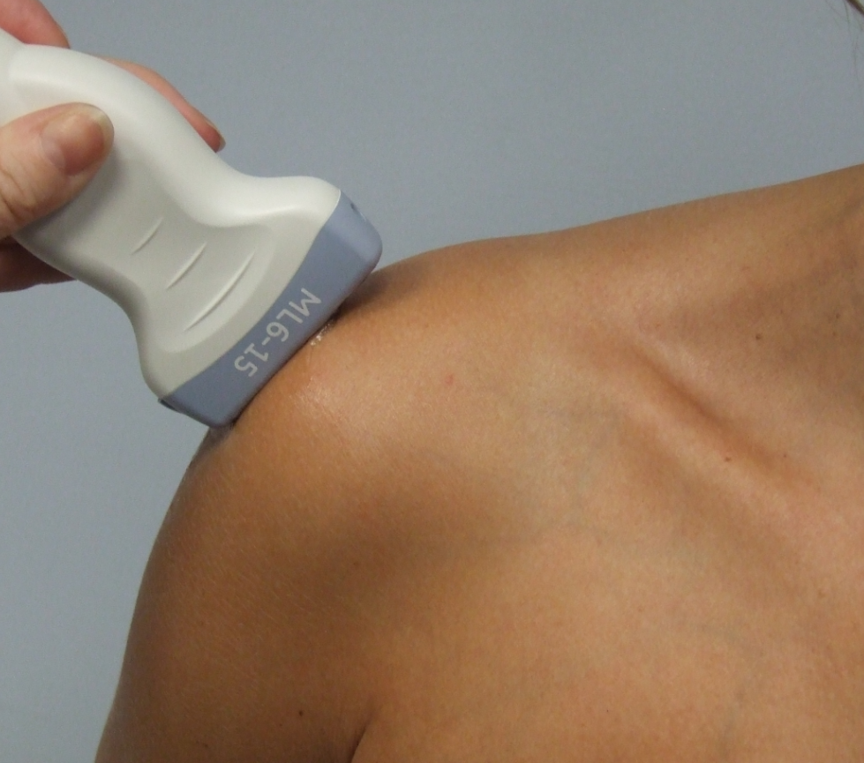
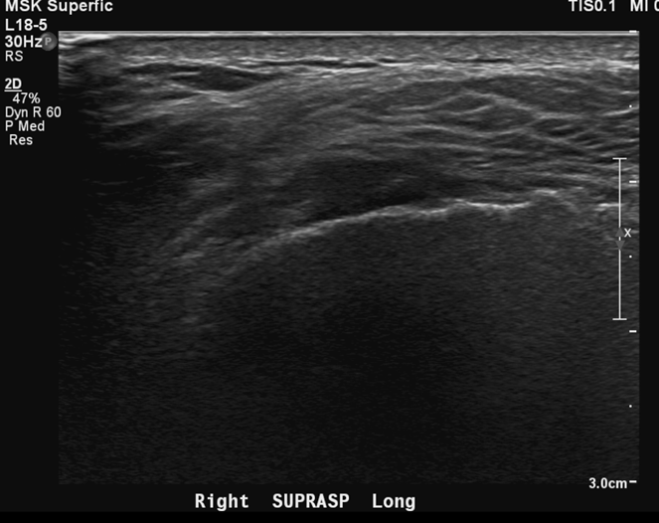
Shoulder - anterior
Full thickness supraspinatus tear
Transverse
Full thickness supraspinatus tear
Longitudinal

