Slide 1
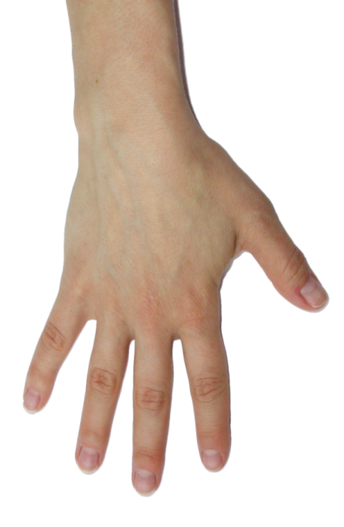
Ultrasound of the Hand: Pathology in Rheumatic Diseases

Slide 2
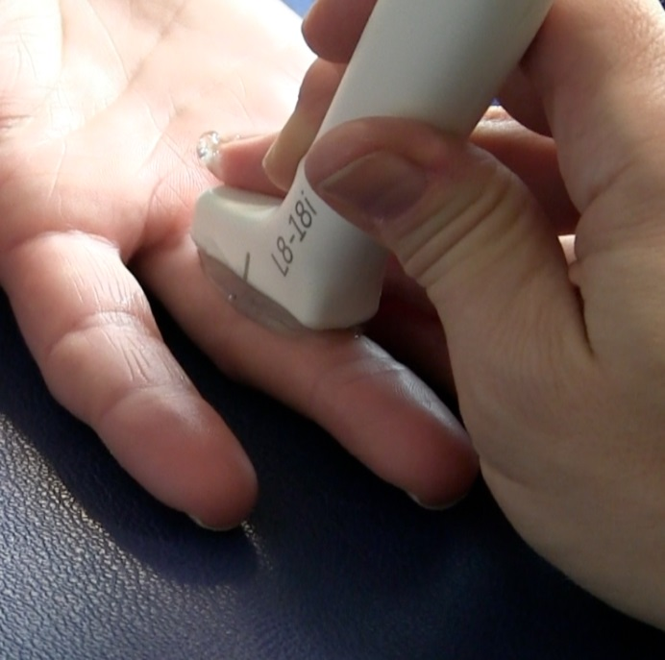
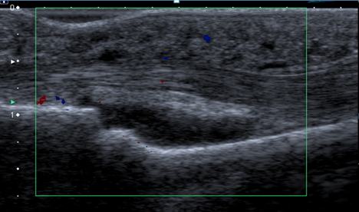
PIP joint
Longitudinal
Synovial hypertrophy

Slide 3
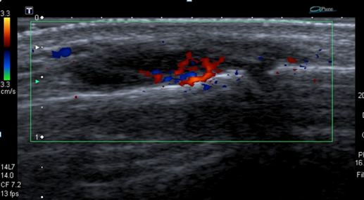
PIP joint
Longitudinal
Synovitis

Slide 4
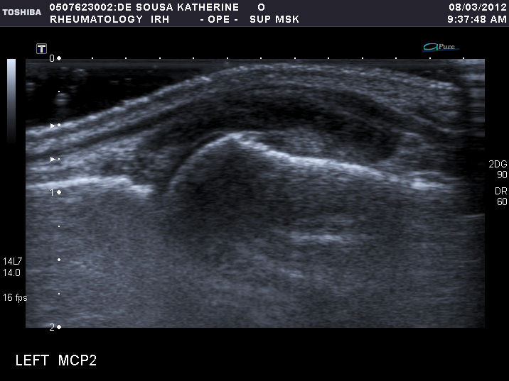
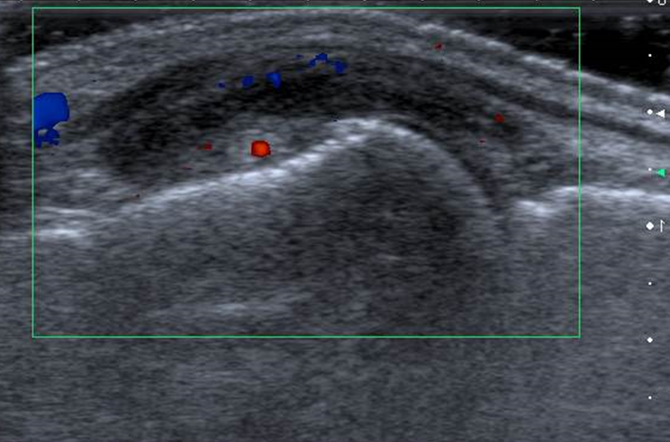
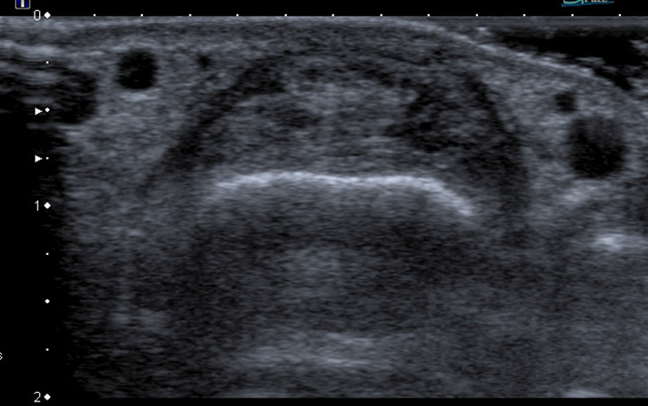
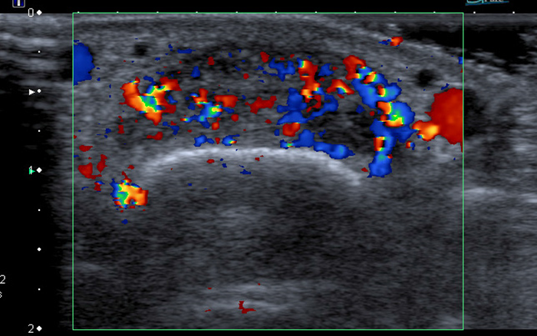
MCP joint
Synovitis
Longitudinal
Synovitis
Transverse

Slide 5
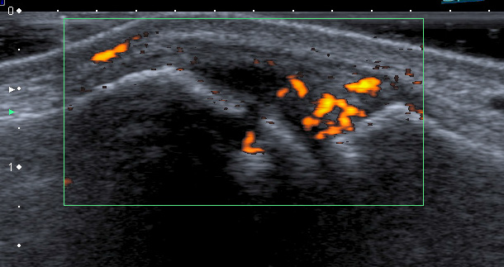
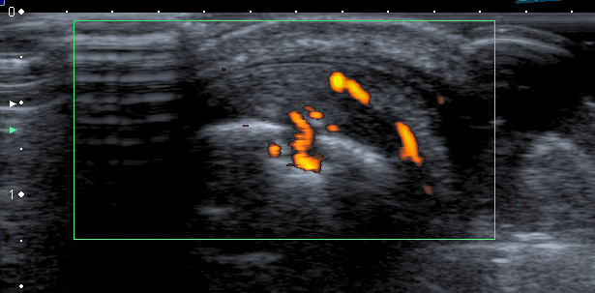
MCP joint
Synovitis + Erosion
Longitudinal
Synovitis + Erosion
Transverse

Slide 6
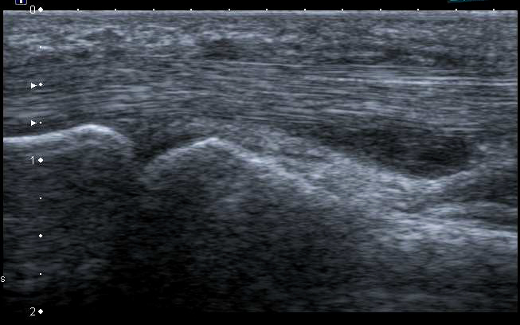
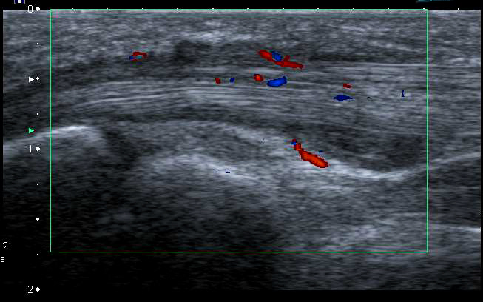
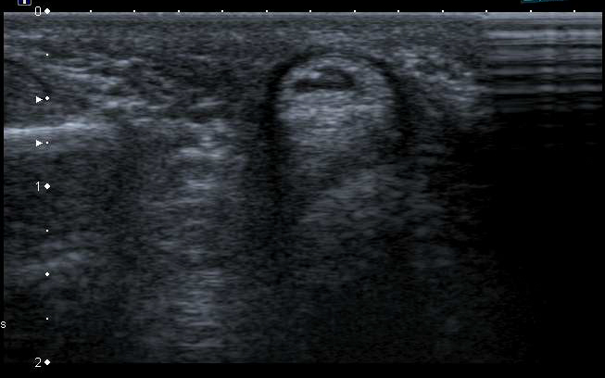
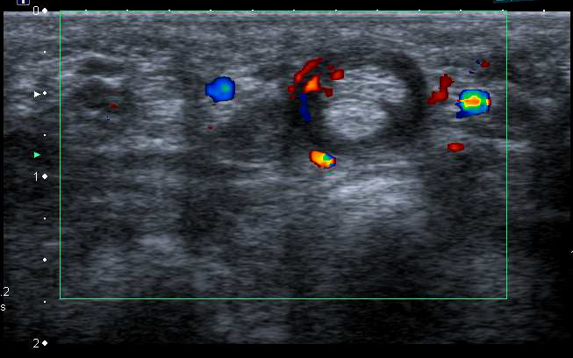
Flexor Tendon
synovitis
Tenosynovitis
Longitudinal
Tenosynovitis
Transverse

