Slide 1
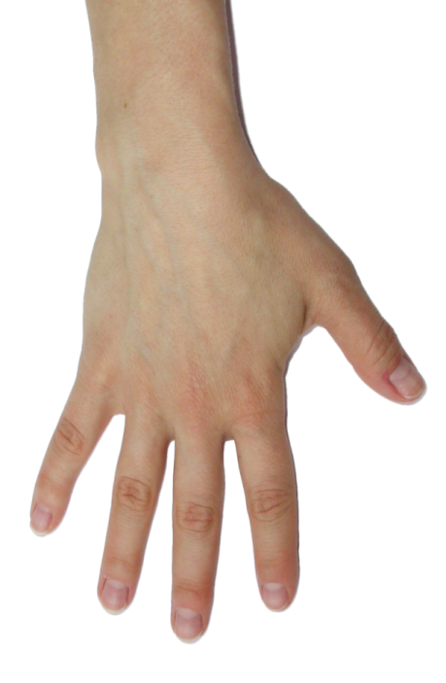
Ultrasound of the Wrist: Pathology in Rheumatic Diseases

Slide 2
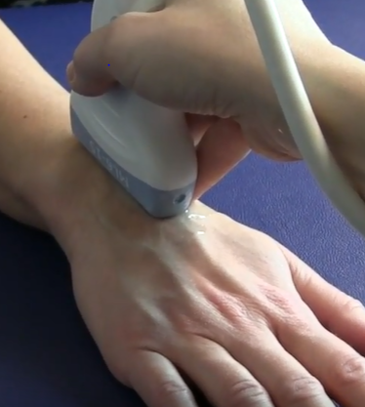
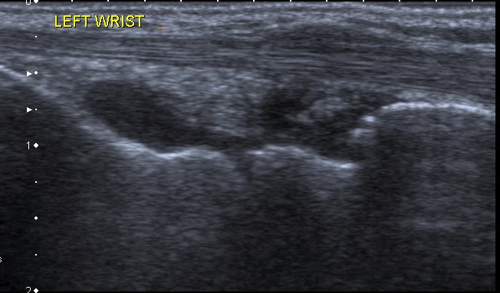
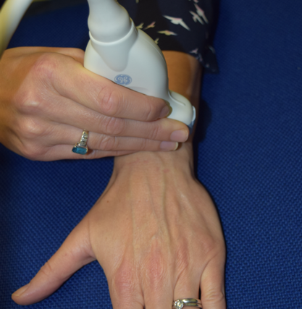
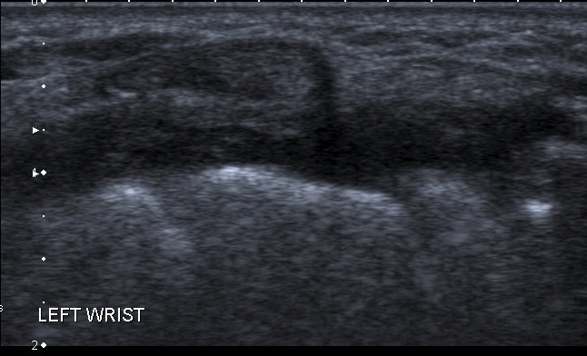
Wrist (radiocarpal, midcarpal)
Synovial hypertrophy
Longitudinal
Synovial hypertrophy
Transverse

Slide 3
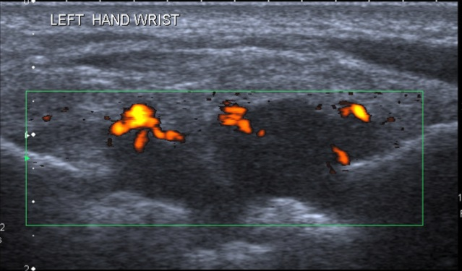
Wrist
Synovitis
Longitudinal
Synovitis
Transverse

Slide 4
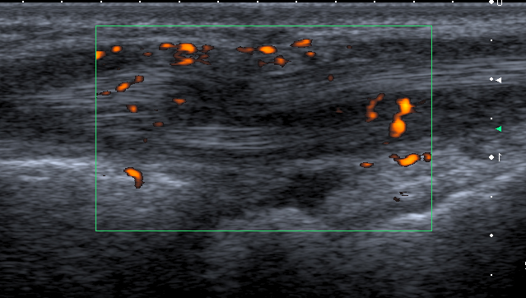
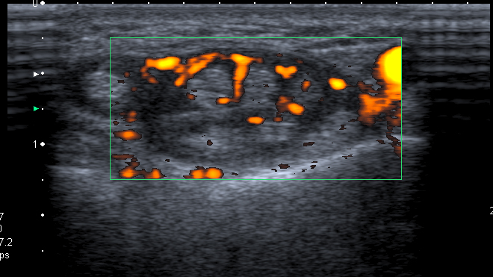
Wrist Extensor Tendon
Tenosynovitis
Longitudinal
Tenosynovitis
Transverse

Slide 5
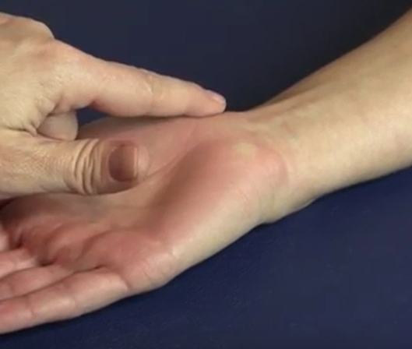
Wrist
Flexor carpi radialis tenosynovitis
with partial tendon tear
Longitudinal
Longitudinal

