Slide 1
Giving Effective Feedback and Feedforward
Graduate Teaching Assistants Workshop, January 2018
Sheila MacNeill
Senior Lecturer Academic Development: Digital Learning, Dept. Academic Quality and Development

Slide 2
Aims
By the end of this session you should be able to:
  Define feedback in the context of learning and teaching
  Recognise and apply feedback principles in learning and teaching practice
  Start developing skills in giving and receiving feedback through practical activities
  Make use of personal experiences of feedback to inform and enhance future practice

Slide 3
Activity 1
Identify one ‘memorable’ example of a time when you received feedback recently
Write a brief description of the feedback on a post-it note (e.g. written feedback on your PhD; verbal comment from friends/ family on a meal you made etc. )
Place the post-it under either the positive or negative columns on the flipchart)

Slide 4
What do you think of this feedback?
https://www.youtube.com/watch?v=4dWj8OhBxM4

Slide 5
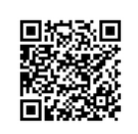
Activity 2: What is good feedback?
Attempting a definition
Use only single words, or a short phrase, to describe what feedback is. Write your definition on the padlet wall.
http://bit.ly/2qn8M1s

Slide 6
Some definitions from the experts
“Feedback is when you receive comments about your work, so that you know how well your studies are going – and of course there’s the other side to this- so you know how badly your studies are going” (Race, 2008)
“So what exactly is feedback? Feedback is any response from a teacher in regard to a student’s performance or behavior. It can be verbal, written or gestural. The purpose of feedback in the learning process is to improve a student’s performance- definitely not put a damper on it. The ultimate goal of feedback is to provide students with an “I can do this” attitude. (Reynolds, 2013)

Slide 7

What is the purpose of feedback?
Confidence building: to give encouragement to students, help them improve their work further
Achievement: give students an idea of how well they have done in comparison to others
Performance improvement: can be used to provide individual students with information on how they can implement actions to improve performance and make a plan (feed forward)

Slide 8

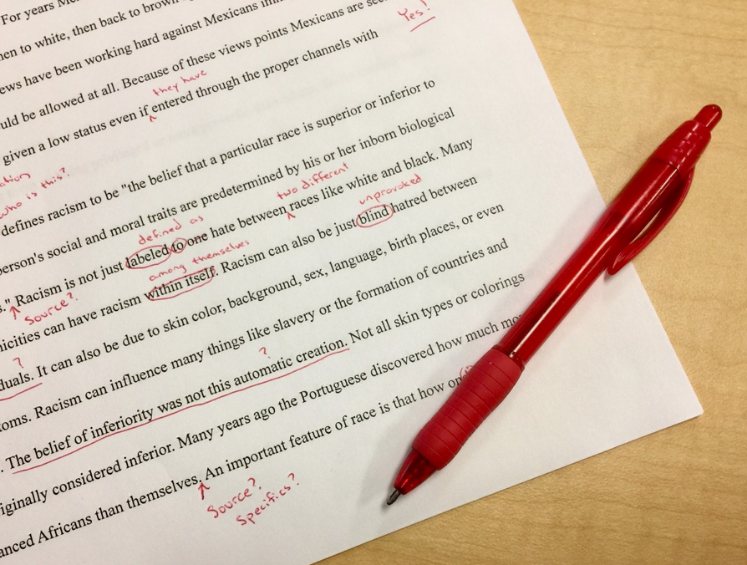
More reasons to give good feedback
Improve perception of strengths and weaknesses: enable students to identify their strengths and weaknesses within the given task
Correction: correct errors and point out information/ resources the student might have missed
Clarification and accountability: where feedback is used to demonstrate/ clarify how a specific grade/ mark was reached
Photo by Ben White on Unsplash
Photo: shutterstock

Slide 9
Bad feedback
Saps students’ confidence
Directs students’ activities in inappropriate directions
Fails to articulate with learning outcomes
Fails to relate clearly to evidence of achievement of assessment criteria
Relates only to what is easy to assess rather than what is at the heart of learning
Focuses on failings rather than achievements

Slide 10
Four strategies for giving good feedback
(Gavan Watson, University of Guelph see video on GCU LEARN)
Good feedback has to be
Specific
Actionable
Timely
Respectful

Slide 11
What do the students expect?

Slide 12
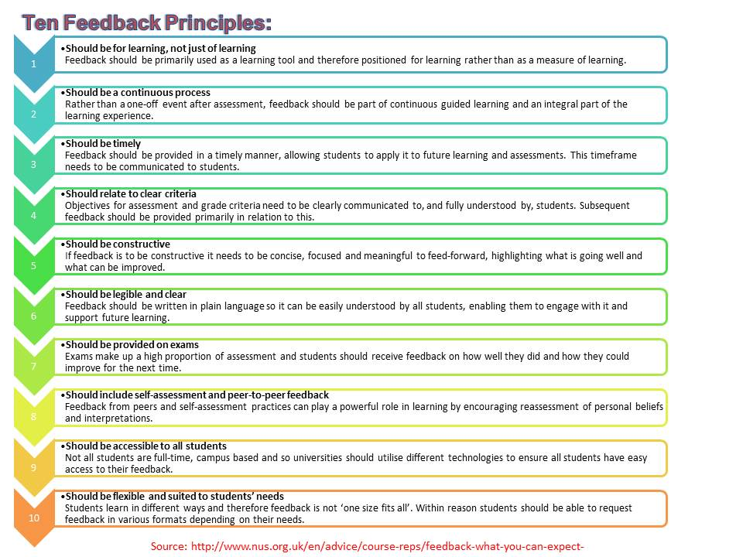

Slide 13
Use appropriate language
Have you thought about /tried…?
I was wondering whether this would work better
It might be a good idea to … because / so that …
Maybe the next time you could also …
Another way to … is …
It might be useful to …
Have you considered…?
I don’t understand ………….

Slide 14
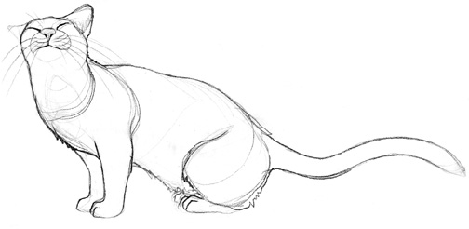
Activity 3: Practising different forms of feedback
Draw a cat in 2 minutes
Swap cats with your neighbour
Give different positive and then critical (negative) feedback – spend 2 mins on each

Slide 15
How did you feel?
What feedback worked best?
What did not work?
How did it feel to receive positive/ negative feedback?
How did it feel to give the feedback?

Slide 16
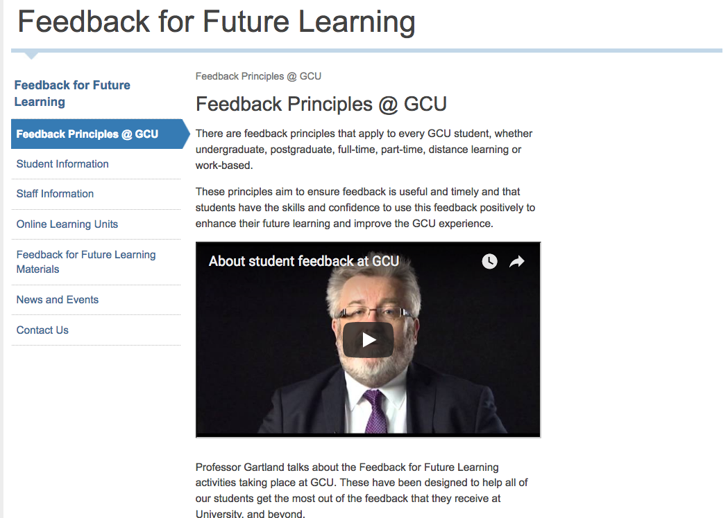

Slide 17
GCU Feedback Principles
Feedback at GCU should be:
A dialogue
Supportive of future learning
Timely
Related to clear criteria
Accessible to all students
A continuous process
Available on all forms of assessment
Flexible and suited to students’ needs

Slide 18
Activity 4
What are the main challenges with giving useful feedback?
Discuss in your group and present the results to the plenary.
You have 5 minutes for this activity.

Slide 19
The challenge of judgement
Difficulties in assigning marks to assignments
Using assessment criteria and rubrics

Slide 20
The Biscuit Challenge
In your groups describe what a biscuit is in 240 characters (2 mins)
Compare definitions
Look at the plate on your table – based on your definition does it contain biscuits?
Agree criteria for: good, adequate, poor and unacceptable biscuits – create a matrix
Share your matrix with another group and assess the (remaining) biscuits

Slide 21
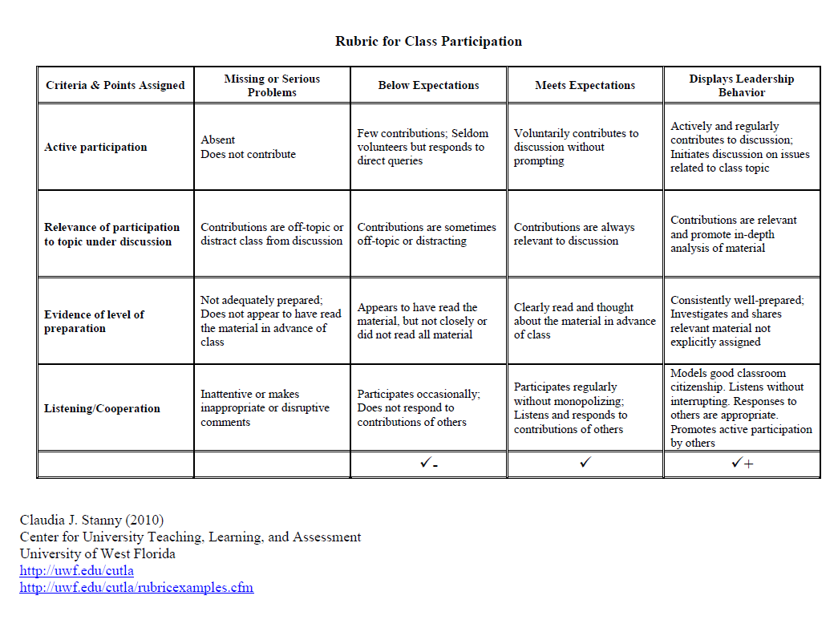

Slide 22
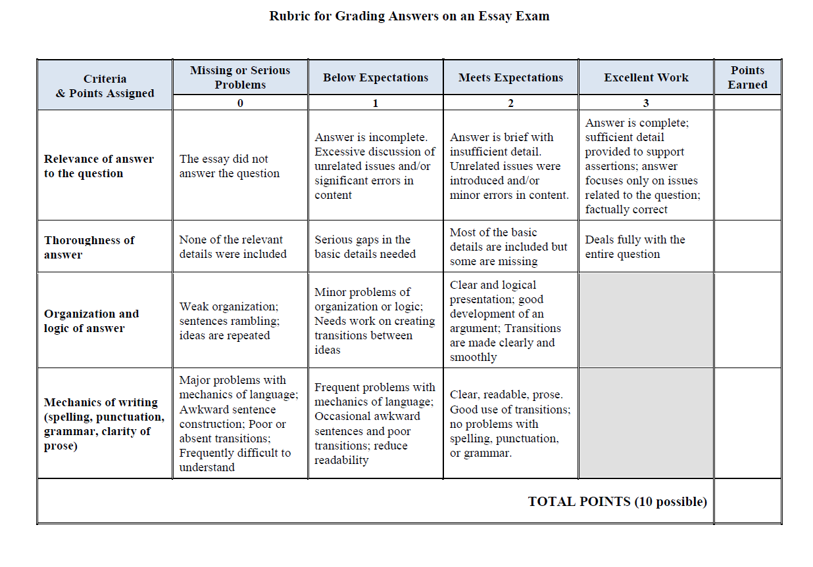

Slide 23
References and resources
Nicol, D.J. and MacFarlane-Dick, D. (2006), Formative assessment and self-regulated learning: a model and seven principles of good feedback practice, Studies in Higher Education, Vol. 31, No.2, April 2006, pp 199-218
Race, P. (2008) Using feedback to help students learn, Higher Education Academy
http://wap.rdg.ac.uk/web/FILES/EngageinFeedback/Race_using_feedback_to_help_students_learn.pdf
Reynolds, L. (2013) Giving student feedback: 20 tips to do it right
http://www.opencolleges.edu.au/informed/features/giving-student-feedback/
GCU Feedback for Future Learning
http://www.gcu.ac.uk/futurelearning/
Collated GCU assessment and Feedback policies and guidance
https://padlet.com/GCUAcademicDevelopment/assessment_feedback

