Slide 1
Digital Learning SLaSE Unit 4 6/3/18
Sheila MacNeill: sheila.macneill@gcu.ac.uk @sheilmcn
Jim Emery: j.emery@gcu.ac.uk @gcujime
Sabine McKinnon : Sabine.McKinnon@gcu.ac.uk @SabineMckinnon

Slide 2
Aims
To support participants to gain a greater understanding, and develop reflective awareness of the role of technology in supporting student learning and engagement.
To explore potential approaches to enhance engagement through the use of technology.

Slide 3
Overview of the session
Part 1 – Overview
Welcome and introductions
Discussion and reflection on personal experiences of technology to support learning and engagement.
A little bit of theory
Tea/coffee break
Part 2 – Blended and Digital Learning at GCU
Overview and of blended and digital learning at GCU
Benchmarking activity
Summary and next steps
#GCUBlend

Slide 4
The bigger picture
Support for you, support for learners
Evaluate effectiveness
Learner profile + context
Types of activities
Which technologies?
www.flickr.com/photos/edinei/3176666887

Slide 5
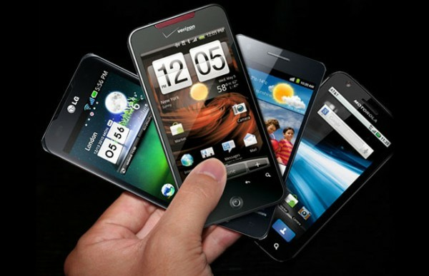
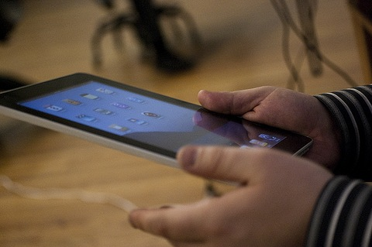
Could we live without it?
http://tinyurl.com/d55kv9q
http://tinyurl.com/cnpuu8d
http://tinyurl.com/c7tntva

Slide 6
Why technology for supporting student learning and engagement?
Global society
Knowledge economy - finding, evaluating and using information effectively
Employer expectations
Student expectations
Learning from others
Digital capabilities
http://tinyurl.com/cmv6hnu
Forming professional and learning networks

Slide 7
GCU Strategy for Learning
Enabling our people
Students as partners
Student support systems
University
systems
Evidence base
for enhancement
Digital development
Campus
development
Partnership and collaboration
“an outstanding student experience which equips students with the employability and entrepreneurial skills to succeed as global citizens and enables them to make a positive impact within their communities, transforming their lives and the lives of others”
Enablers
http://www.gcu.ac.uk/gaq/strategyforlearning2015-2020/

Slide 8
Learning Theories
Behaviourist
Practising skills
Absorbing new knowledge
Constructivist
Building understanding through activity and problem solving
How can technology help?
Social Constructivist
Building understanding through dialogue and collaboration
Cognitivist
Internal processing of information leading to understanding and retention
(Mayes & De Freitas, 2007)

Slide 9
https://cft.vanderbilt.edu/guides-sub-pages/blooms-taxonomy/
Notes:
http://www.celt.iastate.edu/teaching/effective-teaching-practices/revised-blooms-taxonomy/revised-blooms-taxonomy-flash-version

Slide 10
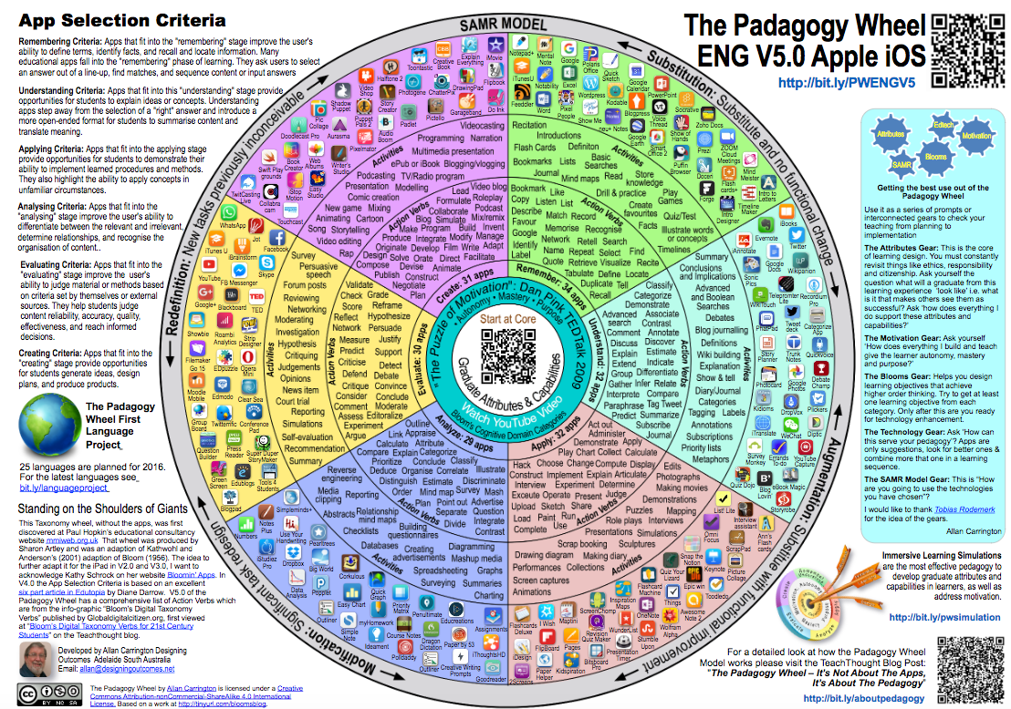

Slide 12
Digital Learning at GCU
developing creative approaches to learning, teaching and assessment through the effective use of technology on campus and online to enhance student engagement and enhance flexible access through a range of digital devices”
https://gcublend.wordpress.com/2016/03/02/gcu-2016-programme-leaders-event/

Slide 13
Blended Learning at GCU
An approach which combines excellence in established modes of learning and teaching with the innovative use of learning technology.
Face to Face
Online
Blended

Slide 14
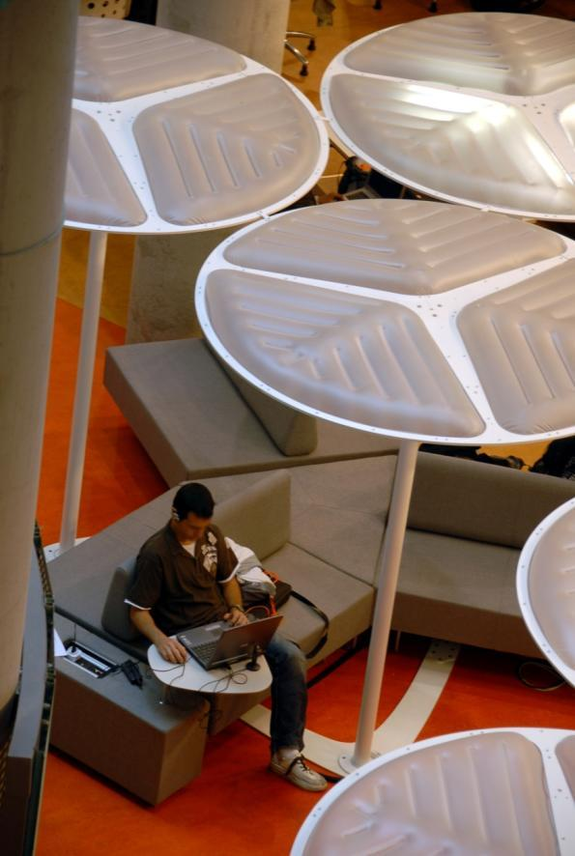
Degrees of ‘blend’
Technology enhanced – content + support (20%)
Some online resources & discussion groups or blogs to supplement classroom-based teaching
Technology enabled – ‘wrap-around’ model (50%)
Technology combined with classroom activities to create a ‘blended’ model
Includes online discussions, online activities, group work
Technology dependent – integrated model (100%)
Entirely online community
Collaborative working, peer support, tutor as facilitator
Notes:
Activity – where does SLaSE sit?

Slide 15
Areas of Blended Learning

Slide 16
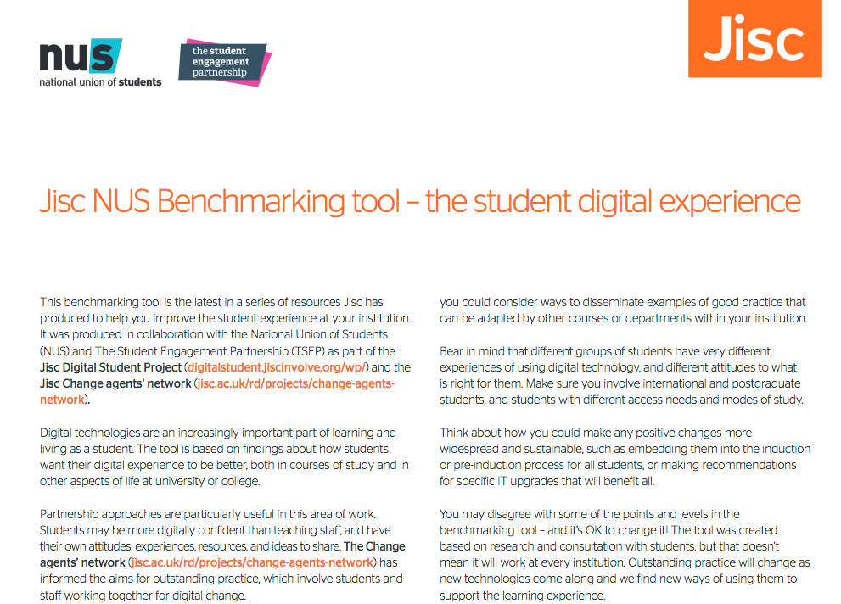
http://repository.jisc.ac.uk/6140/1/Jisc_NUS_student_experience_benchmarking_tool.pdf

Slide 17
Benchmarking
Reflection, discussion and examples

Slide 18
Discussion

Slide 19
Summary
We have looked at -
How technology can help support student learning and engagement
What we mean by blended and digital learning in GCU
Shared experiences of supporting learning and student engagement with technology

Slide 20
References/Useful links
Armellini A. & Nie M. (2013) Open educational practices for curriculum enhancement, Open Learning: The Journal of Open, Distance and e-Learning, 28:1, http://dx.doi.org/10.1080/02680513.2013.796286
Bates, T (2015) Teaching in a digital age. Available at: https://opentextbc.ca/teachinginadigitalage
Blaschke, Lisa Marie (2014) Using social media to engage and develop the online learner in self-determined learning. Research in Learning Technology, [S.l.], v. 22 http://www.researchinlearningtechnology.net/index.php/rlt/article/view/21635
Developing Student Digital Capability Benchmarking Toolkit, (NUS/Jisc 2015) http://repository.jisc.ac.uk/6140/1/Jisc_NUS_student_experience_benchmarking_tool.pdf
Garrison, R. & Vaughan, N. (2008), Blended Learning in Higher Education, Jossey Bass, San Francisco
Smyth, K., MacNeill, S. and Hartley, P. (2016) Technologies and academic development. In D. Baume and C. Popovic (Eds.) Advancing Practice in Academic Development. Routledge, pp.121-141.
Mayes, T, & de Freitas, S. (2007). Learning and e-learning. The role of theory. In Beetham, H. & Sharpe, R. (2007) (Eds.) Rethinking Pedagogy for a Digital Age. Designing and delivering e-learning, 13-25. London: Routledge
MacDonald, J. & Creanor, L. (2010) Learning with Online and Mobile technologies: a student survival guide, Gower http://tinyurl.com/37g69ep

