Slide 1
Toby Hanning
edShare@GCU
A Guide to Training and Advocacy

Slide 2
Background
Legacy AV repository
OER policy
Survey of staff requirements
Aim: “to ascertain the issues surrounding the use of digital resources at GCU, both for learning and teaching, and support services”
Notes:
SpokenWord
OER policy encourages staff to share their resources, openly where possible

Slide 3
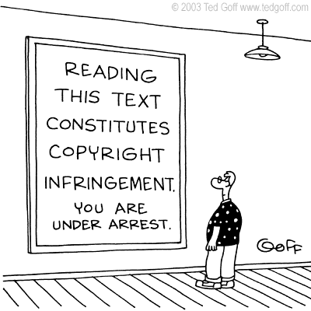

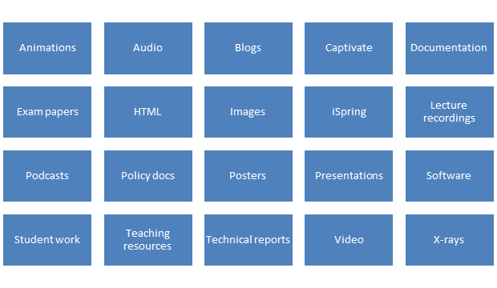

Problems
Notes:
Copyright – those with no knowledge, those with little knowledge
Sharing – desire to share with world, uni, just staff, selected users
Storage – people store resources in a wide variety of places, often unsecure
Variety – a wide variety of resources

Slide 4
Our Aim
Solve all these problems
whilst
Promoting good practice
and
Promoting open practice

Slide 5
The Service
System admin
Manage development
Digital preservation
Training
Advocacy
Copyright and licensing advice

Slide 6

Advocacy
Key users – learning technologists, policy makers, LEADS
Find champions
Target new members of staff
Include copyright in all training
Tailor advocacy to the audience
Institutional policy?
Notes:
Not difficult to find scepticism or closed-mindedness to open access
Institutional policy: similar to a mandate but optional. Usually ‘encourages’ openness where appropriate
Useful but not a solution. Often senior figures at college or school level have greater influence

Slide 7
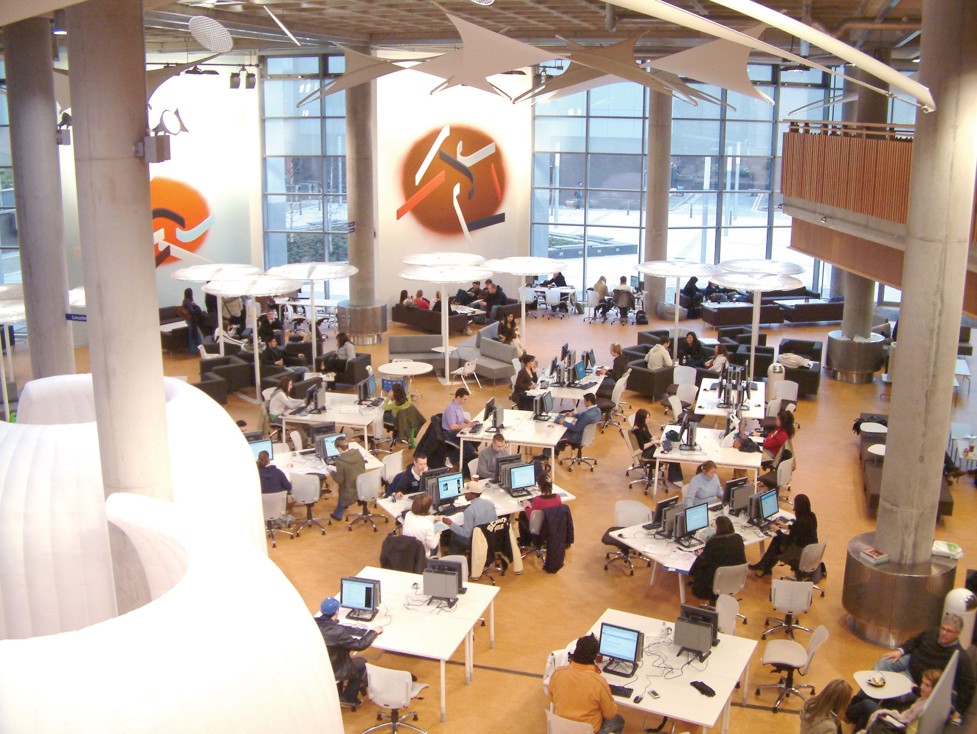
Advocacy: Educators v. Researchers
Knowledge of open access
Knowledge of copyright
Experience of peer review
Resource permanency
Notes:
Not all educators are also researchers – many have little or no experience or knowledge of open access
Many researchers will have some awareness of copyright – after all they’ll be signing a CTA or exclusive licence every time they publish. Most educators will have no experience of copyright
Researchers are used to peer review, they take part in assessment exercises such as the REF. Educators have programme review but these rarely, if ever, focus down to the level of resources e.g. lecture slides
Research outputs are usually fixed and permanent at the point of deposit. Educational resources are fluid; they are constantly being updated and improved. Permanent resources belong in our repository; temporary resources belong in our CMS. Many educators do not see any resource as ‘permanent’

Slide 8
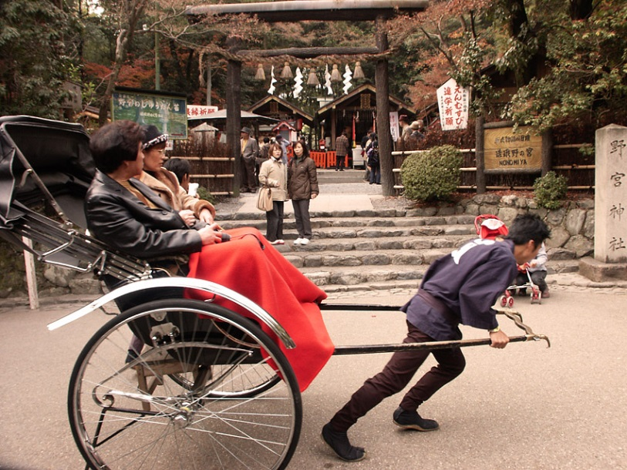
Challenge (1)
Full indexing for text files
Encourage upload of transcripts / closed caption files
Ingest metadata from other sources
Controlled vocabulary
Personal profile
Advocacy
Notes:
You have a choice – metadata volume / quality versus quick upload.
We’ve gone for quick upload – only mandatory fields are title and viewing permissions.
In this case you need to find ways to enhance discoverability (see slide).
The longer it takes to upload the less likely people will bother.

Slide 9
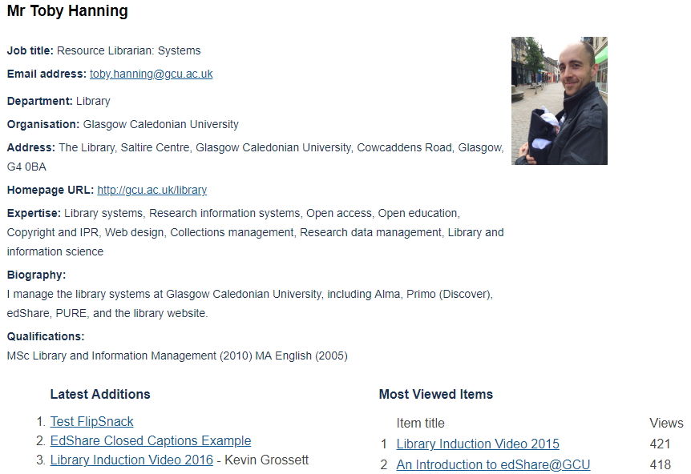
Personal Profile
Notes:
Example personal profile
Chance for non-research staff to sell their professional expertise and interests

Slide 10


Challenge (2)
Clear and consistent guidance on copyright
Encourage questions
Self-policing
Robust takedown policy
Advocacy
Notes:
Resources are available immediately, pending processing time for some resource types.
If you do have a review process then what are you going to review? Metadata, resources, or both? Based on what standards? What happens if you discover an issue?
Solutions for no review (see slide)

Slide 11

Copyright: The Basics
Reuse only licensed content (e.g. Creative Commons)
Adhere to the terms of the licence
Always cite the content you use
Google advanced search, filter usage rights
Common sense should still apply!
Notes:
Get staff doing the basics regardless of whether they plan to make their resource open access or not
Also encourage them to think about how their resource will be shared BEFORE they start building it
You can still break copyright law even if your resource is closed access (it’s just a breach is less likely to be discovered)
Adhering to these basics (see slide) will guarantee copyright compliance

Slide 12
Copyright: Educational Exceptions
Apply to any copyright work
To give or receive instruction
Must illustrate a point
Purpose of the use is non-commercial
Sufficient acknowledgement of authorship of the work (where practical)
Use of the material is fair
Notes:
The law makes a number of exceptions to allow for the use of all types of copyright work for certain educational purposes. These are you get out of jail free card, but you must adhere to ALL conditions (see slide)

Slide 13
Copyright: What is Fair?
No legal definition
Ultimately decided case-by-case by the courts
  Amount of work used
  Compete with owner’s rights
Must not undermine sales of teaching materials
IPO Exception to Copyright Guide: Education and Teaching - http://bit.ly/1MgxJ0O

Slide 14

Legal v. Ethical
Legal ≠ ethical
Examples:
  PBS documentary on YouTube
  X-rays
  Cadavers
Notes:
Psychology video – clearly uploaded illegally, but technically legal for us to link to it (we’re not responsible for this content). However, what sort of example does this set to students and, more practically, what happens when the video is taken down halfway through your course?
X-rays – usually a straight ‘no’. NHSGGC copyright holders, permission to make open if anonymised
Cadavers – usually a straight ‘no’ again. NHSGGC copyright holders. Bodies left to medical research. Legally images and videos could be made open as long as non-commercial and educational use only. Difficult to ensure anonymity. Worth the risk? Restrict to all staff – many would be shocked or take offense. Restricted to selected users with a warning notice.

Slide 15
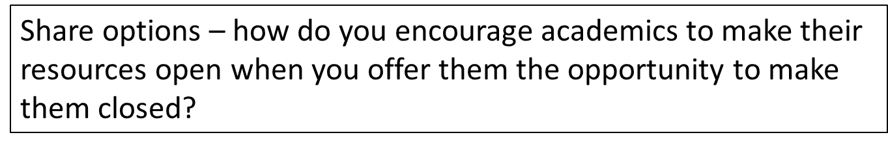
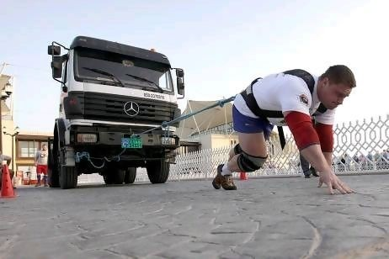
Challenge (3)
Build confidence around copyright
Highlight the advantages of open
Take a ‘risk aware’ approach
Make open the default
Advocacy
Notes:
Risk aware rather than risk averse. Assess the risk on a case-by-case basis

Slide 16
Why Open?
Increase access to education
Improve teaching quality
Self-promotion
Retain access to your own resources
Notes:
Blink Tower OER video on YouTube: https://www.youtube.com/watch?v=ZFeyCc6we-s
Work collaboratively rather than individually or in silos
Opportunity to showcase resources and expertise
In most academic contracts the University holds copyright of any materials created as part of your employment. Licence your resources openly to use them legally if you move to another institution or to another career

Slide 17

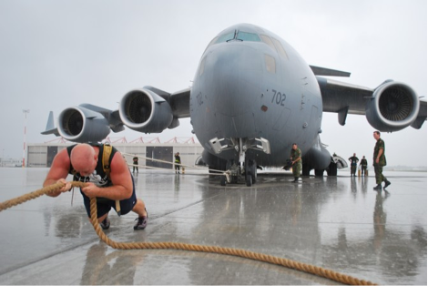
Challenge (4)
Repository versus content management system
What is permanent?
Version control
Digital preservation
Advocacy
Notes:
Repository is for permanent resource; CMS is for temporary (time-bound) resources
Permanent is any resource with no definitive take-down date. For example assessments would belong in a CMS, not in edShare
Version control is key. Links the old and new resource, but supresses the old resource from search indexes

Slide 18
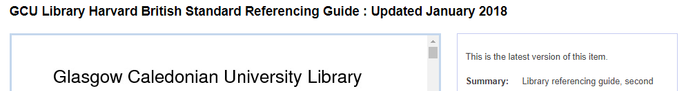
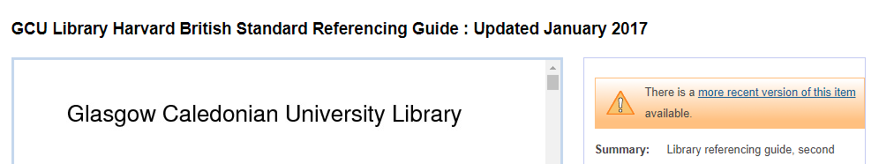
Version Control

Slide 19
Top Tech Tips for Video
Prevent autoplay by using HTML5 video
Use attributes to loop, mute or add a poster to your video
If not using HTML5 embed no more than one video per page
Use % widths to make your video responsive
The % applies to the div, not the whole page
Use an aspect ratio calculator if non-standard ratio
Use coversheets, especially for web integration
Provide branding
Clearly identify title and copyright holder
Display metadata elements using the REST API
Always use a separate VTT or SRT file for closed captions
Closed captions can be switched on or off
VTT or SRT acts as a transcript and is fully indexed
Accessibility compliant – can be read by a screen reader
Notes:
If you embed a single video file (e.g. MP4, WebM, MOV) in an iframe, most browsers will autoplay the video
Static widths are fine but your video will not be responsive. Standard aspect ratios are 16x9 or 4x3; anything else is non-standard
Coversheets provides consistent experience, regardless of how video has been produced. For example borders or blank first frames can look bad or hide video controls
Hard coding your closed captions or subtitles will provide a worse user experience (they can’t be switched off) and make your video inaccessible (screen readers won’t be able to read the captions)

Slide 20
Image Credits
Slide 3 – Copyright Cartoon by Ted Goff. http://www.nuttyhistory.com/uploads/1/2/1/5/12150034/484743_orig.gif
Slide 3 – Share. https://pixabay.com/en/cloud-blog-tweet-like-share-parts-709095/ (CC0 Public Domain)
Slide 3 – Floppy disk. https://pixabay.com/en/black-business-computer-computing-18320/ (CC0 Public Domain)
Slide 8 - NonomiyaRickshaw0289. https://commons.wikimedia.org/wiki/File:NonomiyaRickshaw0289.jpg (CC0 Public Domain)
Slide 10 – Man pulling a car. https://www.vcars.co.uk/news/hot-topics/10-signs-that-its-time-for-a-new-car-10202.html
Slide 14 – Law Vs Ethics. https://keydifferences.com/difference-between-law-and-ethics.html
Slide 15 – Krysztof Radzikov from Poland. http://www.thenational.ae/news/uae-news/world-strongmans-pulling-power-hits-abu-dhabi
Slide 17 – World’s strongest man pulls airplane. http://africanspotlight.com/wp-content/uploads/2012/11/Picture-137.png

Slide 21
Thank you.
Visit edShare: edshare.gcu.ac.uk
Email: toby.hanning@gcu.ac.uk

