Slide 1

Fighting the fear of copyright with the GCU online copyright advisor
Marion Kelt

Slide 2

Feel the fear, but do it anyway!
Part of my job is to promote the production, reuse and sharing of Open Educational Resources (OERs) and support researchers in their use
I am also the Copyright Advisor – the roles go together….
Why?

Slide 3
Why do it?
Research by Gadd(1), Rolfe(2) & Whitfield(2) has identified copyright related barriers to the adoption of OERS
So what are they?

Slide 4

The barriers
uncertainty about copyright ownership of OERs produced at work
lack of knowledge of copyright and licensing issues, leading to a reluctance to engage with the topic
uncertainty on the use of third party materials in OERs (which can include theses shared using open access services like ETHoS)

Slide 5
And another thing …
The rise of distance and transnational education puts more pressure on lecturers and learning technologists to produce quality online resources fast
Some researchers also have a teaching workload
Sound familiar? …..

Slide 6

Breaking down the walls …
The first brick:
Uncertainty about copyright ownership of OERs produced at work
We tackled this one with our OER policy and are now pushing for a copyright policy

Slide 7
Breaking down the walls …
This left:
lack of knowledge of copyright and licensing issues, leading to a reluctance to engage with the topic
uncertainty on the use of third party materials in OERs
So how do we tackle the general fear and loathing produced by copyright and licensing issues?

Slide 8
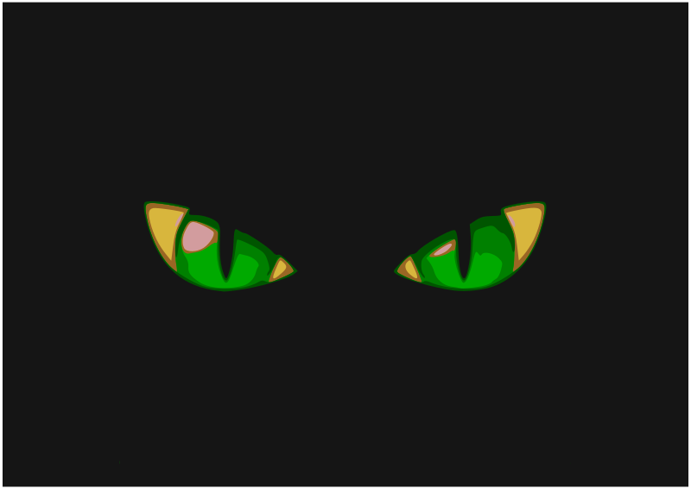
Sanity check … !
Repeatedly answering the same questions or running the same courses is bad for your mental health and emotional equilibrium!

Slide 9
So, how do we fight the fear and keep sane?
We offer an enquiry service and training sessions, but what people really want is quick answers available at the point of need. Ideally this should be available without communicating with a scary librarian!
We decided to put basic copyright advice online and developed the GCU online UK copyright advisor
It is available as an OER and you can use it at https://edshare.gcu.ac.uk/3608/2/index.html
So, how did we do it?

Slide 10

Getting started …
When we set up our team mailbox at copyright@gcu.ac.uk, we used this to keep track of copyright enquiries
As we got more, we started to keep a document of tricky questions
We found that some questions came up often so developed a list of FAQs
We then wondered how we could make these more easy to use

Slide 11
The FAQs list - the start of it all
Our goal was to save ourselves time and effort …
First we asked around to see if any other universities had developed online guidance
None did quite what we wanted to do so we came up with a plan

Slide 12

The big seven …
We decided start with the main types of material:
  Journal articles
  Book chapters
  Audio files
  Video files
  Maps
  Computer code
  Images (photos, mind maps, diagrams)

Slide 13

The next steps …
We developed question and answer flowcharts.
After that we created text answers to the questions in the flowcharts with links to web resources and a glossary.
These are available under CC licence at https://edshare.gcu.ac.uk/2706/

Slide 14

All the right words in the right order?
We found that one or two people working together was not enough!
So we formed a group:
Me (Copyright Advisor)
Toby Hanning (Systems with knowledge of copyright and repositories)
Nicky Stewart (Systems with experience of web design)
Elinor Toland (PURE Repository)
Susan Cunningham (Administrator who contributes to the web group)

Slide 15

Why work in a team?
Teamwork helped with the logical flow of the workflow
charts and the wording of the text documents.
It also helped ensure consistent use of language
BUT eventually you have to stop revising and start building!

Slide 16

Putting it all together
We already had the iSpring quiz software and found that it was compatible with edShare, so decided to use that
It was easy enough to input the questions and answers and set up the branches to the answers

Slide 17

Some little snags …
However, because iSpring is quiz and questionnaire software, the navigation only moves forward
If the user has more than one question, or clicks the wrong choice by accident, they have to restart the session. This is not very clear

Slide 18

The first version has proved popular and effective, but not ideal
We applied for, and were granted, a SLIC innovation grant to develop it further as a more open HTML5 resource
This means the new version will be more mobile friendly and attractive
Watch this space!

Slide 19
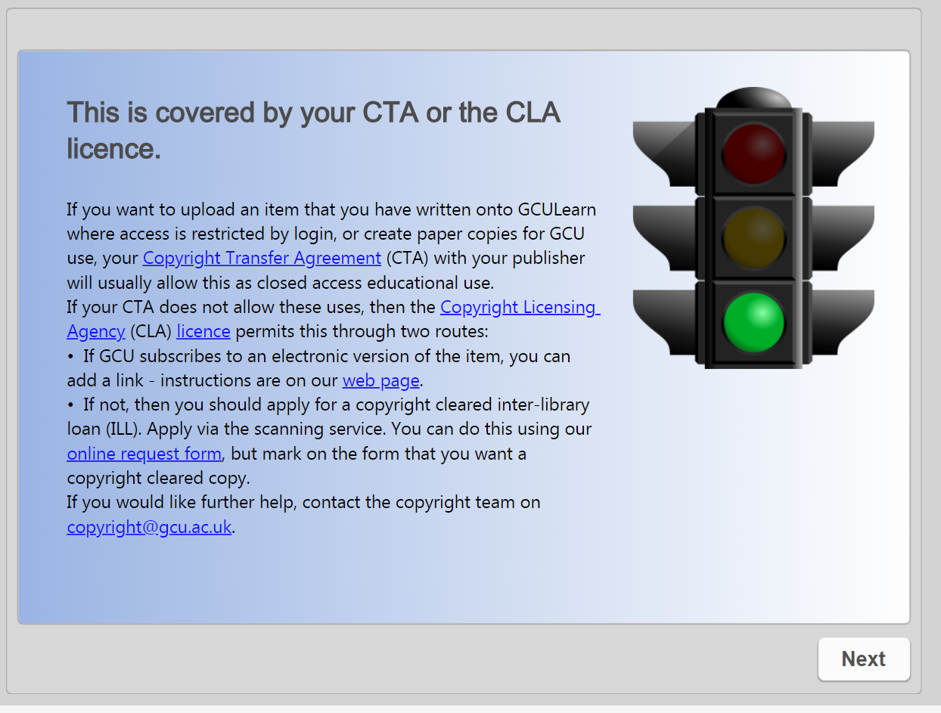

Slide 20
Thank you
https://edshare.gcu.ac.uk/3608/2/index.html
m.kelt@gcu.ac.uk
References:
GADD, E., WEEDON, R. 2017. Copyright Ownership of E-learning and Teaching Materials: Policy Approaches taken by UK Universities. Education and Information technologies. 22(6), 3231-3250.
ROLFE, V. 2012. Open Educational Resources: Staff Attitudes and Awareness. Research in Learning Technology. 20(1), 1-13.
WHITFIELD, S. ROBINSON, Z. 2015. Open Educational Resources: the Challenges of ‘Usability’ and Copyright Clearance. Planet. 25(1), 51-54.

