Slide 1
Gary Steele
edShare@GCU: sharing and preserving our educational resources

Slide 2

Glasgow Caledonian University
Founded in 1993 by merger of The Queen's College (1875) and Glasgow Polytechnic (1971)
Motto “University for the Common Good”
16,415 Students (2016/17)
20% of students from disadvantaged areas
3 Academic Schools
  School of Engineering and Built Environment: Engineering, construction, and computing
  Glasgow School for Business and Society: Business, law, and social sciences
  School of Health and Life Sciences: Nursing, optometry, psychology, and social work
Top modern university in Scotland by research power (REF2014)

Slide 3
edShare origins
Key findings
Copyright
Access
Storage
Resource variety
Legacy AV repository
OER policy
Survey of staff requirements
    “To ascertain the issues surrounding the use of digital resources in the University, both for learning and teaching, and support services”
      Digital Resources Survey (2013) https://edshare.gcu.ac.uk/1011

Slide 4
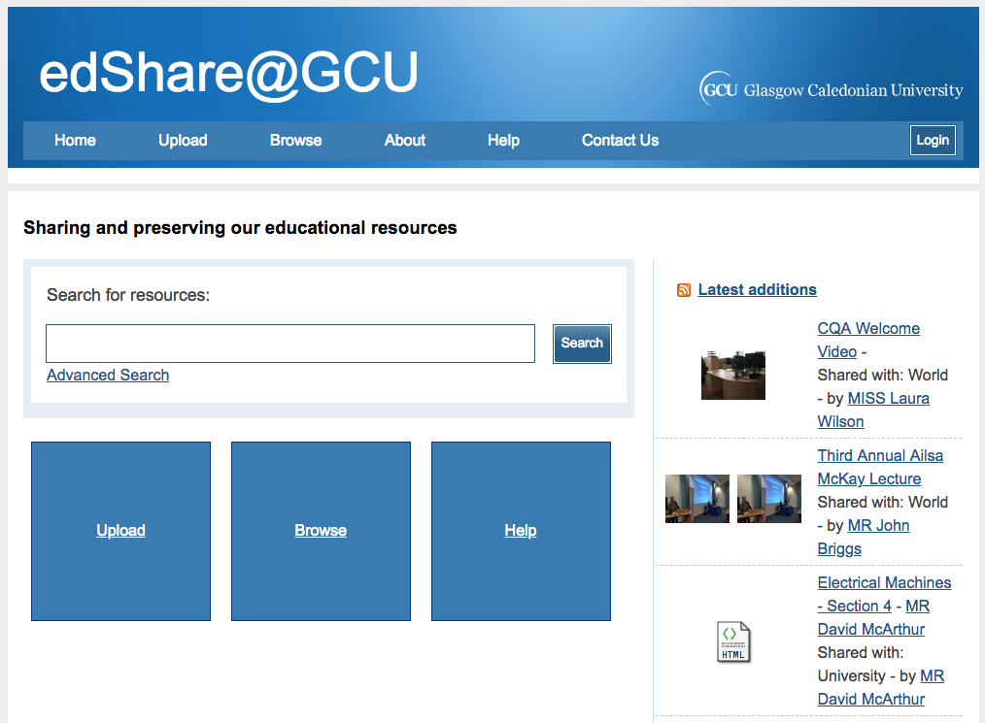
edShare system
Hosted on campus on mirrored servers with 13TB of storage
Variant of ePrints repository open source software
Built and supported by ePrints Services
Built on the key principles of:
  Storing
  Sharing
  Preserving

Slide 5
edShare key features
Self-deposit and quick upload
Version control
Personal profile
Various share options
All file types
Full metadata indexing
No storage limits
Value add for audio, video, and text

Slide 6
edShare service and support
System admin
Manage development
Digital preservation
Training
Advocacy
Copyright and licensing advice
Content
Course materials
Lesson plans
Presentations
Videos
Podcasts
Images
Past papers
Software
Training materials

Slide 7
edShare principles
Community driven
Community content
Self policing
However...
No published resources
Staff deposit only
In return…
Copyright and licensing advice
Community led development
Permanent resources only
Development
Training and advocacy

Slide 8
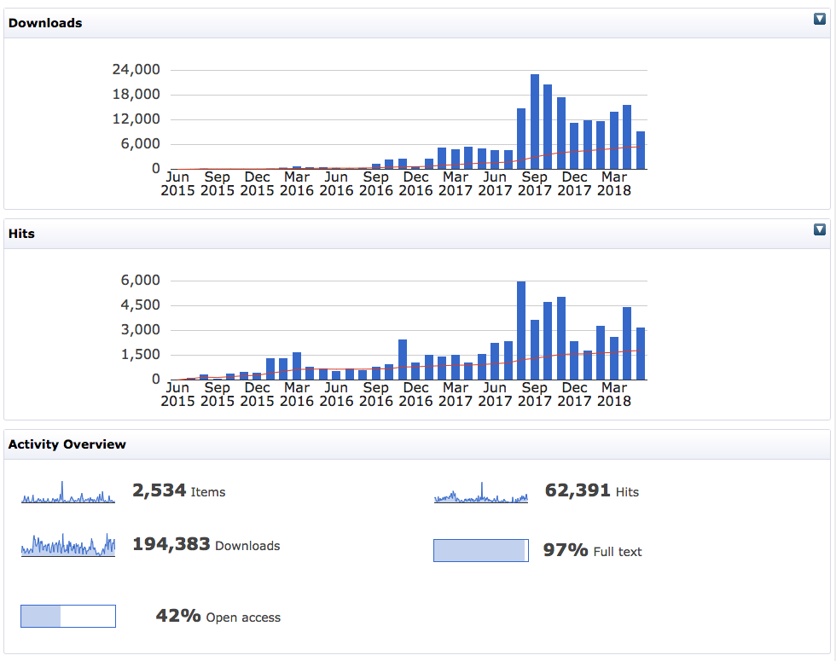
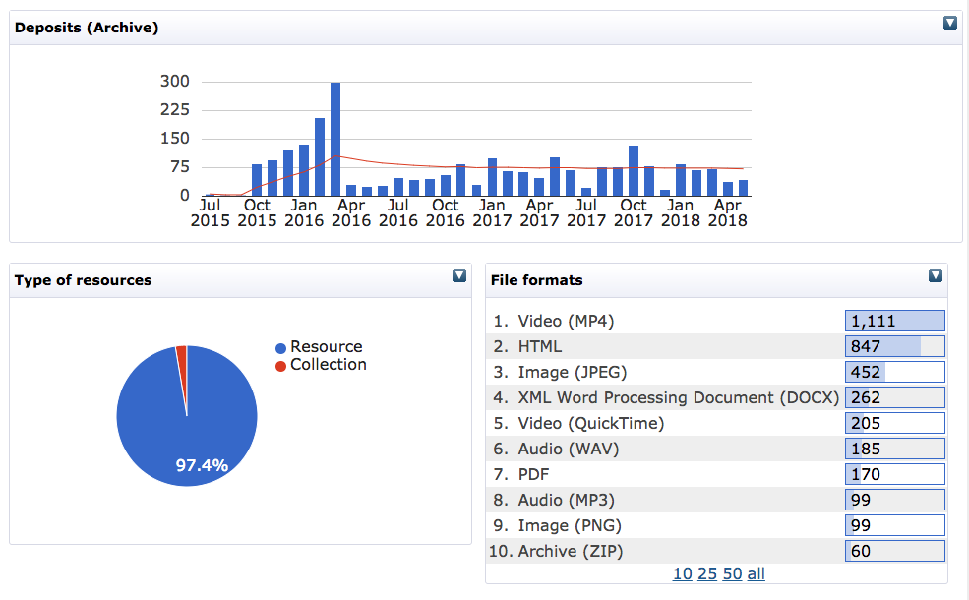
edShare success in numbers

Slide 9
Open Educational Resource Policy
“Freely accessible, openly licensed resources that are used for teaching, learning, educational, assessment and research purposes”
Open Education Working Group http://education.okfn.org
“As a university committed to blended learning, GCU encourages staff and students to use, create and publish OERs to enhance the quality of the student experience, provided that resources used are fit-for-purpose and relevant.”
GCU Interim Open Educational Resources Policy
https://edshare.gcu.ac.uk/1714

Slide 10
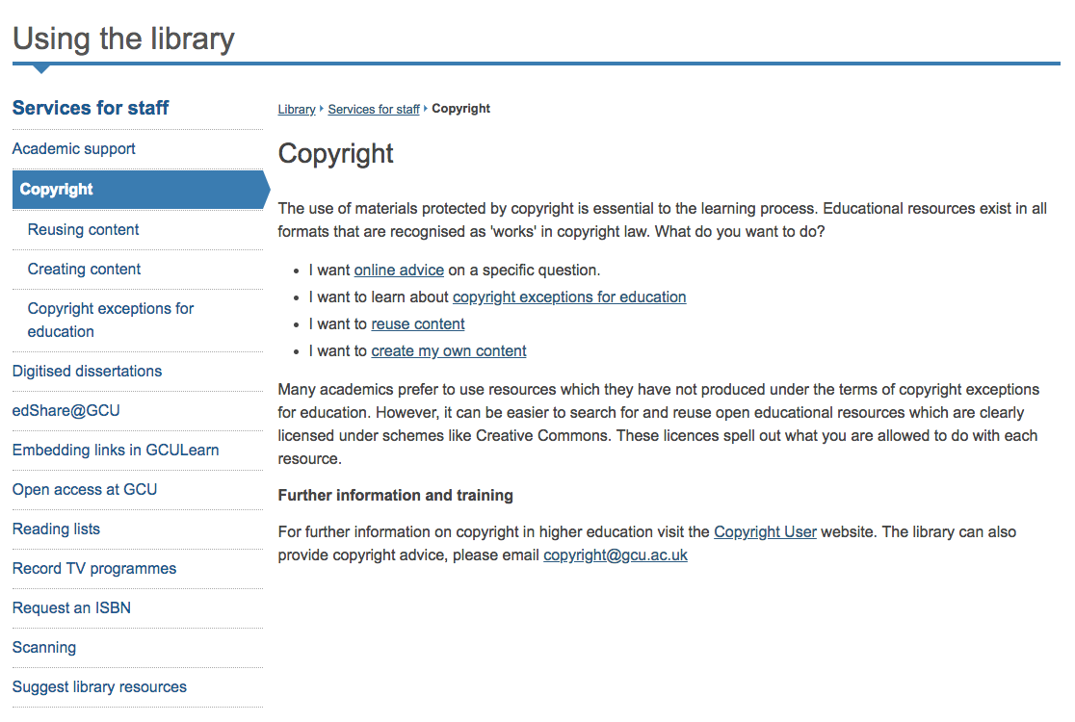
OERs and copyright
Clear and consistent guidance on copyright
Encourage questions
Self-policing
Robust takedown policy
Advocacy and training

Slide 11
Advocacy of Open Educational Resources
Create
Upload
License
Increase access to education
Improve teaching and learning
Self promotion
Retain access to your own resources

Slide 12
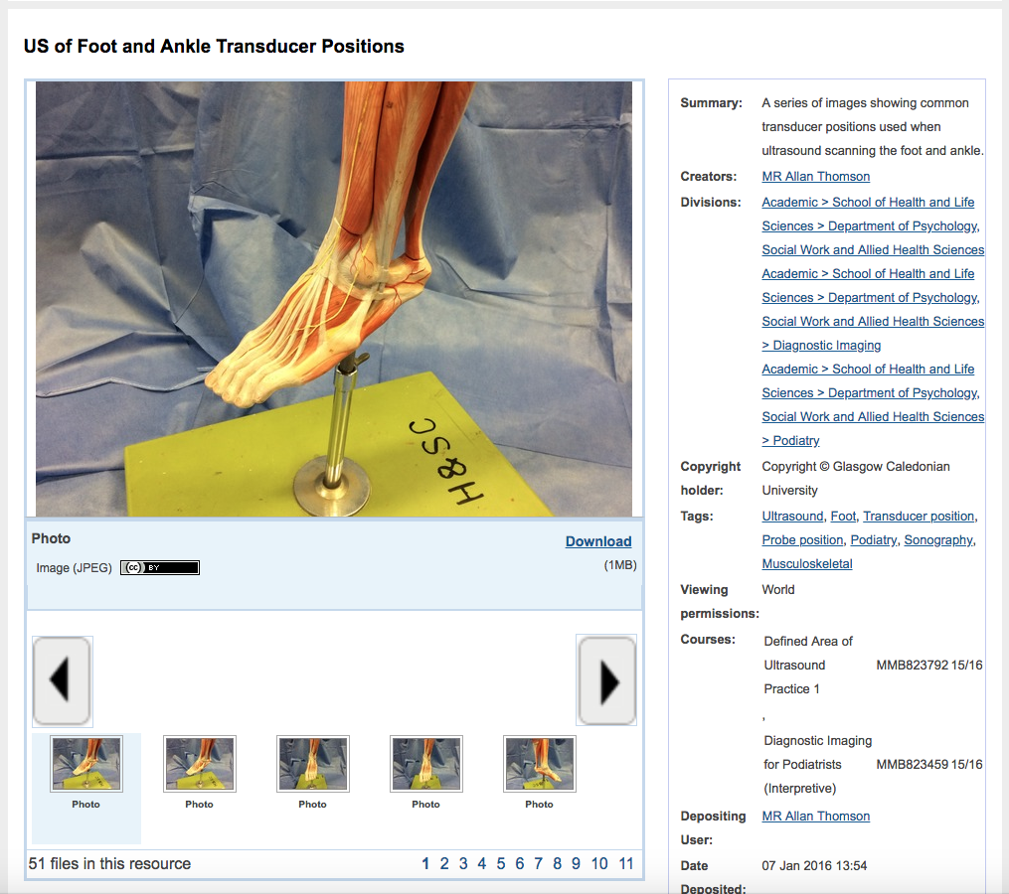
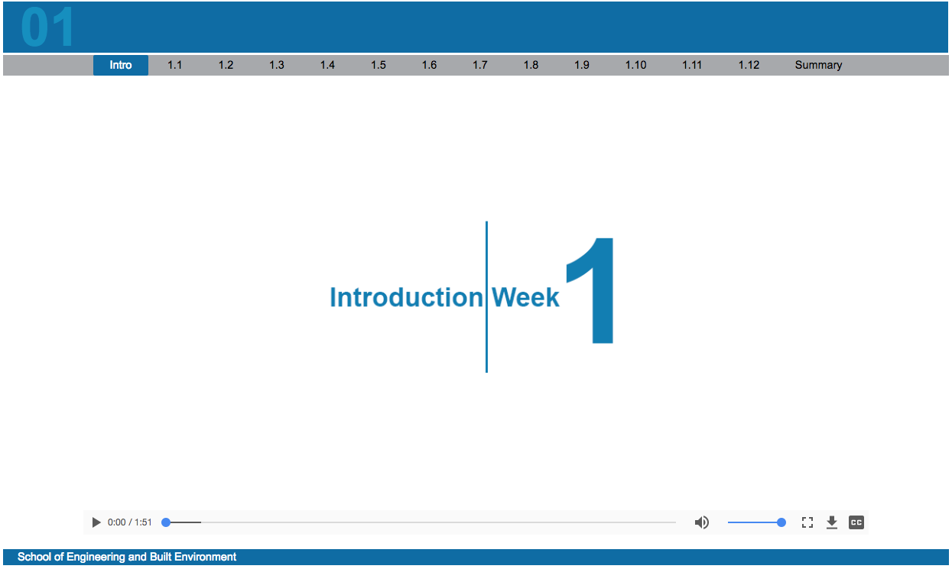
edShare champions

Slide 13
Thank you
Demo:
Presentation:
Visit edShare: edshare.gcu.ac.uk
Email: edshare@gcu.ac.uk

Slide 14
Credits
Slide 2 - Our thriving global network. https://www.gcu.ac.uk
Slide 4 - Home Page. https://edshare.gcu.ac.uk
Slide 3,5,6,7 - An Introduction to edShare@GCU by Toby Hanning.
https://edshare.gcu.ac.uk/1014 (CC-BY)
Slide 8 - Statistics. https://edshare.gcu.ac.uk/cgi/stats/report
Slide 9 - Copyright. https://www.gcu.ac.uk/library/servicesforstaff/copyright
Slide 9,11 - edShare@GCU: A Guide to Training and Advocacy by Toby Hanning. https://edshare.gcu.ac.uk/3667 (CC-BY)
Slide 12 - US of Foot and Ankle Transducer Positions by Allan Thompson. https://edshare.gcu.ac.uk/1022 (CC-BY). & Week 1 - Introduction to object-orientated programming by James Paterson. https://edshare.gcu.ac.uk/2121

