Slide 1
Kim Williams, Frances MacInnes and Calum Nielsen (SHLS)
HEEAPs of Support @GCU Higher Education, English for Academic Purposes

Slide 2
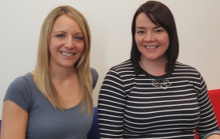
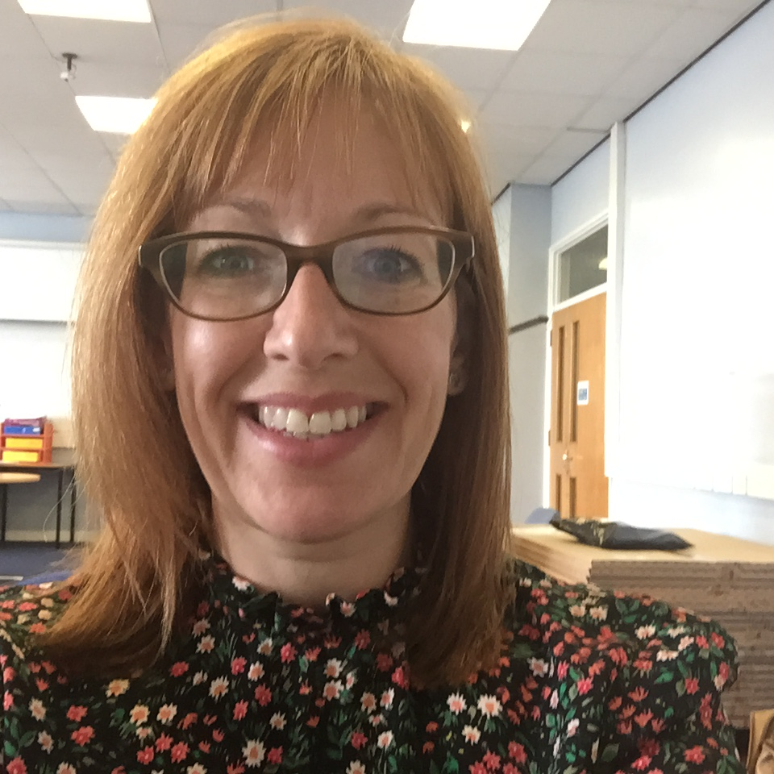
The Project Team
Project Lead(s)
Kim Williams, SHLS and Deborah O’Neil, SHLS
Project Team Members
Associate Dean
Whole University Links
Nichola McLarnon, SHLS
Learning Development Centre
GSBS
Student Partners
Calum Nielsen, SHLS
Jessica Hancock, GCU London
ERASMUS Students SHLS
Learning Development Centre
SEBE
INTO Students (GCU and GCU London)
MSc BIO Suite (international students) SHLS
Frances MacInnes
Life Sciences SHLS
Birgit Schroeter
Psychology
SHLS
Notes:
Led by staff in SHLS (with GCU London as a core partner), the project will involve work across schools (with feedback and advice provided partners in the School of Engineering and Built Environment (SEBE) and Glasgow School of Business and Society (GSBS)), seeking the expertise and knowledge of INTO and the Learning Development Centres within the university to ensure consistency in the provision of academic development for international students, and in particular EAP.

Slide 3
Aims/goals of the project
Identifying the L&T challenges of international students and understanding their support needs
Exploring the experience of a range of International students:
School of Health and Life Sciences (SHLS)
INTO
ERASMUS
GCU London
Developing resources with regard to English for Academic Purposes (EAP)
Highlighting current initiatives and resources via a bespoke marketing campaign and promoting increased student engagement

Slide 4
Interim Outcomes/Findings
International Students missing out on critical pre-sessional transition events eg LDC ‘Bootcamp’
Develop a process assisting students to recognise their EAP strengths and weaknesses
Further support on reading strategies and technical writing skills (i.e. punctuation, grammar etc.) is required.
Videos (with English subtitles provided) and interactive resources are useful
Greater awareness of current services and what learning development is required for the student body within programmes across the school
Smoother transition for students between INTO and GCU LDCs would be desirable, with greater communication and stronger links formed between the two.
Notes:
Pre-sessional issues for International Students. Many international students are not on-campus in time to attend the Learning Development Centre’s pre-sessional ‘Bootcamp’ therefore a need was identified in introducing International students to the relevant resources and services available to them before they arrive.
A clear process needs to be identified and developed for students to recognise their EAP strengths and weaknesses and they should be aware of how they can be supported by the LDC to improve in this area.
Further support on Reading Strategies and technical writing skills (i.e. punctuation, grammar etc.) is required.
Videos (with English subtitles provided) and interactive resources are useful for learners with English as a second language.
Greater awareness of current services and what the Learning Development is required for the student body and within programmes across the school.
A smoother transition for students between INTO and GCU LDCs would be desirable, with greater communication and stronger links formed between the two.

Slide 5
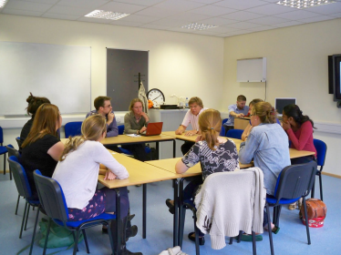
Activities: Evaluation
Focus groups were undertaken with:
X 3 groups of INTO students who intend to progress into SHLS courses.
X 2 groups of GCU London students
X 1 group of current GCU Erasmus students
A semi-structured interview was also undertaken with a current GCU Postgraduate International student from studying within the Life Sciences.

Slide 6
Activities: Activities Based on Initial Findings
The EAP section of Learning Development Centre website is now live.
Accessible to all SHLS students, in this section, are two diagnostic assessments: Reading and Writing skills.
https://sites.google.com/site/ldcgculearn/eap
The EAP section also contains full details of next steps for students once the tests are complete.

Slide 7
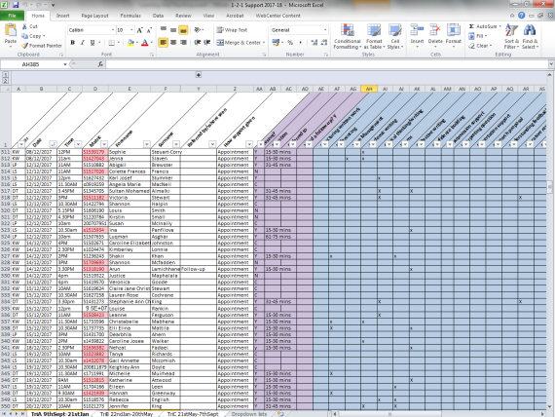
Activities: Activities Based on Initial Findings
The LDC has incorporated, within their internal 1-2-1 support database, a means to identify when students, who go through this route, have booked an appointment.
This allows the team to prepare in advance and tailor the support to the specific student needs prior to the appointment.

Slide 8
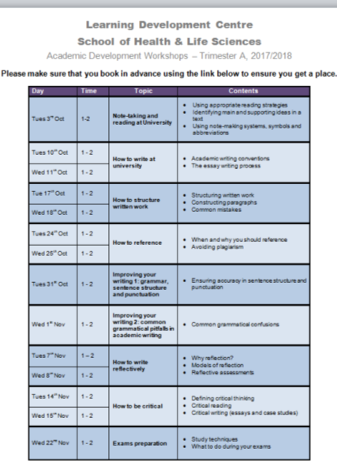
Activities: Activities Based on Initial Findings
x 3 workshops have been developed and delivered in Trimester A to promote EAP skills across the school.

Slide 9
Activities: Activities Based on Initial Findings
Bespoke EAP Online Learning Objects have been developed and are now live on the LDC website.
https://sites.google.com/site/ldcgculearn/academic-skills/writing/grammar

Slide 10
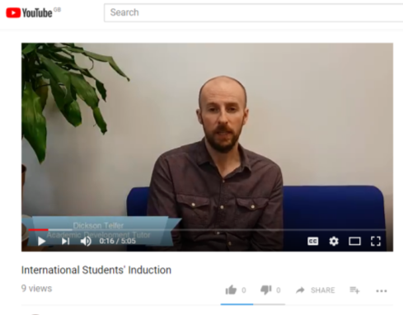
Activities: Whole School/University Dissemination and Marketing
A short video has been produced to market the EAP resources and services currently available to International Students.
https://youtu.be/F3Qqj8mrYh0
This video is aimed at International students who are unable to attend the whole-school LDC pre-sessional bootcamp to make them aware of the support available to them prior to commencement of their course.

Slide 11
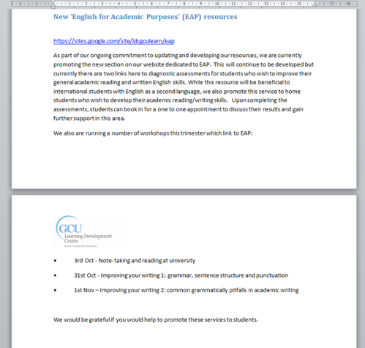
Activities: Whole School/University Dissemination and Marketing
Information about the new EAP services and resources has been disseminated across the school via Programme Boards.
Information has been included in all LDC Programme Board Reports and discussed at Programme Boards in detail where appropriate.

Slide 12
Activities: Whole School/University Dissemination and Marketing
Kim Williams, Project Lead, regularly attends meetings with Sharron Blumenthal (Associate Dean, International) to discuss impact of the project and EAP developments on a whole school level.
The project team have established a regular link with the on-going whole-school International students Listening Events to gain a broad spread of information about International students’ needs across the school.
Kim Williams and Calum Nielsen have established links with Charlotte Craig, INTO, Academic Director. The meetings have led to sharing of resources and an arranged induction in February 2018 for INTO students intending to progress in SHLS courses in order to ensure a smoother transition for students and raise awareness of the LDC/EAP service.

Slide 13
Next Steps
Follow-up focus groups with previous INTO students (Apr/May 2018).
Links with Sharron Blumenthal, Charlotte Craig (INTO), International Students’ Listening Events and LDCs will continue to be strengthened.
INTO SHLS Student Induction to the LDC scheduled for Feb 28th.
Team will continue to develop EAP section of website and workshop programme with any developments based on continual feedback
Notes:
INTO follow-up groups: revisit topic of EAP provision with students once enrolled in School with resources re-developed if appropriate
Team will continue..: Any developments to be based on continual feedback from students/staff so online materials and teaching programme tailored as closely as possible to needs of SHLS student body

Slide 14
Next Steps
On-going evaluation of pre-sessional resources and information for international students.
Marketing materials updated to feature details of EAP provision plus other marketing strategies considered to promote the support.
Team will evaluate current reading material/software for potential purchase for student use.
Team will explore need for (and source) any additional staff training in the provision of EAP.
Notes:
Marketing materials..: e.g. leaflets/brochures

Slide 15
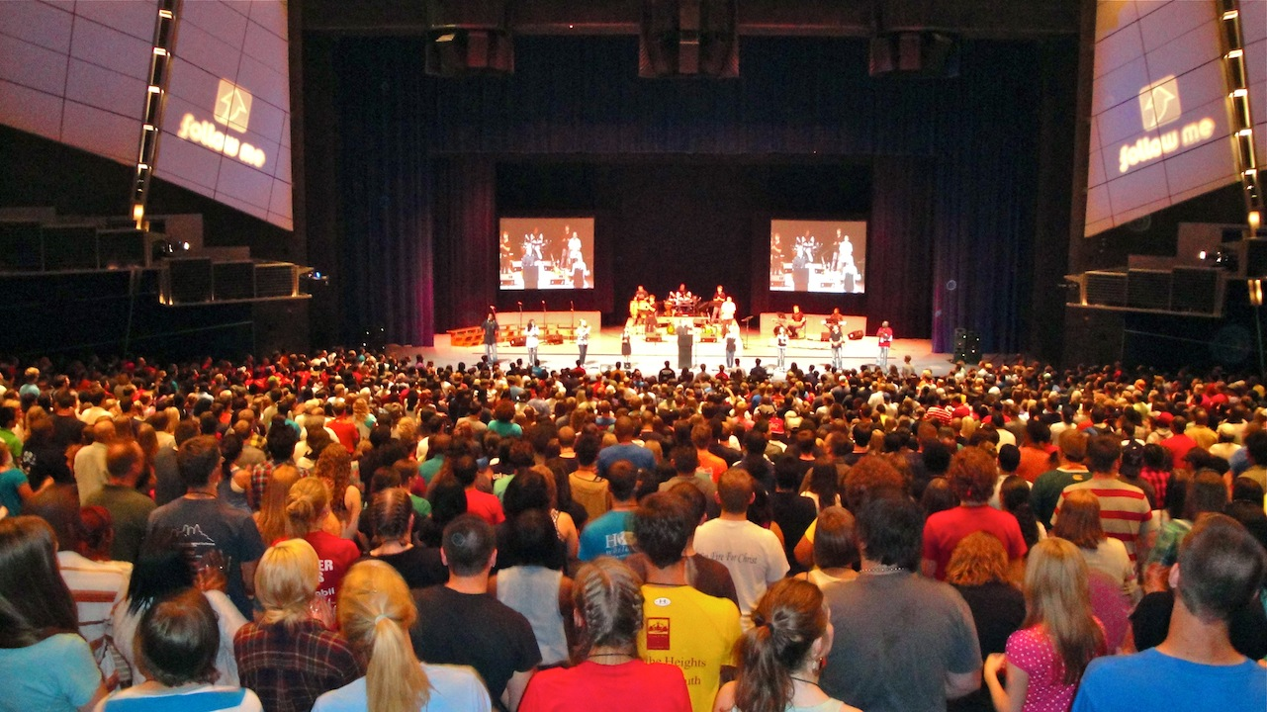
Dissemination/Research Outputs
The project’s findings will be dissemination via:
the GCU Learning and Teaching Event, January 24th, 2018
ALDinHE 2018 Conference, University of Leicester, 26th- 28th March, 2018 (paper submitted - awaiting confirmation).

Slide 16
Interactive element
Please note down any feedback or EAP experience you have had on post-its provided and stick to board for inclusion in the project review process

Slide 17
Thank you.
Any questions?

