Slide 1
Kim Williams, Frances MacInnes &
Calum Nielsen (SHLS)
HEEAPs of Support @GCU
Higher Education, English for Academic Purposes

Slide 2
The Project Team
Project Leads
Kim Williams & Deborah O’Neill LDC, SHLS
Calum Nielsen LDC, SHLS
Jessica Hancock GCU London
Birgit Schroeter Psychology
Frances MacInnes Life Sciences
Whole University Links
Learning Development Centre GSBS
Learning Development Centre SEBE
Team members
Student Partners
ERASMUS students SHLS
INTO students (GCU & GCU London
MSc BIO Suite (international students, SHLS)

Slide 3
International student challenges
Students face many challenges in HE, however those faced by international students are often heightened by cultural and other educational factors, such as the difficulties experienced when writing academically in a second language (Wingate, 2015).
Popp (2015) also identified particular needs in psychosocial and academic domains for international students, meaning that the international student experience can often be extremely challenging.

Slide 4
Why HEEAPs of Support @ GCU?
Increasing international students @ GCU
Resulting in support request increase @ LDC
English language v EAP support?
Desire to improve student performance
Current resources lacking
What do students need?
Student Experience Project opportunity

Slide 5
Aims/goals of the project
L&T challenges
International student experience across GCU
Developing EAP resources
Bespoke marketing campaign promoting student engagement
Notes:
Identifying the L&T challenges of international students and understanding their support needs
Exploring the experience of a range of International students:
School of Health and Life Sciences (SHLS)
INTO
ERASMUS
GCU London
Developing resources with regard to English for Academic Purposes (EAP)
Highlighting current initiatives and resources via a bespoke marketing campaign and promoting increased student engagement

Slide 6
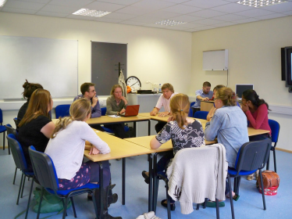
What we did
Focus groups
3 groups of SHLS INTO students
2 groups of GCU London students
1 group GCU Erasmus students
1-2-1 with GCU PG Life Sciences student
Notes:
Focus groups were undertaken with:
X 3 groups of INTO students who intend to progress into SHLS courses.
X 2 groups of GCU London students
X 1 group of current GCU Erasmus students
A semi-structured interview was also undertaken with a current GCU Postgraduate International student studying within the Life Sciences.

Slide 7
What did the students say?
Missing out at transition into GCU eg Bootcamp
Helping students recognise their EAP S & W
Reading strategies & technical writing skills support
Interactive resources (subtitled videos)
Awareness of current services
Smoother transition & stronger links between INTO & LDC
Notes:
International Students missing out on critical pre-sessional transition events eg LDC ‘Bootcamp’
Develop a process assisting students to recognise their EAP strengths and weaknesses
Further support on reading strategies and technical writing skills (i.e. punctuation, grammar etc.) is required.
Videos (with English subtitles provided) and interactive resources are useful
Greater awareness of current services and what learning development is required for the student body within programmes across the school
Smoother transition for students between INTO and GCU LDCs would be desirable, with greater communication and stronger links formed between the two.

Slide 8
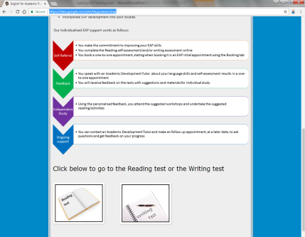
Resource development
Accessible to all SHLS & pre-sessional students - two diagnostic assessments: Reading and Writing skills.
The EAP section also contains full details of next steps for students once the tests are complete.
LDC website now has an EAP section https://sites.google.com/site/ldcgculearn/eap

Slide 9
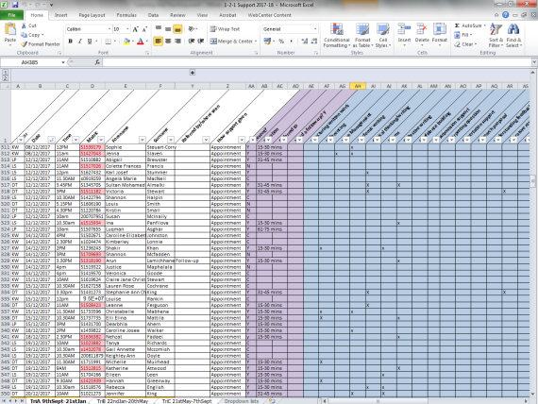
1-2-1 support database
This allows the team to prepare in advance and tailor the support to the specific student needs prior to the appointment.
Through the LDC 1-2-1 support database, students can be identified as looking for EAP support
Notes:
The LDC has incorporated, within their internal 1-2-1 support database, a means to identify when students, who go through this route, have booked an appointment.

Slide 10
Workshops
3 workshops promoting EAP skills have been developed and delivered in SHLS

Slide 11
EAP online learning objects
Bespoke EAP online learning objects are available on the LDC website https://sites.google.com/site/ldcgculearn/academic-skills/writing/grammar

Slide 12
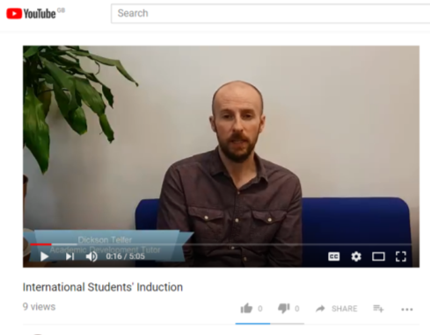
Dissemination and Marketing
A short video to market the EAP resource and services https://youtu.be/F3Qqj8mrYh0
Aimed at international students unable to attend LDC pre-sessional bootcamp
Raises awareness of support available to them prior to commencement of their course

Slide 13
Next Steps
Follow-up focus groups with previous INTO students (Apr/May 2018).
Links with AD International, INTO, International Students’ Listening Events and LDCs will continue to be strengthened
INTO SHLS Student Induction to the LDC
Continuation and development of EAP web resources based on feedback
Notes:
INTO follow-up groups: revisit topic of EAP provision with students once enrolled in School with resources re-developed if appropriate
Team will continue..: Any developments to be based on continual feedback from students/staff so online materials and teaching programme tailored as closely as possible to needs of SHLS student body

Slide 14
Next Steps
On-going evaluation of pre-sessional resources and information for international students.
Marketing materials updated to feature details of EAP provision plus other marketing strategies considered to promote the support.
Team will evaluate current reading material/software for potential purchase for student use.
Team will explore need for (and source) any additional staff training in the provision of EAP.
Notes:
Marketing materials..: e.g. leaflets/brochures

Slide 15
Thank you
Any questions?

Slide 16
References
POPP, H., 2015. Preliminary Efficacy Study of a Conversational English Partners Program for Enhancing Psychosocial Life Quality in International Graduate Students [online]. [viewed 22 December 2017]. Available from: https://baylor-ir.tdl.org/baylor-ir/handle/2104/9413
WINGATE, U., 2015. Academic Literacy and Student Diversity The Case for Inclusive Practice. 1ST ed. Bristol: Multilingual Matters.

