Slide 1
Teaching Large Groups
Sheila MacNeill, Senior Lecturer Academic Development: Digital Learning; Dept of Academic Quality and Development
Graduate Teaching Assistants Workshop
August 2018

Slide 2
Aims
By the end of this session you should be able to:
Be aware of the potential benefits of lectures
Reflect on your preparation for lecturing and your delivery style
Consider how you might improve what you are currently doing
Consider how you could make lectures interactive

Slide 3
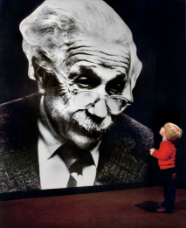
"I never teach my pupils, I only provide the conditions in which they can learn."

Slide 4
What are your ideal learning conditions?
Where and how did you learn the most in your life?
Discuss with your partner
Present your partner’s response to the class
You have 5 minutes for the discussion

Slide 5

Photo by NeONBRAND on Unsplash

Slide 6


Photo by Anete Lūsiņa on Unsplash
Photo by Štefan Štefančík on Unsplash

Slide 7
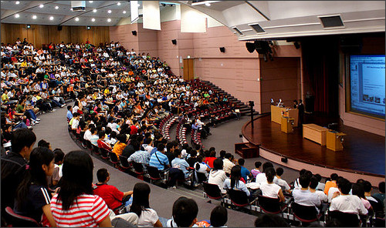

Slide 8
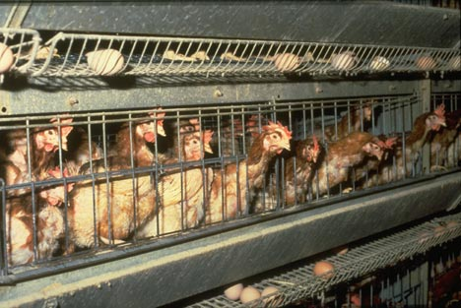

Slide 9
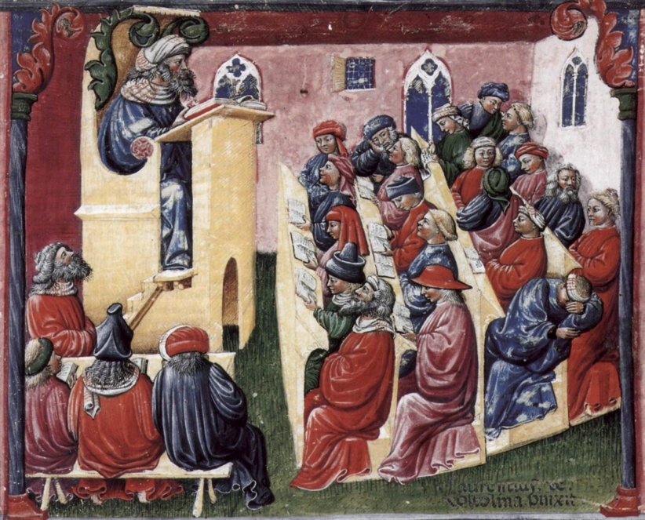
Social networking
10 second concentration
Only came to one lecture
Reading last year’s notes
Reading a newspaper
Never takes notes
Doesn’t know he’s in the wrong class
Hungover

Slide 10
“College is a place where a professor’s lecture notes go straight to the students’ lecture notes, without passing through the brains of either.” (Mark Twain)

Slide 11
Why lecture? Your views
I like lectures.
It depends on the lecturer but, on the whole, I felt that I learned a lot from lectures. I think if you come to them prepared, after reading ahead and looking at the topic beforehand, the lecture is a good way of consolidating knowledge. I don't agree with students who say that they need lectures tailored to their diminishing attention span - how are they going to do well outside university if they can't concentrate for 40-60 mins?!

Slide 12
Why lecture?
Discuss the question with your group and present 3 reasons.
You have 5 minutes for this task.

Slide 13
The best lectures are not those that attempt to pour information into your ear, but those that send you
spinning off into your own mind. Outside the lecture theatre
is where your real enquiry begins.
Christopher Bigsby

Slide 14
What does it take?
Handling nerves
Preparing lectures
Structuring lectures
Using your voice effectively
Include active learning in lectures

Slide 15

Interactivity
Photo by John Schnobrich on Unsplash

Slide 16
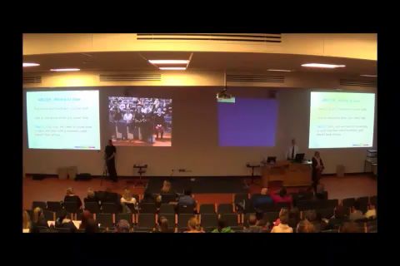

Slide 17






Slide 18

What was your best learning experience?
http://bit.ly/2lWboPc
Notes:
https://padlet.com/GCUAcademicDevelopment/616sbpedh1cb

Slide 19
Group think – lectures
Go to www.menti.com
use the code 61 01 91
Notes:
https://www.mentimeter.com/s/77e2e288e19910e2174e86027853f993/99bb5314e556

Slide 20
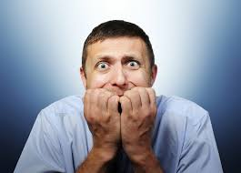
Why are you nervous?

Slide 21
Know yourself, spot the signs and know the reasons
Lack of confidence?
New place to be?
Sense of isolation and vulnerability?
Feeling self-conscious?
Fear of making mistakes?

Slide 22
Some tips
Take the pressure off yourself
Be in the lecture theatre before the students
Check your breathing
Relax your body and your voice
Survive the first 5 minutes
Have your notes in right format
Don’t forget: It will get better

Slide 23
How to prepare
Sketch out themes and connections
What do you want your students to be able to do at the end?
Allocate time sections
Use variety of experience for students
Look for pictures/ illustrative examples
Look for attention hooks/ attention grabbers
Plan interactive elements
Handouts?

Slide 24
How do you deliver?

Slide 25
Grab their attention and take control
Be enthusiastic and interested
Share your excitement and passion
Be able to use the equipment competently

Slide 26
Don’t forget
Less is more
A student’s attention span is short
It’s about storytelling
You are in charge
Create variety AND …

Slide 27


Slide 28
Using your voice effectively
What you should avoid
Monotone delivery
Volume dropping off at end of sentences
No emphasis and pauses
High speed delivery
Colloquialisms and acronyms
Looking away from students

Slide 29
An introduction to your research
Take 10 minutes to prepare a very short introduction to your research which you can present to the class who are not specialists in your field.
You have 2 minutes for your presentation.

Slide 30
Feedback criteria
Enthusiasm?
Clear message?
Delivery: Volume? Speed?
Relationship with audience?
Confidence?

Slide 31

What about PP?

Slide 32


Slide 33
My eyes are burning!
Can you look at this for an hour?
Colours look different on every LCD projector
Colours look different on your computer screen to how they’ll look projected

Slide 34
Colours to avoid with white are
  Light Green
  Light Blue
  Pale Yellow
Can you read this?

Slide 35
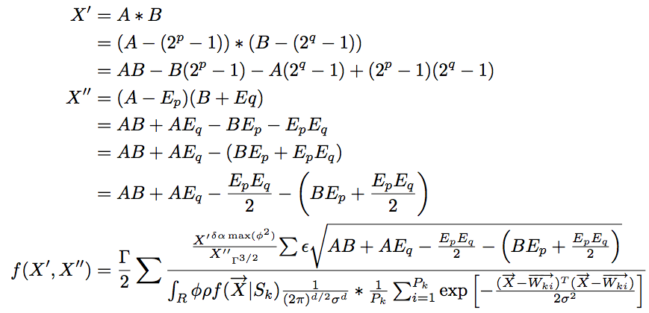

Slide 37
Active learning in lectures
Speak to neighbour or small group
Have a break for a physical activity
Incomplete handouts
Quizzes
Use technology

Slide 38
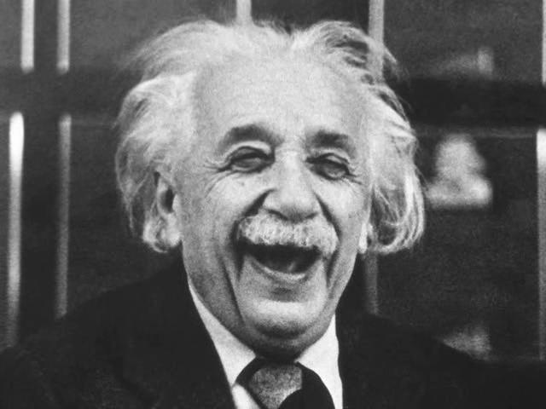
“Learning is experience.
Everything else is just information .”

Slide 39
Watch the experts
Eric Mazur
https://youtu.be/dUJS48XQeXE
Matt Abraham (TED talk)
https://www.youtube.com/watch?v=YdtLELVhEQg
Presenting with slides
https://www.youtube.com/watch?v=Z0EEH80AeUg
How to avoid death by Power Point
https://www.youtube.com/watch?v=Iwpi1Lm6dFo

