Slide 1
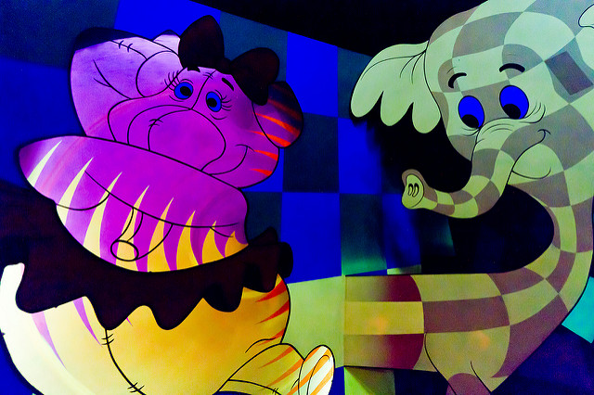
Heffalumps and woozles: copyright and the elephant in the room.
Marion Kelt

Slide 2
Feel the fear, but do it anyway!
Copyright literacy can be regarded as an integral part of information literacy, especially when considering the ethical use of information.
It is the “elephant in the room” of the IL world. Why? People try to avoid thinking about it for various reasons.
This means that they can often delay considering copyright at the start of a project, and then panic when faced with it towards the end!
Often copyright advice can be part of a wider job which can be a problem at busy times.
How do I know this? Part of my job is to act as University Copyright Advisor.
But nobody wants to talk to me!

Slide 3
The heffalumps and woozles …
uncertainty about copyright ownership of teaching materials
lack of knowledge of copyright and licensing issues, leading to a reluctance to engage with the topic
uncertainty on the use of third party materials in OERs
And another thing….
The rise of distance and transnational education puts more pressure on lecturers and learning technologists to produce quality online resources fast
Sound familiar? …..

Slide 4
Chasing away the heffalumps and woozles …
The heffalump:
Uncertainty about copyright ownership of OERs produced at work
We tackled this one with our OER policy and are now pushing for a copyright policy
This left some woozles:
lack of knowledge of copyright and licensing issues, leading to a reluctance to engage with the topic
uncertainty on the use of third party materials in OERs
So how do we tackle the general fear and loathing produced by copyright and licensing issues?

Slide 5
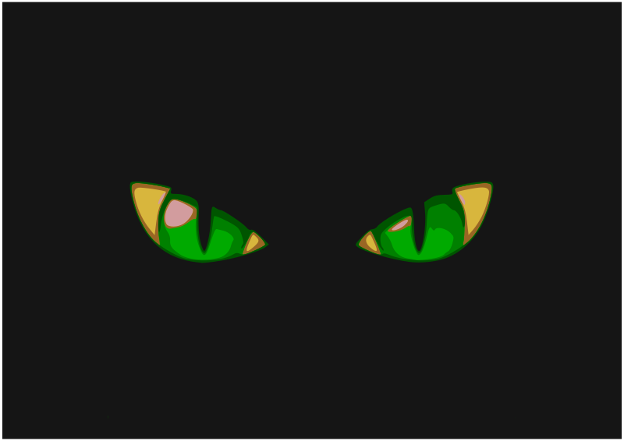
Sanity check … !
Repeatedly answering the same questions or running the same courses is bad for your mental health and emotional equilibrium!

Slide 6
So, how do we fight the fear and keep sane?
We offer an enquiry service and training sessions, but what people really want is quick answers available at the point of need. Ideally this should be available without communicating with a scary librarian!
We decided to put basic copyright advice online and developed the GCU online UK copyright advisor
It is available as an OER and you can use it at https://edshare.gcu.ac.uk/3608/2/index.html
So, how did we do it?

Slide 7
The FAQs list - the start of it all
When we set up our team mailbox at copyright@gcu.ac.uk, we used this to keep track of copyright enquiries
As we got more, we started to keep a document of tricky questions
We found that some questions came up often so developed a list of FAQs
We then wondered how we could make these more easy to use
Our goal was to save ourselves time and effort …
First we asked around to see if any other universities had developed online guidance
None did quite what we wanted to do so we came up with a plan

Slide 8
The plan …
We decided start with the main types of material:
Journal articles
Book chapters
Audio files
Video files
Maps
Computer code
Images (photos, mind maps, diagrams)
Then we developed question and answer flowcharts.
Then we created text answers to the questions in the flowcharts with links to web resources and a glossary.
These are available under CC licence at https://edshare.gcu.ac.uk/2706/

Slide 9
All the right words in the right order?
We found that one or two people working together was not enough!
So we formed a group:
Me (Copyright Advisor)
Toby Hanning (Systems with knowledge of copyright and repositories)
Nicky Stewart (Systems with experience of web design)
Elinor Toland (PURE Repository)
Susan Cunningham (Administrator who contributes to the web group)

Slide 10
Why work in a team?
Teamwork helped with the logical flow of the workflow charts and the wording of the text documents.
It also helped ensure consistent use of language
BUT eventually you have to stop revising and start building!

Slide 11
Putting it all together
We already had the iSpring quiz software and found that it was compatible with edShare, so decided to use that
It was easy enough to input the questions and answers and set up the branches to the answers

Slide 12
Some stray woozles …
However, the navigation only moves forward
If the user has more than one question, or clicks the wrong choice by accident, they have to restart the session. This is not very clear

Slide 13
The first version has proved popular and effective, but not ideal
We applied for, and were granted, a SLIC innovation grant to develop it further as a more open HTML5 resource
This means the new version will be more mobile friendly and attractive

Slide 14
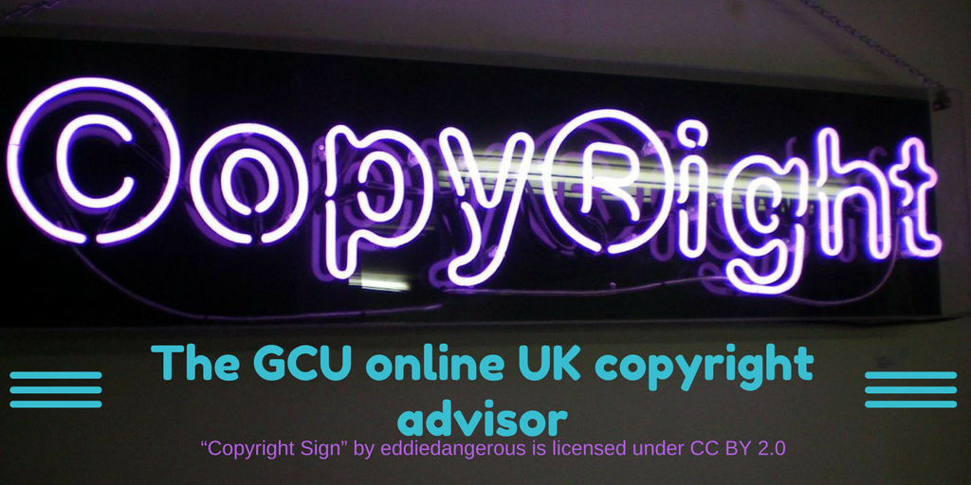
The way forward
We are now working with Worth Knowing, a UK web design company
We hope to produce a new version at the end of the year
This will be shared on Git Hub and edShare as a CC-BY OER
It will be easy to adapt and reuse as it is edited in Markdown
You can add your own branding, change the appearance and even the language!

Slide 15
Demo and questions?
https://edshare.gcu.ac.uk/3608/2/index.html

Slide 16
Links and credits
https://edshare.gcu.ac.uk/3608/2/index.html
m.kelt@gcu.ac.uk
Photo: Magic Kingdom Heffalump and woozles by Ralph Krause. CC-NC-SA Available from: https://www.flickr.com/photos/jeffkrause/5682052197
Photo: Heffalumps and woozles by Megan. CC-SA Available from: https://www.flickr.com/photos/megans22/8504836638
Image: Heffalump by Illinformedandfabulous Available from https://gfycat.com/gifs/detail/IllinformedFabulousBird
Additional images from Open ClipArt (CC 0)

Slide 17
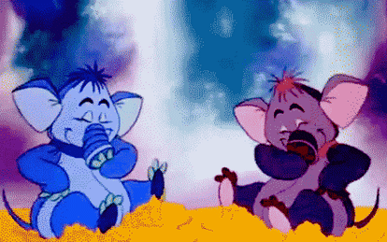
Thank you

