Slide 1



Promoting Excellence in Employability and Transversal Skills (PEETS)
Shared interdisciplinary and multicultural learning from Global Communities
Dr Bob Gilmour SFHEA, FCIWEM, CWEM
Glasgow Caledonian University
Scotland

Slide 2
Overview
Compare and contrast the first 2 years of “Promoting Excellence in Employability and Transversal Skills” (PEETS) project
Annual Implementation plan and key activities
10 day International Intensive Study Period (ISP)
Review preliminary outcomes from Years 1 and 2
Scotland

Slide 3
Promoting excellence in employability and transversal skills (PEETS)
Erasmus + Strategic Partnership (€300,000 3 years)
Industry informed project aimed at developing employability skills (Industry associated with renewables)
Interdisciplinary and multicultural teams
  39 students – Finland, Netherlands and Scotland (plus 3 student mentors)
  Environmental civil engineering, Environmental management, Marketing, Business
  8 staff
Professional service engagement
International Intensive Study Period (10 days)
Scotland

Slide 4
Research and development
Stakeholder consultation – training needs analysis for the renewables industry
Creation of self reflective App – supports students understanding of key graduate attributes
Development of a range of learning environments – in and out of classroom, online (BB collaborate/moodle)
10 day Intensive Study Period (year 1 Scotland, year 2 Finland then Netherlands)
Scotland

Slide 5
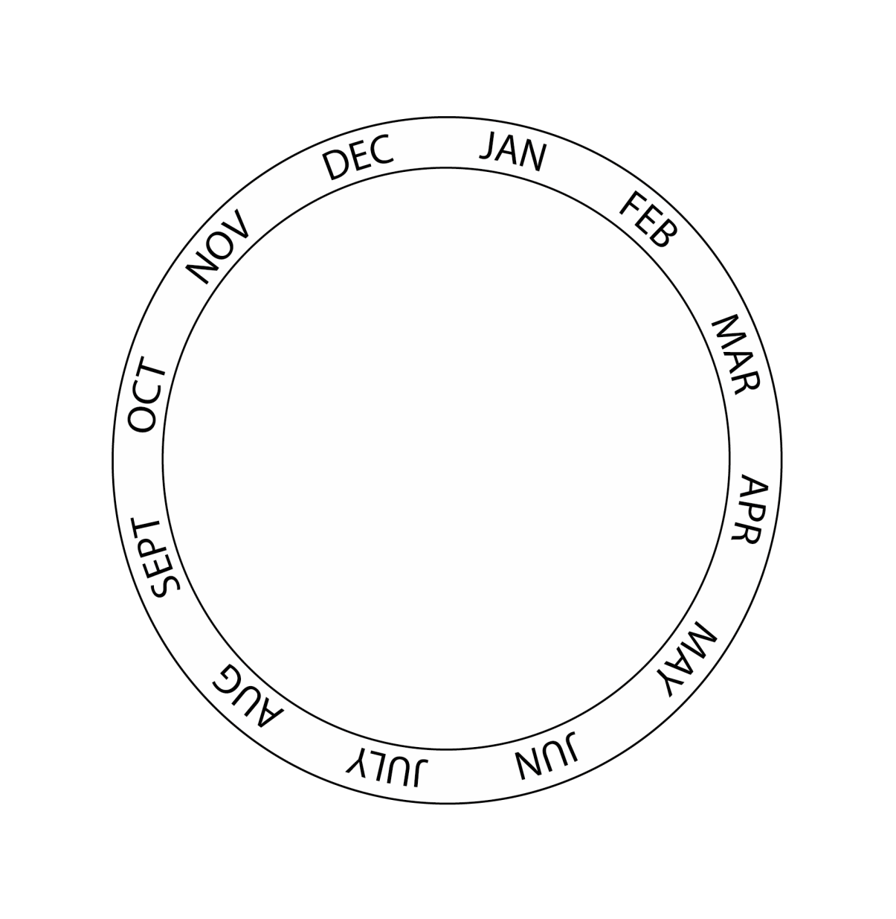







PEETS Project Management and Annual Implementation (Key Activities)
International and employability Competencies (IC)
App Development
Student I.C. Audit – reflect on their competencies/attributes
Key Info Sets on Renewables
Student Induction
Stakeholder Consultation
Individual country analysis
on renewables
Training materials preparation
London
Student Selection
Kick off meeting
Video/online presentations Of renewable energy issues.
Preparation of survival guide, (Host Country)
START 2016
I0 Day Intensive study period in either Scotland (2017),
Finland (2018),
Netherlands (2019).
Annual Evaluation Report
Student I.C. Audit – self-reflection
Key
Project Management Meeting ( * ) = Virtual
Intellectual Output / Activity
Learning /Teaching/ Training Activities

Slide 6
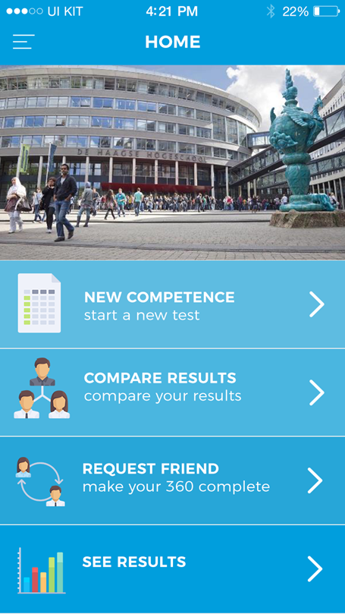
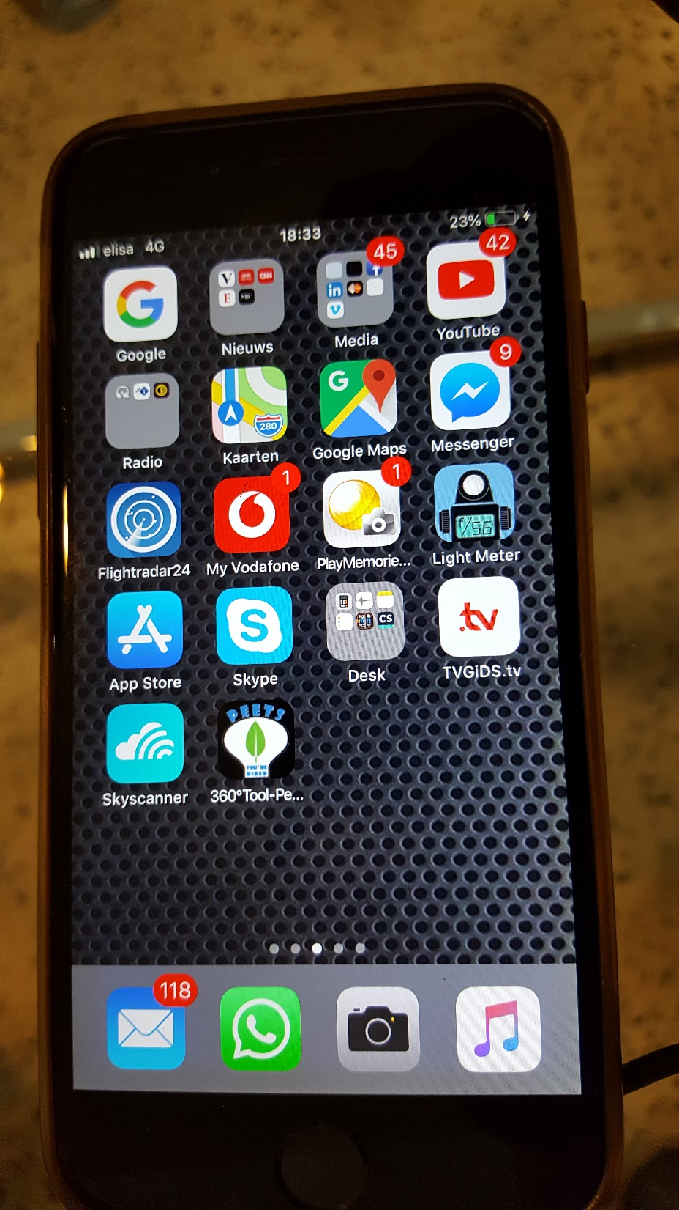
Student International Competencies Assessment App
Insert weblink or …..
Scotland

Slide 7
PEETS Intensive Study Period May and June 2018
Day | 1 | 2 | 3 | 4 | 5 | 6 | 7 | 8 | 9 | 10
 | Thursday 24 May | Friday 25th | Saturday 26th | Sunday 27th | Monday 28th | Tuesday 29th | Wednesday 30th | Thursday 31st | Friday 1st June | Saturday 2nd
Morning | Travel to Lahti in Finland | Official welcome ISP objectives Presentations on pre-ISP work in interdisciplinary and multicultural teams Industry presentation on solar energy | 7.30am depart Travel to Kukonottko Camping site Dissemination of project responsibilities (including student managers for PM, QS, CM, H&S, Design, Bid, CSR) | Solar panel charger building Background research on client requirements | Final completion of solar charger units Completion of background research | 7.30am bus to Helsinki Industry visit to ABB in Helsinki | Workshop Innovation under resource scarcity | LinkedIn presentation Marketing strategy workshop Final Bid preparations (3 groups) | Joint group presentation to Chief Regional Officer | Depart Lahti, Finland
Afternoon | check into apartments | Solar charging - Case study outline Employability and transversal skills Introduction to experiential learning | Preparation of solar charger and other research | Solar panel charger building Background research on client requirements | Exploratory phonecall to client Industry feedback Depart site 5pm | Student time to explore Helsinki and local island | Industry site visits Waste recycling and energy centre Entrepreneurial site visit to Brewery start-up company | Deadline for preparation of presentation brought forward by 3 hours Late change of plan by client – wants just one bid | STARR preparation Post test Certificate Presentations Feedback on ISP
Evening | Objectives induction Ice breaker Team formation and roles | Student free time | Morale boost evening Sauna, campfire pancakes, swimming | Cook salmon by the fire | Student free time | 20.00 bus returns |  | Student final preparation | Final dinner (cultural activity)

Slide 8
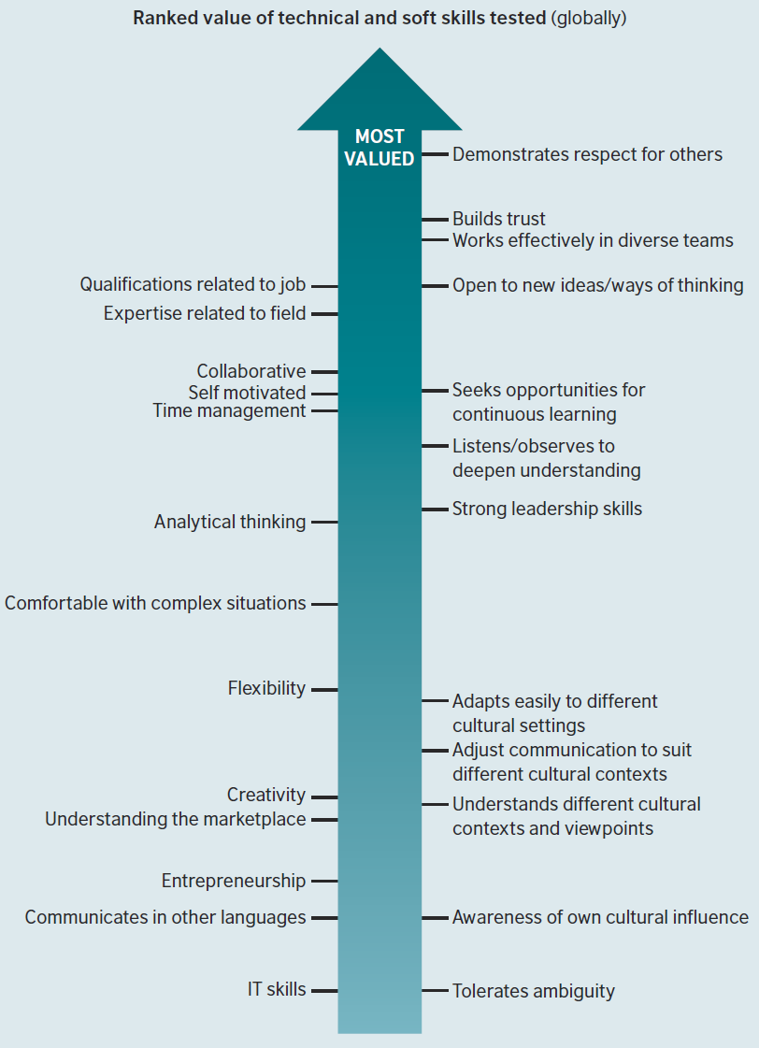
Technical and soft skills sought by Industry Globally
British Council, 2012

Slide 9
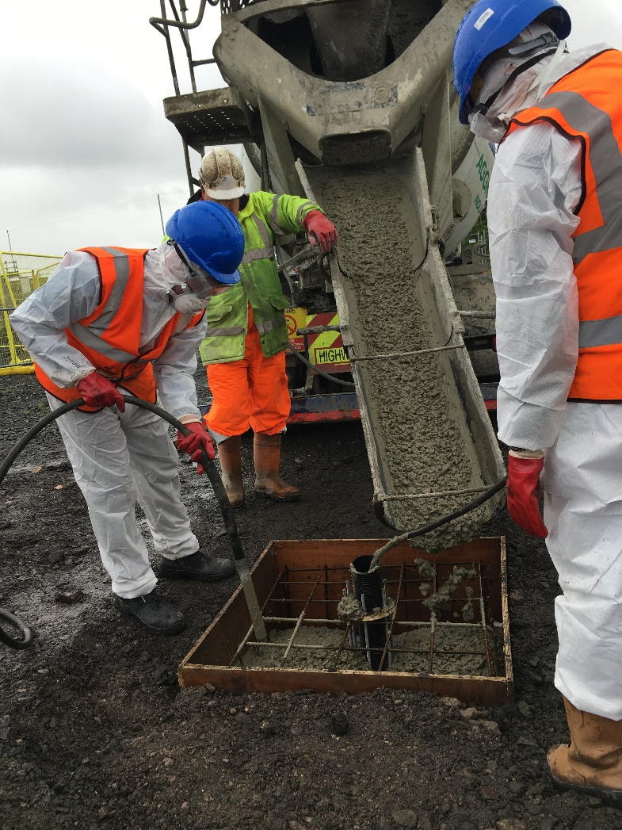
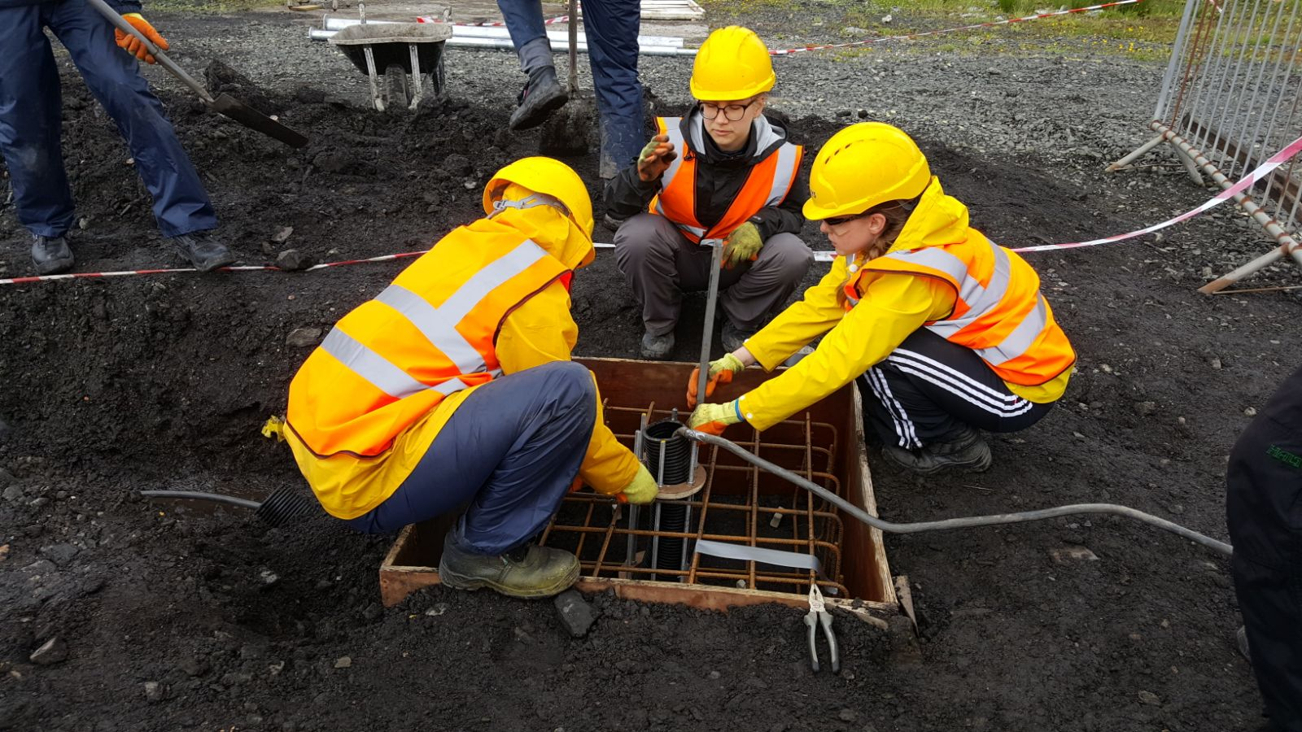
Wind turbine foundation development

Slide 10
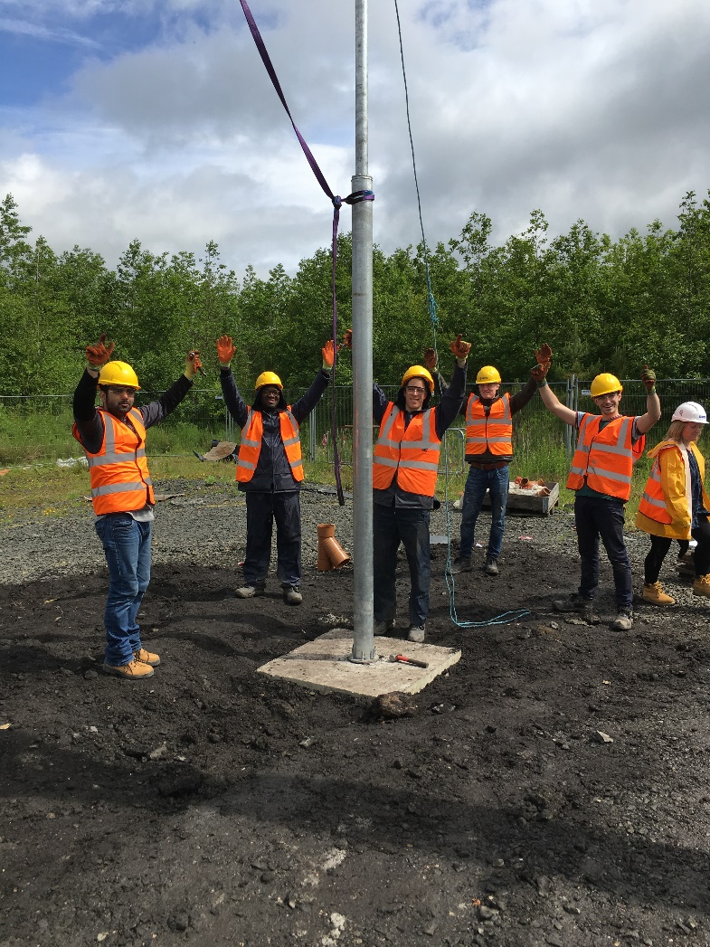
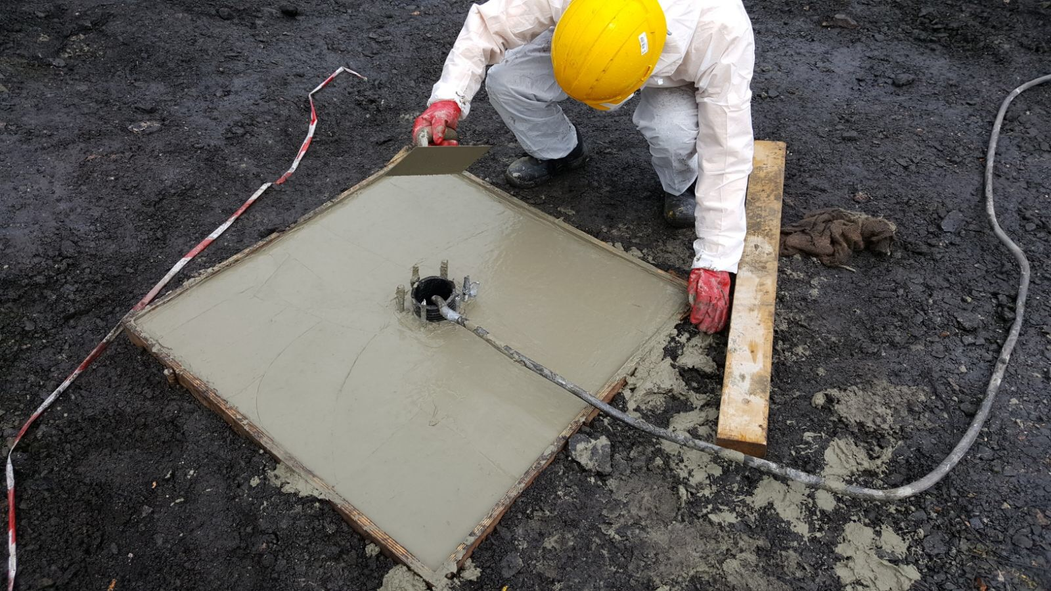
Foundation completion and erection of tower

Slide 11
Overall group task ISP2
Respond to a tender request to provide solar power chargers to a village in Kenya
Plan, cost, build and test a solar charger and battery
Use locked mobile phone to contact regional authority CEO (in Kenya)
Develop a sales presentation to be delivered by your group to the CEO

Slide 12
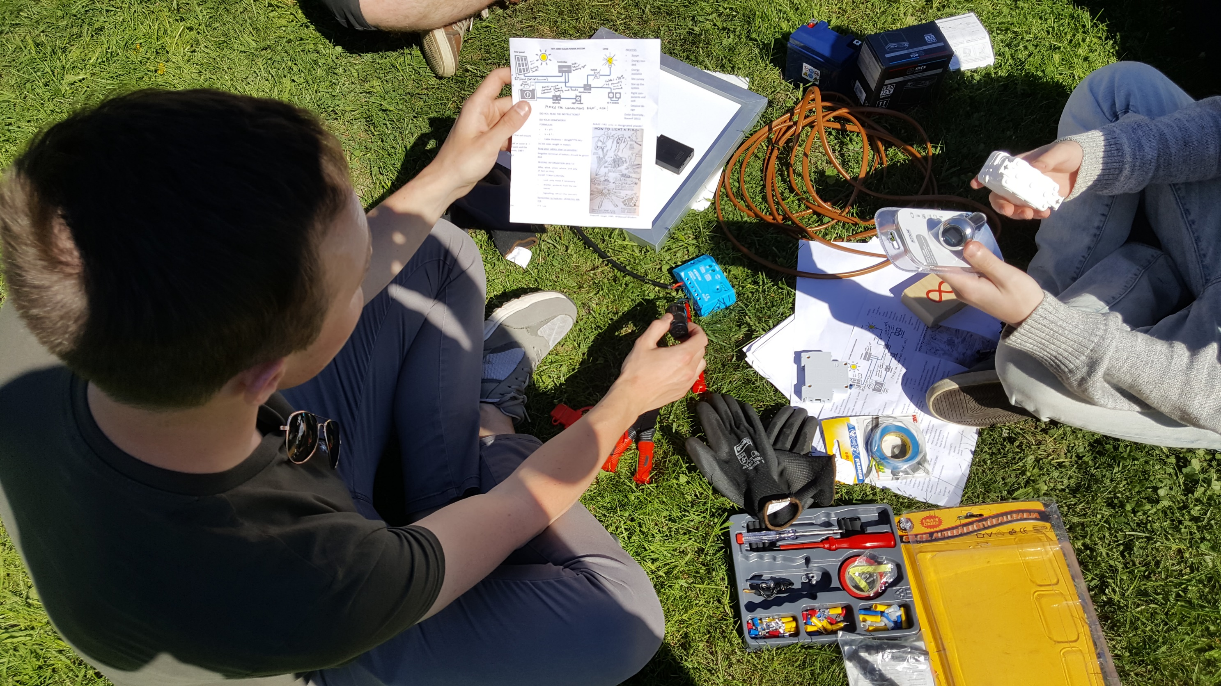
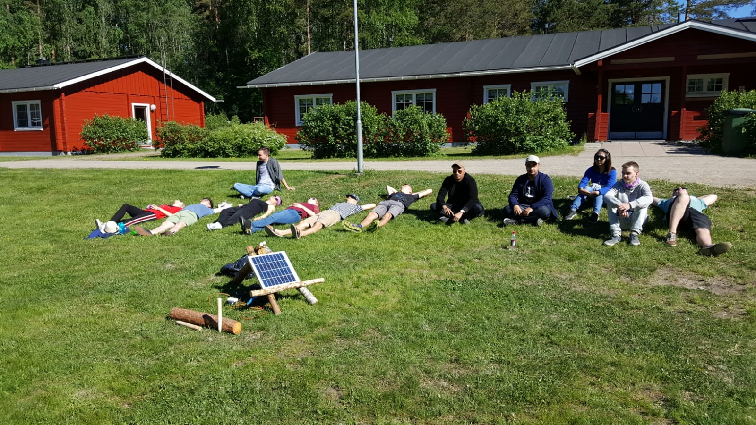
Setting up solar charger

Slide 13
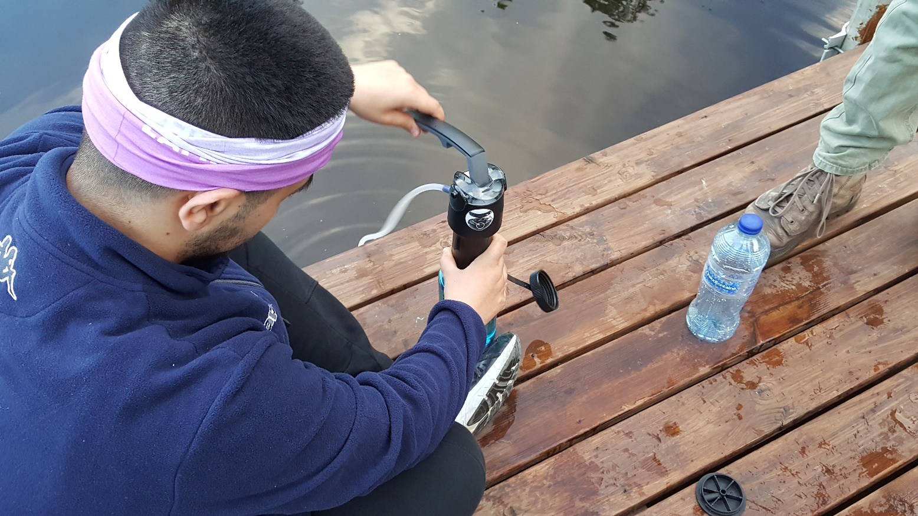
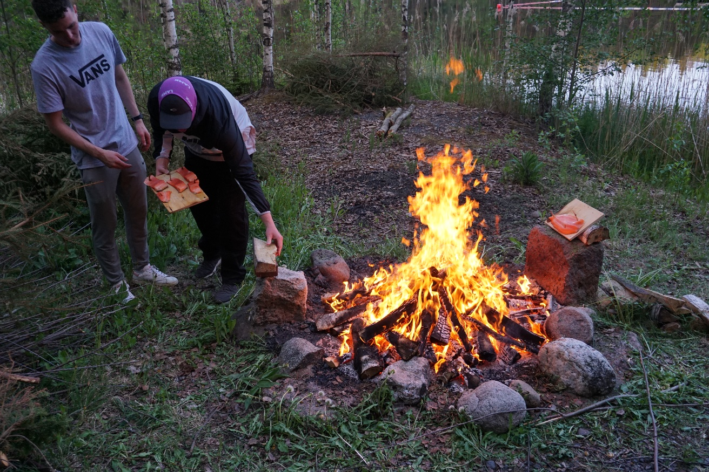
Making water potable and cooking salmon

Slide 14
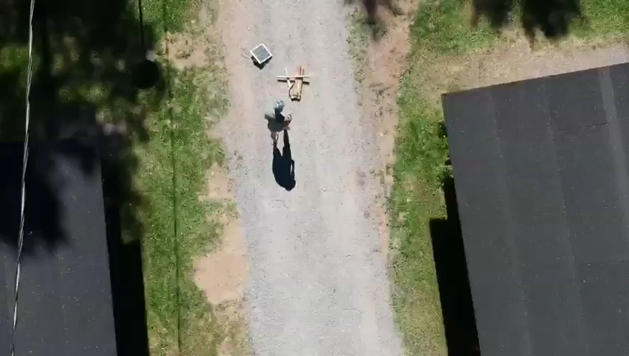
Student video advert

Slide 15
Pressurised learning?
At 12 noon on Thursday initial target of Friday 9am for completion of team Bids brought forward to 5pm Thursday
At 5pm after submission of Bid, teams informed change of plan and that 1 combined bid required by 9am Friday.
Friday 9am combined presentation (instead of 3 groups)

Slide 16
Using STAR(R) to answer questions
(eg interview situation):
Situation: when/where – set the scene
Task: the goal, aim or challenge
Action: what you did/your role
Result: the outcome
Reflection: what did I learn

Slide 17
Student International Competencies Assessment App
Insert weblink or …..
Scotland

Slide 19
Enhanced Student Experience?
Industry informed course development (5 ECTS)
International, multicultural and interdisciplinary experiences
Interactive teaching and learning
Feedback throughout the course
Development of graduate attributes – eg confidence, team responsibility
Improved employability
Fun learning environments
Improved overall student satisfaction (NSS) ?
Staff development
Scotland

Slide 20
Conclusions
A unique project with a wide variety of learning environments
Students challenged to step outside their comfort zone
Students encouraged to reflect on own performance and how they engage with others
Close working with other disciplines, nationalities and cultures enhances the learning experience of students and staff
Reviewed and enhanced for next year
Scotland

Slide 21
Student comments
“Really challenged me in a positive way”
“It was a really great opportunity which helped me to improve my self-confidence and skills, since I have never done anything like this before. It was a good way to get myself out of my comfort zone and experience new things. It was also a lot of fun and I enjoyed getting to know other people.”
“The best experience I’ve ever had!” (at University)
Scotland

