Slide 1
Ultrasound of the Foot and Ankle: Sonoanatomy

Slide 2
Bony landmarks
https://commons.wikimedia.org/wiki/File%3A812_Bones_of_the_Foot.jpg
By OpenStax College [CC BY 3.0 (http://creativecommons.org/licenses/by/3.0)], via Wikimedia Commons

Slide 3
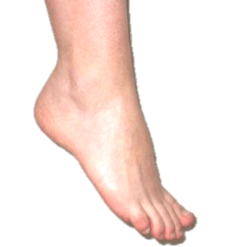
Ankle
Linear probe: 8 - 10 MHz
knee in flexion, foot flat on the examination bed
probe placed on the midline of the ankle joint transverse to the line passing through the lateral and medial malleolus

Slide 4
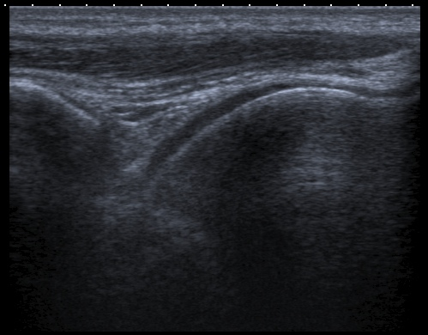
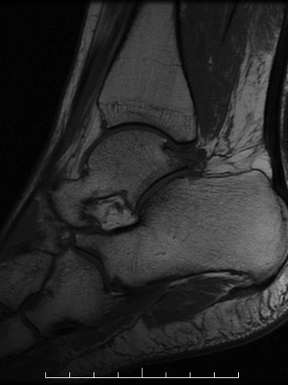
Ultrasound of ankle (Longitudinal)
tibialis anterior tendon/muscle
joint capsule
tibia
talus
Longitudinal Axis

Slide 5
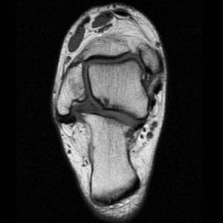
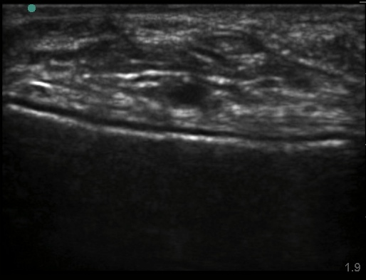
Ultrasound of ankle (Transverse)
Extensor digitorum longus
Extensor hallucis longus
Tibialis anterior
Vessel
joint capsule
talus
Transverse Axis

Slide 6
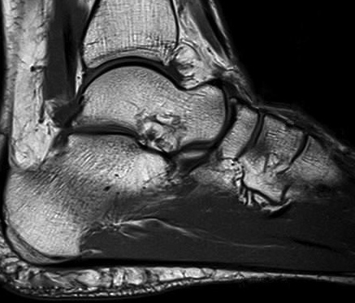
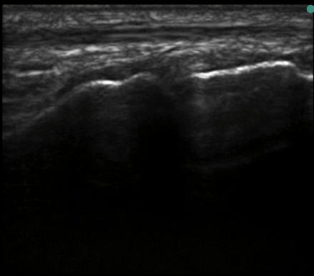
Ultrasound of talonavicular joint
Extensor hallucis longus tendon
joint capsule
Talus
Navicular
Longitudinal Axis

Slide 7
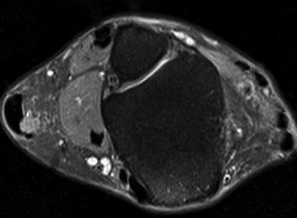
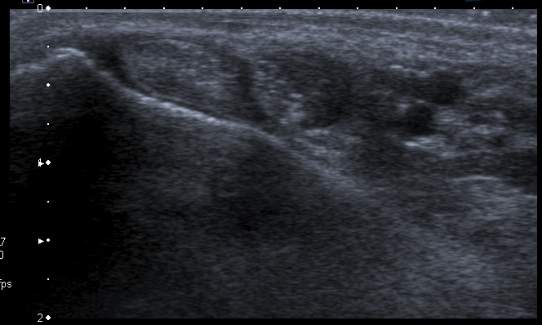
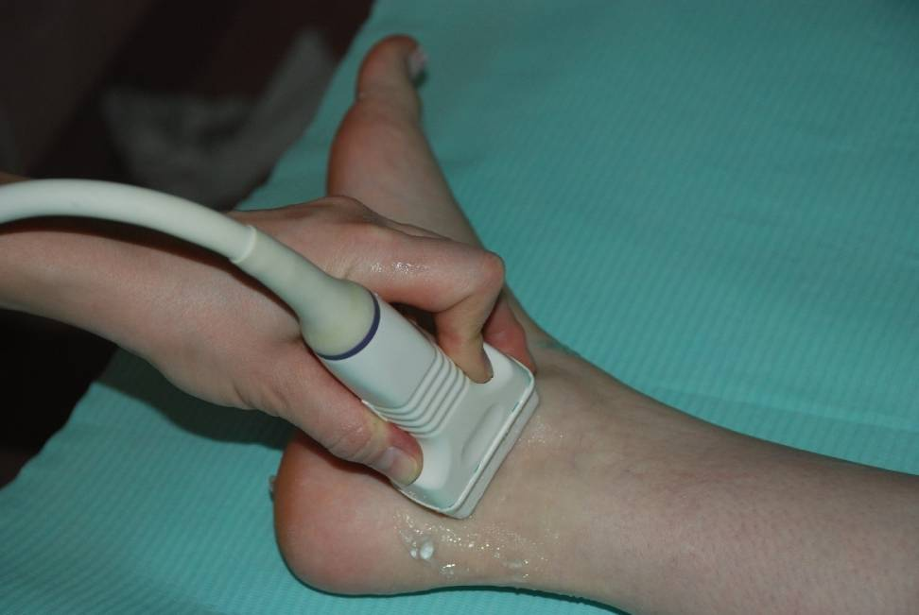
Ultrasound of ankle (medial aspect)
tibialis posterior
flexor digitorum longus
tibial nerve and vessels
medial malleolus
Transverse Axis

Slide 8
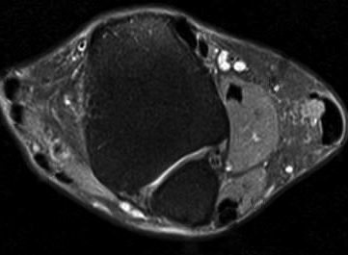
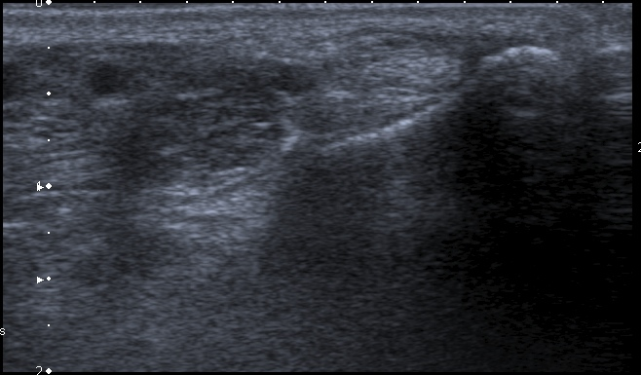
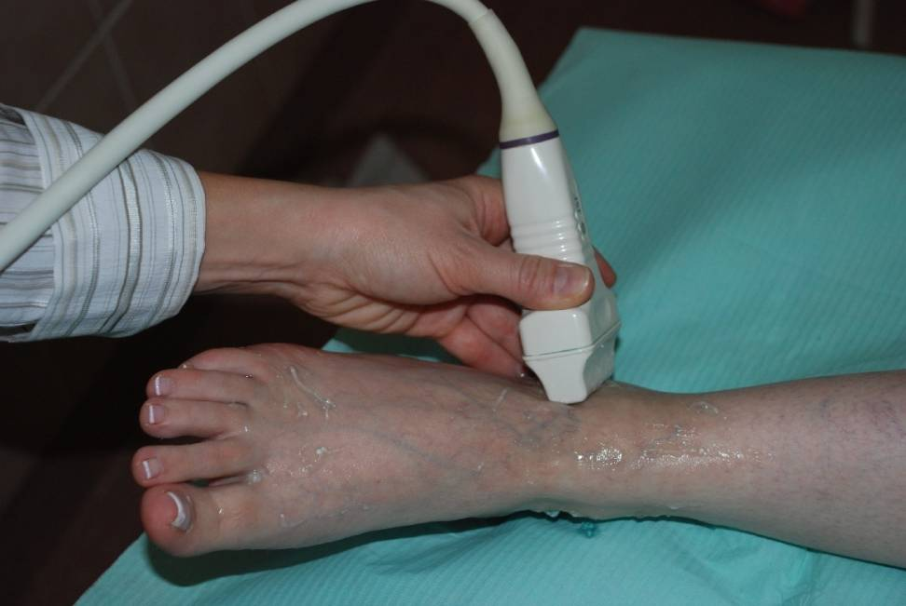
Ultrasound of ankle (lateral aspect)
peroneus longus tendon
peroneus brevis tendon
peroneus brevis muscle
lateral malleolus
Transverse Axis

Slide 9
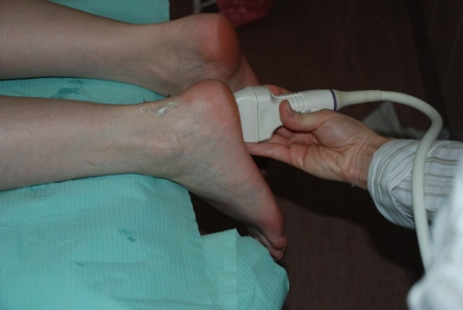
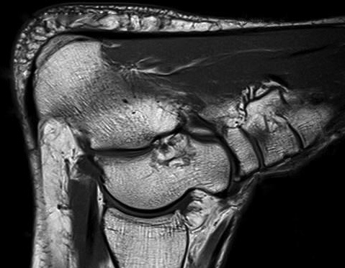
Plantar fascia
Plantar fascia
Calcaneum
Linear probe: 4-10 MHz
Longitudinal Axis

Slide 10
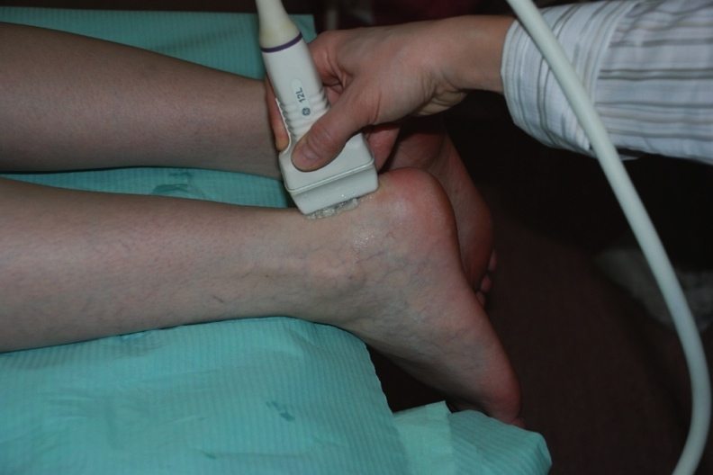
Ankle anatomy: Achilles tendon
Achilles tendon
Retrocalcaneal bursa
Calcaneum
Longitudinal Axis
Linear probe: 10-18 MHz

Slide 11
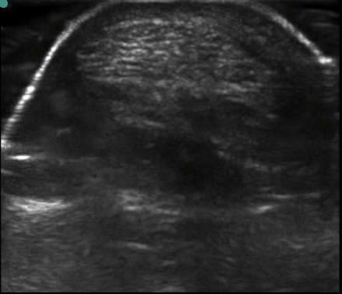
Ankle anatomy: Achilles tendon
Achilles tendon
Transverse Axis

Slide 12
Metatarsophalangeal joint (MTP)
Linear probe: 10-18 MHz
knee in flexion, foot flat on the examination bed
probe placed on the transverse line passing through the MTP joints
slide the probe up and down passing over the joint space

Slide 13
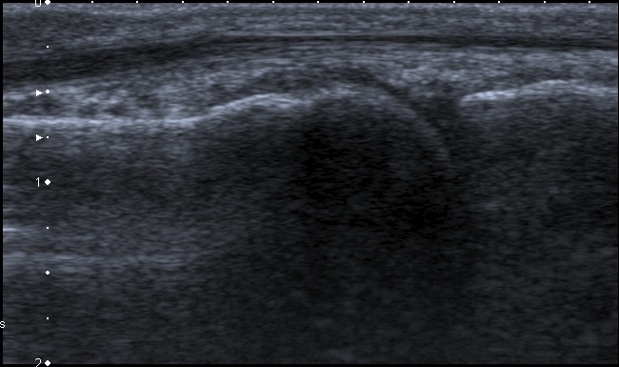
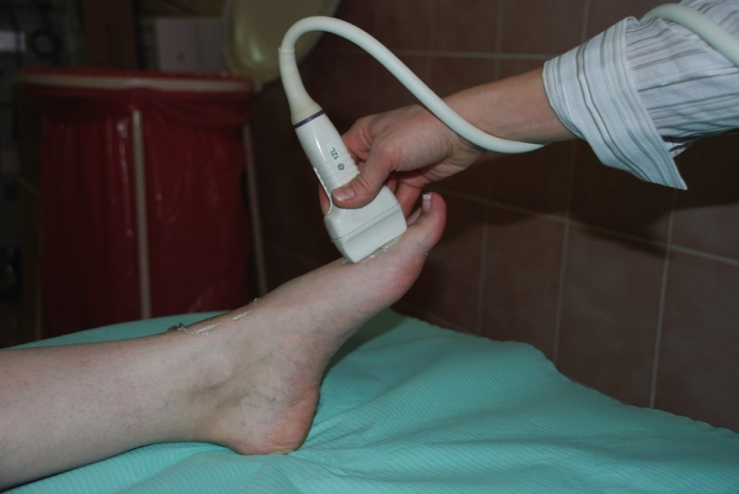
Ultrasound of MTP joint
Extensor tendon
Joint capsule
Metatarsal head
Proximal phalanx
Longitudinal Axis

Slide 14
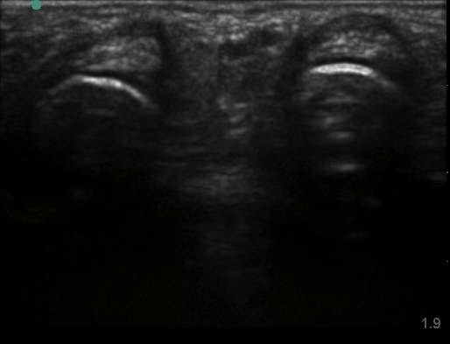
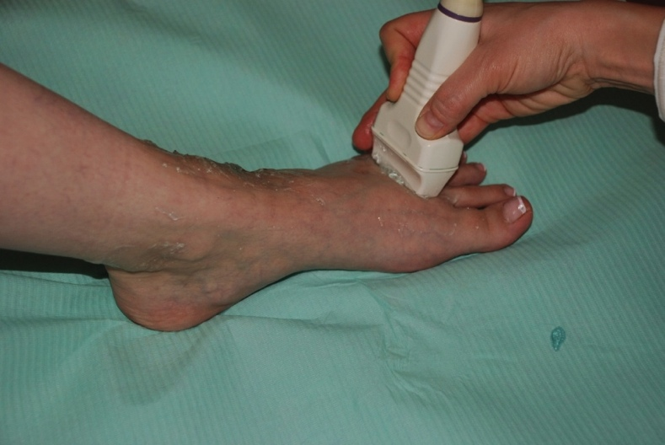
Ultrasound of MTP joints
Extensor tendon
Extensor tendon
Joint capsule
Joint capsule
Metatarsal head
Metatarsal head
Transverse Axis

Slide 15
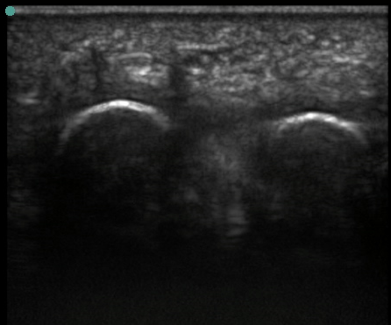
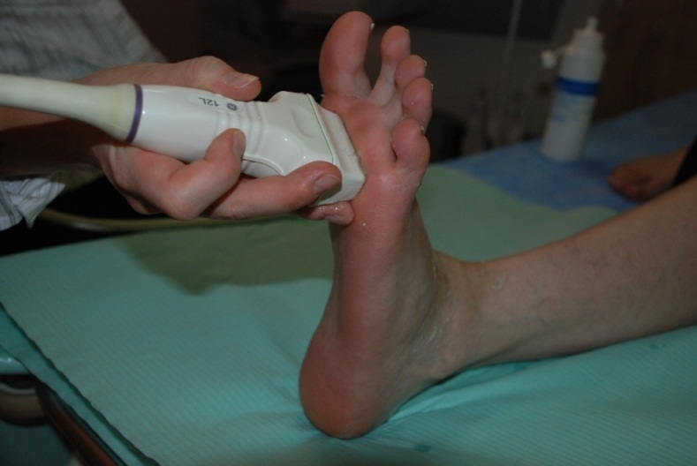
Ultrasound of MTP joints
Plantar approach
Flexor tendon
Plantar plate
Flexor tendon
Joint capsule
Joint capsule
Plantar plate
Metatarsal head
Metatarsal head
Transverse Axis

Slide 16
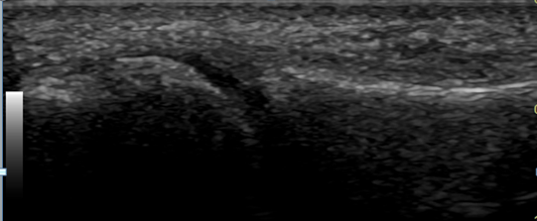
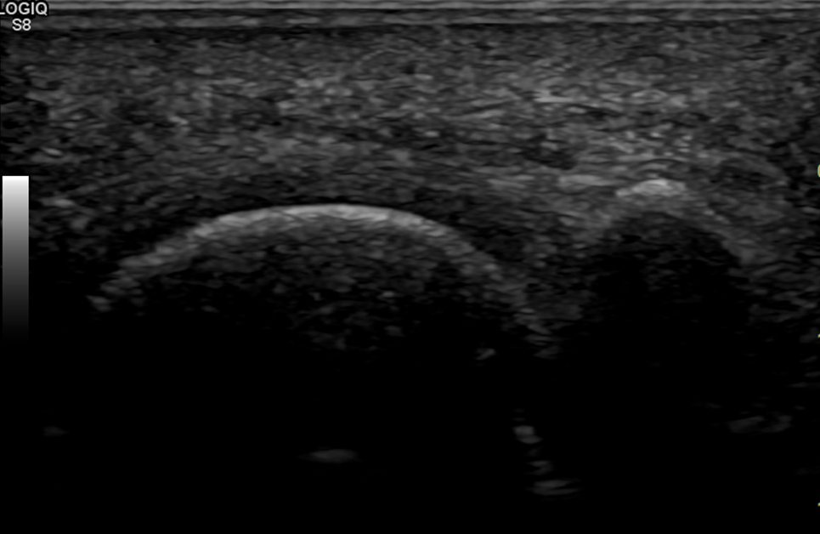
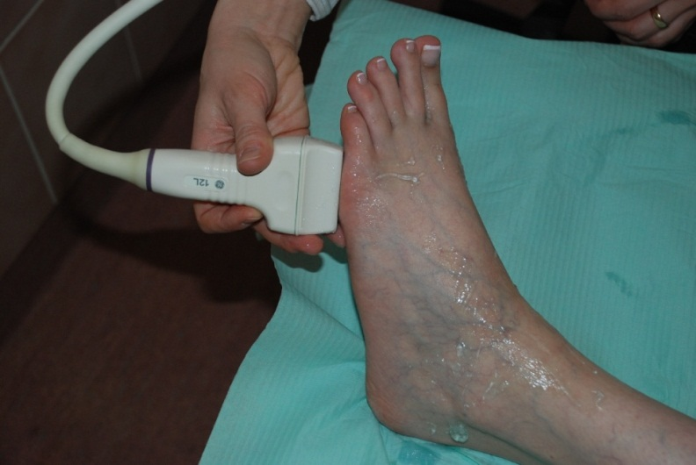
Ultrasound of MTP joints
Lateral and Plantar Approach
Flexor tendon
Joint capsule
Plantar plate
Metatarsal head
Joint capsule
Proximal phalanx
Proximal
phalanx
Longitudinal Axis
Metatarsal head
Longitudinal Axis

