Slide 1
Getting set for Teaching & Teaching with Small Groups
Graduate Teaching Assistants Workshop, January 2019
Sheila MacNeill
Senior Lecturer, Academic Development: Digital Learning, Dept. of Academic Quality and Development

Slide 2
Session Overview
Part 1 - Getting set
Part 2 – Teaching with Small Groups

Slide 3
Part 1 Aims
By the end of this session you should:
Be aware fully of your (potential) teaching commitments and expectations.
Feel more confident about starting teaching and have the basis for building your tool kit for teaching.
Begin an exploration of some potential approaches to enhance engagement through the use of technology.

Slide 4
Where are you now?
https://padlet.com/GCUAcademicDevelopment/startingout
Clarity, confidence, context
? – don’t be afraid to ask for help/advice

Slide 5
What will you (are you) be doing?
Individually take a minute to write down any known teaching commitments for this semester
In groups discuss what excites/challenges you most about these commitments (5 mins)
Collectively share 2 challenges and 2 shareable pieces of advice

Slide 6
https://extend.ecampusontario.ca/

Slide 7
Which one are you?
go to:
www.menti.com
use the code 92 17 93

Slide 8
Technology – could we live without it?
Photo by Dai KE on Unsplash

Slide 9
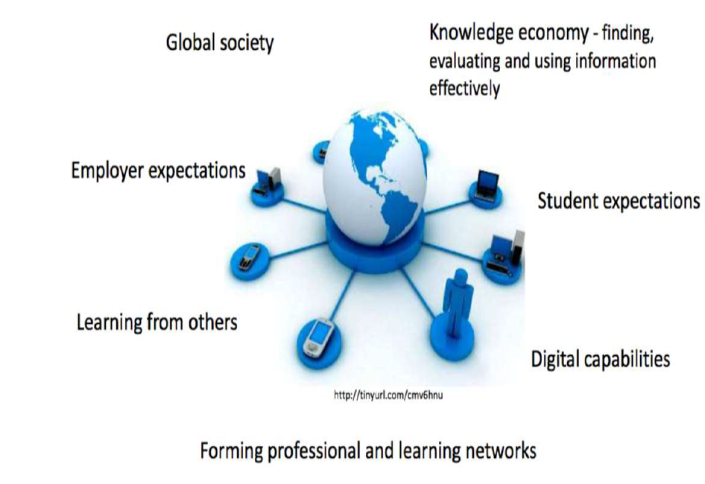
Why?

Slide 10
Digital Learning at GCU
developing creative approaches to learning, teaching and assessment through the effective use of technology on campus and online to enhance student engagement and enhance flexible access through a range of digital devices

Slide 11
Digital, blended learning at GCU
An approach which combines excellence in established modes of learning and teaching with the innovative use of learning technology
Face to Face (f2f)
Online
Digital blended

Slide 12
Digital Learning at GCU
Technology Enhanced – content + support (20%)
Some online resources & discussion groups or blogs to supplement classroom based teaching.
Technology Enabled – ‘wrap-around’ model (50%)
Technology combined with classroom activities to create a ‘blended’ model.
Includes online discussions, online activities, group work.
Technology dependent – integrated model (100%)
Entirely online community.
Collaborative working, peer support, tutor as facilitator.
Photo by Mike Petrucci on Unsplash

Slide 14
GCU Learn
https://padlet.com/GCUAcademicDevelopment/GCULearn

Slide 15
Part 2 Teaching With Small Groups
Photo by Nathan Dumlao on Unsplash

Slide 16
Aims
By the end of this session you should be able to:
Demonstrate knowledge of what constitutes small group working and how it can be used in higher education
Outline the potential benefits and challenges of small group working
Consider some of the skills for managing small group teaching
Participate and learn from involvement in a small group

Slide 17
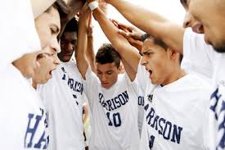
What is a small group?
Informal groups

Slide 18
Formal groups
Consciously created and organised, recruited for and put together by somebody for a specific aim
Members share:
common objectives, goals and rewards
have complimentary skills
are committed to a common purpose, performance goals, and approach
hold themselves mutually accountable for achieving these goals
the teacher becomes a facilitator
Planning is vital

Slide 19
What is the best group size?
Depends on context and nature of learning outcomes.
Consider size of whole class, available rooms and facilities
Passenger behaviour?
Personalities?
Subgroups?
Casting vote?
Avoidance behaviour?
Mixed abilities?

Slide 20
What is the best group size?
Group of 3: (Very popular)
Likelihood of passenger behaviour low
One member might feel marginalised
Vulnerable if one is often absent
Group of 4:
Can be split for subdividing tasks
Passenger behaviour possible
No possibility of ‘casting vote’
Group of 5:
Sufficient people for range of perspectives but still manageable
Increased risk of passenger behaviour →leader for each stage of work
Photo by rawpixel.com on Unsplash

Slide 21
Larger groups (6-10)
Still workable but needs careful management
Can be split into subgroups
Best for substantial tasks
Passengers might avoid contribution → outcasts
Shy members can be overshadowed
Skilled facilitator needed
Learning Teams
Select on prior experience, expertise and ability
Opportunity to benefit from each other’s divergent talent and skills
Often assessed
Takes careful organisation
PLANNING IS VITAL

Slide 22
Small Group Activity 1
Each group discusses a given topic
You have 5 minutes for the discussion
Agree on the 3 best points from your discussion and present them on the flipchart on your table
Appoint a presenter who feeds back your results to the class

Slide 23
Topics for discussion
Reflecting on your learning as a student . . .
Groups 1 & 4:
What have been the advantages of small group working for you?
Groups 2 & 5:
What have been the disadvantages of small group working for you
Group 3:
What skills should the ‘ideal’ facilitator have?

Slide 24
Why is small group learning important? (Group activity 2)
You have 10 minutes for the whole activity.
Discuss the question in your group.
Agree on the 3 best points from your discussion and present them on the flipchart on the table.
Appoint a presenter who feeds back your results to the class.

Slide 25
Why is small group learning important?
Learning from other people is the oldest, most natural and instinctive learning context we experience.
Learning can only be done by the learner not to the learner
Practises essential skills for research and employment:
Listening to others’ ideas sympathetically and critically
Thinking creatively and collaboratively
Building on others’ work
Managing time and processes effectively
Persevering in the face of adversity

Slide 26
The power of group work
https://www.youtube.com/watch?v=_woD1MH-dvA

Slide 27
What has been your experience with group work?
I don’t think I have ever had a good experience when working in a group. I have lots of horror stories, including people not turning up for presentations (where they had to be present), people waiting to the last minute, then putting pressure on me to help them get it done and finally, I fell out with a friend over our final year project and 4 years on we are till not talking.

Slide 28
What can go wrong? Conformity in groups : the Asch effect
https://www.youtube.com/watch?v=qA-gbpt7Ts8

Slide 29
Activity 3: Challenges of small group working
How can individuals sabotage a group?
You have 5 minutes for the discussion
Agree on the 3 best points from your discussion
Appoint a (different) presenter to feed back your results

Slide 30
An example of group work operating guidelines
Discuss the following points with the members of your group and tick those with which you ALL agree. Sign and date your copy
I will contribute and share my ideas equally with other team members.
I will listen to and value the ideas of other team members.
I will be open to new ideas and to different ways of working.
I will encourage other team members.
I will give feedback in the form of constructive criticism.
I will bring a positive attitude to teamwork in this project.
I will complete tasks assigned within the group on time.
I will attend all team meetings decided on by the group.
If delayed, I will advise the other members of the team in advance.
I will do my share of the work associated with the team project.
My contributions will equal (or exceed) others in quality.

Slide 31
What’s your role? Some essential skills for a facilitator (HEA, 2013)
Preparation matters
Set tasks ahead of the group work
Have clear aims for the session
Be enthusiastic and understanding
Be honest
Be a good listener
Be attentive
Be creative
Be reflective
Be a learner too !

Slide 32
How can individuals sabotage a team? (Group activity 3)
You have 10 minutes for the whole activity.
Discuss the question in your group.
Agree on the 3 best points from your discussion and present them on the flipchart on the table.
Appoint a presenter who feeds back your results to the class.

Slide 33
Group effort can bring out the best and the worst in people

Slide 34
References and sources of information
Exley, K. and Dennick (2004) Small group teaching: tutorials, seminars and beyond. Abingdon:Routledge
Higher Education Academy (2013) Small group teaching: a toolkit for learning
https://www.heacademy.ac.uk/resource/small-group-teaching-toolkit-learning
Jaques, D. (2004) Learning in groups: a handbook fort improving groupwork; London: Kogan Page
Race, P. (2015) Making small-group teaching work;
in: Race, P., The Lecturer’s toolkit, 4th edition, London: Routledge
http://phil-race.co.uk/making-small-group-teaching-work/
University of Sheffield, Toolkit for Learning and Teaching: Small group teaching
https://www.sheffield.ac.uk/lets/toolkit/teaching/smallgroup

