Slide 1
Giving Effective Feedback and Feedforward
Sheila MacNeill, Senior Lecturer Academic Development : Digital Learning, Dept. Academic Quality and Development
Graduate Teaching Assistants Workshop January 2019

Slide 2
Aims
By the end of this session you should be able to:
Define feedback in the context of learning and teaching
Recognise and apply feedback principles in learning and teaching practice
Start developing skills in giving and receiving feedback through practical activities
Make use of personal experiences of feedback to inform and enhance future practice

Slide 3
Activity 1
Identify one ‘memorable’ example of a time when you received feedback recently
Write a brief description of the feedback on a post-it note (e.g. written feedback on your PhD; verbal comment from friends/ family on a meal you made etc. )
Place the post-it under either the positive or negative columns on the flipchart)

Slide 4
What do you think of this feedback?
https://www.youtube.com/watch?v=4dWj8OhBxM4

Slide 5
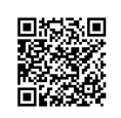
Activity 2: What is good feedback? Attempting a definition
Use only single words, or a short phrase, to describe what feedback is. Write your definition on the padlet wall.
http://bit.ly/2qn8M1s

Slide 6
Some definitions from the experts
“Feedback is when you receive comments about your work, so that you know how well your studies are going – and of course there’s the other side to this- so you know how badly your studies are going” (Race, 2008)
“So what exactly is feedback? Feedback is any response from a teacher in regard to a student’s performance or behavior. It can be verbal, written or gestural. The purpose of feedback in the learning process is to improve a student’s performance- definitely not put a damper on it. The ultimate goal of feedback is to provide students with an “I can do this” attitude. (Reynolds, 2013)

Slide 7
What is the purpose of feedback?
Confidence building: to give encouragement to students, help them improve their work further
Achievement: give students an idea of how well they have done in comparison to others
Performance improvement: can be used to provide individual students with information on how they can implement actions to improve performance and make a plan (feed forward)
Photo by Miguel Bruna on Unsplash

Slide 8
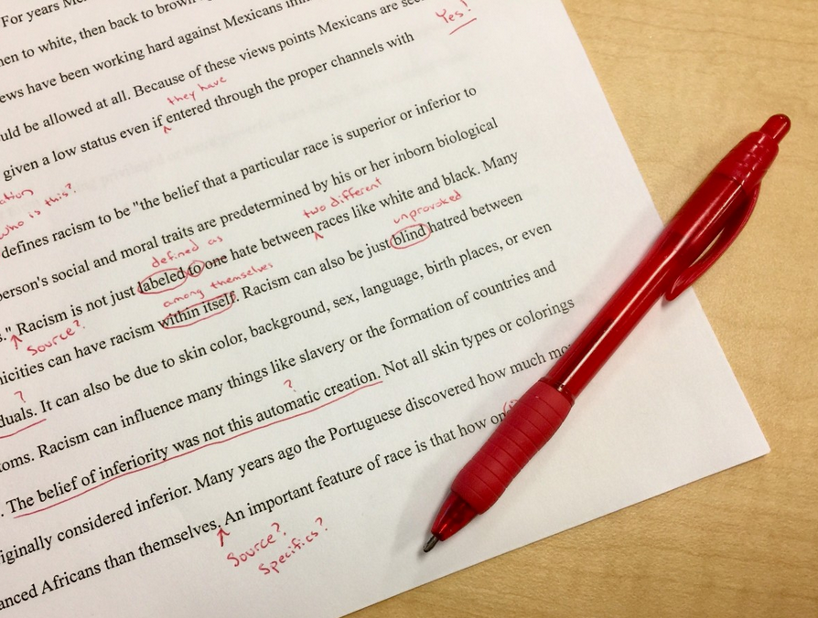
More reasons to give good feedback
Improve perception of strengths and weaknesses: enable students to identify their strengths and weaknesses within the given task
Correction: correct errors and point out information/ resources the student might have missed
Clarification and accountability: where feedback is used to demonstrate/ clarify how a specific grade/ mark was reached
Photo by Ben White on Unsplash
Photo: shutterstock

Slide 9
Bad feedback
Saps students’ confidence
Directs students’ activities in inappropriate directions
Fails to articulate with learning outcomes
Fails to relate clearly to evidence of achievement of assessment criteria
Relates only to what is easy to assess rather than what is at the heart of learning
Focuses on failings rather than achievements

Slide 10
Four strategies for giving good feedback (Gavan Watson, University of Guelph see video on GCU LEARN)
Good feedback has to be
Specific
Actionable
Timely
Respectful

Slide 11
What do the students expect?

Slide 12
NUS 10 Feedback Principles
Should be for learning, not just of learning Feedback should be primarily used as a learning tool and therefore positioned for learning rather than as a measure of learning.
Should be a continuous process Rather than a one-off event after assessment, feedback should be part of continuous guided learning and an integral part of the learning experience.
Should be timely Feedback should be provided in a timely manner, allowing students to apply it to future learning and assessments. This timeframe needs to be communicated to students.
Should relate to clear criteria Objectives for assessment and grade criteria need to be clearly communicated to, and fully understood by, students. Subsequent feedback should be provided primarily in relation to this.
Should be constructive If feedback is to be constructive it needs to be concise, focused and meaningful to feed-forward, highlighting what is going well and what can be improved.

Slide 13
NUS 10 Feedback Principles cont.
Should be legible and clear Feedback should be written in plain language so it can be easily understood by all students, enabling them to engage with it and support future learning.
Should be provided on exams Exams make up a high proportion of assessment and students should receive feedback on how well they did and how they could improve for the next time.
Should include self-assessment and peer-to-peer feedback Feedback from peers and self-assessment practices can play a powerful role in learning by encouraging reassessment of personal beliefs and interpretations.
Should be accessible to all students Not all students are full-time, campus based and so universities should utilise different technologies to ensure all students have easy access to their feedback.
Should be flexible and suited to students’ needs Students learn in different ways and therefore feedback is not ‘one size fits all’. Within reason students should be able to request feedback in various formats depending on their needs.
https://www.nus.org.uk/advice/course-reps/feedback-what-you-can-expect-/

Slide 14
Use appropriate language
Have you thought about /tried…?
I was wondering whether this would work better
It might be a good idea to … because / so that …
Maybe the next time you could also …
Another way to … is …
It might be useful to …
Have you considered…?
I don’t understand ………….

Slide 15
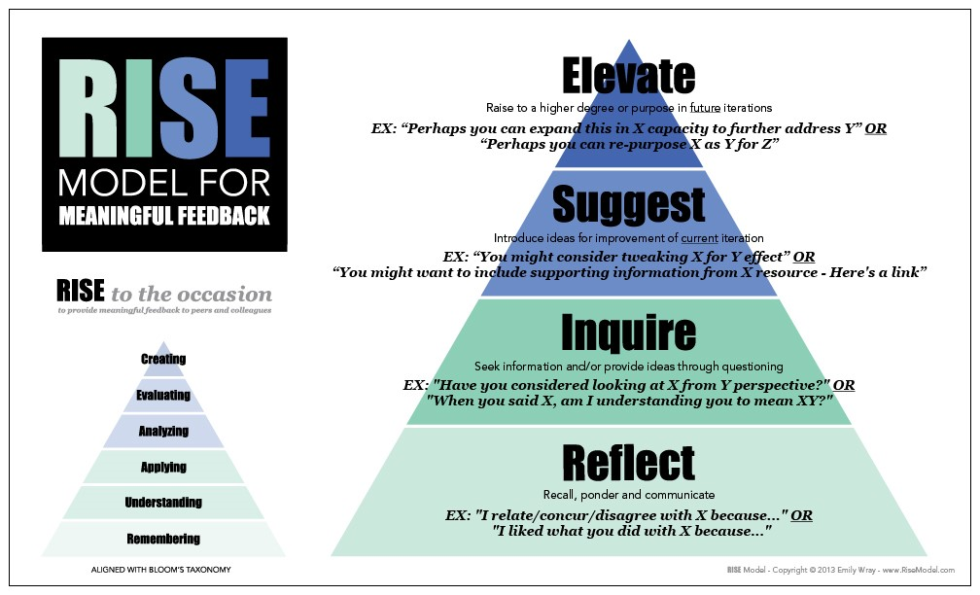
http://www.emilywray.com/rise-model/

Slide 16
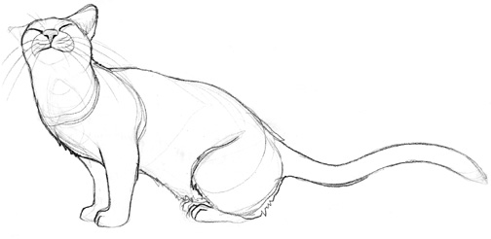
Activity 3: Practising different forms of feedback
Draw a cat in 2 minutes
Swap cat drawings with your neighbour
Take it in turns to give 2 different types of verbal feedback – firstly negative, then positive (1 min for each feedback )

Slide 17
How did you feel?
What feedback worked best?
What did not work?
How did it feel to receive positive/ negative feedback?
How did it feel to give the feedback?

Slide 18
GCU Feedback Principles
https://www.gcu.ac.uk/futurelearning/feedbackprinciplesgcu/

Slide 19
Activity 4
What are the main challenges with giving useful feedback?
Discuss in your group and present the results to the plenary.
You have 5 minutes for this activity.

Slide 20
The challenge of judgement (part 2)
Difficulties in assigning marks to assignments
Using assessment criteria and rubrics

Slide 21
The Biscuit Challenge
In your groups describe what a biscuit is (2 mins, 2 sentences)
Share and compare definitions
Look at the plate on your table – based on your definition does it contain any biscuits?
Agree criteria for: good, adequate, poor and unacceptable biscuits (create a matrix)
Share your matrix with another group and assess the remaining biscuits based on the other groups matrix

Slide 22
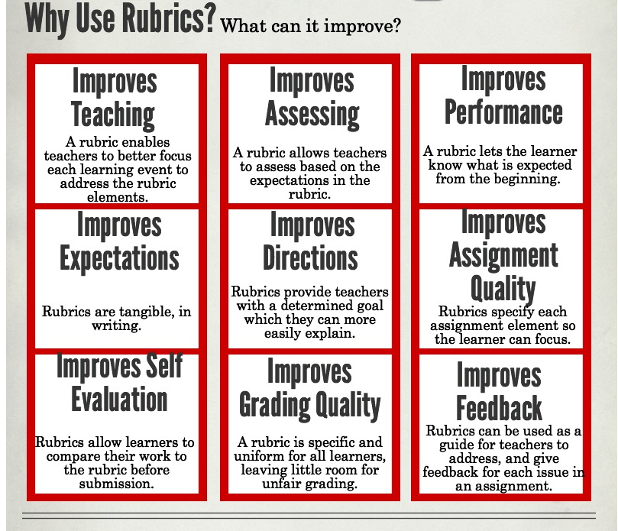
https://anethicalisland.wordpress.com/category/online-learning-infographics/

Slide 23
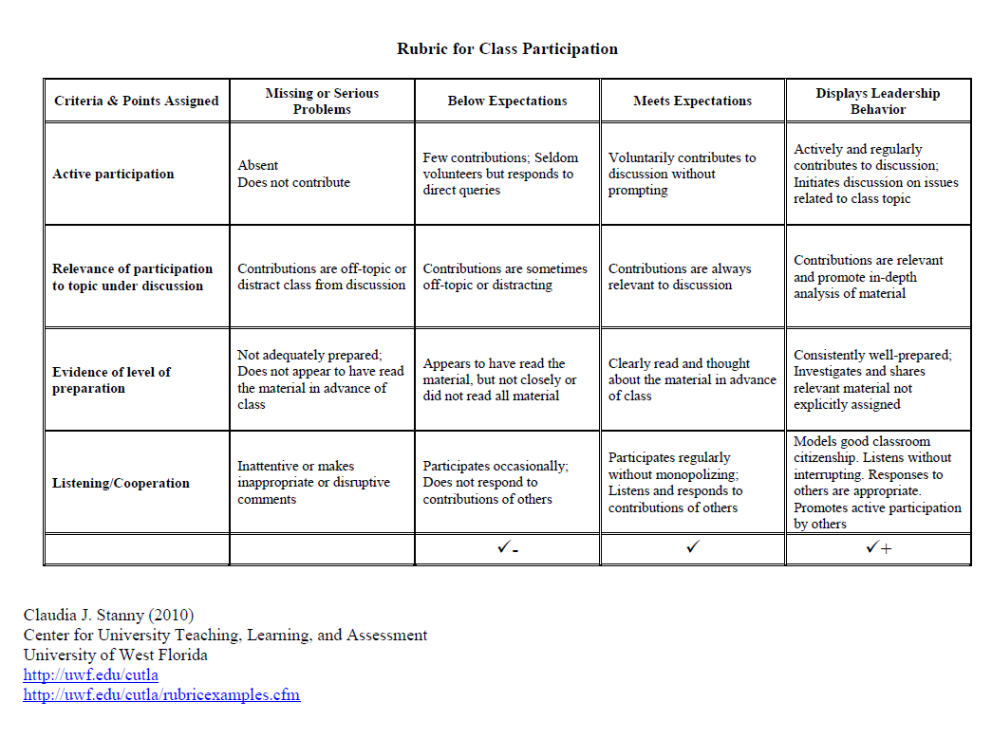

Slide 24
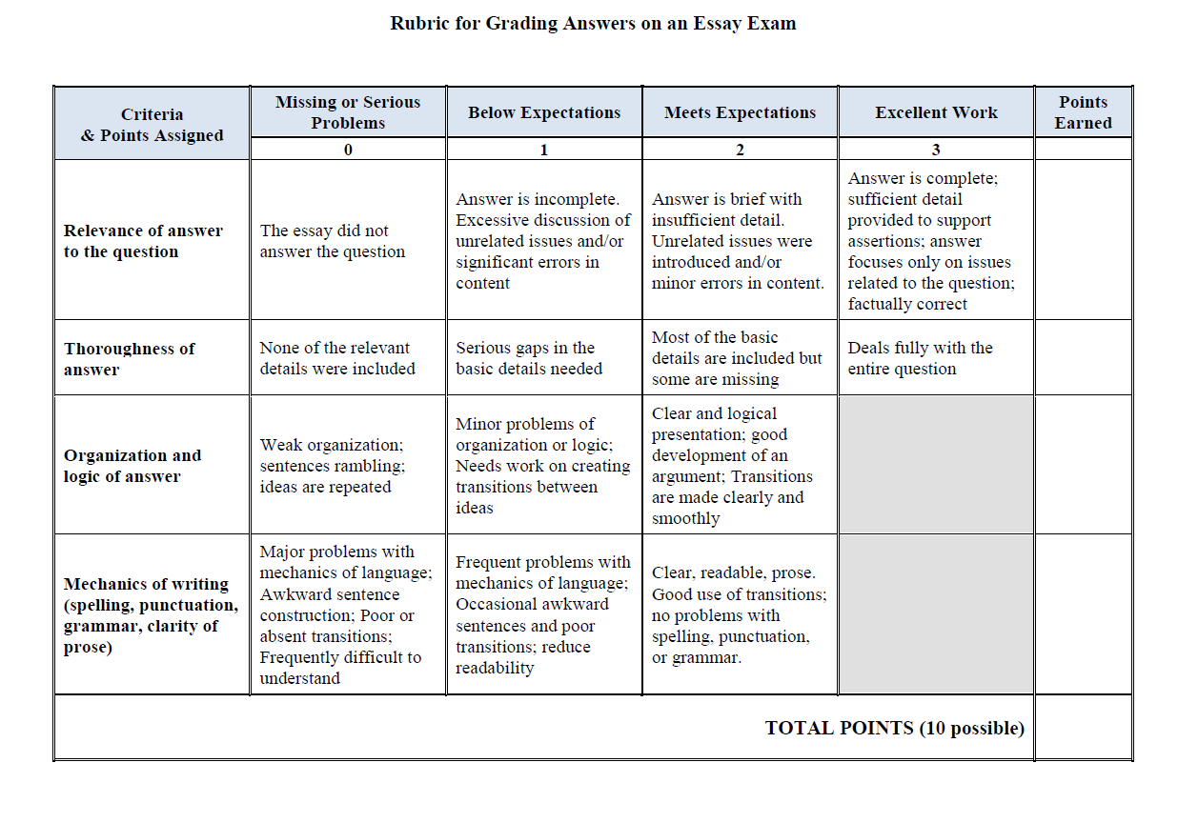

Slide 25
References and resources
Nicol, D.J. and MacFarlane-Dick, D. (2006), Formative assessment and self-regulated learning: a model and seven principles of good feedback practice, Studies in Higher Education, Vol. 31, No.2, April 2006, pp 199-218
Race, P. (2008) Using feedback to help students learn, Higher Education Academy
http://wap.rdg.ac.uk/web/FILES/EngageinFeedback/Race_using_feedback_to_help_students_learn.pdf
Reynolds, L. (2013) Giving student feedback: 20 tips to do it right
http://www.opencolleges.edu.au/informed/features/giving-student-feedback/
GCU Feedback for Future Learning
http://www.gcu.ac.uk/futurelearning/
Collated GCU assessment and Feedback policies and guidance
https://padlet.com/GCUAcademicDevelopment/assessment_feedback

