Slide 1
Marion Kelt
Copyright and images, or how not to be a pirate!

Slide 2
Online advice – anytime!
The new and improved GCU Online Copyright Advisor!
Try it!

Slide 3
Introduction
Copyright is a form of intellectual property that protects original literary, dramatic, musical and artistic works, as well as layouts or typographical arrangements of published work, sound recordings, film and broadcast.
There is no formal registration procedure for copyright; a work is protected as soon as it is in a permanent or fixed form.
More than one person can own copyright on a resource.
Infringement of copyright occurs when someone takes either all of a work, or a substantial part of it, without permission.
Soetendorp, R., Meletti, B. Education. http://copyrightuser.org/ Available under a CC-BY 3.0 License

Slide 4
Worth a thousand words?
We all need to use images in our teaching, especially in Health and Life Sciences.
You may be the creative type, and generate your own, but today I am going to concentrate on reusing images.
Under the exceptions to copyright law you can use any type of material for teaching purposes.
You have to meet three conditions:
  The purpose of the use is non-commercial
  Where practical, there should be sufficient acknowledgement of authorship of the work
  The use of the material is fair

Slide 5
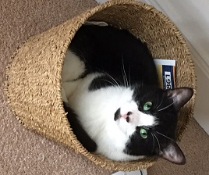
One that I made earlier …..
I took this photo, so can share it!

Slide 6
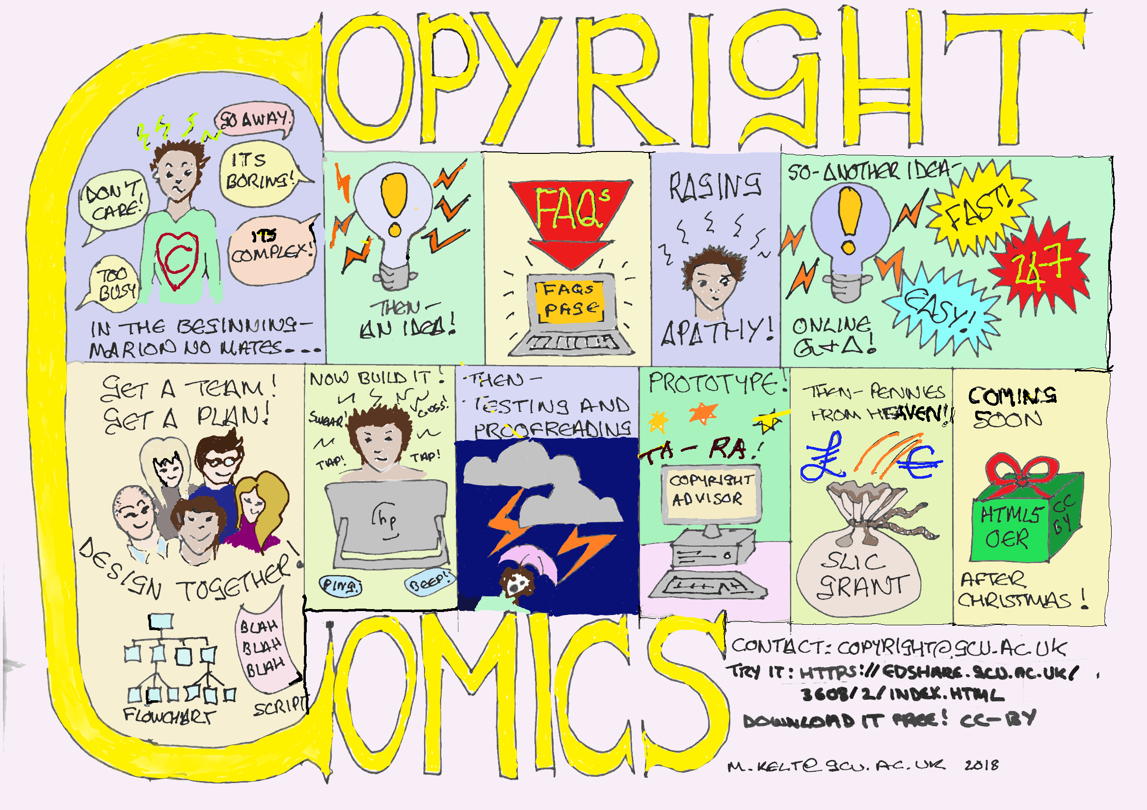
Another one I made earlier
I made this too, so OK to use it….

Slide 7
Is education commercial?
A tricky question for a Friday!
However, for the purposes of copyright law, Higher Education in Scotland is seen as a non-commercial enterprise.
This is an interesting question to debate, but let’s stick with this definition!

Slide 8
What is sufficient acknowledgement?
Don’t panic! This is not turning into a referencing session.
Here is a simple format for crediting media items:
Type of content: Title by Author. Link (Licence)
  For example:
  Image: The Thinker by John Smith. http://commons.wikimedia.org (CC-BY-SA-3.0)

Slide 9
What is fair use?
There is no legal definition of what is fair or unfair in this context.
It is an issue decided by courts depending on a number of factors, such as the amount of the work taken and whether the use would commercially compete with the copyright owner’s exploitation of the material.
According to the UK government 'minor uses, such as displaying a few lines of poetry on an interactive whiteboard, will be permitted, but uses which would undermine sales of teaching materials will still need a licence'.
In short:
  Use only as much as needed to make your point
  Only use images for teaching purposes, not to cheer up a session!

Slide 10
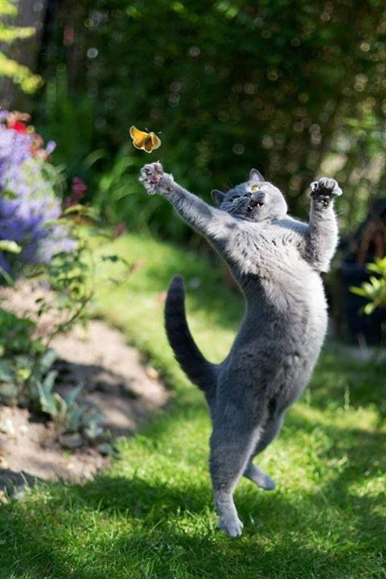
Not a fair use …..
Why?

Slide 11
So what if I want to use images I find on the web?
Warning! Not everything on the web is meant for sharing!
This is where the licensing or terms and conditions part comes in.
Many photographers and artists use Creative Commons licensing to specify what use can be made of their creations.
This is an international legally binding scheme which is complimentary to the copyright laws in each country (they vary!).
It uses components to specify what type of use can be made of the item, from very open (CC0) to very limited (CC-NC-ND-SA).
Over the next few slides I’ll explain…..

Slide 12
CC building blocks
CC = Creative Commons - Signifies a legally binding Creative Commons licence
BY = Attribution - You must cite the original source when reusing content
ND = No Derivatives - You must not alter or change the content when reusing it
SA = Share Alike - You must license your new resource under the same terms when reusing content
NC = Non-Commercial - You must not make commercial gain from your new resource when reusing content

Slide 13
Common licenses
CC0 Public domain licence, completely open
CC-BY lets you distribute, remix, tweak, and build upon a work, even commercially, as long as you credit the creator
CC-BY-SA lets you distribute, remix, tweak, and build upon a work, even commercially, as long as you credit the creator and license your new creations under identical terms
CC-BY-ND allows redistribution, commercial and non-commercial, as long as the content is passed along unchanged and you credit the creator
CC-BY-NC lets you distribute, remix, tweak, and build upon a work non-commercially, as long as you credit the creator

Slide 14
OK, so how does it work?
You can run a Google advanced search and specify by license type
Use a Creative Commons search
Use recommended websites – see our list at https://www.gcu.ac.uk/library/subjecthelp/findingandusinginformation/findingimages/

Slide 15
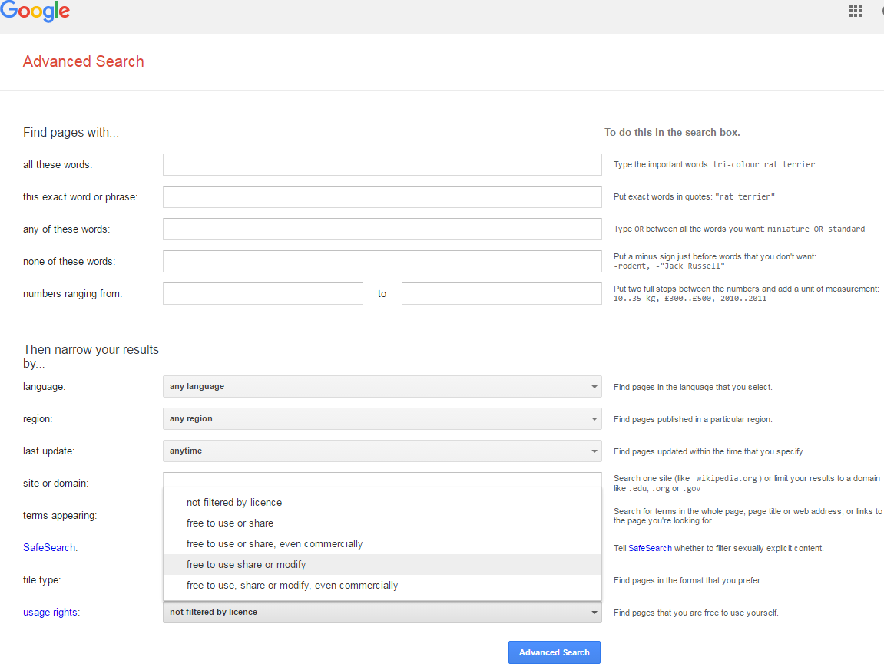

Slide 16
Where do I find a list of good websites to use?
We have made a list of good resources for you!
On the library web site at https://www.gcu.ac.uk/library/subjecthelp/findingandusinginformation/findingimages/
They are arranged into general, medical and fashion related sites.
We have included both open access and GCU subscribed services for you.
If you are not sure how to use an item, check the online copyright advisor or email copyright@gcu.ac.uk

Slide 17
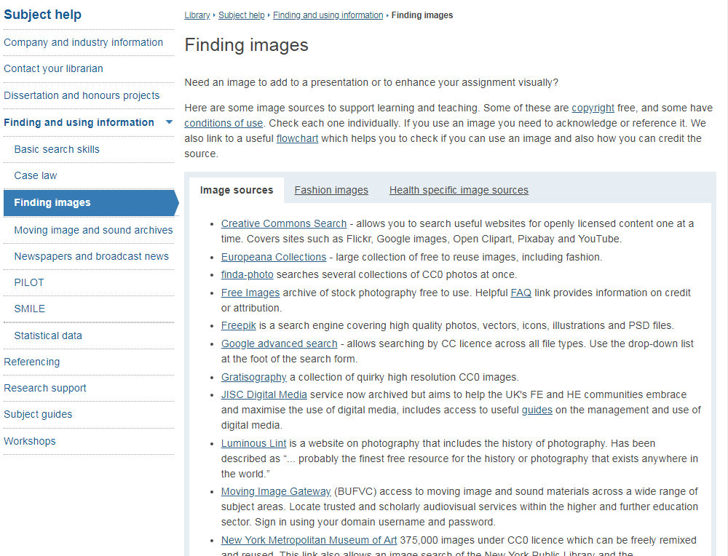
The web page ….

Slide 18
Thank you
Contact details and links:
http://gcu.ac.uk/library/servicesforstaff/copyright/
More detail and examples available at the Copyrightuser.org website
copyright@gcu.ac.uk

