Slide 1
An introduction to Open Educational Resources (OER)
Seth Thompson
Library Assistant
Collections and Discovery
Glasgow Caledonian University
seth.thompson@gcu.ac.uk
Twitter: @sthom_23
This work was created by Seth Thompson and licensed under a Creative Commons Attribution 4.0 International License

Slide 2
Personal introduction
Seth Thompson
Library Assistant
Collections and Discovery (Resource Management)
RGU graduate November 2018: Information and Library Studies
Worked at GCU Library for just over 4 years
2 years + in current role
Almost 2 years as a Library Assistant at Library Desk (student/service user support)
Prior to GCU Library, worked in health and fitness industry
Undergraduate degree in sport, health and exercise

Slide 3
Presentation contents
What are Open Educational Resources (OER)?
Origins of OER
Open Licenses
Why make educational resources open?
Issues relating to OER
How can libraries and librarians fit in with OER?
Opportunity for questions and discussion
Some examples of OER and where to find them

Slide 4
What are OER?
OER are teaching, learning and research materials in any medium, digital or otherwise, that reside in the public domain or have been released under an open license that permits no-cost access, use, adaptation and redistribution by others with no or limited restrictions.
UNESCO Paris Declaration (2012)
UNESCO (2011a; 2011b)

Slide 5
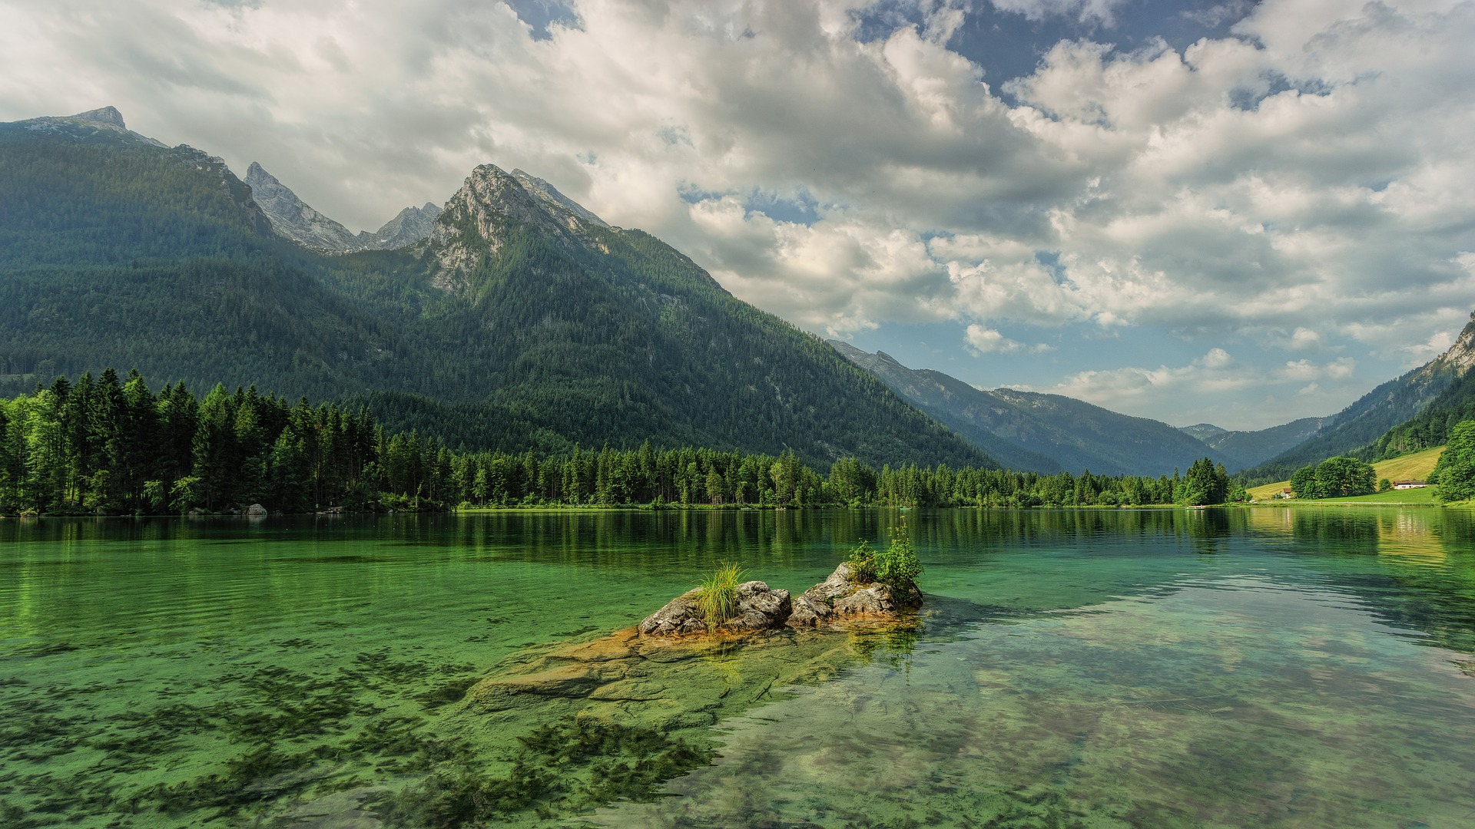
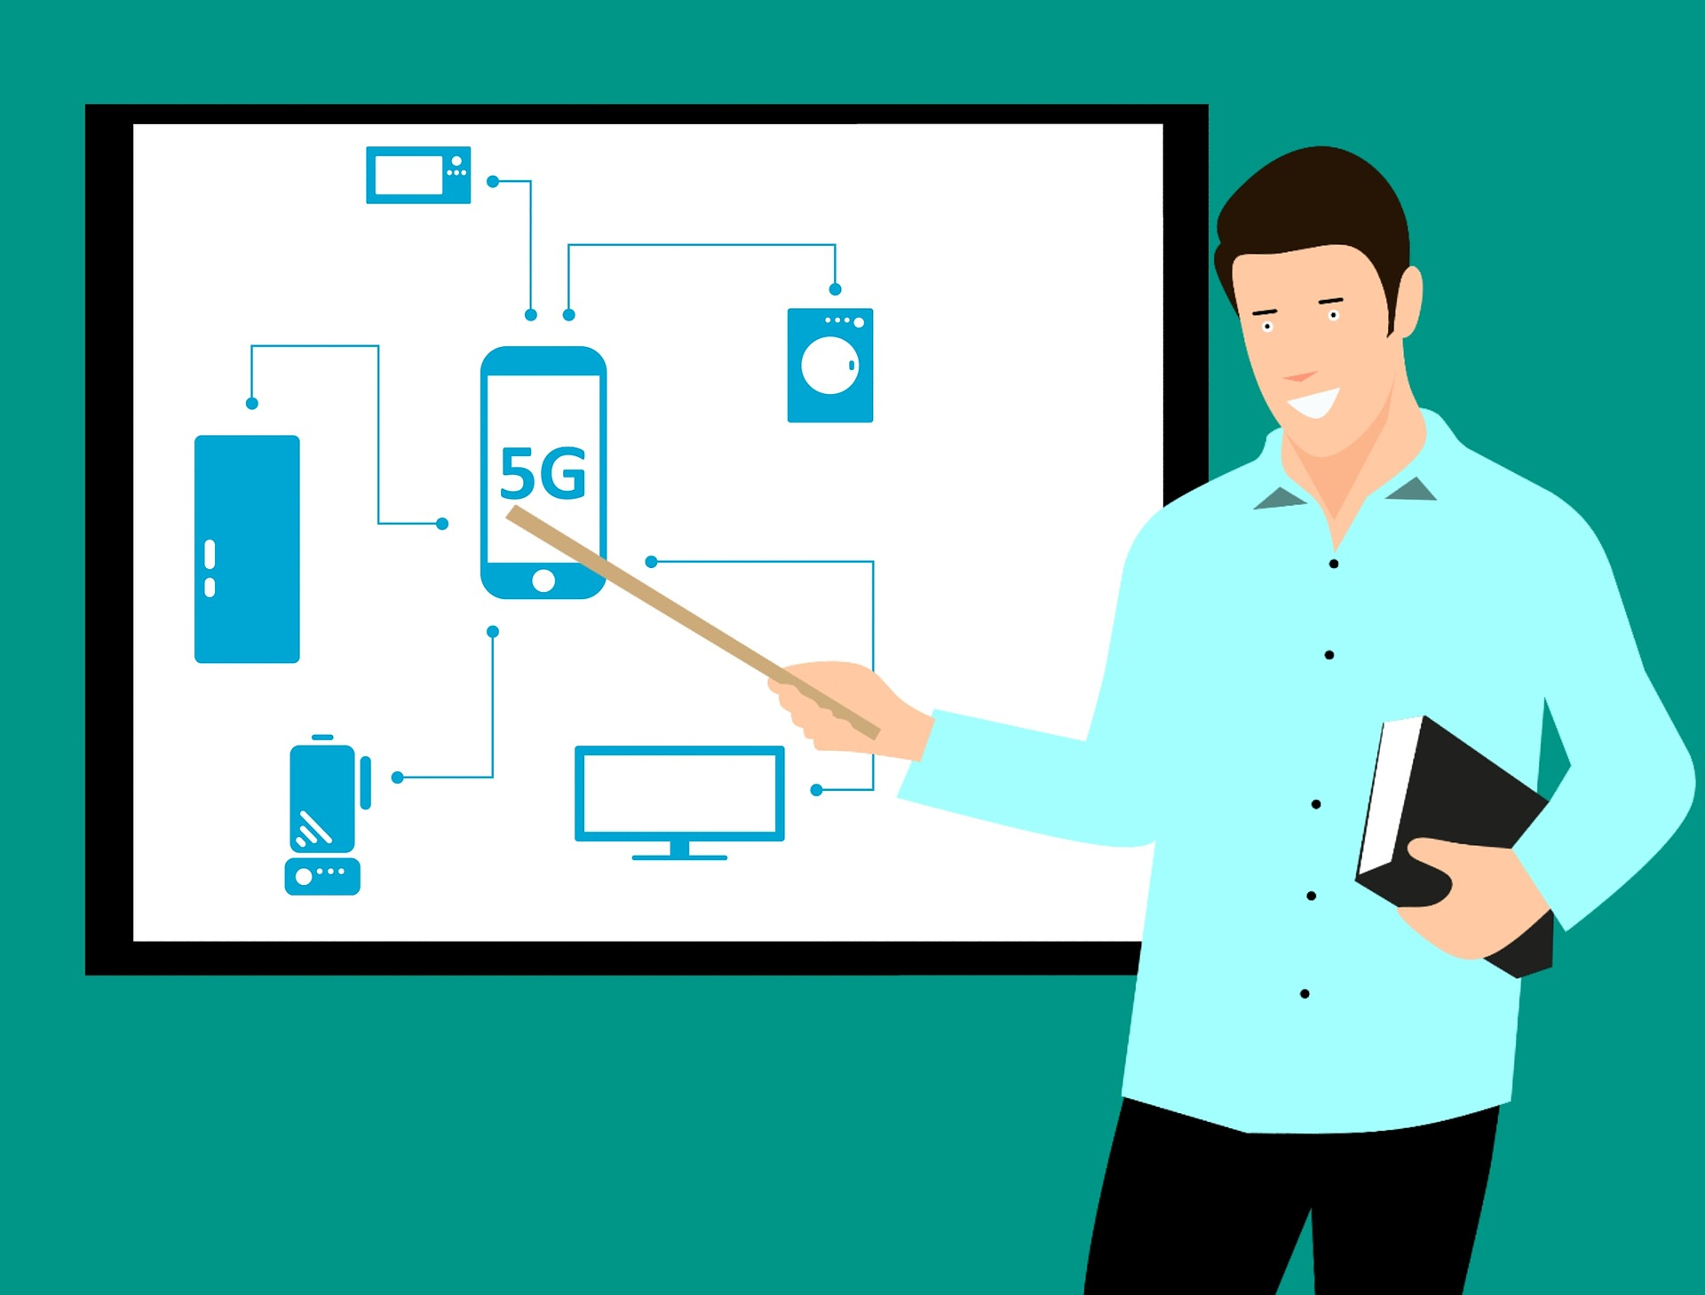
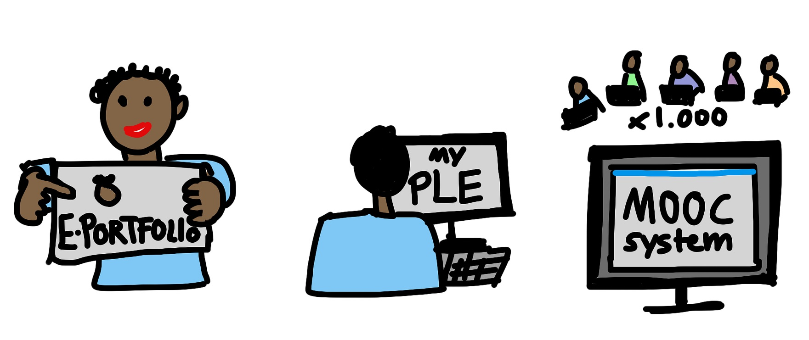
What are OER?
All images Pixabay Licensed. Free for commercial use. No attribution required.

Slide 6
What are OER?
The 5 Rs of OER
Retain- make, own, control
Reuse- wide ranging
Revise- adapt, adjust, modify, alter
Remix- combine, create new
Redistribute- share
(Wiley n.d., available from: http://opencontent.org/definition/)

Slide 7
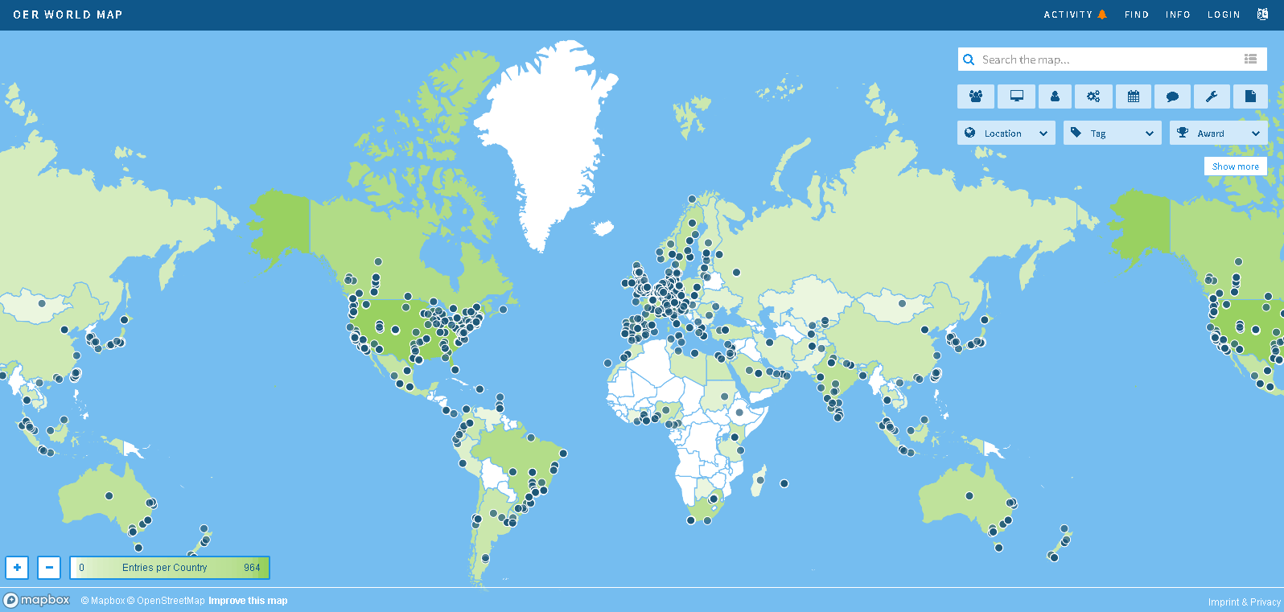
Before we discuss OER origins…
https://oerworldmap.org/
OER World Map. Licensed under a Creative Commons Attribution 4.0 International License

Slide 8
Origins of OER
USA
David Wiley, Utah State University – proposed license for free and open content (1998)
Massachusetts Institute of Technology (MIT) – OpenCourseWare (OCW, 1999)
(both Bliss, T J and Smith, M. 2017. In: Jhangiani, R. S. and Biswas-Diener, R. (eds.)

Slide 9
Origins of OER
UK
OER being developed by communities of enthusiasts
HEFCE funded programme (£16m) of development through the HEA and JISC 2008-2012
Open Scotland Education Declaration (2013)
OEPS Report (2017)

Slide 10
Open Licenses
Creative Commons Licenses
7 licenses with different level of openness
CCO- waive rights
CC BY- attribution
SA- share alike
NC- non-commercial
ND- non-derivatives
Creative commons license spectrum. Created by Shaddim and licensed under the Creative Commons Attribution 4.0 International License.

Slide 11
Open Licenses
Creative Commons Platforms. Creative Commons website. licensed under the Creative Commons Attribution 4.0 International License.

Slide 12
Why make educational resources open?
OER could:
Improve curricula
reduce cost
support educational transformation
UNESCO (2011b)
However… potential may depend on:
Use of peer review
OER contextualisation
Openness
OER as professional development
Student needs and inclusion in processes
Budgets
Correct acknowledgement
UNESCO (2011b)

Slide 13
Why make educational resources open?
JISC UKOER/SCORE Review of HEFCE funded OER projects:
Increased access
Improved pedagogy
Greater sharing
Increased confidence
Improved collaborative projects
Educator reflections
quality of learning materials
Enhanced digital literacies
McGill et al. (2013)
Motivations to adopt OER:
Reputation
Improve efficiency (cost, quality)
Open access
Pedagogy and student experience
Technological enhancement
McGill et al. (2013)

Slide 14
Why make educational resources open?
Weller et al. (2015)
Mixed method study- 21 surveys, 7,500 responses (both educators and students)
Positive impacts on student attitude and perception of learning
Authors acknowledge comparative data hard to identify
Similar findings to McGill et al (2013)
No evidence suggested OER use negatively impacting upon student performance

Slide 15
Issues relating to OER
A lack of awareness
OEPS
de Los Arcos et al. (2016)
???
???
???
Image Pixabay Licensed. Free for commercial use. No attribution required.

Slide 16
Issues relating to OER
???
Difficulties locating quality OER
de los Arcos et. al (2016), Hess et al. (2016)
Institutional repositories or wider social sites?
Atenas and Havemann (2014)
Rolfe (2016)
Multiple locations- increased availability and resilience
Nikoi and Armellini (2012)
???
???
Image Pixabay Licensed. Free for commercial use. No attribution required.

Slide 17
Issues relating to OER
Copyright and licensing
OEPS
de Los Arcos et al. (2016)
Copyright policy
Gadd and Weedon (2017)
conflicting copyright ownership information
global legal and cultural context confusion
shared resource ownership interests
ownership issues unresolved by UK copyright law
Image Pixabay Licensed. Free for commercial use. No attribution required.

Slide 18
Issues relating to OER
Institutional Policy
Corrall and Pinfield 2014; Mishra 2017; Nikoi and Armellini 2012; Reed 2012
Hard mandate or soft encouragement?
Policy a direct motivator? Maybe not…
Cox and Trotter (2016)
OER policy…
Image Pixabay Licensed. Free for commercial use. No attribution required.

Slide 19
Issues relating to OER
Institutional culture
Cox and Trotter (2016; 2017)
Image Pixabay Licensed. Free for commercial use. No attribution required.

Slide 20
Issues relating to OER
Sustainability
Financial
Annand (2015); Barrett et al. (2009)
The role of educators as creators- ‘a critical mass’
(Rolfe 2012)
Image Pixabay Licensed. Free for commercial use. No attribution required.

Slide 21
Issues relating to OER
The educators themselves
Reticence to share, fear of judgement, loss of control
Open educational practice a complex, personal and contextual decision- continually negotiated.
Cronin (2017); Rolfe (2012); Anderson (2010)
Benefit to career?
Browne et al. (2010)
Image Pixabay Licensed. Free for commercial use. No attribution required.

Slide 22
How can libraries and librarians fit in with OER?
Potential to play key roles in OER initiatives? (Borchard and Magnuson 2017; Smith and Lee 2017)
Librarian skill set transferable to OER
Advocacy, discovery, evaluation, preservation, curation (Okamoto 2013; Kleemeyer 2010)
Skill set inclusive of copyright?.. maybe not (Secker and Morrison 2016)
Librarians early adopters of technology (Allen et al. 2014; Cassner and Adams, 2012)
Challenges associated with this?

Slide 23
Thanks for listening!

Slide 24
Some examples of OER and where to find them
GCU UK Copyright Advisor
How to Google search for CC images (Tools, Usage rights)
Other good sites for copyright free images- Pixabay, Pexels
University of Edinburgh- Open.Ed
Textbooks- OpenStax, Open Textbook Library
MOOCs- OpenLearn

Slide 25
References
ALLEN, N., BELL, S. and BILLINGS, M., 2014. Spreading the word, building a community: vision for a national librarian OER movement. Against the Grain, 26(4), pp. 14-16.
ANDERSON, M.H., 2010. To share or not to share: is that the question? EDUCAUSE Review, 45(4), pp. 40-49.
ANNAND, D., 2015. Developing a sustainable financial model in higher education for open educational resources. International Review of Open and Distributed Learning, 16(5), pp. 1-15.
ATHENAS, J. and HAVEMANN, L., 2014. Questions of quality in repositories of open educational resources: a literature review. Research in Learning Technology, 22(1), 20889.
BARRETT, B., GROVER, V., JANOWSKI T., VAN LAVIERENA, H., OJOA, A. and SCHMIDTA, P., 2009. Challenges in the adoption and use of OpenCourseWare: Experience of the United Nations University. Open Learning, 24(1), pp. 31-38.
BLISS, T. J. and SMITH, M. 2017. A brief history of Open Educational Resources. In: JHANGIANI, R. S. and BISWAS-DIENER, R. eds. Open: the philosophy and practices that are revolutionizing education and science. London: Ubiquity Press. pp. 9–27.
BORCHARD, L. and MAGNUSON, L., 2017. Library leadership in open educational resource adoption and affordable learning initiatives. Urban Library Journal, 23(1), Article 1.
BROWNE, T., HOLDING, R., HOWELL, A. and ROWAY-DYER, S., 2010. The challenges of OER to academic practice. Journal of Interactive Media in Education, pp 1-15.
CASSNER, M. and ADAMS, K., 2012. Continuing education for distance librarians. Journal of Library & Information Services in Distance Learning, 6(2), pp. 117-128.

Slide 26
References
CORRALL, S. and PINFIELD, S., 2014. Coherence of “open” initiatives in higher education and research: framing a policy in agenda. In: iConference 2014 Proceedings. Berlin, 4-7 March 2014. pp. 293-313.
COX, G. and TROTTER, H., 2016. Institutional culture and OER policy: how structure, culture, and agency mediate OER policy potential in South African universities. International Review of Research in Open and Distributed Learning, 17(5), pp. 147-164.
COX, G. and TROTTER, H., 2017. An OER framework, heuristic and lens: Tools for understanding lecturers’ adoption of OER. Open Praxis, 9(2), pp. 151-171.
CRONIN, C., 2017. Openness and Praxis: Exploring the Use of Open Educational Practices in Higher Education. International Review of Research in Open and Distributed Learning, 18(5), pp. 15-34.
DE LOS ARCOS, B., CANNELL, P. and MCILLWHAN, R., 2016. Awareness of open educational resources (OER) and open educational practice (OEP) in Scottish higher education institutions: survey results: interim report. Edinburgh: Opening Educational Practices in Scotland.
GADD, G. and WEEDON, R., 2017. Copyright ownership of e-learning and teaching materials: policy approaches taken by UK universities. Education and Information Technologies, 22(6), pp. 3231-3250.
HESS, J.I., NANN, A.J. and RIDDLE, K.E., 2016. Navigating OER: the library’s role in bringing OER to campus. The Serials Librarian, 70(1-4), pp. 128-134.

Slide 27
References
KLEEMEYER, P., KLEINMAN, M. and HANSS, T. 2010. Reaching the heart of the university: libraries and the future of OER. In: Open ED 2010 Proceedings. Barcelona, 2-4 November 2010, UOC, OU, BYU, pp. 241-250.
MCGILL, L., FALCONER, I., DEMPSTER, J.A., LITTLEJOHN, A. and BEETHAM, H., 2013. Journeys to open educational practice: UKOER/SCORE review final report. [online]. JISC. Available from: https://oersynth.pbworks.com/w/page/60338879/HEFCE-OER-Review-Final-Report [Accessed 5 January 2017].
MISHRA, S., 2017. Open educational resources: removing barriers from within. Distance Education, 38(3), pp. 369-380.
NIKOI, S. and ARMELLINI, A., 2012. The OER mix in higher education: purpose, process, product, and policy. Distance Education, 33(2), pp. 37-41.
OKAMOTO, K., 2013. Making higher education more affordable, one course reading at a time: academic libraries as key advocates for open access textbooks and educational resources. Public Services Quarterly, 9(4), pp. 267-283.
REED, P., 2012. Awareness, attitudes and participation of teaching staff towards open content movement in one university. Research in Learning Technology, 20(4), 18520.
ROLFE, V., 2012. Open educational resources: staff attitudes and awareness. Research in Learning Technology, 20(1), 14395.
ROLFE, V., 2016. Web strategies for the curation and discovery of open educational resources. Open Praxis, 8(4), pp. 297-312.

Slide 28
References
SECKER, J. and MORRISON, C., 2016. From anxiety to empowerment: supporting librarians develop copyright literacy. ALISS Quarterly, 12(1), pp. 10-13.
SMITH, B. and LEE, L., 2017. Librarians and OER: cultivating a community of practice to be more effective advocates. Journal of Library and Information Services in Distance Learning, 11(1-2), pp.106-122.
UNESCO, 2011a. A basic guide to Open Education Resources (OER). Paris: UNESCO and Commonwealth of Learning.
UNESCO, 2011b. Guidelines for Open Educational Resources (OER) in Higher Education. Paris: UNESCO and Commonwealth of Learning.
WELLER, M., DE LOS ARCOS, B., FARROW, R., PITT, B. and MCANDREW, P., 2015. The impact of OER on teaching and learning practice. Open Praxis, 7(4), pp. 351-361.

