Slide 1
Marion Kelt
Copyright, edShare, OERs and sharing - or how not to be a pirate!

Slide 2
Online advice – anytime!
The new and improved GCU Online Copyright Advisor!
Try it!

Slide 3
Introduction
Copyright is a form of intellectual property that protects original literary, dramatic, musical and artistic works, as well as layouts or typographical arrangements of published work, sound recordings, film and broadcast.
There is no formal registration procedure for copyright; a work is protected as soon as it is in a permanent or fixed form.
More than one person can own copyright on a resource.
Infringement of copyright occurs when someone takes either all of a work, or a substantial part of it, without permission.
Soetendorp, R., Meletti, B. Education. http://copyrightuser.org/ Available under a CC-BY 3.0 License

Slide 4
Worth a thousand words?
We all need to use images and media items in our teaching, especially in Health and Life Sciences.
You may be the creative type, and generate your own, but today I am going to concentrate on reusing resources.
Under the exceptions to copyright law you can use any type of material for teaching purposes.
You have to meet three conditions:
The purpose of the use is non-commercial
Where practical, there should be sufficient acknowledgement of authorship of the work
The use of the material is fair

Slide 5
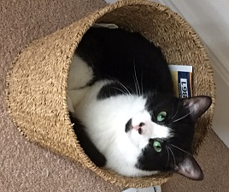
One that I made earlier …..
I took this photo, so can share it!

Slide 6
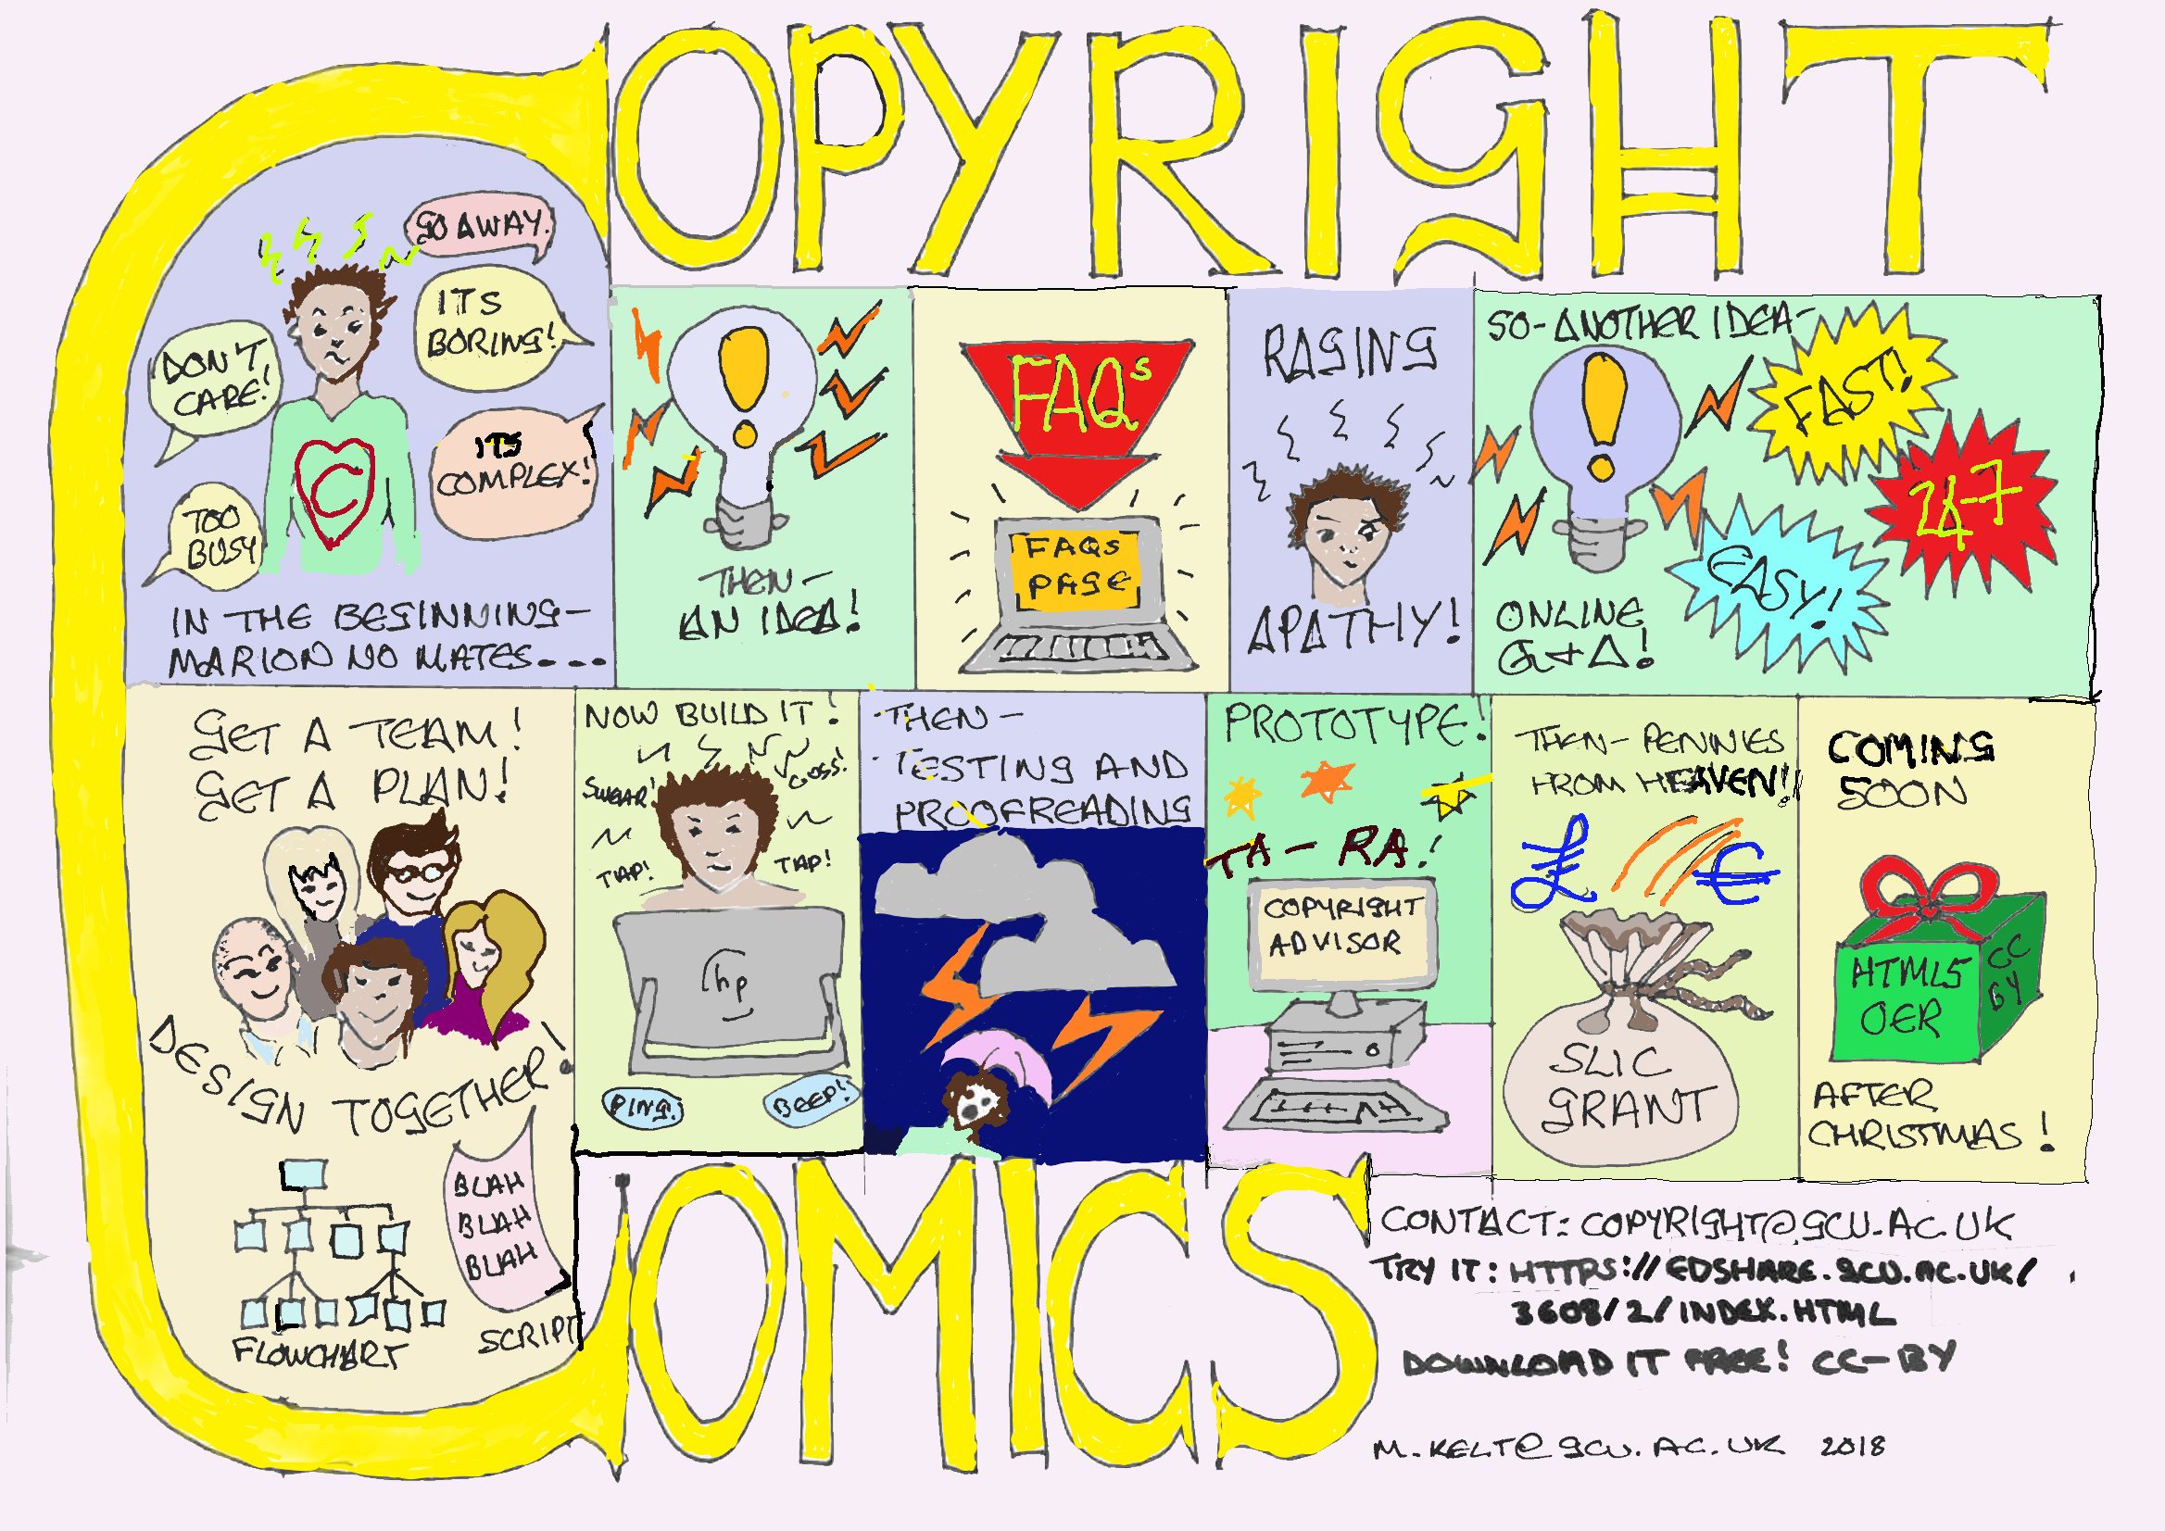
Another one I made earlier
I made this too, so OK to use it….

Slide 7
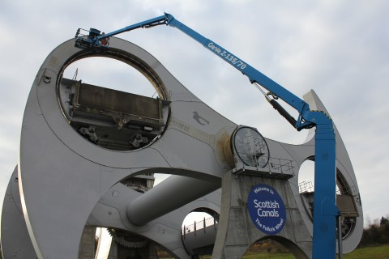
Example - Photograph
Image: The Falkirk wheel gets an MOT by Angela Finlay. https://www.scottishcanals.co.uk/media-centre/galleries/the-falkirk-wheel-gets-an-mot.
Notes:
Why do this? If I have found this photo on the web and want to illustrate my talk on the maintenance of the Falkirk Wheel, this referencing format allows me to acknowledge the photographer’s work and the student to view the photo in its original context.

Slide 8
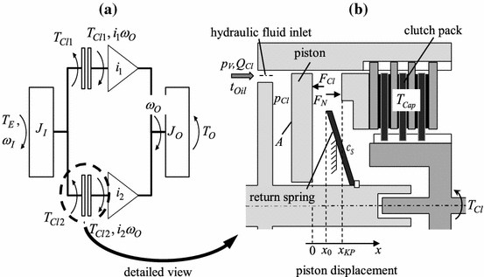
Example - Diagram
Schematic diagram of a double clutch (a) and detailed cylinder model. In: WURM, A., BESTLE, D. 2015. Robust design optimization for improving automotive shift quality. Optimization and Engineering [online]. [viewed 13 April 2016]. Available from: http://dx.doi.org/10.1007/s11081-015-9290-1.
Notes:
Why do this? If I have found this diagram in a text and want to illustrate my talk on engineering design, this referencing format allows me to acknowledge the authors’ work and the student to view the full text.

Slide 9
Is education commercial?
A tricky question!
However, for the purposes of copyright law, Higher Education in Scotland is seen as a non-commercial enterprise.
This is an interesting question to debate, but let’s stick with this definition!

Slide 10
What is sufficient acknowledgement?
Don’t panic! This is not turning into a referencing session.
Here is a simple format for crediting media items: Type of content: Title by Author. Link (Licence)
For example: Image: The Thinker by John Smith. http://commons.wikimedia.org (CC-BY-SA-3.0)

Slide 11
What is fair use?
There is no legal definition of what is fair or unfair in this context.
It is an issue decided by courts depending on a number of factors, such as the amount of the work taken and whether the use would commercially compete with the copyright owner’s exploitation of the material.
According to the UK government 'minor uses, such as displaying a few lines of poetry on an interactive whiteboard, will be permitted, but uses which would undermine sales of teaching materials will still need a licence'.
In short:
Use only as much as needed to make your point
Only use images for teaching purposes, not to cheer up a session!

Slide 12
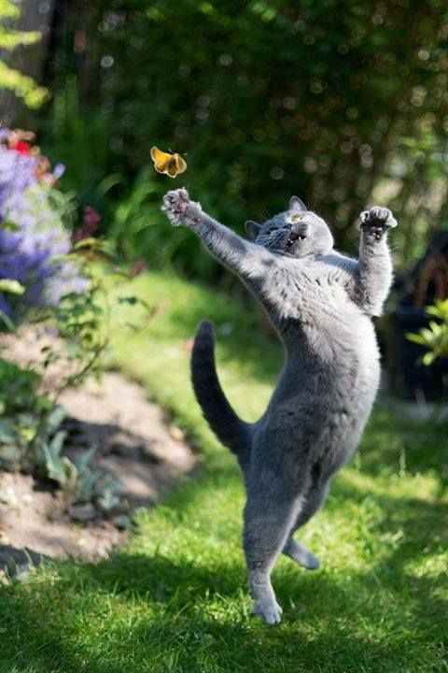
Not a fair use …..
Why?

Slide 13
So what if I want to use images and other media resources I find on the web?
Warning! Not everything on the web is meant for sharing!
This is where the licensing or terms and conditions part comes in.
Many photographers and artists use Creative Commons licensing to specify what use can be made of their creations.
This is an international legally binding scheme which is complimentary to the copyright laws in each country (they vary!).
It uses components to specify what type of use can be made of the item, from very open (CC0) to very limited (CC-NC-ND-SA).
Over the next few slides I’ll explain…..

Slide 14
Copying and using longer broadcast, video, or audio recordings
Box of Broadcasts is an off-air recording and media archive service. Only available in the UK and cannot be used abroad.
If longer broadcast, video, or audio recordings are required for an course they may only be played for students in the classroom.
Content played during a lecture cannot be recorded.

Slide 15
CC building blocks
CC = Creative Commons - Signifies a legally binding Creative Commons licence
BY = Attribution - You must cite the original source when reusing content
ND = No Derivatives - You must not alter or change the content when reusing it
SA = Share Alike - You must license your new resource under the same terms when reusing content
NC = Non-Commercial - You must not make commercial gain from your new resource when reusing content

Slide 16
Common licenses
CC0 Public domain licence, completely open
CC-BY lets you distribute, remix, tweak, and build upon a work, even commercially, as long as you credit the creator
CC-BY-SA lets you distribute, remix, tweak, and build upon a work, even commercially, as long as you credit the creator and license your new creations under identical terms
CC-BY-ND allows redistribution, commercial and non-commercial, as long as the content is passed along unchanged and you credit the creator
CC-BY-NC lets you distribute, remix, tweak, and build upon a work non-commercially, as long as you credit the creator

Slide 17
OK, so how does it work?
You can run a Google advanced search and specify by license type
Use a Creative Commons search
Use recommended websites – see our lists at
https://www.gcu.ac.uk/library/subjecthelp/findingandusinginformation/findingimages/
https://www.gcu.ac.uk/library/onlineresources/openaccessresources/
https://www.gcu.ac.uk/library/servicesforstaff/copyright/reusingcontent/#Tab107844

Slide 18
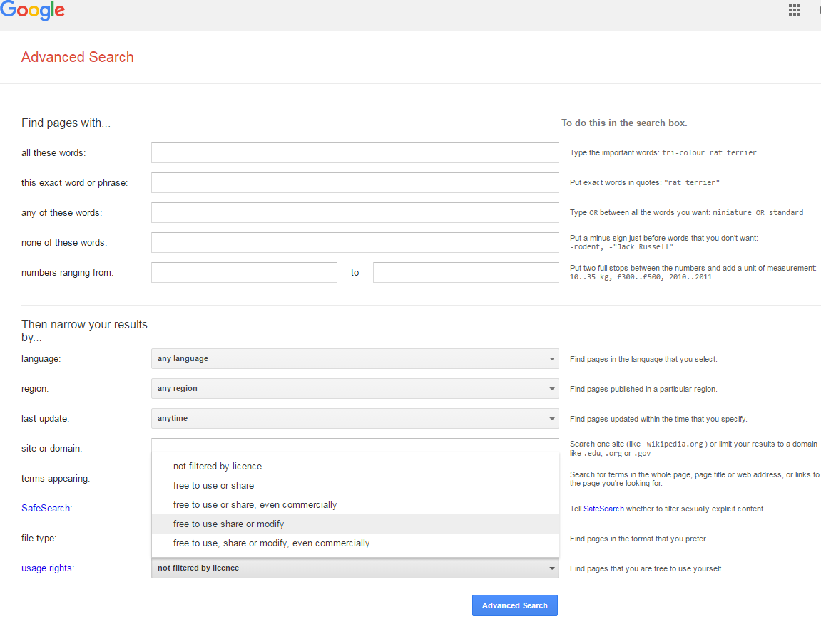

Slide 19
The web page ….

Slide 20
Using edShare
edShare is the best place to store and share your educational resources
You can find it on the intranet page under services or the library staff pages
It works using drag and drop technology and allows easy CC licensing
It supports a wide range of file types
You can link to the resource from a website, blog or VLE…..
Live demo…..
https://edshare.gcu.ac.uk/

Slide 21
Thank you
Contact details and links:
http://gcu.ac.uk/library/servicesforstaff/copyright/
More detail and examples available at the Copyrightuser.org website copyright@gcu.ac.uk
edShare@gcu.ac.uk

