Slide 1
Yoga and Mindfulness in Stroke Rehabilitation
Dr Maggie Lawrence

Slide 2
Overview
What is Yoga? Mindfulness?
Therapeutic benefits
Experiences of yoga and Mindfulness after a stroke
But is it ‘rehab’?
Do we need stroke-specific adaptations?
HEADS: UP: co-creating an adapted MBSR programme

Slide 3
What is yoga? What is Mindfulness Based Stress Reduction (MBSR/mindfulness)?

Slide 4
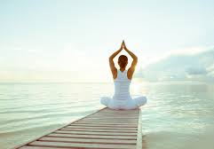
Yoga
This is yoga!
After a stroke
does this look like something you would want to do?
What are your thoughts …?

Slide 5
Yoga
This is yoga …
Yoga is a group of physical and spiritual practices which originated in ancient India. One of the forms of yoga most commonly practiced in the West is hatha yoga. Often, it is practiced as a form of physical exercise, but it has a spiritual and meditative core.

Slide 6
This is yoga …
The term yoga stems from the Sanskrit root ‘yuj’ meaning to ‘yoke’ or ‘join together’ – alluding to the desired bond between mind, body, and spirit.
Yoga practice in the West is limited to physical postures (asana), breath control (pranayama) and meditation (dhyana).

Slide 7
Yoga video

Slide 8
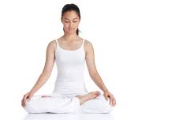
Mindfulness
This is Mindfulness!
After a stroke, is Mindfulness something you would like to do?
What are your thoughts?

Slide 9
Mindfulness
This is mindfulness …
Mindfulness means paying attention in a particular way; on purpose, in the present moment, and non-judgementally.

Slide 10
This is mindfulness …
Mindfulness is about being more fully present in our lives, embracing all our experiences and, importantly, changing the relationship we have towards our suffering.
Mindfulness Based Stress Reduction is delivered as a standardised self-management intervention.
2.5 hour sessions, weekly for 8 weeks, with one 6-hour silent retreat in week 6
Skills taught in class are practiced ‘at home’

Slide 11
Mindfulness podcast

Slide 12
Therapeutic benefits?

Slide 13
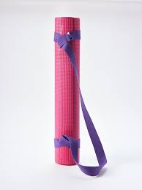
Yoga: the evidence
Increasingly, yoga is used to treat health conditions e.g.
Cardio vascular disease
Low-back pain
Asthma
Review findings: stroke
2 randomised controlled trials
72 participants
Significant effect on
Memory
Anxiety
Very low grade evidence

Slide 14
Mindfulness: the evidence
Developed to treat untreatable chronic pain
Review findings: stroke
4 studies; 160 participants
Positive trend across a range of outcomes
anxiety
depression
mental fatigue
blood pressure
perceived health
quality of life

Slide 15
Experiences of yoga and Mindfulness after stroke

Slide 16
Yoga: Qualitative findings
Participant quotes
I still have fatigue, but I think I have improved my endurance
I’m not sure how it [yoga] works, but . . . I got my arm over my head
I never realized that 80% of people have
this fatigue thing. And kind of a zoning out thing … which my spouse complains about … so, that was very helpful
I think I can walk easier and go faster
… this is ruining my walking … I’m catching
my toe, and I’m doing all these things I didn’t usually do. But as we’ve progressed … I think I walk better than I did originally, because it made me clean up some bad habits
Alter et al 2017
Improved abilities & capacities
New knowledge
Enhanced engagement in activities

Slide 17
Yoga: Qualitative findings
Alter et al 2017
Improved relaxation
Increased confidence and inspiration
Participant quotes
It helped me relax and . . . gave me focus . . . really paying attention to breathing, and relaxing.
I think I was maybe asleep before she finished [referring to the voice on the recording]
I learned an awful lot here … [we’ve all] made huge strides. I remember the first time we had to get down on the floor. Even just when we started the yoga, we had to get x out of the wheelchair and sit in a regular
chair, you know, how [she’s] changed! [She’s] changed! And it’s just been, uh, God’s gift to me, this study

Slide 18
Yoga: Qualitative findings
Garrett et al. 2011
Experiences of stroke
Feelings & expectations of yoga
Participant quotes
[recovery was] ‘a long hard road’ but common to this group of individuals was a dedication to participation in rehabilitation to … ‘get back as much as possible of what had lost’.
could do no harm
sounded like a good thing to try
to break the stress of daily activities
[My aim is] to run like my life depended on it

Slide 19
Yoga: Qualitative findings
Garrett et al. 2011
Yoga experience
Participant quotes
The teachers were excellent. They had a good understanding of people’s limitations.
there was no pressure or judging . . . it was gentle. They [teachers] said if it hurt you shouldn’t be doing it.

Slide 20
Yoga: Qualitative findings
Garrett et al. 2011
Physical outcomes
Participant quotes
I have greater sensation and feeling of the body from within
I have become more aware of my body … my [affected side] was totally dead; there was no feeling in half of my body, so yoga has helped
My toes were numb …but … yoga has enabled me to differentiate between my toes … my toes would curl but now I can take 6–7 steps with everything nicely flat on the ground.

Slide 21
Yoga: Qualitative findings
Garrett et al. 2011
Psychosocial outcomes
Participant quotes
Yoga has made an amazing difference to my confidence & my calmness. It has improved my ability to think clearly & talk to people and explain myself. The breathing & meditation is powerful stuff that has changed me, & that is why I will continue.
Yoga has helped me catch up emotionally. I have pushed myself physically for the last 20 years … I am feeling more committed to myself. When I am stressed I don’t eat. I can go for days and not realise. I am much more in control of that . . . yoga has made me feel supported, I am OK. I can listen to that calm, yoga is supporting this. I still stress from time to time but it doesn’t feel as bad … I think the emotional side of yoga has been really more important than the physical.

Slide 22
Mindfulness: Qualitative findings
Participant quotes
…found it interesting. Very informative, and very relaxing
I have no focus; you’ve got to be very focused. It’s actually very hard to do, that’s the impression I get
If we’re talking about 2 hours of mindfulness practice then, yeah, it’s too much
If someone feels they’re physically able, then they might need it [for] the anxiety
… for someone else who maybe needs rehab, physical rehab first, then maybe it’s further down the line …
Jani et al 2018
Experience of
Mindfulness
Organisation of MBSR sessions

Slide 23
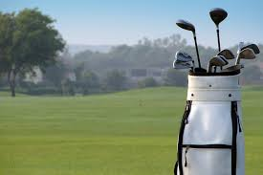
Mindfulness: Qualitative findings
Participant quotes
Mindfulness is not golf. You don’t have to go and find a [golf] bag and, then, however many clubs to stick it out. And, then, find a [golf club] membership and then book a tee time it’s... you can do it anywhere. And, it’s [mindfulness] not, it’s not expensive … it’s accessible
But I still think, at home, you wouldn’t do it [mindfulness]
… if that means it’s giving me a wee bit of ‘me-time’, you know, just to get away from everybody and, see the [thoughts] that are giving me a rough time, [I]
just block them out
Jani et al 2018
Future mindfulness participation

Slide 24
But, is it rehab?

Slide 25
Discuss ….

Slide 26
Do we need stroke-specific adaptations?

Slide 27
Hypothesis …
… a one-to-one session just before the group starts where you just … the person delivering [mindfulness to] the group is able to see what level of disability …
So, if you were holding a session for mindfulness for stroke survivors, it’s setting that scene and holding that space uniquely for people in that context. And, I think some of that is recognising that everybody is coming with different challenges with different … at a different place on their healing journey and there’s lots of different things …

Slide 28
HEADS UP: co-creating an adapted programme

Slide 29
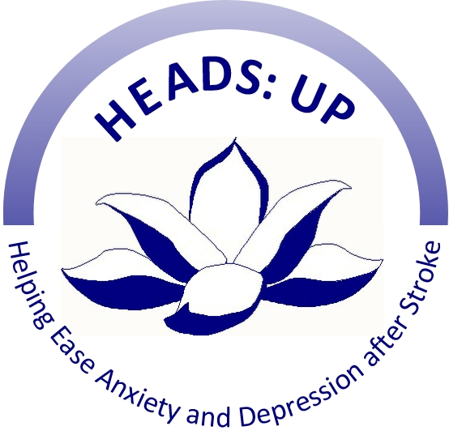
HEADS: UP Helping Ease Anxiety & Depression after Stroke

Slide 30
HEADS: UP Development work
30 participants: stroke survivors & family members
Mindfulness ‘taster’ sessions (groups of 10; October 2017)
Focus groups: how can the Mindfulness course be adapted to help people follow the whole course & practice at home?
Adapted the materials; re-ran taster sessions & focus groups
Currently: adapting course materials; a manual for trainers
Applied for funding for feasibility & pilot testing

Slide 31
Unleash your superpower ….
https://www.youtube.com/watch?v=w6T02g5hnT4

Slide 32
References and Resources

Slide 33
References and Resources
References
Alter 2017. Yoga … self-management. DOI: 10.1177/0308022617690536
Garrett 2011. Experience of yoga. DOI: 10.3109/09638288.2011.573058
Jani 2018. Acceptability of Mindfulness. DOI: 10.1186/s40814-018-0244-1
Kabat-Zinn, J. 2013. Full Catastrophe Living. Bantam Books: New York
Lawrence 2017. Yoga … review. DOI: 10.1002/14651858.CD011483.pub2
Lawrence et al. 2012. Mindfulness review. DOI: 10.1111/ijs.12135
Resources
Selfhelp4stroke.org
www.mindfulnessscotland.org.uk

