Slide 1
Systematic Reviews in Theory and in Practice
Dr Maggie Lawrence
Reader in Stroke Prevention

Slide 2
On behalf of …
Mr Garth Ravenhill, Charge Nurse, Norfolk and Norwich University Hospitals NHS Foundation Trust, UK
Loukia Gkanasouli, Mental Health Nurse, Astley Ainslie Hospital, Edinburgh, Scotland

Slide 3
Overview
Rationale
Methods (brief)
Findings
Implications

Slide 4
Rationale

Slide 5
Rationale
Annually in the UK > 46,000 people have a Transient Ischaemic Attack (TIA)
>1:12 will have a stroke within a week
Early diagnosis & medical management is essential
Information & advice
individual risk of stroke
lifestyle changes

Slide 6
Methods

Slide 7
Methods
Meta-aggregation
2 independent reviewers
Electronic databases
CINAHL, MEDLINE, AMED, PsycInfo
Complex search: key words & subject headings
E.g. stroke OR TIA AND diagnosis OR experience
Quality appraisal
Critical Appraisal Skills Programme Qualitative Checklist
Data analysis
Findings Categories Synthesised Findings

Slide 8
Findings

Slide 9
Findings
4 studies; 1 from Australia, 3 from the UK
69 participants
3 Synthesised Findings
Onset (first 24 hours)
Impact and effect
Reducing the risk
Participant characteristics
male | n=42, 61%
age | 72 years
Time post-TIA | 2 weeks – 25 years

Slide 10
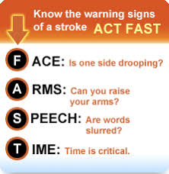
Onset (first 24 hours)
Sudden onset
[It was] completely out of the blue!
(not) Recognising the symptoms
It never occurred to me I might be having a TIA …
… I thought had tripped over something on the floor
(lack of) Awareness of implications
I had a little wobble … I took no notice of it
Seeking (medical) help
I thought it was nothing … ‘I’ll be alright; I’ll get it checked out next week’. ‘No you won’t! [wife says], I I’m phoning the doctor now!’

Slide 11
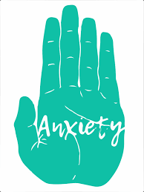
Impact & Effect
Transient physical symptoms/lasting effect
I suffer from a lot of fatigue
Anxiety (recurrence)
I’ve been worrying a lot … wondering when, or how, it was going to happen again… which takes some of the pleasure out of life
Anxiety (others)
People around me have convinced me I am a bit fragile
Finances/employment
I can’t drive; my job involves driving
You’ve had this TIA and your insurance goes up £50!

Slide 12
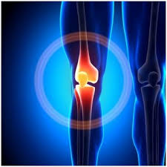
Reducing the Risk
Understanding the significance
… it wasn’t until I saw the surgeon that the alarm bells rang
Co-morbidities
Arthritis is worse …
Back to normal
It’s over & done with now. I’m back to normal, you know? … I’ve enough to think about without thinking about a thing that might never come again …

Slide 13
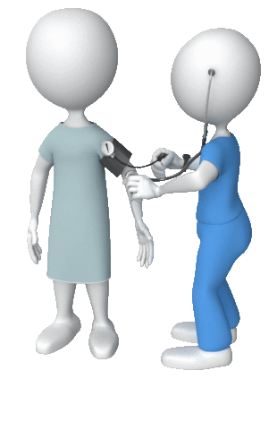
Reducing the Risk
Secondary prevention
… it was a tap on the shoulder
I am very particular about taking my medication
I think it would just [have] been nice to be able to sit & talk to somebody & tell them how scared I am, still am in fact … I’d like for somebody to turn around & say ‘Well, this is how you can really prevent it happening again,’ but there’s nobody to do it, there’s no doctors doing it, there’s no … GPs [primary care physicians] don’t do it
4/11 participants felt that they were at no further risk (Kamara et al.)

Slide 14
Implications

Slide 15
Implications

Slide 16
References and Resources

Slide 17
References and resources
Critical Appraisal Skills Programme (CASP), 2017. CASP Qualitative Checklist. Available www.casp-uk.net
Crowfoot et al., 2016. DOI: 10.1111/nhs.12227
Gibson & Watkins, 2012. DOI: 10.1111/j.1365-2648.2011.05849.x
Joanna Briggs Institute (JBI), 2014. Joanna Briggs Institute Reviewers’ Manual. Adelaide, Australia: JBI
Kamara & Singh, 2012. DOI: 10.1017/S146342361100051X
Lawrence et al., 2015. DOI: 10.1371/journal.pone.0120902
Spurgeon et al., 2013. DOI: 10.3109/09638288.2013.774062
Self-management website: Selfhelp4stroke.org

Slide 18
Contact:
Maggie Lawrence
Maggie.Lawrence@gcu.ac.uk
@StrokePathways

