Slide 1
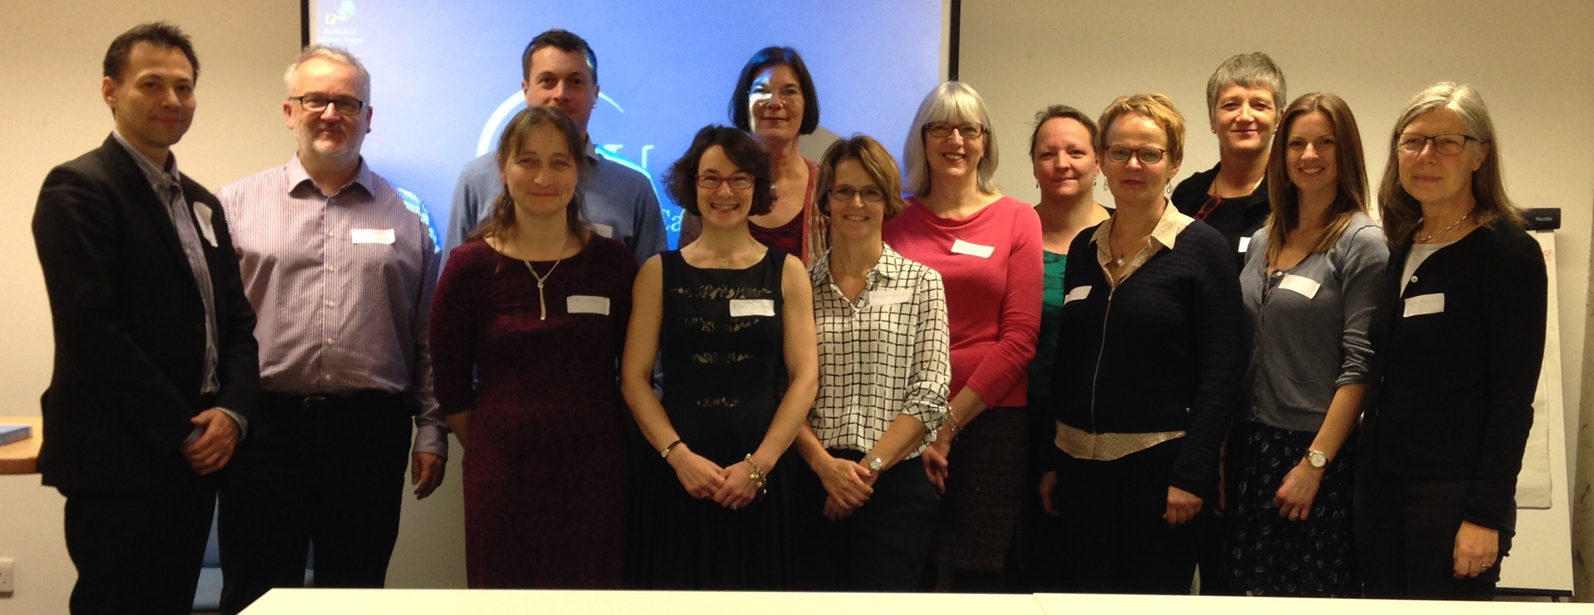
INSsPiRE International Network of Stroke Secondary Prevention Researchers
Lack of core standardised outcomes and associated measures impacted potential for meta-analysis of results from empirical non-pharmacological, non-surgical stroke secondary prevention (SSP) research. This in turn impacts development of evidence-based clinical guidelines. To facilitate consensus a group of like-minded experts was assembled.
In December 2015, INSsPiRE came into being at a meeting in London
hosted by Glasgow Caledonian University
supported by the UK Stroke Association
Founder INSsPiRATIONAL researchers, academics & clinicians come from:
Denmark
England
Ireland
New Zealand
Scotland
South Africa
Sweden

Slide 2
INSsPiRE
Who we are
Eric Asaba, KI, Sweden, Occupational Therapist
Elaine Duncan, GCU, UK, Sport & Exercise Psychologist
Marie Elf, Dalarna University and Chalmers University of Technology, Sweden, Nurse
Gunilla Eriksson, KI, Sweden, Occupational Therapist
James Faulkner, University of Winchester, UK, Sport & Exercise Physiologist
Susanne Guidetti, KI, Sweden, Occupational Therapist
Nette Hornnes, Herlev-Gentofte Hospital (HGH), Denmark, Nurse
Jennie Jackson, GCU, UK, Dietician
Birgitta Johansson, University of Gothenburg, Sweden, Psychologist
Christina Kruuse, HGH, Denmark, Physician
Danielle Lambrick, University of Southampton, UK, Exercise Physiologist
Maggie Lawrence, founder and Chair, GCU, UK, Information scientist (former nurse)
Caitlin Longman, Stroke Association, UK, Speech and Language Therapist
Olive Lennon, UCD, Ireland, Physiotherapist
Lena von Koch, KI, Sweden, Health services, Physiotherapist
Suzie Wang, Leeds Becket University, UK, Psychologist
What we’re about
Raising the scientific profile of SSP
Promoting person/family-centeredness
Building a body of SSP evidence
Sharing information & resources
Facilitating international collaboration
Promoting capture of long-term follow-up SSP data (big data)

Slide 3
Impact
2016
Appreciative Inquiry (priority setting, work planning); UKSF Forum, Harrogate, UK
2017
Began to establish a social media presence (Facebook & Twitter)
Definition of SSP Delphi Consensus work commenced, virtually
Seminar, GCU, UK; 70 registered attendees (clinicians, researchers)
Delphi Meeting, GCU, UK
Overview Review work commenced, virtually & at meetings in GCU & University College Dublin, Ireland
2018
Overview Review protocol published doi: 10.1186/s13643-018-0888-1
Seminar, Karolinska Institutet (KI), Stockholm, Sweden
Experience-based exchange event with the Swedish Stroke Association, Aphasia Association, Hjärna tillsammans and KI
Delphi Meeting, KI, Sweden
Collaborative draft Delphi consensus paper commenced
Open meeting & workshop; UKSF, Telford, UK; 170+ attendees

Slide 4
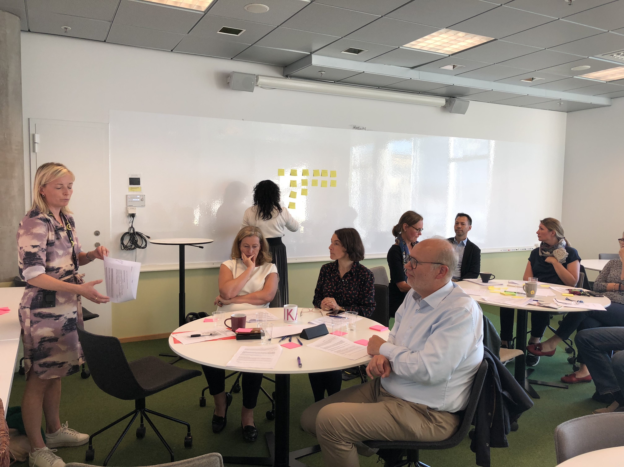
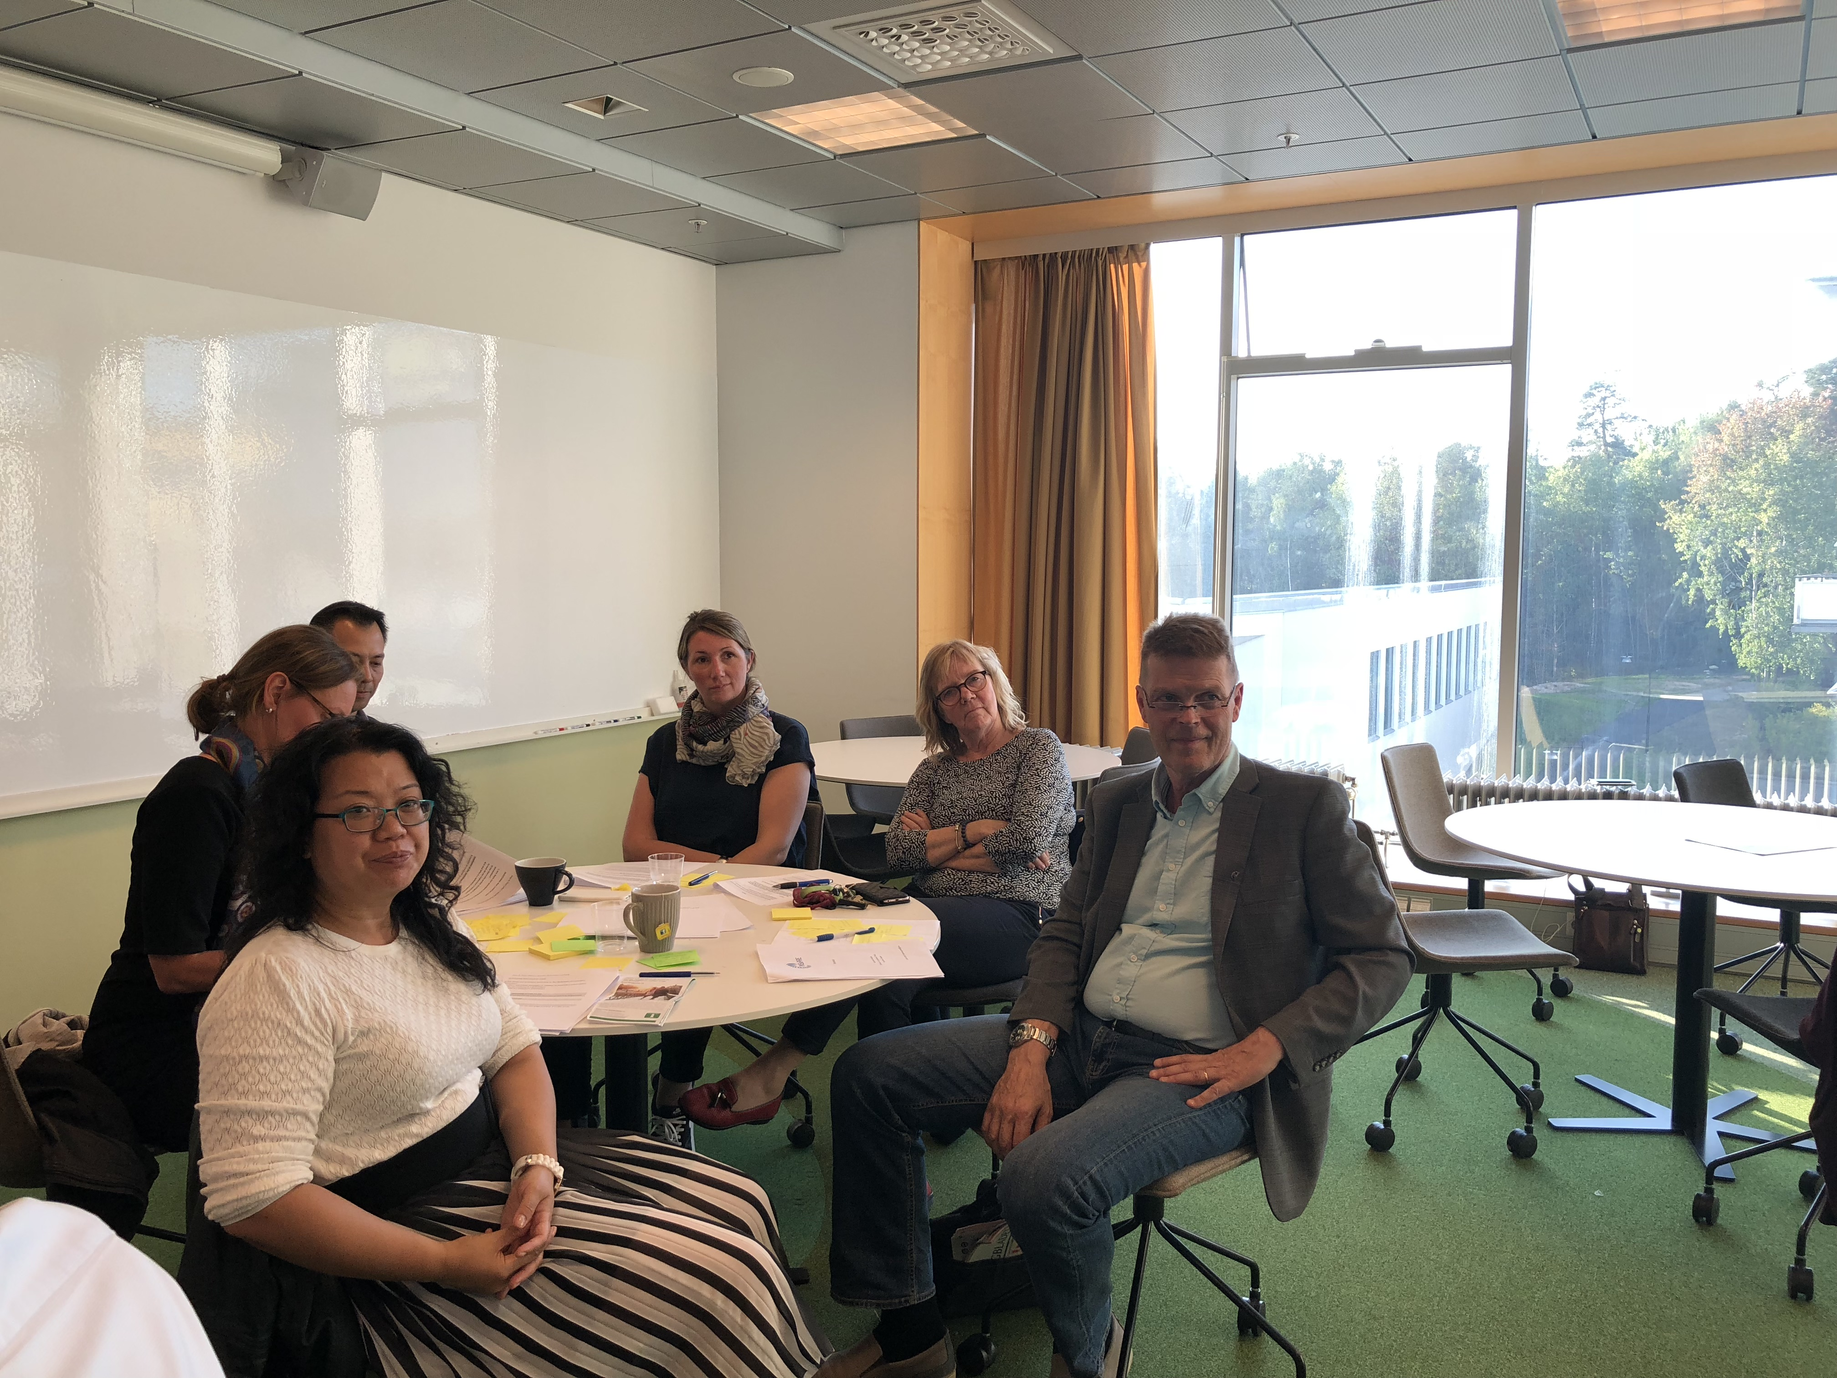
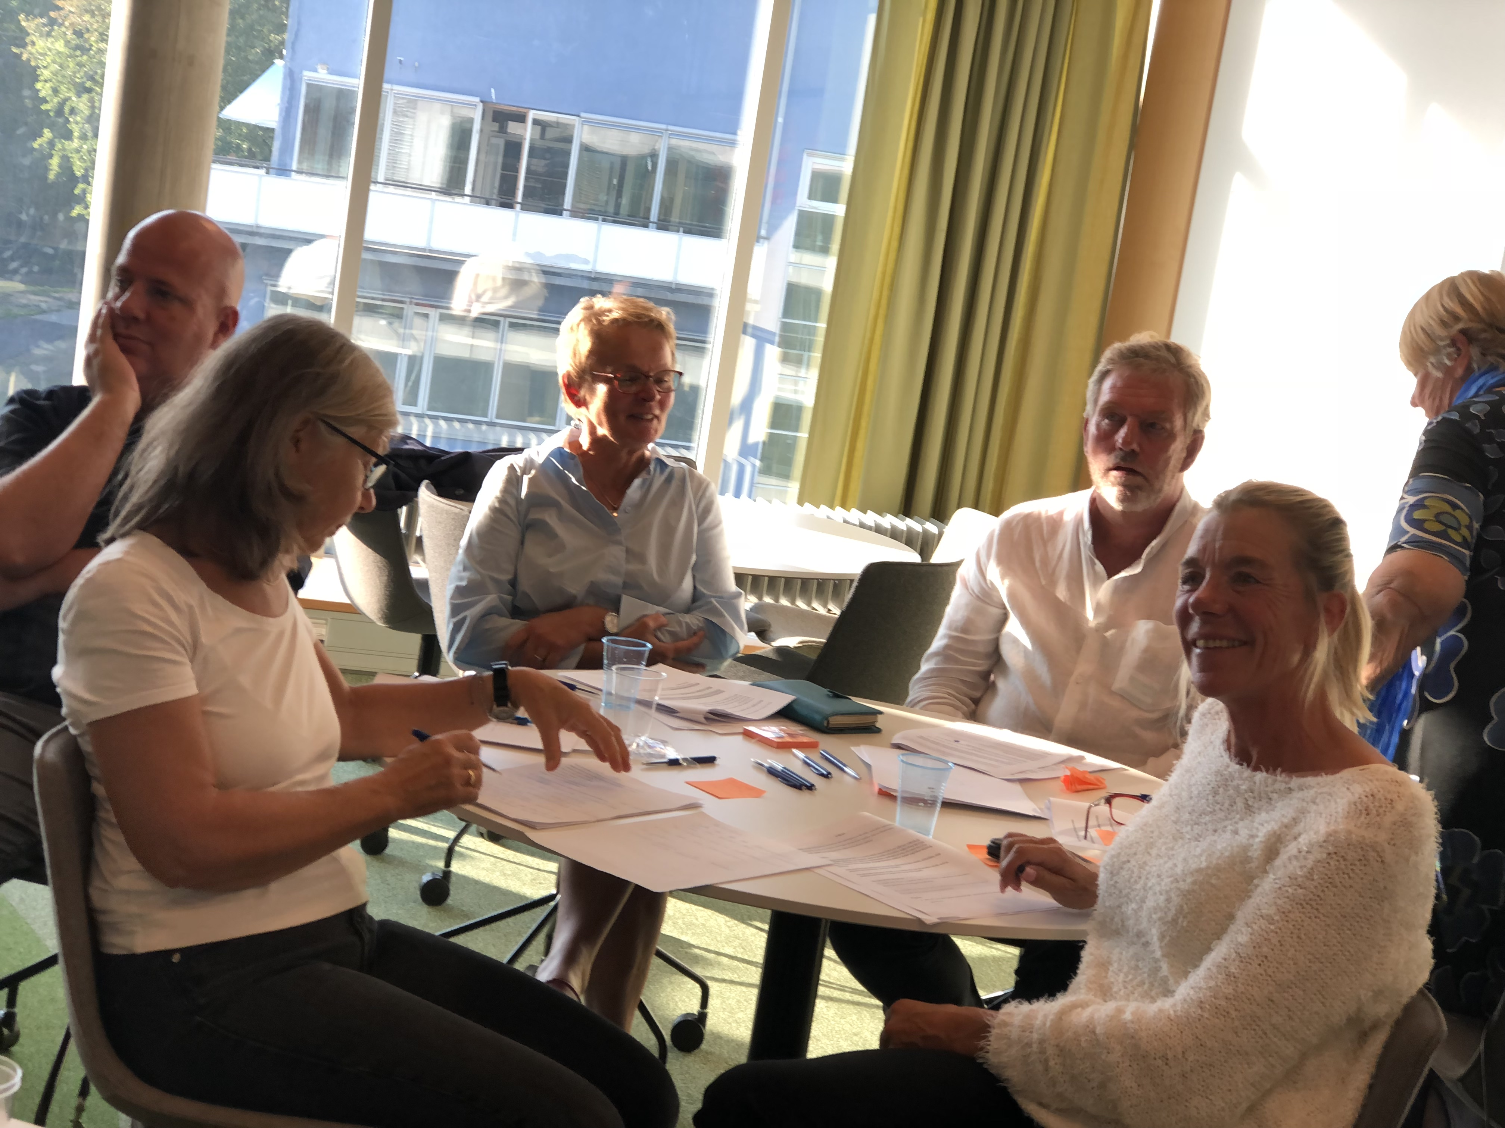
Where next?
To do list
Publish Delphi Consensus paper (submitted May 2019)
Conference, UCD, Ireland
Apply for PhD funding for core outcomes & measures consensus work
Open meeting; UKSF, Telford, UK
Revisit Appreciative Inquiry
Plan application for funding for training network e.g. Marie Curie
Challenges
Prioritising unfunded work
Maintaining a social media presence
Tension between establishing a credible network and growing the membership

Slide 5
Join our inspirational network today!
Like us on Facebook StrokeSecondaryPrevention/
Follow us on Twitter @INSsPIRE_stroke
Email: maggie.lawrence@gcu.ac.uk

