Slide 1
Maggie Lawrence
Fiona Duncan, Susan Kerr, Jo Booth
An evaluation of Keeping Well:
a patient-centred self-management
resource for stroke risk reduction

Slide 2
Overview
Developing Keeping Well
Evaluation study (methods)
Questionnaire results
Interview findings
Conclusion and implications …

Slide 3
Development: Identifying priorities
Self-management/Goal-setting
Keeping Healthy
Being Active
Emotional Support
Coping with Setbacks

Slide 4
Development team: Keeping Well
Name | Job title | Organisation
Dr Maggie Lawrence | Stroke Association Senior Research Training Fellow | Glasgow Caledonian University
Elaine Grubb | Stroke Education Facilitator & Stroke Nurse | Chest Heart & Stroke Scotland
Pauline Halliday | Stroke Specialist Occupational Therapist | NHS Lothian
Julia Haydon | Community Pharmacist | NHS Greater Glasgow & Clyde
Heather Hunter | Stroke Specialist Nurse | NHS Greater Glasgow & Clyde
Ann Marie Irving | Stroke Specialist Speech & Language Therapist | NHS Forth Valley
Jayne McKerrow | Community Stroke Services Regional Manager | Chest Heart & Stroke Scotland
Morag Ogilvie | Dietetic Lead | NHS Forth Valley
Margaret Somerville | Director of Advice & Support | Chest Heart & Stroke Scotland
Heather Bryceland | Selfhelp4stroke Project Manager | Chest Heart & Stroke Scotland

Slide 5
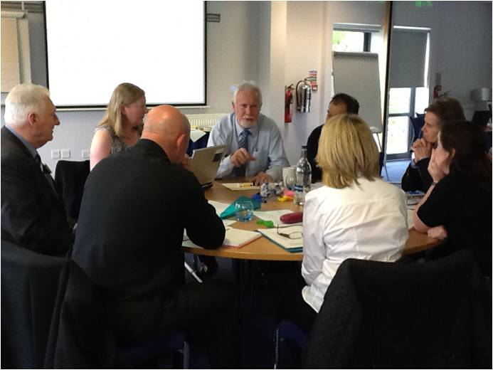
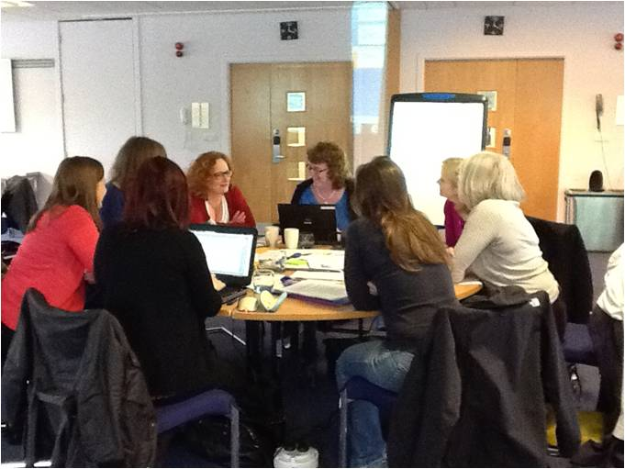
Development

Slide 6
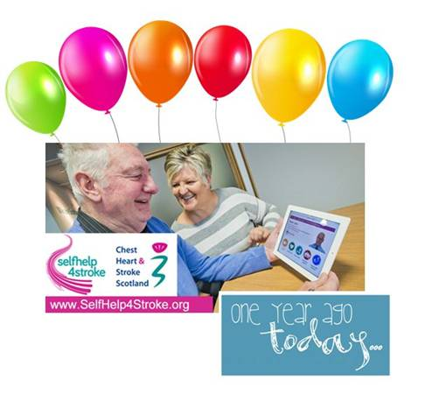
Site statistics
Since launch in June 2015
12755 hits to the site by
9807 unique users from
110 countries
Approx 400 to 600 hits per month
In Scotland there were
5597 hits by
3788 unique users

Slide 7
Evaluation: Questions
Were people who accessed Keeping Well Knowledgeable about stroke i.e. causes, signs & symptoms, risk factors, action if stroke is suspected?
Had they
Considered/initiated lifestyle changes to help reduce risk of stroke recurrence?
Sustained healthy changes ?

Slide 8
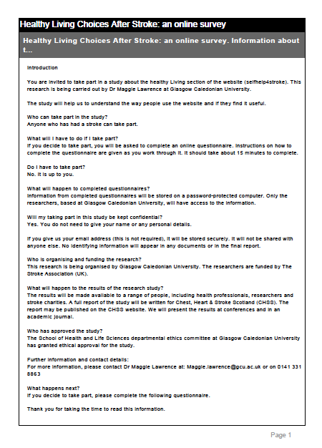
Evaluation: Methods
Six months after launch*
Participants: people who self-identified as having had a stroke
Online questionnaire (n=42)
Demographic data
Stroke knowledge
Lifestyle behaviour
Brief phone interviews (n=7)
*June 2014

Slide 9
Results: Demographics
Characteristic (no. answered) | Frequency , %, or median
Male (n=39) | 18 (46%)
Age (n=35) | 60 (median; range 32-80)
Employment (n=36) | Employed: 22 (61%) Carer: 3 (8%) Unemployed/retired: 10 (28%)
Living arrangements (n=36) | With someone else: 31 (86%) Alone: 5 (14%)
Education (n=37) | Secondary/High School: 14 (38%) Higher education: 23 (62%)
Time since (last) stroke (n=34) | 53 months (median; range 22.5 – 144)

Slide 10
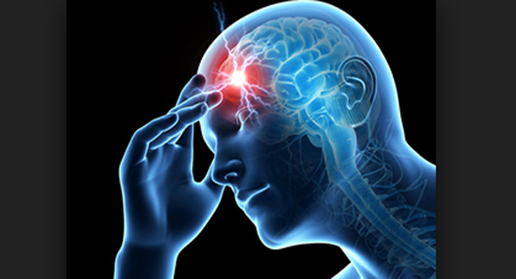
Results: Causes of stroke
What caused your stroke? (n=29) | Frequency (%)
Stress over a long period of time | 10 (35%)
Another medical condition | 10 (35%)
Pressure at work | 8 (28%)
Not enough exercise | 7 (24%)
Bad diet | 5 (17%)
A stressful event | 5 (17%)
Note: respondents commonly reported 2 or more causes

Slide 11
Results: Stroke knowledge
What I filled in, I filled in from my own knowledge
It was things that I knew about
Risk factors | Frequency (%)
High blood pressure | 22
Stress | 12
Smoking | 11
Obesity/overweight | 10
Lack of exercise | 9
Poor diet | 8
re-affirmed what I thought

Slide 12
Getting information after stroke
I used my knowledge from the hospital, the stroke nurse, all that stuff
I passed the information on to a friend…
How did you get Information about stroke? | Frequency (%)
Spoke to GP | 22 (71%)
Spoke to Stroke Nurse | 18 (58%)
‘Googled’ it | 17 (54%)
Spoke to a health professional | 17 (54%)
Spoke to a friend | 5 (16%)
There’s a lot of good advice in there (selfhelp4stroke)
Trust Me I’m a Doctor (TV programme)
I’ve not really had much guidance … in terms of self-management
You don’t like to bother the specialists in hospital with questions …

Slide 13
Behaviour change
My age group are quite aware of what’s good and what’s not good
There were some real light bulb moments
6 people responded
4: I have a healthy lifestyle
2: thought about
Doing more exercise
Giving up smoking
Eating better
Using the goal setting tool
Both had made at least 1 change
It’s OK reading about the changes, but actually putting them into practice ….
I will use this to maintain the things I’ve done …. because I can quite easily slip back

Slide 14
Conclusions? Implications …?
What does this tell us?

Slide 15
http://selfhelp4stroke.org
Keeping Well Evaluation
Contact:
maggie.lawrence@gcu.ac.uk

