Slide 1
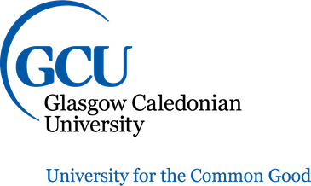
©OPYRIGHT BASICS
Open Access and Open Educational Resources
This work is licensed under a Creative Commons Attribution 4.0 International License

Slide 2
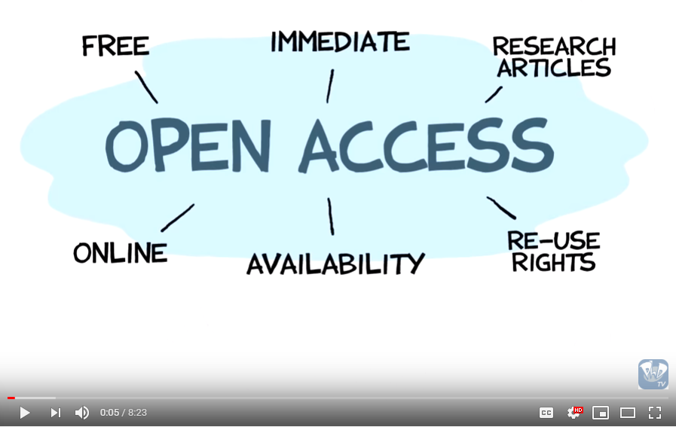
You probably recognise the symbol, but what is Open Access, where are we now and what could be?
What is Open Access?
Open Access Explained!
Animation by Jorge Cham
Narration by Nick Shockey and Jonathan Eisen
Transcription by Noel Dilworth
Produced in partnership with the Right to Research Coalition, the Scholarly Publishing and Resources Coalition and the National Association of Graduate-Professional Students
Available at: https://youtu.be/L5rVH1KGBCY
By art designer at PLoS, modified by Wikipedia users Nina, Beao, and JakobVoss
Available at: https://commons.wikimedia.org/w/index.php?curid=15736161
Licensed under CC-BY 3.0

Slide 3
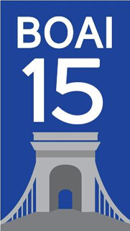
The first formal definition of Open Access was provided by the Budapest Open Access Initiative in 2002:
Why is Open Access important for staff and researchers?
Access to published research is available quickly and free of charge to any user improving the reach of the research. That means more readers, more citations and more collaborations.
Research funding bodies increasingly require Open Access as a condition of their awards. This is so that publicly funded research can benefit the whole of society. Open Access is a requirement of submission to The Research Excellence Framework (REF) which evaluates the quality of research in UK higher education institutions.
Open access enables powerful text and data mining and creates conditions that could accelerate 'discovery in academia and in the private sector, and of learning at every strata of education.'
'By "open access" to this [research] literature, we mean its free availability on the public internet, permitting any users to read, download, copy, distribute, print, search, or link to the full texts of these articles, crawl them for indexing, pass them as data to software, or use them for any other lawful purpose, without financial, legal, or technical barriers other than those inseparable from gaining access to the internet itself. The only constraint on reproduction and distribution and the only role for copyright in this domain should be to give authors control over the integrity of their work and the right to be properly acknowledged and cited.'
SPARC Europe. Available at: https://sparceurope.org/who-we-are/about-us/
Why is Open Access important for students?
Open Access means that students' access to materials is not limited by the library's budget or collections.
Budapest Open Access Initiative. Available at: https://www.budapestopenaccessinitiative.org/boai15-1
Improved educational experience for transnational students as licensing barriers are broken down.
Logo celebrating the 15th anniversary of the Budapest Open Access Initiative in 2019, featuring the Széchenyi Chain Bridge in Budapest. Image available at:
Anyone can educate themselves by having access to the research. Access doesn't begin and end with the privilege of higher education.
https://www.budapestopenaccessinitiative.org/BOAI_15.png/view
Licensed under CC-BY 3.0

Slide 4
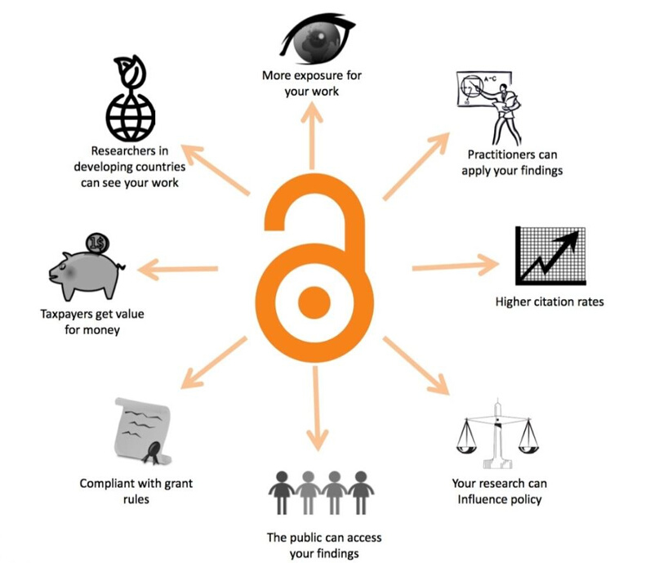
Open Access at GCU
The University is strongly committed to the principle that the outcomes arising from its publicly funded research are a public good that should be made as widely available as possible.
External research funding bodies (such as Research Councils UK (RCUK), The Wellcome Trust, and the European Commission) require that the full text of publications arising from funded research projects are made available to the public in an open access text format.
Open access requirement for REF from 1 April 2016 onwards stipulate that journal articles and conference proceedings with an international standard serial number (ISSN) need to be deposited in Pure to be eligible for the next REF.
For further guidance on Open Access at GCU visit the library website or contact the repository team.
Benefits by Llywelyn, by Danny Kingsley, Sara Brown & Robin Owain. Available at: https://commons.wikimedia.org/wiki/File%3ABenefitsofopenaccess_cc-by_logo.cy.svg
Licensed under CC BY-SA 4.0

Slide 5
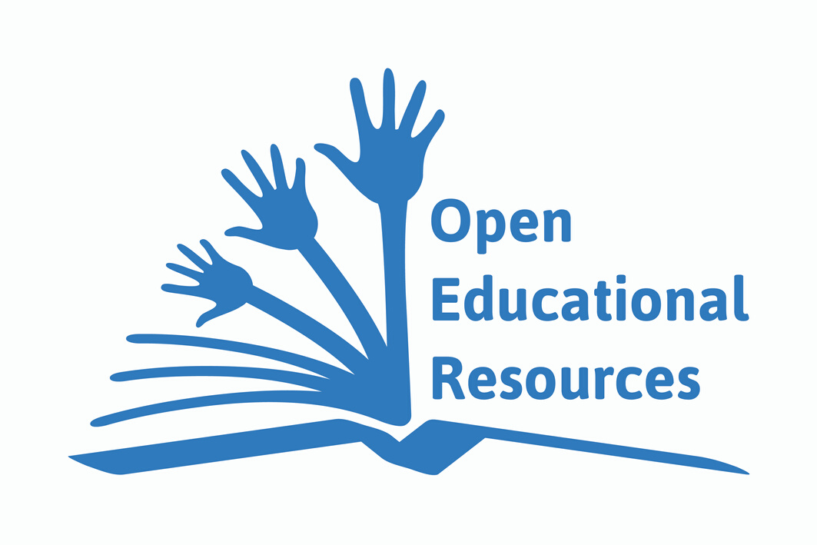
What are Open Educational Resources?
Academic and Social Entrepreneur David Wiley describes a 5Rs framework for the permissions that define an OER:
Retain – the right to make, own, and control copies of the content
Reuse – the right to use the content in a wide range of ways (e.g., in a class, in a study group, on a website, in a video)
Global Open Educational Resources Logo by Jonathas Mello
Available at: https://commons.wikimedia.org/wiki/Category:Open_Educational_Resources_-_Logo#/media/File:Global_Open_Educational_Resources_Logo_-_White_background_variation.svg
CC-BY 3.0
Revise – the right to adapt, adjust, modify, or alter the content itself (e.g., translate the content into another language)
UNESCO define Open Educational Resources as:
Open Educational Resources (OER) are teaching, learning and research materials in any medium – digital or otherwise – that reside in the public domain or have been released under an open license that permits no-cost access, use, adaptation and redistribution by others with no or limited restrictions.
Remix – the right to combine the original or revised content with other open content to create something new (e.g., incorporate
the content into a mashup)
Redistribute – the right to share copies of the original content, your revisions, or your remixes with others (e.g., give a copy of the content to a friend)
UNESCO 2012 Paris OER Declaration. Available at: https://en.unesco.org/oer/paris-declaration
The 5R Permissions, by David Wiley. Available at: https://opencontent.org/blog/archives/3221
CC-BY 4.0

Slide 6
Why are OERs important for staff and researchers?
Save time creating your own learning resources from scratch by using and / or adapting readily available OERs.
Contribute your own knowledge and increase access to education for all. You can help build a fairer, more democratic, healthier and wealthier society.
Why are OERs important for students?
They're free of charge,
Digital and online OERs have the potential to provide continually updated material available in multiple languages and producing boundless opportunities for collaboration and exchange between students.
According to SPARC Europe, '93% of students who use OER do as well or better than those using traditional materials, since they have easy access to the content starting day one of the course'.
SPARC EUROPE, Setting the Default to Open. Available at: https://sparceurope.org/what-we-do/open-education/open-educational-resource-benefits/

Slide 7
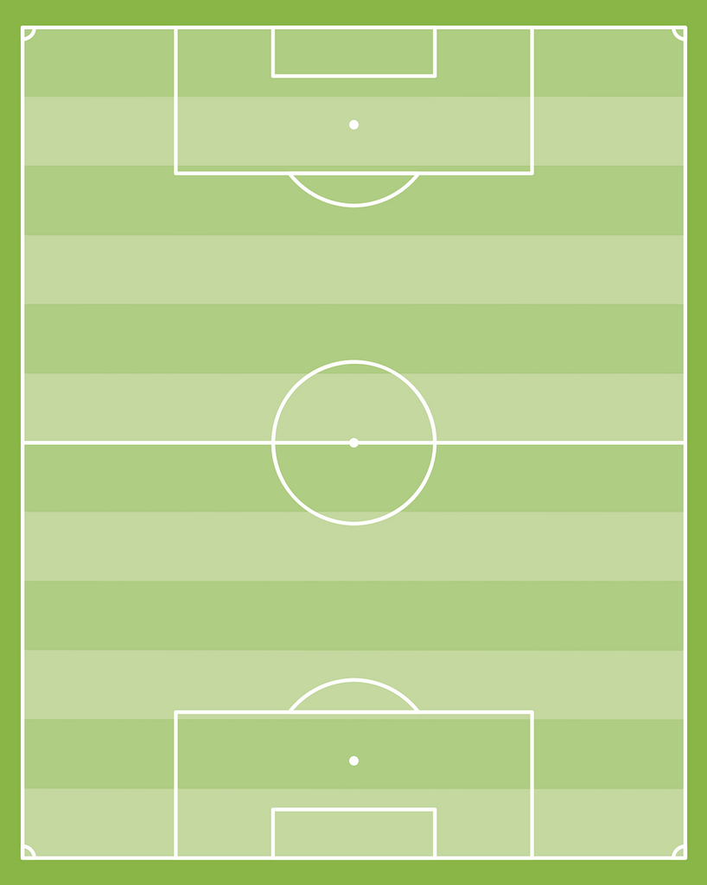
How do Open Access and OERs relate to one another?
Open Access
OERs
Both are publicly available online free of charge to users.
Both can be used as tools to help achieve the UN Sustainable Development Goals.
Both have the potential to revolutionise access to education.
Not all OA materials are OERs. Some OA materials are licensed in a way that does not support the 5Rs. While OAs do permit sharing they may prohibit adaptation.

Slide 8
The future is Open
For further guidance on Open Access at GCU visit the library website
You can also contact the repository team: repository@gcu.ac.uk
This work is licensed under a Creative Commons Attribution 4.0 International License

