Slide 1
REF OA Exceptions Survey
Open Research Scotland meeting, 30 April 2020
Elinor Toland, Glasgow Caledonian University

Slide 2
REF OA Exceptions survey
Conducted in April 2020 with Open Research Scotland group (11 responses)
Aim: to see what risk we attribute to the different exceptions and where we agree/disagree
The categories below were used:
Level 1: considered lowest risk (e.g. routinely added by Library/Research Office staff)
Level 2: considered medium risk (may involve input from the author, usually straightforward to assess)
Level 3 : considered highest risk (usually involves contribution from the author and greater level of judgement required by Library/Research Office staff)
Uncertain: exception risk level difficult to determine

Slide 3
Deposit exceptions risk level

Slide 4
Deposit exceptions results
Highest risk: 252e - deposit would present a security risk
This is also the deposit exception with the most uncertainty around the risk level
Comments:
‘Require input external to the Library regarding security risk’
‘Further elaboration needed on what type of security risk..’
Lowest risk: 252c - staff not on Cat A contract at UK HEI at submission
Comments:
‘Quite straightforward, we can check employment dates on Pure. It might require further investigation with author if in doubt’
252b - delay in obtaining AAM
Comments:
‘We have to check and exclude cases where authors ask for this when they have no evidence of delay. They sometimes try to claim this because they were not aware of the requirements or forgot to deposit the text on time.’

Slide 5
Access exceptions risk level

Slide 6
Access exceptions results
253b (embargo exceeds maxima for Panel) and 253c (publication disallows open access deposit)
Identical results for these exceptions where the author has to indicate the journal was the most appropriate for publication.
Equal split between high and medium risk
Comments:
253b
‘This is subjective. Where authors claim this the process is Units of Assessment have to satisfy themselves that this is robust’
253c
Several people noted they would use Sherpa/contact publisher to determine this

Slide 7
Technical exceptions risk level

Slide 8
Technical exceptions results
Highest risk: 254b - short term technical failure
Comments:
‘Would require input external to library’
‘Not used so far. Some debate as to whether process issues can be covered by 'systemic issues' or if it is strictly a software or hardware error.’
Lowest risk: 254a - staff not at UK HEI at acceptance
Comments:
‘We do search online for deposit in other repositories if required but don't seek confirmation of compliance with repository staff’
‘We would email the repository to try and verify’
‘We assign this if we have evidence/author claims but the Units of Assessment are responsible for checking the contract dates.’

Slide 9
‘Other’ + 3 months from publication exceptions
These are considered the highest and the lowest risk exceptions by respondents. Also no uncertainty about the risk for these.
Comments on ‘Other’ exception:
‘Try to avoid use of this exception as believe it may leave us open to audit if over used’
‘We were told other exception was high risk and would increase the chances of audit’
‘Any unusual cases need to be checked out. Often this is the responsibility of the Unit of Assessment.’

Slide 10
Overall summary
The REF open access exceptions considered highest risk:
In addition, a number of other exceptions were considered high risk by 5 people in each case.

Slide 11
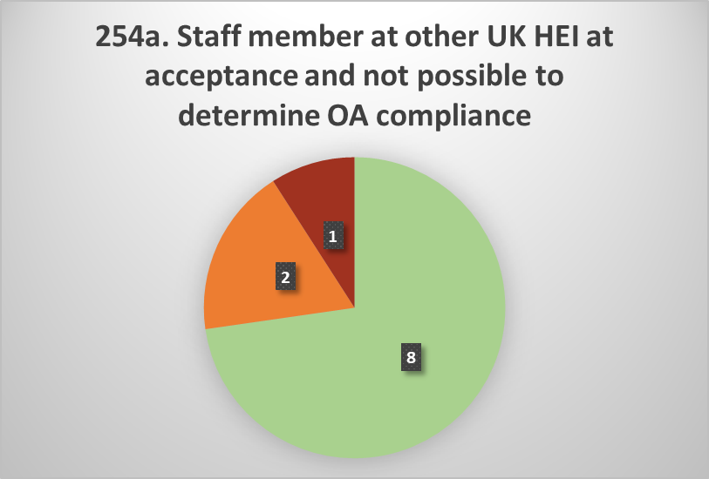
Overall summary
The REF open access exceptions considered lowest risk:
There were only 2 exceptions where 5 or more people considered them low risk in each case. Relates to audit and level of caution/extra caution needed.

Slide 12
Overall summary
General comment:
‘Exceptions are a grey area, very much open to interpretation, which is making things very complicated’
No complete agreement on any of the exceptions (closest was results for ‘Other’ and 3 months from publication exceptions):
Indicates policy is open to interpretation and/or we’re adopting different internal approaches
The number of exceptions where there was some level of uncertainty about the risk level also would support the above comment
Results of the majority for each exception closely matches our interpretation at GCU

Slide 13
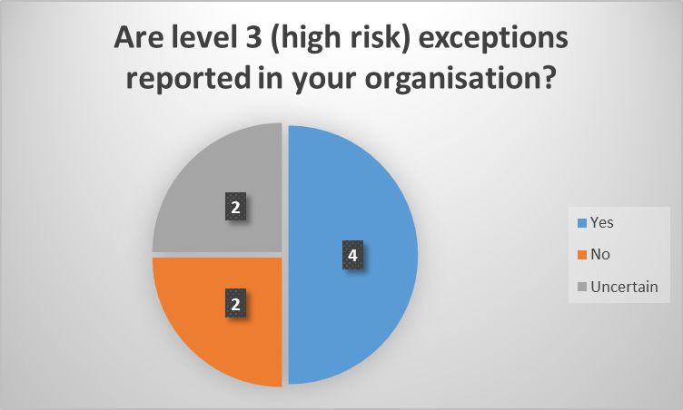
For Level 3 exceptions: is the risk/uncertainty for individual outputs reported in your organisation (e.g. to a Research Director)?
If yes, who is this information reported to?
‘REF Panel groups and/or Associate Deans of Research’
‘Unit of Assessment Leads’
‘Units review the data for their selected items and are responsible for satisfying themselves that exceptions are robust’
‘These will be discussed with the REF team’

Slide 14
For exception(s) categorised as Level 3: who makes the final judgement on whether the exception is applied and/or included in your 5% tolerance?
‘Currently the library in discussion with UoA leads. We expect this will extend to the REF management group of the university when final decisions are to be made closer to the REF submission date.’
‘not sure’
‘Repository Librarian applies exceptions; REF Co-ordinator determines whether the output is included in the submission and how to account for it in the 5% tolerance.’
‘Research team and directors of research for the school’
‘Unit of Assessment Coordinators and REF Manager’
‘Last call would be on Unit of Assessments, after consultation with Library and REF Team’
‘The Unit of Assessment Champion’
‘REF Team’

Slide 15
Contact: elinor.toland@gcu.ac.uk
Thanks to Jackie Proven, Head of Open Research, University of St Andrews for input into the survey

