Slide 1
Seth Thompson
An introduction to copyright and licensing in teaching
Presentation by Seth Thompson. Licensed under the terms of a CC-BY-4.0 license

Slide 2
What we will cover in this workshop
What is copyright and what can be protected by copyright?
So you want to use copyright material?.. what do you want to use it for?
Copyright license information in teaching and education
Copyright exemptions
Copyright and licensing in open and closed spaces
Putting it all together: some worked examples of copyright queries
  GCU UK Copyright Advisor

Slide 3
What is copyright and what can be protected by copyright?
Copyright is a form of intellectual property that protects original literary, dramatic, musical and artistic works, as well as layouts or typographical arrangements of published work, sound recordings, film and broadcast
(Copyright User, n.d. CC-BY-3.0)
Copyright, designs and patents act 1988 (CDPA)
Literary, dramatic, musical and artistic works: copyright expires 70 years from the end of the calendar year of the author's death
(Deazley and Meletti, n.d. CC-BY-3.0)
Notes:
1. Copyright gives the creator of the work the exclusive rights to copy, license, rent, lend, perform, show the work to the public, make an adaptation of the work or translate a work.
The copyright regime consists of not only economic rights but also moral rights.
Moral rights give the creator the right to be identified as the author of the work; not to have their work changed and the right to object to derogatory treatment of their work.
2. The Copyright, Designs and Patents Act 1988 (as amended and revised), is the current UK copyright law
3. Copyright for different types of works can last for different durations. However, literary, dramatic, musical and artistic works currently expires 70 years from the end of the calendar year of the author's death. After this the work is within the public domain.

Slide 4
What is copyright and what can be protected by copyright?
There is no formal registration procedure for copyright; a work is protected as soon as it is in a permanent or fixed form
More than one person can own copyright on a work
Infringement of copyright occurs when someone takes either all of a work, or a substantial part of it, without permission.
(Soetendorp and Meletti, n.d. CC-BY-3.0)
Notes:
3. What makes copyright a complex mechanism is that it has to encourage learning and the spread of knowledge while securing economic and personal rights to authors and creators.
Striking the correct balance is one of the major challenges of copyright law.

Slide 5
So you want to use copyrighted material?.. what do you want to use it for?
Why consider types of copyright usage?
  Certain activities are considered ‘restricted acts’ under copyright legislation
Restricted acts defined by CDPA
Restricted acts must be ‘mapped’ onto activities in order to understand if licenses and exceptions are available
(Morrison and Secker, 2020. CC-BY-4.0)

Slide 6
Do you want to use copyrighted material?.. what do you want to use it for?
Restricted acts…
Copyright owner has the right to, or allow others to:
  Make copies of a work
  Distribute copies (e.g. publishing)
  Rent or lend the work
  Perform, play, or show the work in public
  Communicate the work by electronic means (internet or broadcasting)
  Adapt the work
(Morrison and Secker, 2020. CC-BY-4.0)
Notes:
7. Key issue: is one of these acts taking place?
If not, no copyright issues taking place
For example, reading a journal article does not involve an usage controlled by copyright.
However, making a copy of the journal article and posting it on the internet does.

Slide 7
Copyright license information in teaching and education
Copyright licenses…
  Legal agreements that allow use of copyright material
Advantage of licenses over relying on a copyright exemption- they give certainty (provided you stick to the terms!)
All licenses involve limitations
(Morrison and Secker, 2020. CC-BY-4.0)
Notes:
1. Copyright licenses are legal agreements that allow people/organisations to use copyright material with the permission of the copyright owners. First point of call
2. If what you want to do with copyright material is covered by a license arranged by GCU it is a legal certainty as long as you stick to the terms of that license
3. Worth reiterating all licenses have limits, having a license is not an opportunity to do as you wish

Slide 8
Copyright Licensing Agency (CLA) UK HE License
Copying, scanning and using extracts from work
CLA UK HE license facilitates permission to:
  Make copies from digital and print books, magazines, journals and websites
  Share copies with students and staff
  Store copies on GCU Learn (intranet)
  Copy up to one article, chapter or 10% of the total, whichever is greater
  Copy publications from the UK plus 38 international territories
(CLA, n.d)

Slide 9
Copyright Licensing Agency (CLA) UK HE License
Need to get something scanned…
Fill out a scanning request and contact the Library Scanning Team:
  https://www.gcu.ac.uk/library/servicesforstaff/scanning/requestascan/
You can find out more about CLA scanning at GCU, and how to request scan renewals at our webpages:
  https://www.gcu.ac.uk/library/servicesforstaff/scanning/

Slide 10
Educational Recording Agency (ERA) License
ERA Licence enables GCU staff to make recordings or copies of TV and radio programmes for educational use.
Facilitates permissions to:
  Show clips or copies of whole programmes
  Use clips from broadcasters’ websites and catch-up services
  Any number of copies can be made and retained
  Copies can be kept for as long as an ERA Licence is held
  Share on VLEs and embed clips in presentations
  Access recordings via an approved third party for example: BBC iPlayer or Box of Broadcasts (BoB)
  Students can access ERA licensed material over a secure network on or off-site in the UK
  (ERA, n.d.)
Notes:
The ERA license provides the relevant licensing scheme in relation to making recordings or copies of TV and radio programmes for educational use

Slide 11
Newspaper Licensing Association (NLA) License
The NLA Education Establishment Licence permits the copying and reuse of print and digital news content.
Facilitates permissions to:
  Make copies from UK national newspapers plus 5 regional titles
  Upload and store copies of news articles on a VLE or intranet
  Email copies to students and staff
  (NLA, n.d.)

Slide 12
Creative Commons (CC) licenses
An international legally binding scheme which is complimentary to copyright laws
Provides people and organisations with a simple, and standardised method to grant copyright permissions for creative and academic works; ensure proper attribution; and allow others to copy, distribute, and make use of those works
You may encounter CC licenses when searching online for teaching materials
You can apply a CC license to any resources you develop- allows you to control how your resource can be reused
(Creative Commons, n.d. CC-BY 4.0)

Slide 13
Common CC licenses
License | Logo | Description
CC0 |  | Public domain licence, completely open
CC-BY |  | lets you distribute, remix, tweak, and build upon a work, even commercially, as long as you credit the creator
CC-BY-SA |  | lets you distribute, remix, tweak, and build upon a work, even commercially, as long as you credit the creator and license your new creations under identical terms
CC-BY-ND |  | allows redistribution, commercial and non-commercial, as long as the content is passed along unchanged and you credit the creator
CC-BY-NC |  | lets you distribute, remix, tweak, and build upon a work non-commercially, as long as you credit the creator

Slide 14
CC licences and GCU policy
CC licenses recommended within GCU Open Educational Resources Policy when creating teaching resources
  https://edshare.gcu.ac.uk/5415/
Approved by GCU Executive Board in 2015

Slide 15
Copyright exemptions
There are a number of copyright exceptions set out in the CDPA
Concerning education, non-commercial research and private study, quotation and news reporting amongst others
Learn about the UK’s copyright exceptions here: https://www.copyrightuser.org/understand/exceptions/
Focus of this workshop is on the education exemption

Slide 16
Education exemption
Under the exceptions to copyright law you can use any type of material for teaching purposes.
To use the education exemption, you must also comply with…
Notes:
1. The use of materials protected by copyright is essential to the learning process. Educational resources exist in all formats that are recognised as ‘works’ in copyright law.
However, if you are using materials in an educational context this does not mean that you can forget about copyright.
What it does mean is that you need to be aware of when you can use a work without obtaining permission or paying a licence fee, and when permission or a licence is required.

Slide 17
Education exemption
Three conditions to use the education exemption:
  The purpose of the use is non-commercial
  Where practical, there should be sufficient acknowledgement of authorship of the work
  The use of the material is fair
… education exemption only applicable when a license is not available
(Soetendorp and Meletti, n.d. CC-BY-3.0)
Notes:
The law makes clear that certain exceptions for education can only be relied upon in the absence of a relevant educational licensing scheme

Slide 18
Education exemption
Copyright is not infringed upon if:
  Work used to give/receive instruction
    Can include setting exam questions, communicating questions and answer questions
  Work is used to illustrate a point
… must illustrate a point!
(Soetendorp and Meletti, n.d. CC-BY-3.0)
Notes:
2. One of the most important exceptions for education permits the use of any type of work for the purpose of teaching (or as the law puts it: ‘for the sole purpose of illustration for instruction’).
This means that copyright in the work is not infringed by an individual teacher or a student as long as they are copying the work to give or receive instruction (or when preparing to give or receive instruction)
3… and the copying is used to illustrate a point about the subject being taught.

Slide 19
Three conditions to use the education exemption
  Purpose of the use is non-commercial
Is education commercial?
  For the purposes of copyright law, Higher Education in Scotland is seen as a non-commercial enterprise.

Slide 20
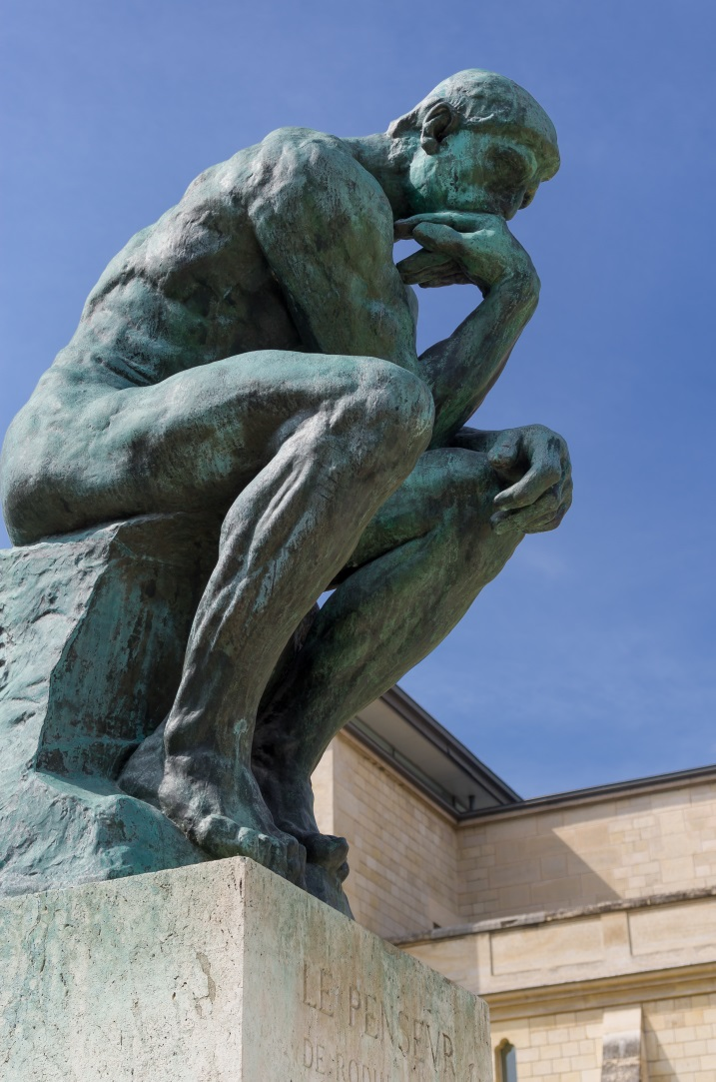
Three conditions to use the education exemption
What is sufficient acknowledgement?
Type of content: Title, by Author. Source. (Licence)
Image: Le Penseur in the Jardin du Musée Rodin, Paris, by Douglas O’Brien. https://bit.ly/2GZ85AQ (CC BY-SA 2.0)
Notes:
Where practical, there should be sufficient acknowledgement of authorship of the work
Here is a simple format for crediting media items:
Type of content: Title by Author. Source (Licence)

Slide 21
Three conditions to use the education exemption
The use of the material is fair and of ‘fair dealing’
No legal definition of what is fair or unfair in this context
Fair dealing determines whether usage is lawful or infringing based on how a ‘fair minded and honest person’ would deal with the work.
Key questions:
  Does using the work affect the market for the original work?
  Does it affect or substitute the normal exploitation of the work?
  Is the amount of the work taken reasonable and appropriate?
  Was it necessary to use the amount?
(Morrison and Secker, 2020. CC-BY-4.0)
Notes:
7. ‘Fair dealing’ an issue decided by courts depending on a number of factors, such as:
amount of the work taken
whether the use would commercially compete with the copyright owner’s exploitation of the material
Just to reiterate one again, the law makes clear that certain exceptions for education can only be relied upon in the absence of a relevant educational licensing scheme.

Slide 22
Three conditions to use the education exemption
UK government on ‘fair’:
  'minor uses, such as displaying a few lines of poetry on an interactive whiteboard, will be permitted, but uses which would undermine sales of teaching materials will still need a licence'.
(Soetendorp and Meletti, n.d. CC-BY-3.0)
In short…
  use only as much as needed to make your point

Slide 23
Copyright and licensing in open and closed spaces
Open and closed spaces can be physical or digital
Open:
  Websites and social media platforms- viewable to anyone with the address
  Public teaching spaces and conferences
Closed:
  GCU Learn (VLE) or authenticated spaces only open to GCU staff and students
  Lecture theatres, tutorial, lab and seminar spaces
(Campbell and Farley, n.d. CC-BY-4.0)

Slide 24
What teaching materials can we use in open and closed spaces?
Open:
  Content you have created
  Any Public Domain or openly licensed (CC) materials and Open educational resources (OER)
  Copyright materials under the CDPA exceptions
Closed:
  Database and subscription materials
  Texts - within CLA licence terms
  Film and broadcast materials - within ERA licence terms
  Newspapers – within NLA license terms
  Any Public Domain or openly licensed (CC) materials and OER
(Campbell and Farley, n.d. CC-BY-4.0)

Slide 25
Putting it all together: some worked examples of copyright queries
  Have a look at the scenarios, use the GCU UK Copyright Advisor to work out if you can or can’t use the work and if a license of exemption may be applicable
  https://edshare.gcu.ac.uk/4481/13/CARP/index.html

Slide 26
Putting it all together: some worked examples of copyright queries
A World Health Organisation (WHO) infographic detailing alcohol awareness. You wish to use the work with a group of community health and nursing students within a classroom environment in order to test their knowledge on the health risks associated with excessive alcohol consumption. You have found the image on the WHO website.

Slide 27
Putting it all together: some worked examples of copyright queries
A video clip on management that you found online. You are delivering a lecture on leadership in the workplace. The lecture is open to the public. You wish to use the clip as it illustrates examples of poor management, you also think its funny and would be a good ice breaker for the attendees.

Slide 28
Putting it all together: some worked examples of copyright queries
A chapter from a print version of a textbook called Craig’s Soil Mechanics. You wish to post it on GCU Learn as a course reading for week 3 of a Geotechnical Engineering module.

Slide 29
GCU Library Copyright team contact details
If you have any queries you can contact us at:
  copyright@gcu.ac.uk
You can also check out our copyright webpages for more information:
  https://www.gcu.ac.uk/library/servicesforstaff/copyright/
Some other useful websites:
  https://www.copyrightuser.org/
  https://copyrightliteracy.org/
  http://www.legislation.gov.uk/ukpga/1988/48/contents
Thanks for coming!

Slide 30
References
CAMPBELL, L.M. and FARLEY C., n.d. Will it Bite Me? Media, Licensing, and online teaching environments [presentation online]. [viewed 03 February 2020] Available from: https://media.ed.ac.uk/playlist/dedicated/42223461/1_attqfb92/0_dpdxtviw. Licensed under CC-BY-4.0
COPYRIGHT LICENSING AGENCY, n.d. CLA UUK/GuildHE Higher Education Licence [online]. Copyright Licensing Agency. [viewed 03 February 2020]. Available from: https://www.cla.co.uk/higher-education-licence
COPYRIGHT USER, n.d. Question #1: What is copyright and what can be protected by copyright? [online]. Copyright User. [viewed 03 February 2020]. Available from: https://www.copyrightuser.org/faqs/question-1/. Licensed under CC-BY 3.0
CREATIVE COMMONS, n.d. What we do [online]. Creative Commons. [viewed 03 February 2020]. Available from: https://creativecommons.org/about/. Licensed under CC-BY-4.0

Slide 31
References
DEAZLEY, R. and Meletti, B., n.d. Public Domain [online]. Copyright User. [viewed 03 February 2020]. Available from: https://www.copyrightuser.org/create/public-domain/duration/. Licensed under CC-BY 3.0
EDUCATIONAL RECORDING AGENCY, n.d. The ERA License [online]. Educational Recording Agency. [viewed 03 February 2020]. Available from: https://era.org.uk/the-licence/the-era-license/
NEWSPAPER LICENSING AGENCY, n.d. Educational licences [online]. Newspaper Licensing Agency. [viewed 03 February 2020]. https://www.nlamediaaccess.com/apply-for-a-licence/education-establishment/
SOETENDORP, R. and MELETTI, B., n.d. Education [online]. Copyright User. [viewed 03 February 2020]. Available from: https://www.copyrightuser.org/understand/exceptions/education/. Licensed under CC-BY 3.0
Presentation by Seth Thompson. Licensed under the terms of a CC-BY-4.0 license

