Slide 1
I want to find…
a specific journal article
journal articles on a subject
journals on a subject

Slide 2
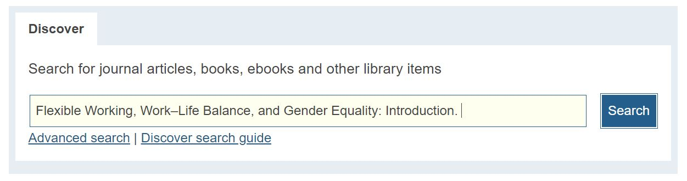
Finding a specific article
CHUNG, H. & VAN DER LIPPE, T., 2018. Flexible Working, Work–Life Balance, and Gender Equality: Introduction. Social Indicators Research [online]. pp. 1–17. Available from:DOI:10.1007/s11205-018-2025-x
1. Note the article details
CHUNG, H. & VAN DER LIPPE, T., 2018. Flexible Working, Work–Life Balance, and Gender Equality: Introduction. Social Indicators Research [online]. pp. 1–17. Available from:DOI:10.1007/s11205-018-2025-x
2. Identify the article title
3. Search for it in Discover
journals on a subject

Slide 3
I can’t find the article on Discover
Scenario 1. The library have it but it’s not in the first page of results:
Filter results to show articles
Scenario 2. Still can’t find it? Not part of library collection.
Request an Inter-library loan

Slide 4
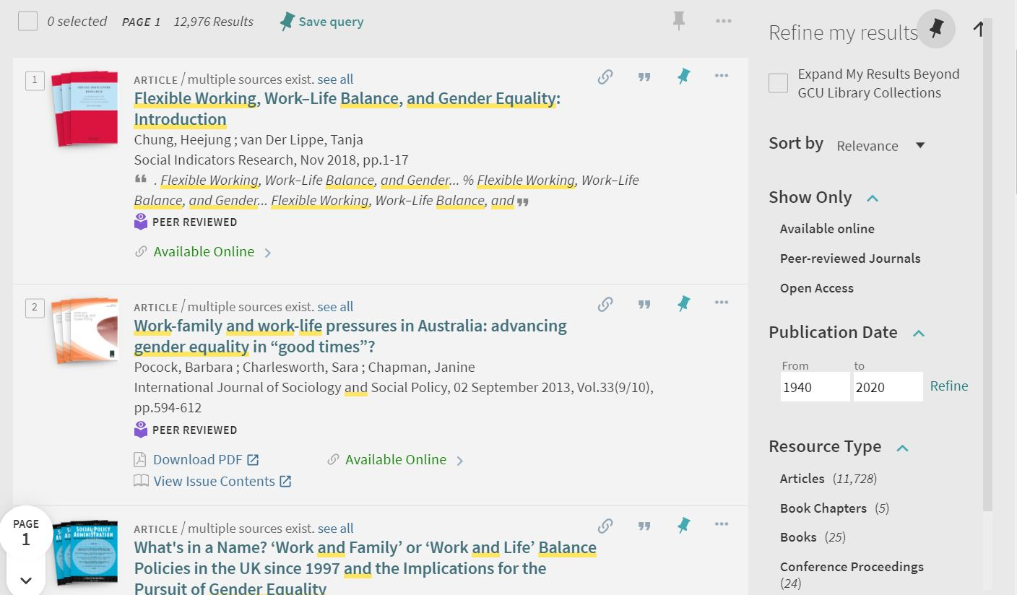
Filtering results on Discover
Use the Refine my results options on the results screen.
For Resource Type
select Articles.
journals on a subject
Article not there? Request an inter-library library loan. Click here

Slide 5
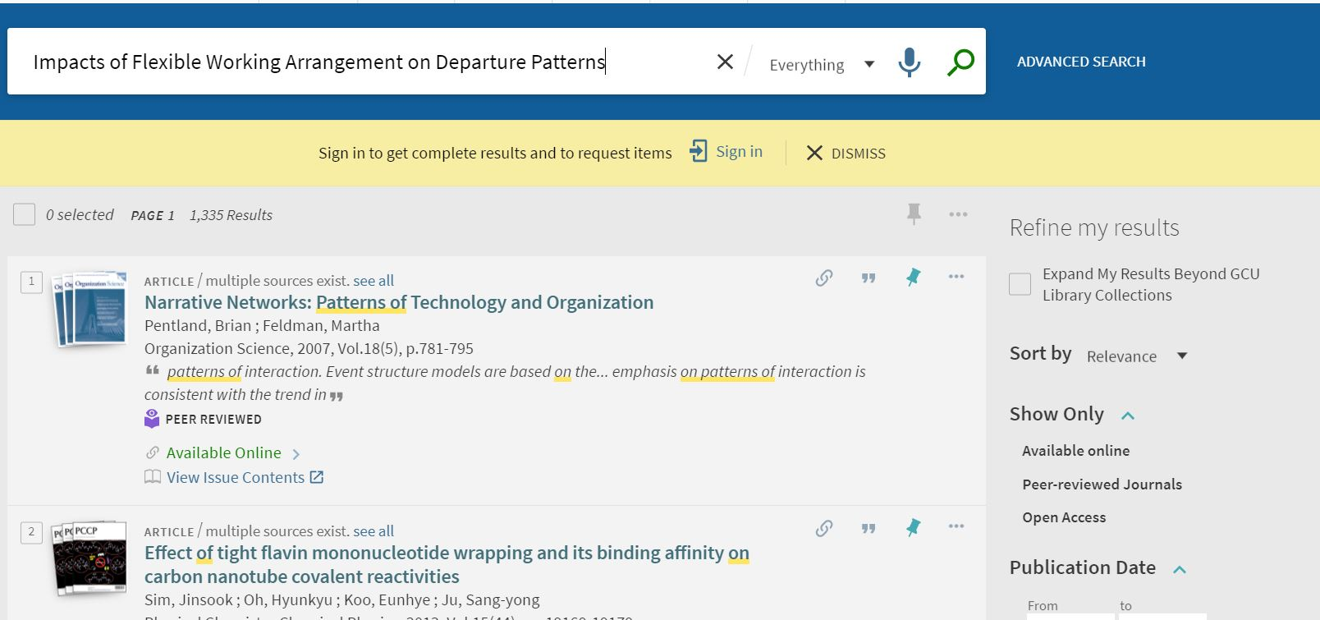
Requesting an inter-library loan on Discover
Sign in using your GCU username and password
journals on a subject

Slide 6
Requesting an inter-library loan on Discover
Select Expand My Results Beyond GCU Library Collections
journals on a subject

Slide 7
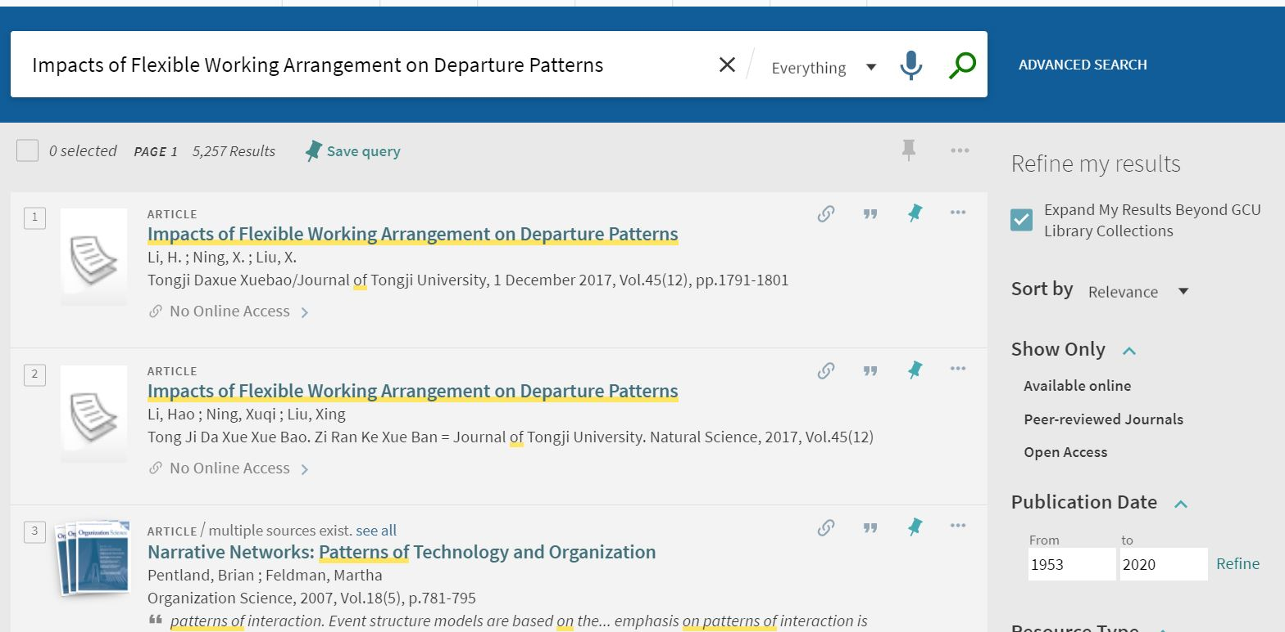
Requesting an inter-library loan on Discover
Click on the article you are searching for
journals on a subject

Slide 8
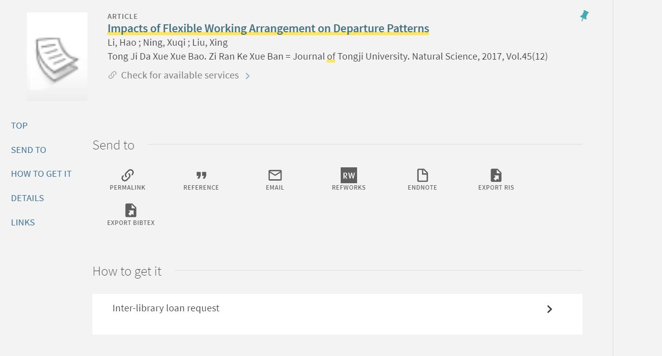
Requesting an inter-library loan on Discover
Click on Inter-library loan request and complete the online form.
journals on a subject
The Inter-library loan team will process your request. Note: not everything is available via lnter-library loan

Slide 9
Finding articles on a topic
Two main places to search on a topic using keywords:
Discover
High hit rate, low accuracy
Learn more about Discover
Subject databases
Low hit rate, high accuracy
Learn more about subject databases
journals on a subject

Slide 10
Discover
Discover searches across most of the library’s collections, including most subject databases.
More on Discover
Discover is good for simple searches
Use the Articles filter to view only journal articles
If you have several search terms, your search needs to be comprehensive or you don’t find what you need in Discover then…
use subject databases

Slide 11
Subject databases
The library subscribes to a range of databases, both multidisciplinary, for example Science Direct or ProQuest Central and subject specific, for example Emerald or Business Source Elite.
A subject database gives you more control over your search. You can:
use more keywords
use more filters
save and rerun searches
Your academic librarians can advise on effective database searching.
Contact your librarian
Find the best databases for your subject

Slide 12
Finding journals by subject
Browzine enables you to browse, read and monitor journals by subject
1. Select Browse Journals on library homepage
journal articles on a subject
2. Choose Connect to Browzine
journals on a subject
More information on Browzine

Slide 13
Contact us for further assistance
African Leadership College lib-alc@gcu.ac.uk
Glasgow School for Business and Society lib-gsbs@gcu.ac.uk
School for Computing, Engineering and Built Environment lib-scebe@gcu.ac.uk
School for Health and Life Sciences lib-hls@gcu.ac.uk
Institute for University to Business Education lib.u2b@gcu.ac.uk

