Slide 1
GCU Guest Lecture Redstone Risk Ltd

Slide 2
Agenda
Introduction to Redstone Risk
Our Take on Operational and Strategic Risk
Real Life Case Studies

Slide 3
Will Foulds
BEng, MSc, CFIRM
Gareth Day
BA(Hons), LL.Dip, MSc, PMQ
17 years’ Experience
Previously: Babcock International Group, QinetiQ and BMT
Fellow of IRM
MSc with Distinction in Risk Management
Former external examiner to Glasgow Caledonian
6 years’ Experience
Previously: Babcock International Group
MSc Management
APM PMQ

Slide 4
Providing trusted risk management consulting, modelling, and analytics to Defence and Energy customers. We make risk information useful.

Slide 5
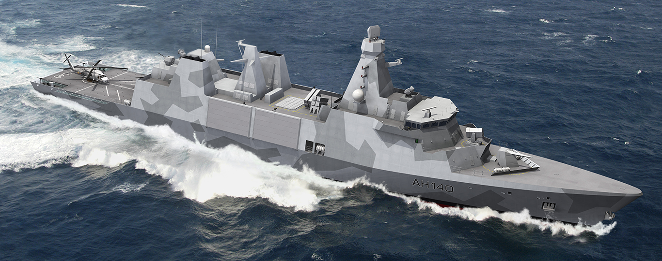
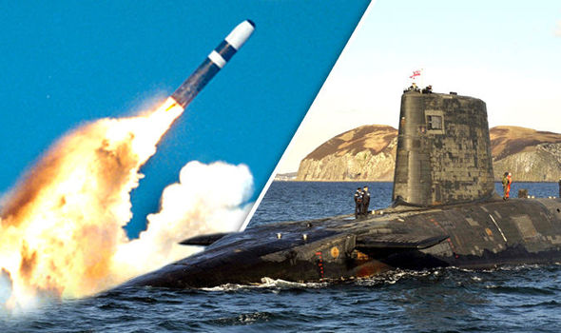
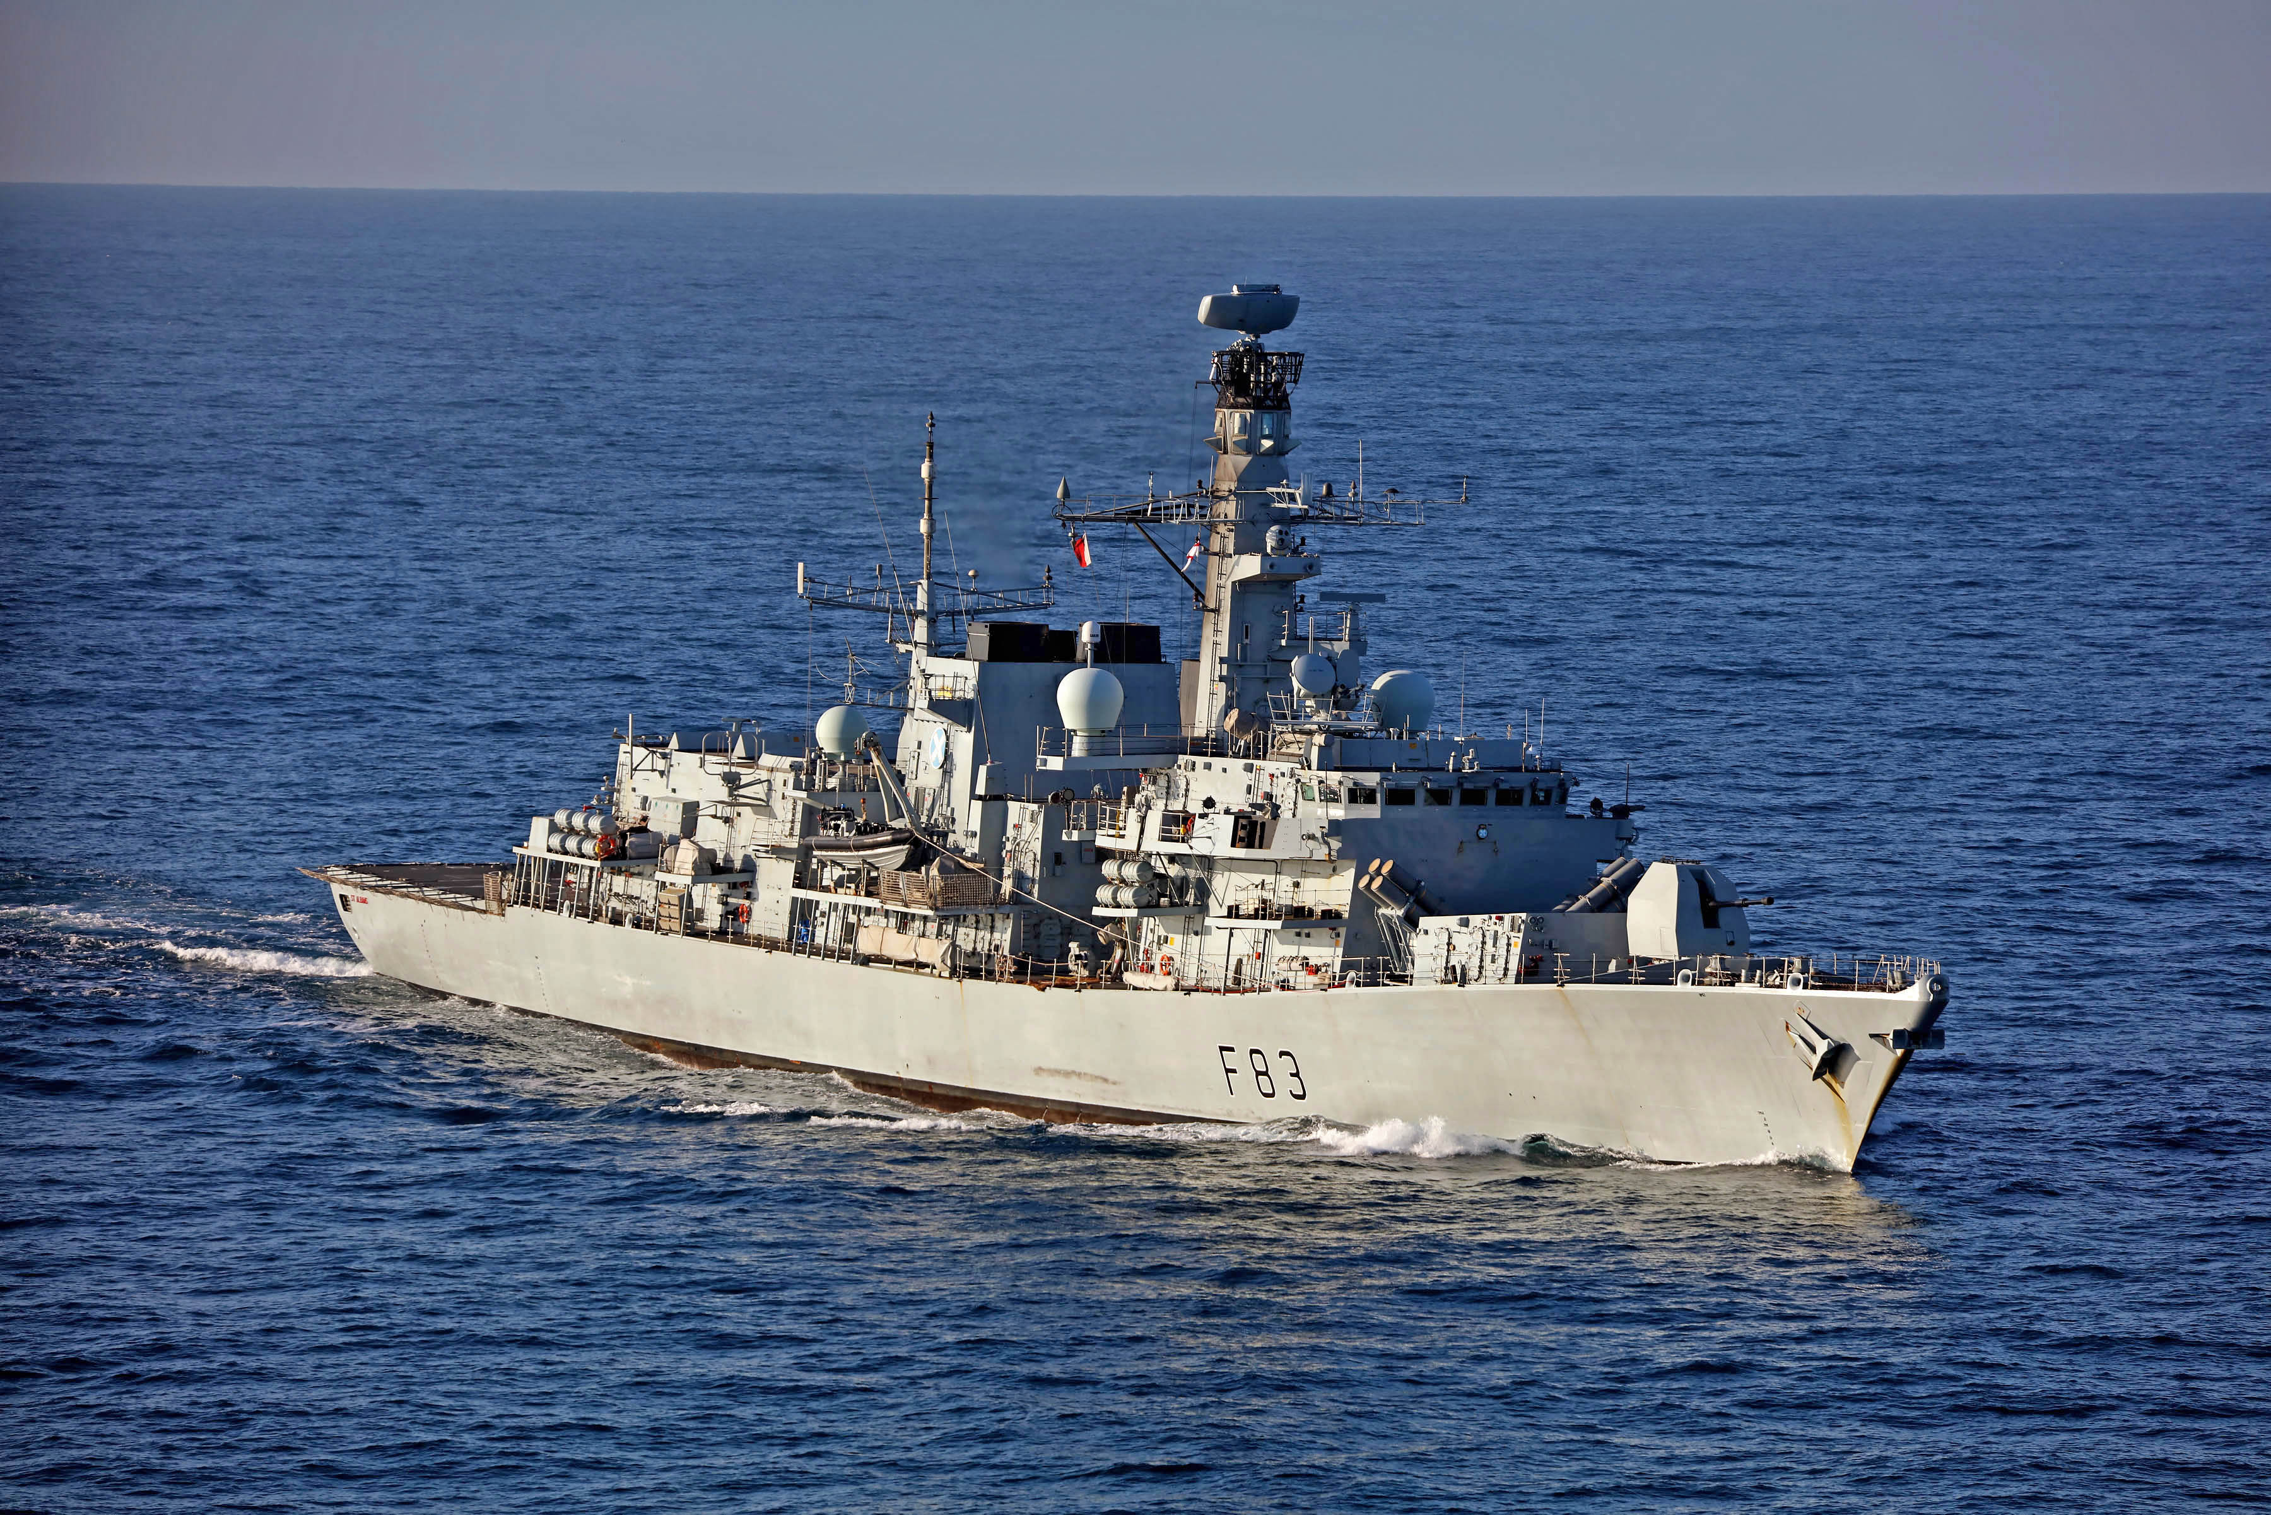
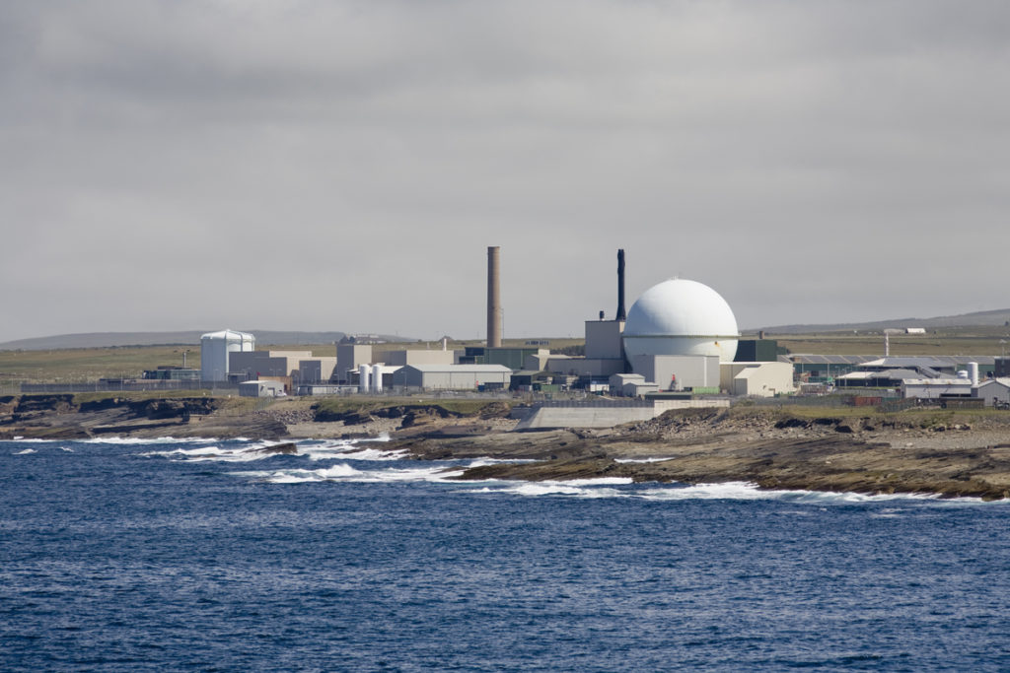
What do we do?

Slide 6
Values & Mission
TRUST
Our core values are…
Trust & Reliability
Flexibility
Integrity
Our mission is to...
Maintain our reputation as trusted advisors and reliable practitioners by continuing to deliver high quality, highly valued services to existing customers.
Develop our capabilities in line with the needs of existing and new customers, e.g. growing “Redstone Risk Analytics”.
Grow our team to enable us to strengthen our core business, develop our capabilities to solve our customers problems, improve our flexibility and expand our client base.
FLEXIBILITY
INTEGRITY

Slide 7
Our Take on Operational and Strategic Risk

Slide 8
Our view of the world
Operational Risk
Project based
Day-to-day
Outputs/outcomes
Data capture
Strategic Risk
Enterprise level
Executive objectives
Delivery of intended benefits
Risk informed decision making
But is it really this easy to define? …
Should we be even be defining it like this?...

Slide 9
Operational Risk
=
Project Risk
Scope (Requirements)
‘How many risks are there in my project?’
Quality
‘What’s going to stop us doing what we’re already doing’
Time
Cost
Risks that could prevent the project from delivering its intended outputs

Slide 10
Strategic Risk
=
Enterprise Risk
Benefits
Objectives
Scope (Requirements)
Benefits
Objectives
‘What’s going to stop us going where we want to go’
‘How risky is my project?’
Quality
Time
Cost
Objectives
Benefits
Risks that could prevent the company achieving its strategic objectives or delivering its intended benefits

Slide 11
The Data Journey
Scope / Requirements
Customer Risk Register
Enterprise Risk Register
Strategic Objectives / Benefits
Flow of Information
Portfolio Risk Register
Programme Risk Register(s)
Outcomes
Project Risk Register(s)
Outputs
Number of risks being managed
Notes:
Where is the line between operational and strategic risk management? It’s not always so clear cut (portfolio upwards) – flow of information often dictates the boundary. When the information is used to directly inform strategic decision making.
Strategic and operational risk go hand in hand and it often depends on the lens we’re using to look at the data through as to where the boundary is (the journey of data). We can’t have strategic risks without knowing the day to day impacts and we can’t undertake operations without strategic direction
Key is often in how we communicate the data and formulate the message we want to tell people. This is a big trend in risk management – that all risks should be viewed through the strategic lens and used to help inform decision making

Slide 12
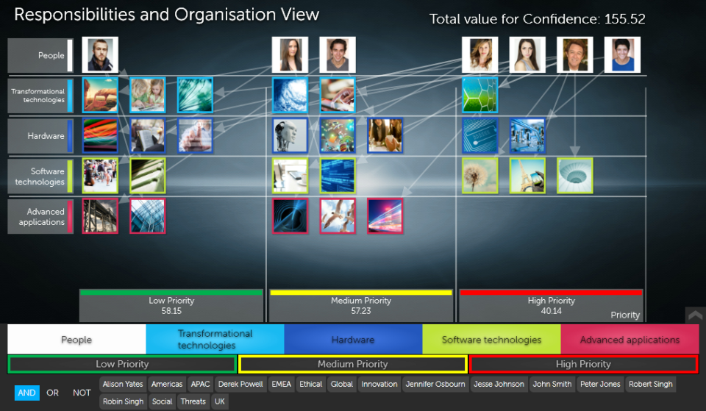
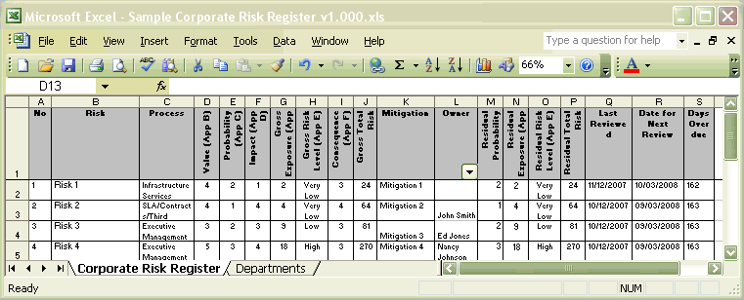
What does this mean in practice?
Support the data journey by…
Not using complicated language only we understand
Making use of dynamic and visual data presentation methods
Not relying on static data
Shifting the focus from compliance-driven data gathering to supporting strategic decision making
Risk management isn’t really about managing risks at all; it’s about enhancing performance by embedding risk thinking into business decisions.
The New
Courtesy of SharpCloud (www.sharpcloud.com)
The Old
Notes:
So if Alexi is right and all risk management should be looked at through the strategic lens through the close links to objectives and benefits, how do we put this into practice?
The key is in the way we use our data and present our information up the chain.
Instead of producing lots of data and reports that are focussed on compliance and process box ticking, we need to focus on making our outputs more visually engaging, easy to understand and available to decision makers at the point of need. We need to move away from the complex meta language of common risk processes and speak in plain English to increase engagement
.
The future of risk management is one where emerging developments in technology are harnessed to improve the communication of our risk data. Data visualisation is not just a ‘nice to have’ or an afterthought, it is a necessity; the next generation coming through are expecting to make decisions using highly visual, dynamic toolsets not the old tools and processes that still dominate much of what we do.

Slide 13
Case Study 1 Risk Analysis and Risk Process support for the successful Babcock tender for the Type 31e Frigate programme

Slide 14
Case Study 1
Risk Analysis and Risk Process support for the successful Babcock tender for the Type 31e Frigate programme

Slide 15
Case Study 2 Risk Analysis and Risk Process support for a major contractor within the UK Defence Nuclear industry

Slide 16
Case Study 2
Risk Analysis and Risk Process support for a major contractor within the UK Defence Nuclear industry

Slide 17
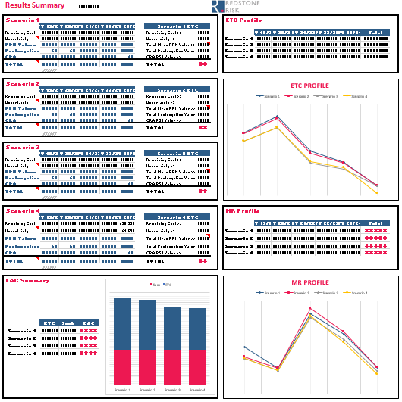
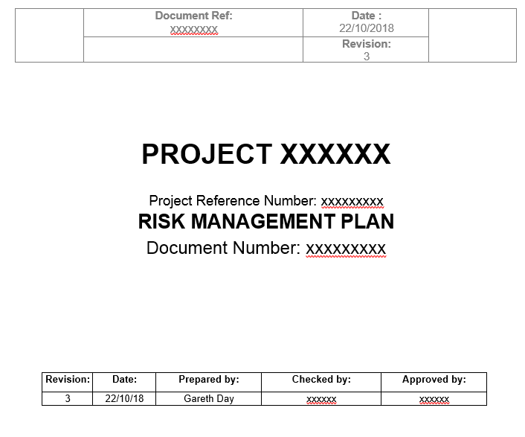
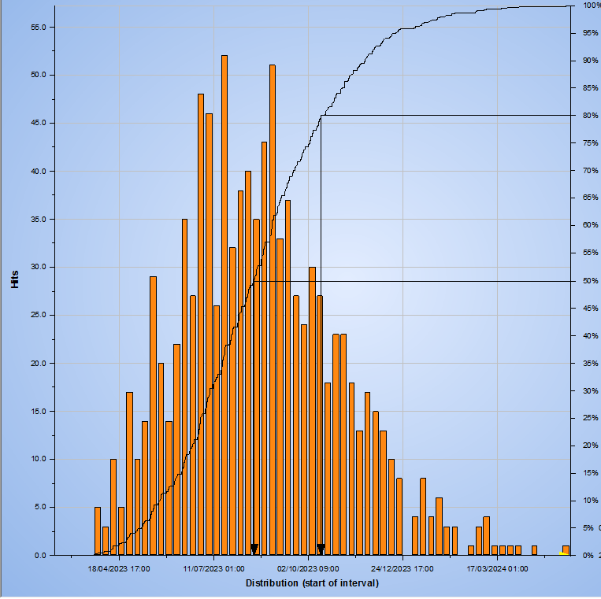
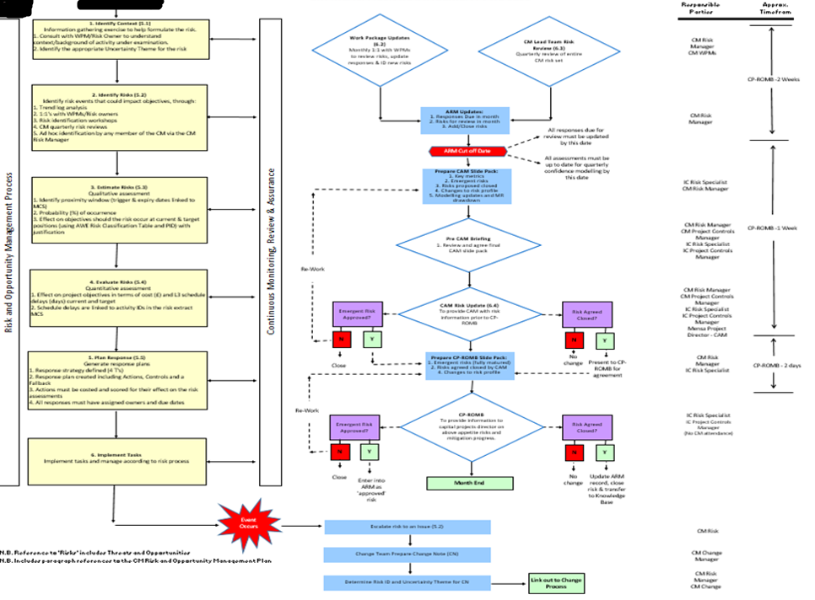
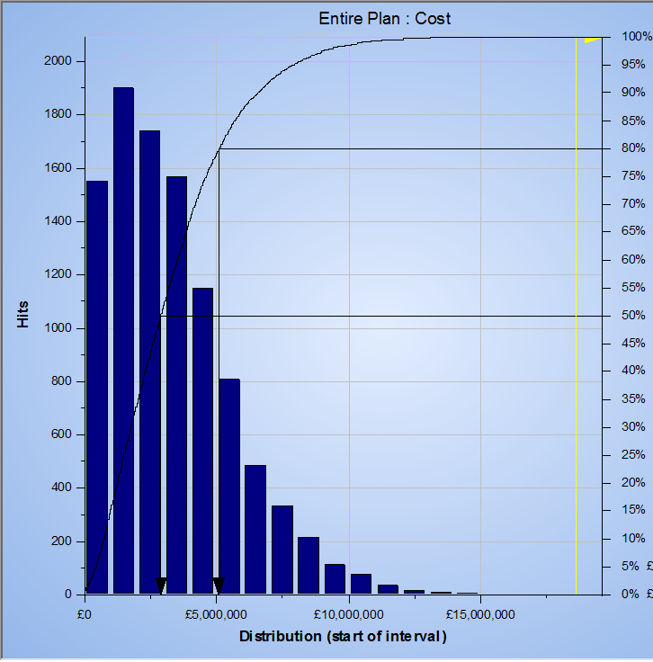
Procedures
Presentation
Practices
Process

