Slide 1
The Power of Dreams community economic development after the virus Ed Mayo John Pearce Memorial Lecture November 16th 2020
#JPLecture @edmayo1 @PilotlightUK

Slide 2
Participation is a way to…

Slide 3
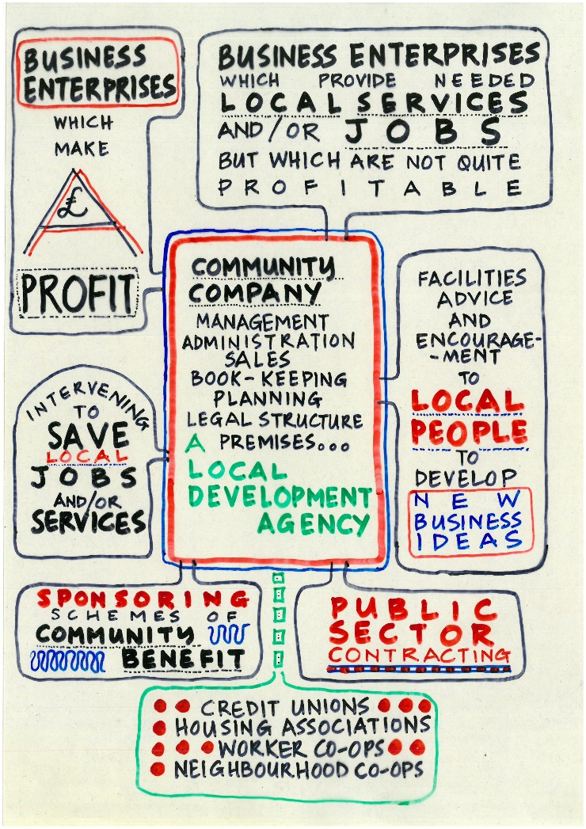
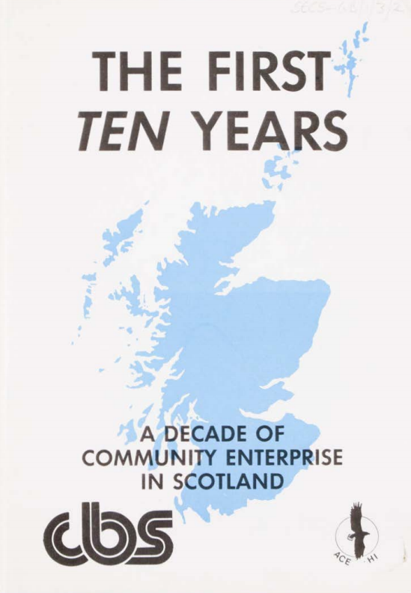

Slide 4
Community Economic Development Toolkit
Social participation | Anchor organisations, culture, participatory decision making, equalities and human rights, co-production
Resource development | Land in common ownership, asset transfer, community housing, permaculture, renewable energy, energy conservation, planning
Value chain development | Buy local loyalty schemes, enterprise networking, local food systems, complementary currencies, plugging the leaks
Infrastructure development | Micro-grids, micro-renewables, community broadband, public social partnerships, community transport
Labour market interventions | Local apprenticeships, local hiring, equalities action, intermediate labour markets, skills development
Access to capital | Community development finance initiatives, social investment, community shares, mutual guarantees, credit unions
Innovation | University / community partnerships, intrapreneuring, social innovation, challenge prizes
Enterprise development | Accelerators, business advice, leadership development, skills exchange, co-op & social enterprise development
Productivity | Employee ownership trusts & worker co-ops, cluster development, export advice

Slide 7
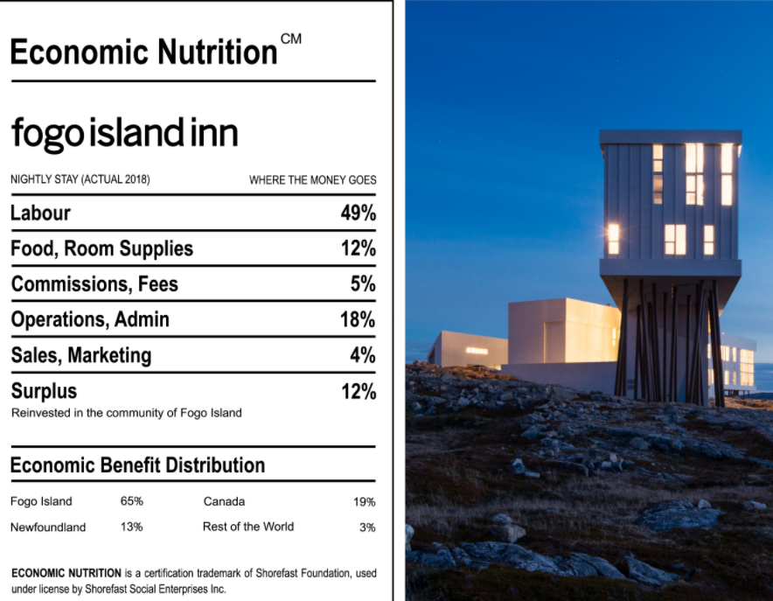

Slide 17
