Slide 1

Dr Maggie Lawrence
Professor of Stroke Prevention
School of Health & Life Sciences
Qualitative review methods

Slide 2

Outline of session
Approaches to meta-synthesis of qualitative data
Meta-aggregation
Reporting a qualitative review

Slide 3
Approaches to meta-synthesis of qualitative data

Slide 4
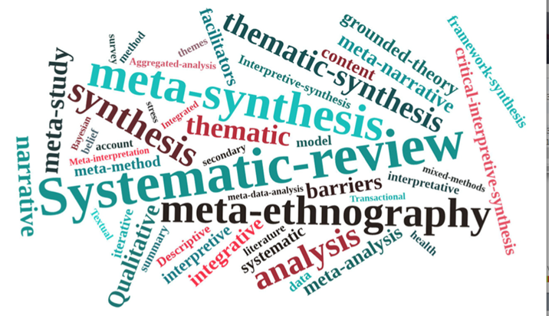
Meta-synthesis
Methodological development
Range of methodological approaches (ethnography; aggregation)
Range of methods of synthesis
Terminology used inconsistently
Key differences
Core techniques
Common features
Tong et al. 2012

Slide 5
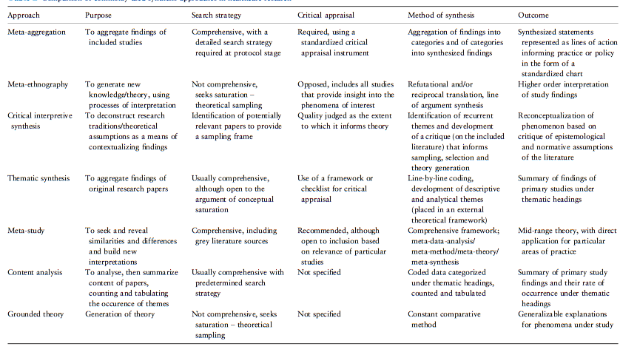
Methodological approaches
Hannes & Lockwood 2011

Slide 6
Meta-aggregation

Slide 7

Meta-aggregation
Modeled on Cochrane methods
Structured; process driven; a priori protocol; 2 reviewers work independently on each stage
Sensitive to the nature of qualitative research
Does not aim to reinterpret primary data
Moves beyond implicit suggestions to produce a directive statement

Slide 8

Meta-aggregation: Methods
A priori protocol
Explicit Inclusion/Exclusion criteria: Study design, Population, (Phenomenon of) Interest, Outcomes (SPIO)
Search strategy
Quality appraisal
Data extraction
Data analysis

Slide 9
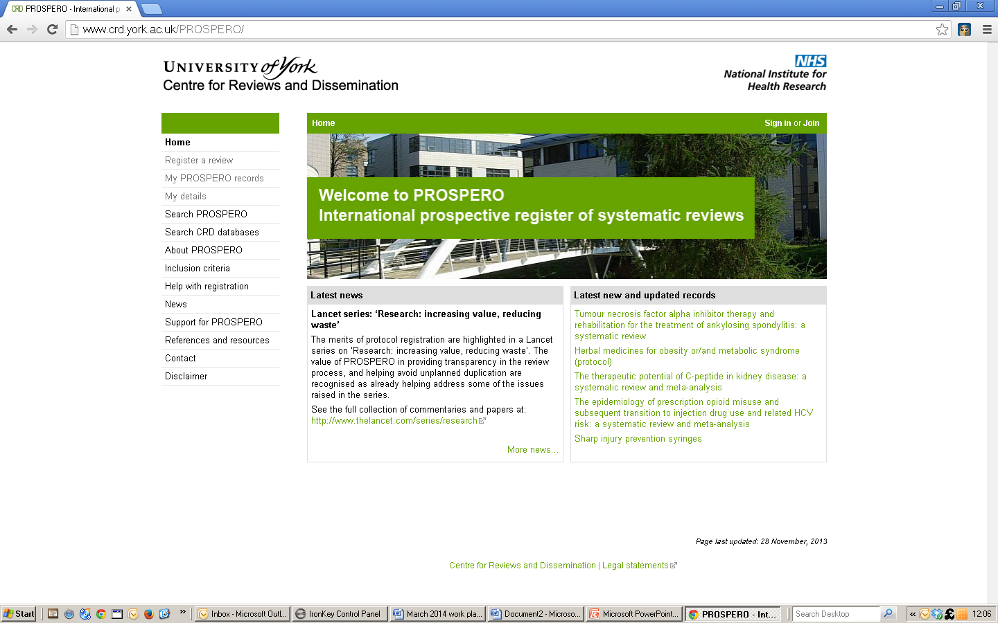
PROSPERO
International database of prospectively registered systematic reviews in health & social care
Provides a comprehensive listing of systematic reviews registered at inception to help avoid unplanned duplication and enable comparison of the final report with the planned protocol

Slide 10
Methods: Quality appraisal
Quality appraisal undertaken for included papers
Quality appraisal tools for qualitative research
CASP (Critical Appraisal Skills Programme) Qualitative Studies checklist
https://casp-uk.net/wp-content/uploads/2018/03/CASP-Qualitative-Checklist-2018_fillable_form.pdf
SRQR: Standards for Reporting Qualitative Research
O’Brien et al., 2014 DOI: 10.1097/ACM.0000000000000388
COREQ: COnsolidated Criteria for REporting Qualitative Research
Tong et al., 2007 DOI: 10.1093/intqhc/mzm042

Slide 11
A published example

Slide 12
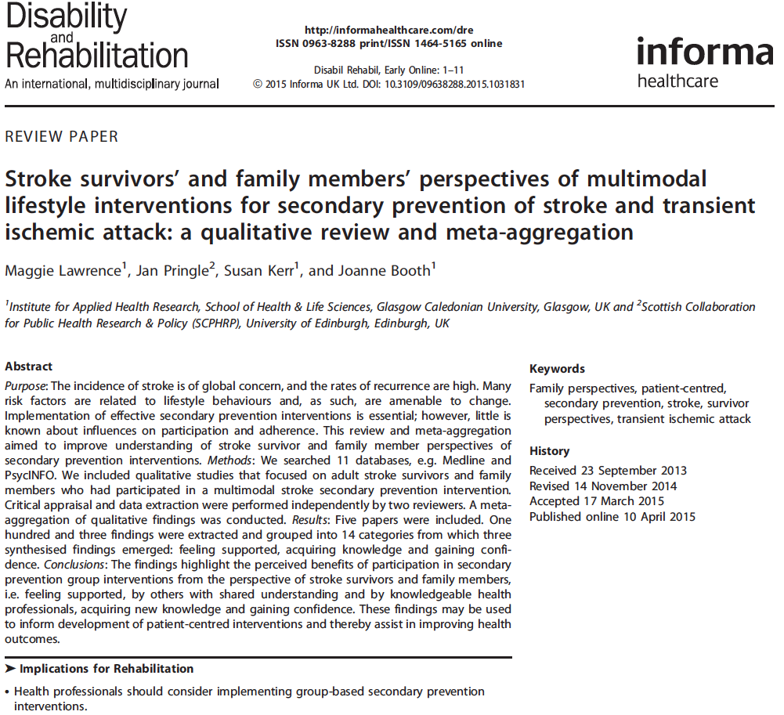

Slide 13

Review Question
What are stroke survivors’ and family members’ perceptions of participation in multimodal secondary prevention interventions?

Slide 14
Inclusion criteria (SPIO)
 | Inclusion | Exclusion
Study design | Qualitative study designs Mixed method studies where the qualitative data may be extracted | Quantitative studies Audit Discussion/opinion papers
Population | Stroke Adults aged ≥ 18 Family carers of stroke survivors | Non-stroke populations Children (aged 0-18)
Phenomenon of Interest | Experience of complex stroke secondary prevention interventions | Experience of interventions for other health conditions
Outcomes (findings) | Experiential accounts | Theoretical outcomes Quantitative results

Slide 15
Meta-aggregation: Methods
Search strategy
Databases: included AMED, CINAHL, MEDLINE, PsycINFO
Searches: subject headings & keywords relating to stroke, lifestyle risk factors & secondary prevention
Delimiters: English language, age (exclude 0-18 years)

Slide 16
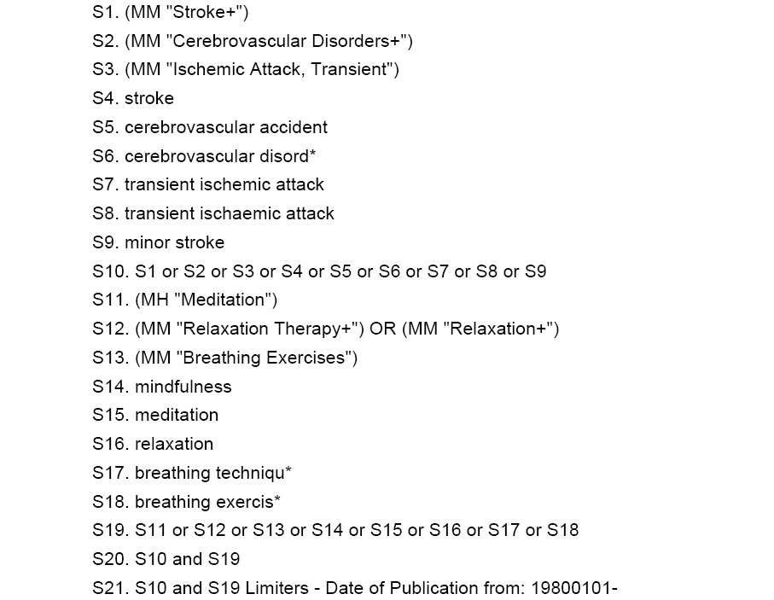
Step 2 – Identifying relevant studies: Literature searching
Example of a basic search: ‘stroke’ AND ‘mindfulness’
Search terms
  Subject headings or controlled vocabulary e.g. MeSH (Medline)
  Key words
  Synonyms
Currency
  Define dates; provide rationale
Language
  Specify any limitations ; provide rationale
Databases
  Specify databases to be searched
  Hand searching, Grey literature, Experts, Specialist websites
  Rationale

Slide 17
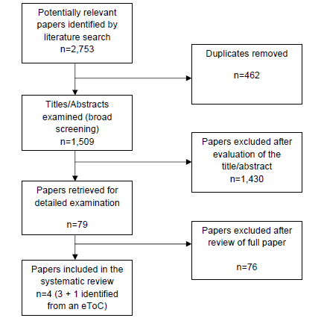
Example flow chart
Tip: Google ‘Prisma flow chart’

Slide 18

Quality appraisal
Critical Appraisal Skills Programme
Qualitative Studies checklist
Was there a clear statement of the aims of the research?
Is a qualitative methodology appropriate?
Was the research design appropriate to the aims of the research?
Was the recruitment strategy appropriate to the aims of the research?
Were the data collected in away that addressed the research issue?
Has the relationship between the researcher and participants been adequately considered?
Have ethical issues been taken into consideration?
Was the data analysis sufficiently rigorous?
Is there a clear statement of findings?
How valuable is the research?

Slide 19
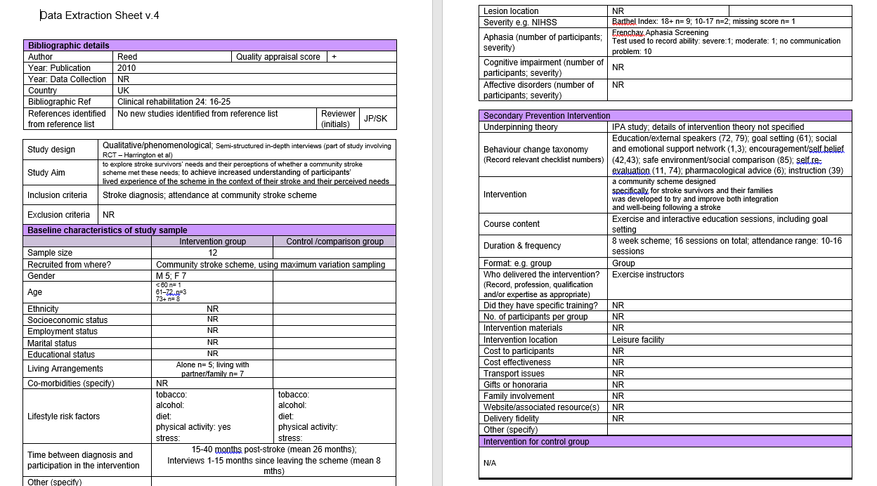
Data extraction
Bibliographic details and study characteristics

Slide 20
3 stage analysis process: Stage 1
Findings

Slide 21
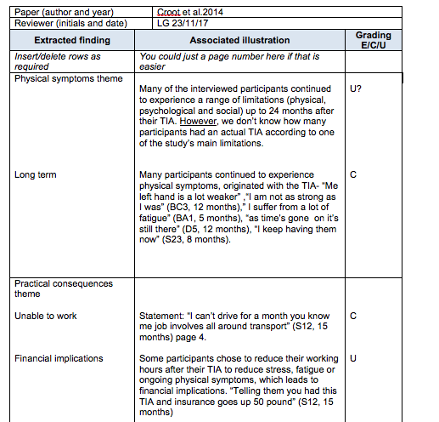
Data extraction (findings)
Findings are conclusions reached and reported by the author of the paper, often in the form of themes or categories
Each finding is graded i.e. assigned a level of credibility
Unequivocal: evidence that is beyond reasonable doubt, including findings that are factual, directly reported/observed, and not open to challenge
Credible: findings that are plausible in light of the data and theoretical framework. They can be logically inferred from the data. Because findings are interpretive they can be challenged.
Unsupported: findings are not supported by the data

Slide 22
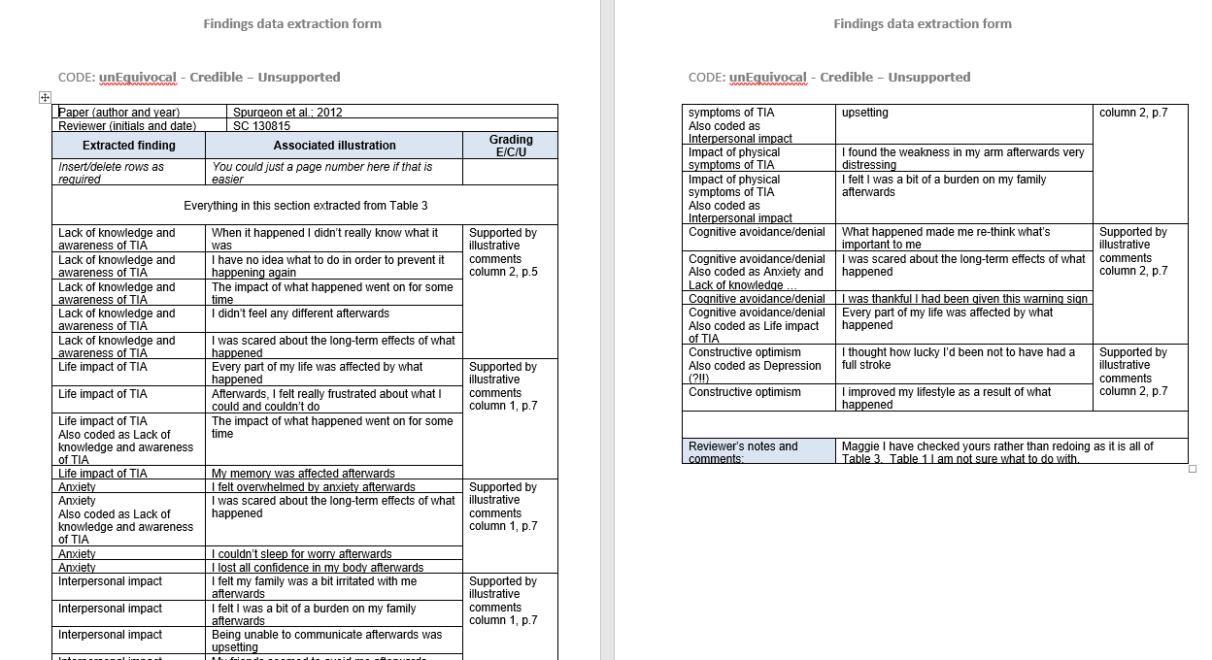
Data extraction
Qualitative findings

Slide 23
3 stage analysis process: Stage 2
Findings
Categories

Slide 24
Developing categories from extracted findings

Slide 25

3 stage analysis process: Stage 3
Synthesised Findings
Findings
Categories

Slide 26
Developing Synthesised Findings from Categories

Slide 27
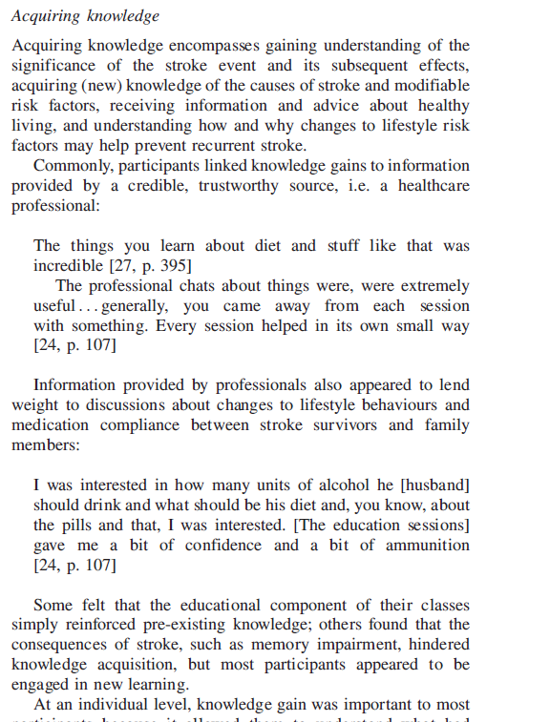
Writing up …

Slide 28
Reporting

Slide 29
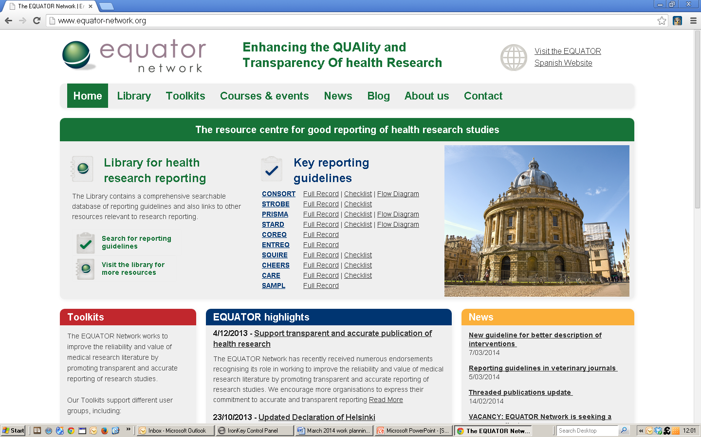
Reporting guidelines
Enhance rigour & systematicity
Recognised and required by journal editors

Slide 30
Reporting guidelines
Enhance rigour & systematicity
Recognised and required by journal editors

Slide 31
Reporting guidelines
Enhancing Transparency in REporting the synthesis of Qualitative research (ENTREQ)
5 domains, 21-items
Introduction
Methods and Methodology
Literature Search & Selection
Appraisal
Synthesis of Findings
Tong et al. 2012

Slide 32

Thank you!
Maggie.Lawrence@gcu.ac.uk

Slide 33

References
Aromataris E, Munn Z (Editors). Joanna Briggs Institute Reviewer's Manual. The Joanna Briggs Institute, 2017. Available from https://reviewersmanual.joannabriggs.org/
Hannes K, Lockwood C. Pragmatism as the philosophical foundation for the Joanna Briggs meta-aggregative approach to qualitative evidence synthesis. Journal of Advanced Nursing, 2011, 67:1632-1642
Tong A, et al. Enhancing transparency in reporting the synthesis of qualitative research: ENTREQ. BMC Medical Research Methodology, 2012, 12:181

Slide 34
Resources
Cochrane Qualitative & Implementation Methods Group
https://methods.cochrane.org/qi/
The Joanna Briggs Institute Critical Appraisal tools for use in JBI reviews, Checklist for qualitative research
http://joannabriggs.org/assets/docs/critical-appraisal-tools/JBI_Critical_Appraisal-Checklist_for_Qualitative_Research2017.pdf
PROSPERO, Centre for Reviews and Dissemination, https://www.york.ac.uk/crd/

Slide 35


