Slide 1
Mechanical Condition
Monitoring

Slide 2
Module Content
This module aims to provide an understanding of both Mechanical and Electrical Condition Monitoring and associated instrumentation requirements for successful condition monitoring.
The main focus in Mechanical Condition Monitoring is vibration monitoring since this is the most popular method of determining the condition and diagnosing faults in rotational machines, although other techniques used in condition monitoring are also covered.
The module also includes a review of relevant sensors, data acquisition/ analysis and the essential
instrumentation required in condition monitoring.
Electrical Condition Monitoring will develop an understanding of the need for, and challenges in, measuring electrical signals in machinery. The application of standard and non-standard electrical condition monitoring systems to a range of electrical plant will be explained. The students will learn to use condition monitoring tools and then to evaluate the data provided by them.

Slide 3
Mechanical Condition Monitoring
 Develop an understanding of the principles of condition monitoring and its application areas.
 Gain a theoretical insight into vibration theory and a detailed understanding of vibration analysis techniques to be able to critically analyse collected data from various vibration monitoring equipment.
 Develop an understanding of other condition monitoring
methods such as thermography and oil/debris analysis.

Slide 4
Electrical Condition Monitoring
 Develop an understanding of the various stresses which exist in electrical plant and how these lead to degradation of the system performance;
 Develop an understanding of the range of techniques that
can be applied to determine the presence of electrical faults;
 Learn the application of standard diagnostic techniques to
data from electrical condition monitoring systems;
 Develop an appreciation of the shortcomings of the analysis of the data presented by the techniques for electrical condition monitoring;

Slide 5
Sensors, Data acquisition and Analysis
for Condition Monitoring
 Understand the operation of a range of sensing techniques used for the measurement of the motion of rotating and reciprocating machines.
 Understand the sensing techniques used for the
measurement of mechanical vibration.
 Understand a range of techniques used for the measurement
of temperature, both contact sensors and radiation sensors.
 Be able to specify the basic requirements of a data acquisition system intended to perform measurements relevant to a condition monitoring application.

Slide 6
Mechanical Condition Monitoring
 Maintenance strategies, concept of condition monitoring and main methods involved (vibration monitoring, visual / performance monitoring, Oil & debris analysis etc.)
 Basic vibration theory, vibration measurement and analysis, machine vibration; Rotational machine faults and vibration characteristics.
 Applications of vibration monitoring to rotating machines. Vibration monitoring in practice
 Overall vibration monitoring and experience based spectrum analysis to detect machine condition and faults in bearings and gears. Current diagnostic techniques/tools commercially available.
 Thermal Monitoring :Introduction to thermal monitoring; thermal monitoring techniques, application of thermal monitoring to manufacturing processes. Thermal imaging camera, and its application as a condition monitoring tool.
 Lubricant analysis/monitoring : Introduction to tribology - lubricant types and their properties. Introduction to wear debris monitoring; collecting and quantifying wear debris; wear debris and oil analysis in practice.

Slide 7
Maintenance
 What is the importance of maintenance on the life-cycle costs of machines and structures?
 What are the factors to be considered when organising a maintenance strategy?
 What are the cutting-edge techniques for the early
identification of damage in a variety of situations?

Slide 8
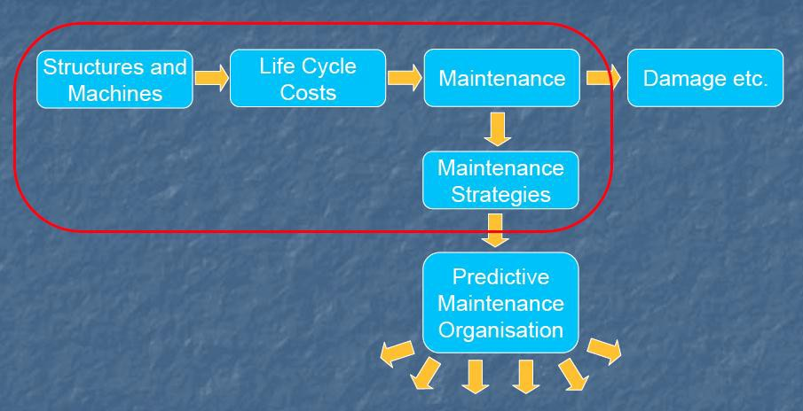
Importance of Maintenance
Depending on industry, maintenance costs can represent between 15 and 60%
of production.
Estimated that one-third of all maintenance costs is wasted due to unnecessary or improperly carried out maintenance. (~$60bn out of $200bn).
Difficult to compete with countries like Japan who have more advanced
maintenance strategies.
10

Slide 9
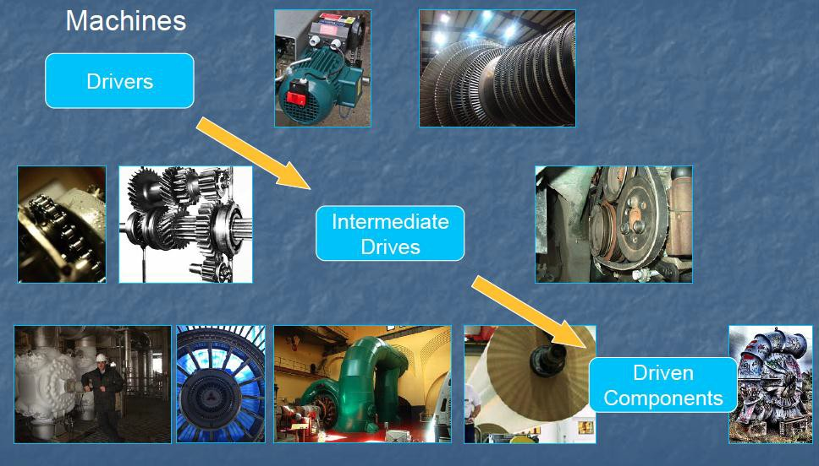
Machines Considered

Slide 10
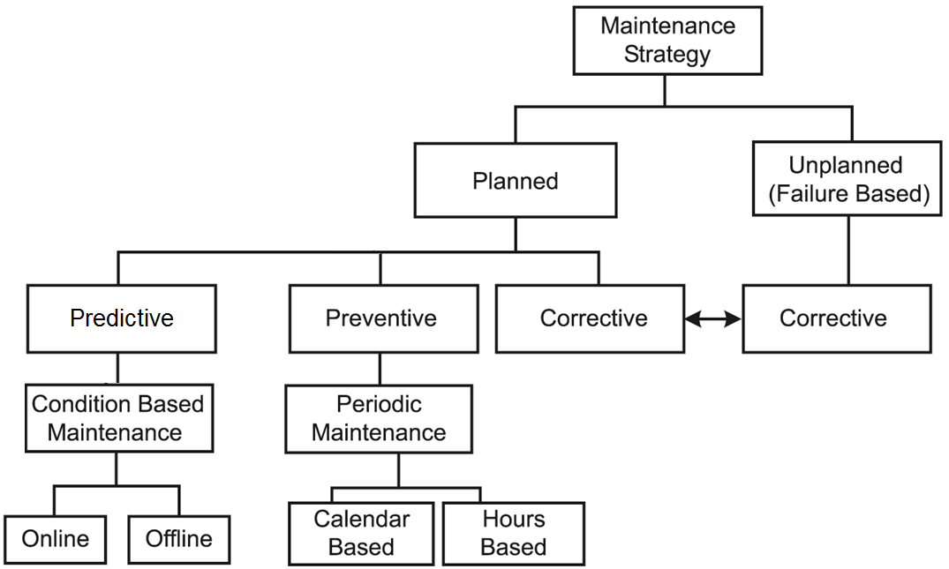
Maintenance Strategies
There are essentially three main approaches to maintenance of structures and machines.
 Run-to failure maintenance
 Preventive maintenance
 Predictive maintenance

Slide 11
Run-to-failure Maintenance
 If it ain’t broke, don’t fix it – sounds reasonable
 No money spent on maintenance until machine or structure stops working
 Also known as reactive maintenance
 Most expensive maintenance method.
 High spare parts inventory
 High overtime costs
 Long machine downtime
 Low production availability
 Spare machines required
 Knock-on effects on other machines and overall loss of production

Slide 12
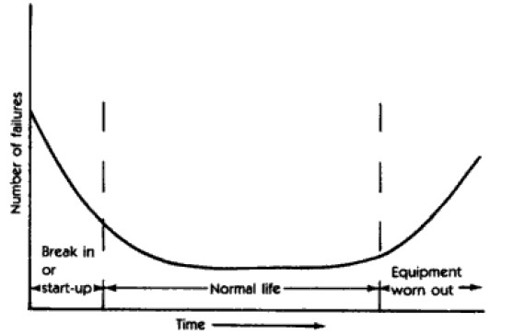
Preventive Maintenance
 Many definitions –all maintenance is time-
driven
 Based on elapsed time or hours of operation
 Time between maintenance decided on statistical data
 Generally based on bathtub curve
–not reliable in many cases
 Treats all similar machines as same.
 Scheduled maintenance costs are around one-third of run-to-failure costs

Slide 13
Predictive Maintenance
 Involves the regular monitoring of actual mechanical condition of machine or structure and other indicators of operating condition provide data for maximum interval between repairs.
 Involves Non destructive Techniques (NDT) which are only part of the predictive maintenance strategy.
 The actual operating condition of the machine is used to optimise total plant or structure operation.

Slide 14
Predictive Maintenance
 Costs
 monitoring equipment
 staff training
 labour costs for measurement and analysis
 Savings
 elimination of unexpected breakdowns and secondary breakdowns
 increased time between services
 reduction of spare part stock
 reduction in insurance premium
 Benefits
 increased reliability
 increased quality
 increased profitability
 increased productivity
* NDT tools will vary depending upon machine and types of likely damage.

Slide 15
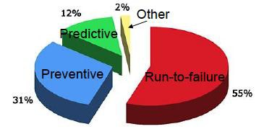
Maintenance strategy in average facility

Slide 16
Condition Based Maintenance (CBM)
The objective of CBM is not just the prediction of time to failure, it is also to maximize the operating time for all components and optimize maintenance practices, as well as Operational Readiness

Slide 17
Vibration Basics

Slide 18
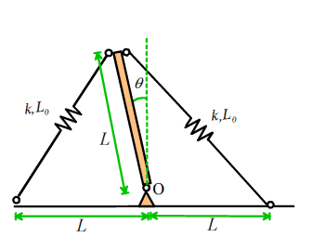
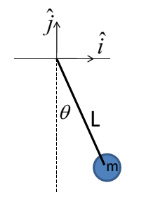
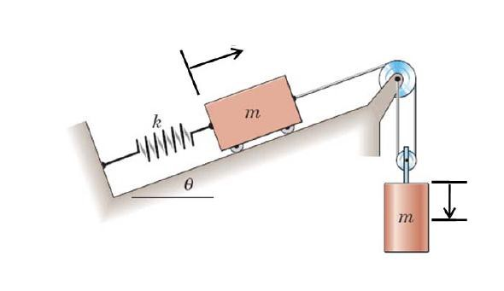
Natural frequency for 1 DOF undamped system
Information on the ‘natural frequency’ , ‘Vibration mode’ , and dissipation of a system

Slide 19
Natural frequency for 1 DOF undamped system
kx
ma
k
m
x
m
mg
x
Static Equilibrium
F = kx F = mg
k = spring rate = force/deflection
x = displacement from static position

Slide 20
Natural frequency for 1 DOF undamped system
kx
_{ma}
m
x
mg
EOM for small vibration of any 1DOF undamped system has form
m
d ² x
kx − mg = 0
dt ²
mx + kx = 0
21

Slide 21
Natural frequency for 1 DOF undamped system
mx + kx = 0
⎛ ⎞
_{ω}2
₌ k
k
mx + ⎜ ^{k} ⎟x = 0
ω_{n} =
⎝ m ⎠
2
n
m
m

x + ω x = 0
n
ω_{n}
is the natural frequency
Solution is of the form of
x = e^{st}
x = se^{st}
x = s²e^{st}
Therefore, by substitution
_{s}2_{e}st 2 _{e}st
+ ω = 0
n
22

Slide 22
Natural frequency for 1 DOF undamped system
By substitution
_{s}2_{e}st
+ ω²
_{e}st
= 0
n
s² + ω² = 0
n
s = − ω
2
n
= + /− iω_{n}
_{x = C e}iω_{n} t _{+ C e}−iω_{n} t
1 2
x = C₁ (cosω_{n} t + i sin ω_{n} t)+ C₂ (cosω_{n} t + i sin ω_{n}t)
Grouping terms
x = (C₁ + C₂ )cosω_{n} t + (C₁ − C₂ )i sin ω_{n} t

Slide 23
Natural frequency for 1 DOF undamped system
x = (C₁ + C₂ )cosω_{n} t + (C₁ − C₂ )i sin ω_{n} t Let (C₁ + C₂ ) = A (C₁ − C₂ )i = B
x = A cosω_{n} t + Bsin ω_{n} t
A & B are now found from initial conditions
@ t = 0
x(0) = A = X₀
(initial displacement)
x(0) = A(1) + B(0)
x = −X₀ω sin ω_{n} t + Bω_{n} cosω_{n} t x (0) = −X₀ω_{n} (0) + Bω_{n} (1) = V₀

Slide 24
Natural frequency for 1 DOF undamped system
x (0) = −X₀ω_{n} (0) + Bω_{n} (1) = V₀
B = ^{V0}
ω
Therefore, for a free vibrating single DOF system
⎛ ⎞
V
x(t) = X₀ cosω_{n} t +
⎜
0
⎟
sin ω t
⎜
⎟
n
⎝ ^{ω}n ⎠
k
ω_{n} =
m
₌ 1 k
f
n
2π m

Slide 25
Natural frequency for 1 DOF undamped system
Parallel: stiffness
k = k₁ + k₂
k₁
k₁ +k₂
m
m
k₂
Series: stiffness
k₁
k₂
1 1 1
= +
k k₁ k₂

Slide 26
Natural frequency for 1 DOF Damped system
kx
Cx.
k
C
m
x
m
_{m x}..
x
∑^{F}x
= 0
d² x dx
m + C + kx = 0
dt²
dt

Slide 27
Natural frequency for 1 DOF Damped system
∑^{F}x
= 0
d² x dx
m + C + kx = 0
dt ²
dt
2
d x _{+ ⎜} C ⎟ dx _{+ ⎜} k _{⎟x = 0}
⎛ ⎞ ⎛ ⎞
dt ² ⎝ m ⎠ dt
⎝ m ⎠
Utilizing the quadratic equation
⎛ C ⎞ ⎛ C ⎞
2
− ⎜
⎟ + /−
⎜ ⎟
4 ^{k}
m
C
⎜ ⎟
C
⎜ ⎟
2
k
⎝ m ⎠
⎝ m ⎠
or
₋ ⎛ ⎞ ₊ ₋
⎛ ⎞
λ =
/
2
⎝ 2m ⎠
⎝
2m ⎠ m

Slide 28
Natural frequency for 1 DOF Damped system
2
⎛ ⎞
C k
⎜ ⎟ −
2m ⎠ m
s , s = − ⎜ ^{C} ⎟ + /−
⎛ ⎞
1 2
⎝ 2m ⎠
⎝
2
C k
⎜ ⎟ −
⎝ 2m ⎠ m
⎛ ⎞
can be = 0, + and real, - and imaginary
The solution is of the form
x(t) = C e^{s1t} + C e^{s2 t}
1 2
2
⎛ ⎞
C k
⎜ ⎟ −
⎝ 2m ⎠ m
s , s = − ⎜ ^{C} ⎟ + /−
⎛ ⎞
1 2
⎝ 2m ⎠

Slide 29
Natural frequency for 1 DOF Damped system
Expanding
⎡
C
2 ⎤
⎛ ⎞
⎡
2 ⎤
⎛ ⎞
⎛ ⎞
C
C
C
⎢_{−⎜}
⎟+
⎜ ⎟
^{k ⎥} t
⎢_{−⎜}
⎛ ⎞
⎟−
⎜ ⎟
^{k ⎥} t
x(t)
= C₁e
⎢ ⎝ 2m ⎠
⎝ 2m ⎠ m ⎥
C₂e
⎢ ⎝ 2m ⎠
⎝ 2m ⎠ m ⎥
⎣
⎦
⎣
⎦
or
⎧
t ⎪
⎡
2
⎤
⎡
⎢
2
⎤
⎫
t
C k
⎜ ⎟ − ⎥ t
C k
⎜ ⎟ −
⎛
C 2m
⎞
⎢₊
⎢
⎛ ⎞
−
⎛ ⎞
⎥
⎪
⎬
x(t) = e
−⎜
⎝
⎟
⎠
⎨C₁e
⎪
⎩
⎣
⎝
2m
⎠
m ⎥
C₂e
⎢
⎝
2m
⎠
m ⎥
⎦
⎣
⎦
⎪
⎭
Note that three conditions can occur
C
⎜ ⎟
2
k
⎛ ⎞
can be = 0, + and real, - and imaginary
⎝ 2m ⎠ m
30

Slide 30
Natural frequency for 1 DOF Damped system
Condition 1, CRITICAL DAMPING
C
⎜ ⎟
2
k
2m ⎠ m
⎛ ⎞
= 0
⎝
⎛ C ⎞
2
k m
⎜ ⎟
⎝ m ⎠
= 4
or C = 2 km = C_{c}
(critical damping)
⎛ ⎞
x(t) = e
−⎜ ^{C} ⎟ t
⎝ 2m ⎠
{C₁ (1) + C₂ (t)}
k m
2 ₌ k m
Recall
ω =
ω
n
n
By substitution
C_{c} = 2
km = 2mω_{n}

Slide 31
Natural frequency for 1 DOF Damped system
Condition 2, UNDER DAMPING
2
k
⎝ 2m ⎠ m
⎛ C ⎞
−
< 0 {imaginary}
⎜ ⎟
₋⎛ C ⎞ _{t} ⎧
⎛
2
⎞
⎛
2
⎞ ⎫
x(t) = e
⎜ ⎟
2m
⎪
⎜
⎛ C ⎞
k _{⎟t}
⎜
⎛ C ⎞
k _{⎟t}⎪
⎝ ⎠
⎨C Cos⎜
⎜ ⎟
⎟ + C Sin⎜
⎝
⎜ ⎟
−
⎟ ⎬
⎪⎩
1
⎝ 2m ⎠ m ⎠
2
⎝ 2m ⎠
m ⎠ ⎪⎭
⎝
Note: The system now has damped oscillatory behavior

Slide 32
Natural frequency for 1 DOF Damped system
Condition 3, OVER DAMPING
2
k
⎝ 2m ⎠ m
⎛ C ⎞
−
> 0 {All Real}
⎜ ⎟
⎧
⎡
⎢
⎤
⎡
⎢
⎢
k ⎥ ⎫
C
⎜ ⎟
+
⎛ C ⎞
2
k ⎥
⎛ C ⎞
2
⎤
₋⎛ ⎞ _{t}
⎪
⎢
⎜
⎟ − t
−
⎜
⎟ − t
⎪
⎬
x(t) = e
⎝ 2m
⎠
C e
⎣
⎝ 2m ⎠ m ⎥
C e⎣
⎝ 2m ⎠ m ⎥
⎨
⎪
⎩
1
⎦
2
⎦
⎪
⎭
Note: The system now has no oscillatory behavior

Slide 33
Natural frequency for 1 DOF Damped system
By definition
C = 2 km = C_{c}
(critical damping)
^{C} = ξ = (damping ratio)
C_{c}
Also
C
ξ = ^{C} =
C = ξ 2 km
C_{c}
2 km
2
C k
⎜ ⎟ −
⎝ 2m ⎠ m
⎛ ⎞
= ξ ²ω ²− ω
2
= ω ξ² −1
n n
n
C
2 km
k
= ξ
2m
= ξ
= ξ ω_{n}
m
2m
Therefore
ω_{d} = ω_{n}
ξ² −1

Slide 34
Natural frequency for 1 DOF Damped system
s=L₀+x
k, L₀
m
c
2
x ₊ c dx ₊ kx ₌ ₀
F = ma ⇒ ^{d}
dt²
m dt m
d ²x
dx
2
k m
c
+ 2ζω_{n}
+ω_{n} x = 0 ω_{n} =
ζ =
dt²
dt
2 km

Slide 35
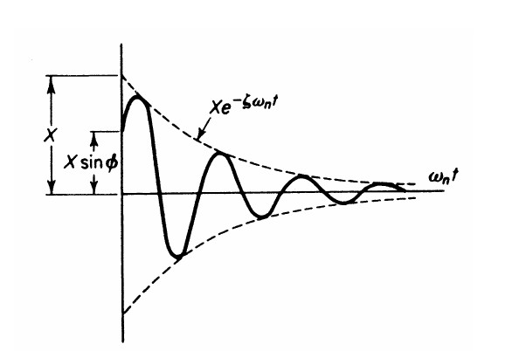
Natural frequency for 1 DOF Damped system
d
2
k c
m
^{x} + 2ζω ^{dx} + ω² x = 0 ω =
ζ =
dt²
^{n} dt
n
n
2 km
dx dt
Initial conditions:
x = x₀
= v₀ t = 0
Underdamped:
ς < 1
⎧
v₀ + ςω_{n} x₀
x(t) = exp(−ςω_{n}t) ⎨x₀ cos ω_{d} t +
⎩
sin ω_{d} t ⎬
⎭
ω
d

Slide 36
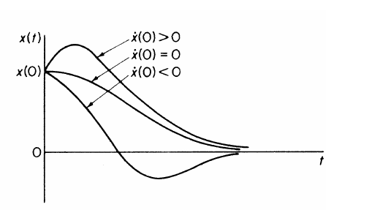
Natural frequency for 1 DOF Damped system
d
2
k c
m
^{x} + 2ζω ^{dx} + ω² x = 0 ω =
ζ =
dt²
^{n} dt
n
n
2 km
x = x₀
dx
Initial conditions:
= v₀ t = 0
dt
x(t) ={x₀ +[v₀ + ω_{n}x₀ ]t}exp(−ω_{n}t)
Critically damped:
ς = 1
Critically damped gives fastest return to equilibrium

Slide 37
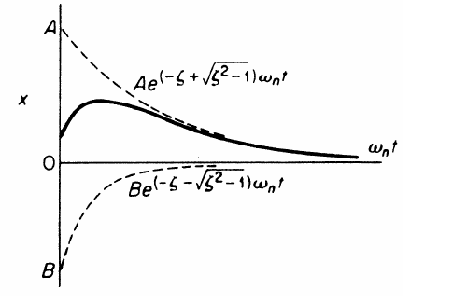
Natural frequency for 1 DOF Damped system
d
2
k m
c
^{x} + 2ζω ^{dx} + ω² x = 0 ω =
ζ =
dt²
^{n} dt
n
n
2 km
Initial conditions: Overdamped:
ς > 1
dx dt
x = x₀
= v₀ t = 0
⎧
⎨
⎩
v + (ςω + ω )x
v₀ + (ςω_{n} − ω_{d} )x₀
⎫
⎬
⎭
x(t) = exp(−ςω t)
0
n
d 0
exp(ω t) −
exp(−ω t)
n
2ω_{d}
d
2ω_{d}
d

Slide 38
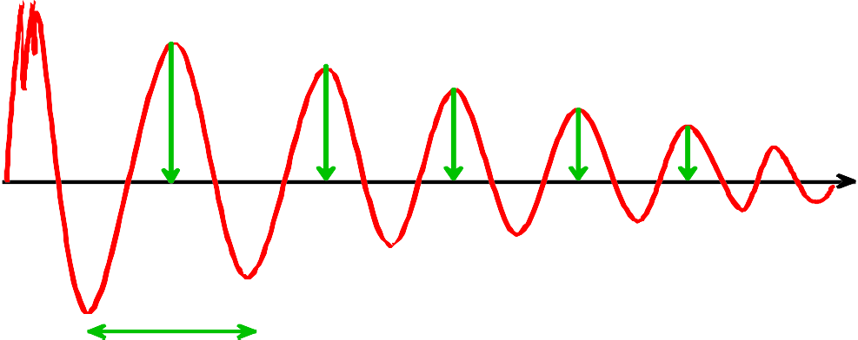
Natural frequency for 1 DOF Damped system
Displacement
x(t₀)
x(t )
1
x(t )
x(t )
2
3
time
t₀
t₁
t₂
t₃
t₄
T
Log decrement:
⎛
x(t )
⎞
1
n ⎝ x(t_{n} ) ⎠
δ =
log
⎜
0
⎟
Period: T
δ
4π ² + δ ²
ς = ω_{n} =
Then
4π ² + δ ²
T

Slide 39
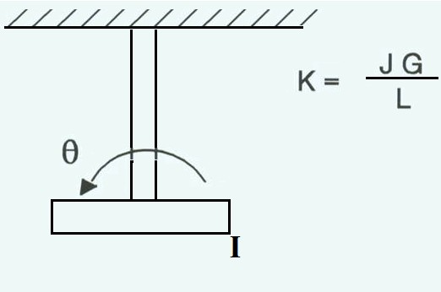
Torsional Vibration
k
₌ JG
(N.m/rad)
torsion
L
ω =
^{k}torsion
(rad/s)
n
I
G is modulus of rigidity (N/m²)
J=polar moment
4
_{J =} πd
32
L= length of shaft (m)
D = diameter of shaft (m)
I = disk moment of inertia (kgm²)
40

Slide 40
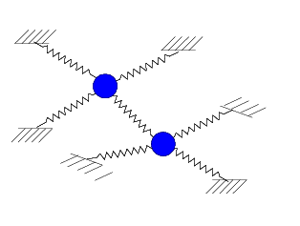
Vibration Principles
If masses are particles
x₁
x₂
k
k
k
Expected No. of vibration modes = No. of masses x No. of directions masses can move independently
m
m
If masses are rigid bodies (can rotate and have inertia)
Expected No. of vibration modes = No. of masses x (No. of directions masses can move + No. possible axes of rotation)

Slide 41
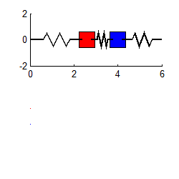
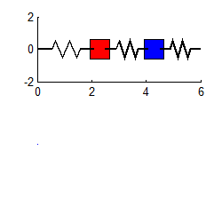
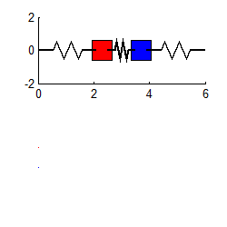
Vibration modes and natural frequencies
A system usually has the same number of natural frequencies as the degrees of freedom
Vibration modes are the special initial deflections that cause entire system to vibrate harmonically
Natural Frequencies are the corresponding vibration frequencies
x₁ x₂
k
k
k
m
m

Slide 42

Forced Vibration
Important information include:
‘Amplitude’ and ‘phase’ of steady-state response of a forced vibration system
amplitude-v-frequency formulas (or graphs), resonance, high and low frequency response for 3 systems
s=L₀+x
k, L₀
1 d ² x 2ς dx
x = KF₀ sinω t
dt
m
+
ω² dt² ω
n
n
c
ω =
k m
λ
1
k
n
, ς = ,
K =
2 km

Slide 43
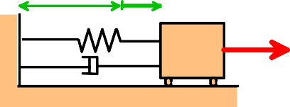
Forced Vibration
L₀ x(t) k, L₀
F(t)=F₀ sin ωt
Force Balance
m
λ
F = (X k-mω X )² + (Cω)²
o
2
0 0
⎛
2 ₂
mω² ⎞ ⎛ Cω ⎞
F_{o} = X₀k
⎜⎜1-
⎟⎟
+ ⎜
⎝
⎟
⎠
mω²X
0
⎝
k
⎠
k
F_{t}
CωX₀
2
_{ω}2 ⎞
⎛
2
⎛ Cω ⎞
φ
kX₀
F_{o} = X₀k
⎜⎜1- _{ω2 ⎟}⎟ + ⎜
⎟
⎠
⎝
n ⎠
⎝
k
ωt
⎛
2
2 ⎞
⎛
2
⎞
F = X k
⎜1- ^{ω}
⎟
+ ⎜ 2ξ ^{ω} ⎟
o
0
⎜
2 ⎟
⎜
⎟
⎝ ^{ω}n ⎠
⎝ ^{ω}n ⎠

Slide 44

Forced Vibration
L₀ k, L₀
x(t)
F(t)=F₀ sin ωt
m
λ
1 d ² x 2ς dx
k ,
m
2
+ x = KF (t)
² ω dt
ω =
ς = ^{λ} , K = ¹
ω_{n} dt
n
n
2 km
k
x(t) = X ₀ sin (ω t + φ )
KF₀
X =
_{φ = tan−1} −2ςω / ω_{n}
0
⎧
(
n )
2
⎫
⎬
⎭
1/2
1 − ω² / ω²
2 2
( )
2
n
⎨
1 − ω / ω
+ 2ςω / ω
n
⎩

Slide 45

Forced Vibration
F_{o} k
L₀ k, L₀
x(t)
X =
static response
F(t)=F₀ sin ωt
st
X₀
1
m
=
λ
^{X}st
⎛
⎛ ω ⎞
2
2 ⎞
⎛
⎛ ⎞
2
⎞
⎜1− ⎜
⎟
⎟
+ ⎜ 2⎜ ^{C} ⎟ ^{ω} ⎟
⎜
⎜
⎟
⎟
⎜
⎜ ⎟
⎟
ω
C ω
⎝
⎝ n ⎠
⎠
F_{o}
⎝
⎝ c ⎠ n
⎠
X
₌ k
0
⎛
2
⎞
2
⎛ ⎞
2
⎛ ω ⎞
⎟
⎛ ⎞
⎜1− ⎜
⎟
+ ⎜ 2⎜ ^{C} ⎟ ^{ω} ⎟
⎜
⎜
⎟
⎟
⎜
⎜ ⎟
⎟
ω
C ω
⎝
⎝ n ⎠
⎠
⎝
⎝ c ⎠ n
⎠

Slide 46
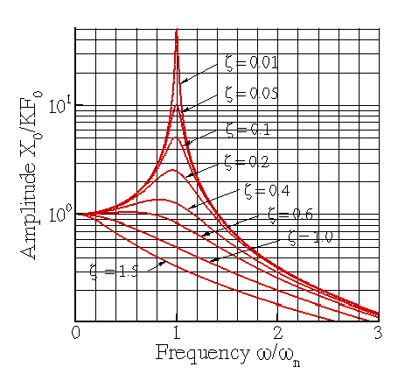
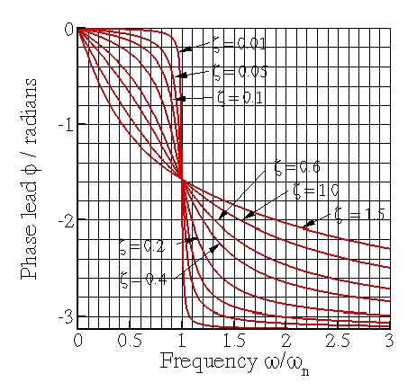
Frequency Response
x(t) = X ₀ sin (ω t + φ )
X₀ =
KF₀
_{φ = tan−1} −2ςω / ω_{n}
⎧
( n )
2
2
⎫
⎬
⎭
1/2
1 − ω² / ω²
2 2
(
)
n
⎨
1 − ω / ω
+ 2ςω / ω
n
⎩
s=L₀+x
k, L
0
m
c
System vibrates at same frequency as force
Amplitude depends on forcing frequenc⁴y⁷, nat frequency, and damping coeft.

Slide 47
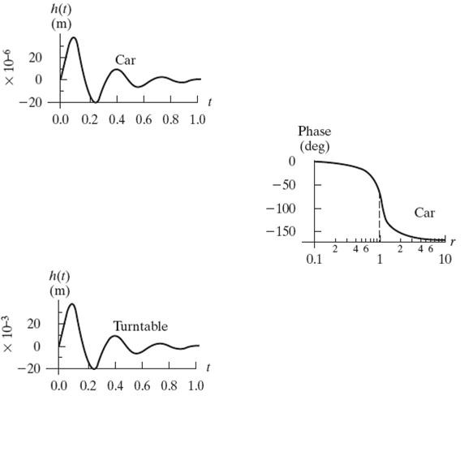
Ex.: Different devices with the same frequency
car
m = 1000 kg
k = 400,000 N/m C = 8000 Ns/m
ω = ^{400,000} = 20 rad/s
n
1000
8000
ζ =
2(1000)(20)
= 0.2
ω = 20 1− 0.2² = 19.5959 rad/s
d
CD drive
m = 1 kg
k = 400 N/m C = 8 Ns/m
ω = ⁴⁰⁰ = 20 rad/s
n
1
8
ζ =
= 0.2
Magnitude plot will have the same shape
Time responses will have the same form for similar (but scaled) disturbances BUT WITH DIFFERENT MAGNITUDES
2(1)(20)
ω = 20 1− 0.2² = 19.5959 rad/s
d

Slide 48

Base Excitation
F(t)
m
m
k
c
kx Cx
base
Force Transmitted to the base
F = C ^{dx} + kx
t
dt

Slide 49
Transmissibility
Ft = (X k)
2
+ (CωX )
2
0
0
F_{t}
CωX₀
⎛ Cω⎞
2
kX₀
F_{t} = X ₀k 1+ ⎜ ⎟
⎝ ⎠
k
ωt
⎛ ω ⎞
2
F_{t} = X ₀k
1+ ⎜⎜ 2ξ
⎟⎟
⎝ ^{ω}n ⎠
50

Slide 50
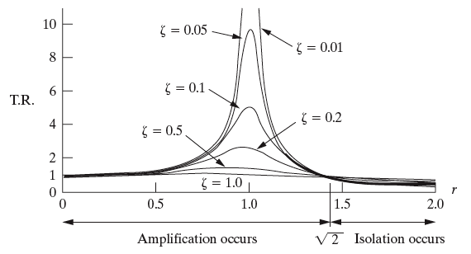
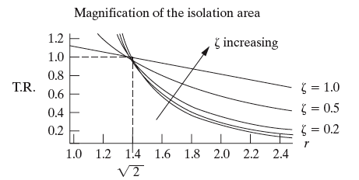
Transmissibility- isolation as a function of stiffness
 For stiffness such that the frequency ratio is larger than root 2, isolation
occurs, but increased damping reduces the effect
 For less than root 2, increased damping reduces the magnitude.
52

Slide 51

Transmissibility
$\left|\frac{F_{t}}{F_{0}}\right|$ = $\frac{\sqrt{{k^{2}+(Cω)}^{2}}}{\sqrt{(k−m{ω^{2})}^{2}+(C{ω)}^{2}}}$ = $\frac{\sqrt{{1+(2ζr)}^{2}}}{\sqrt{(1−{r^{2})}^{2}+(2ζr)^{2}}}$ = $\left|TR\right|$
$\tan{Φ}=(\frac{2ζr}{1−r^{2}})$
$X$ = $\frac{F_{0}}{\sqrt{(k−m{ω^{2})}^{2}+(C{ω)}^{2}}}$
$\frac{X}{X_{0}}$ = $\frac{1}{\sqrt{(1−{r^{2})}^{2}+(2ζ{ω)}^{2}}}$
r = $\frac{ω}{ω_{n}}$ $ζ=\frac{C}{C_{c}}$ ω_{n} =$\sqrt{\frac{k}{m}}$
for $ζ=0 and r>\sqrt{2};$ $\left|TR\right|$ = $\frac{1}{r^{2}−1 }$, $C_{c}=2mω_{n}$

