Slide 1
Digital Business and Marketing Tools, Technologies & Applications

Slide 2
Structure
Digital Business Infrastructure
Web stores (Company websites)
Search Engine Optimisations
E-mail marketing
Social Media
Mobile Computing
Intelligent Agents

Slide 3
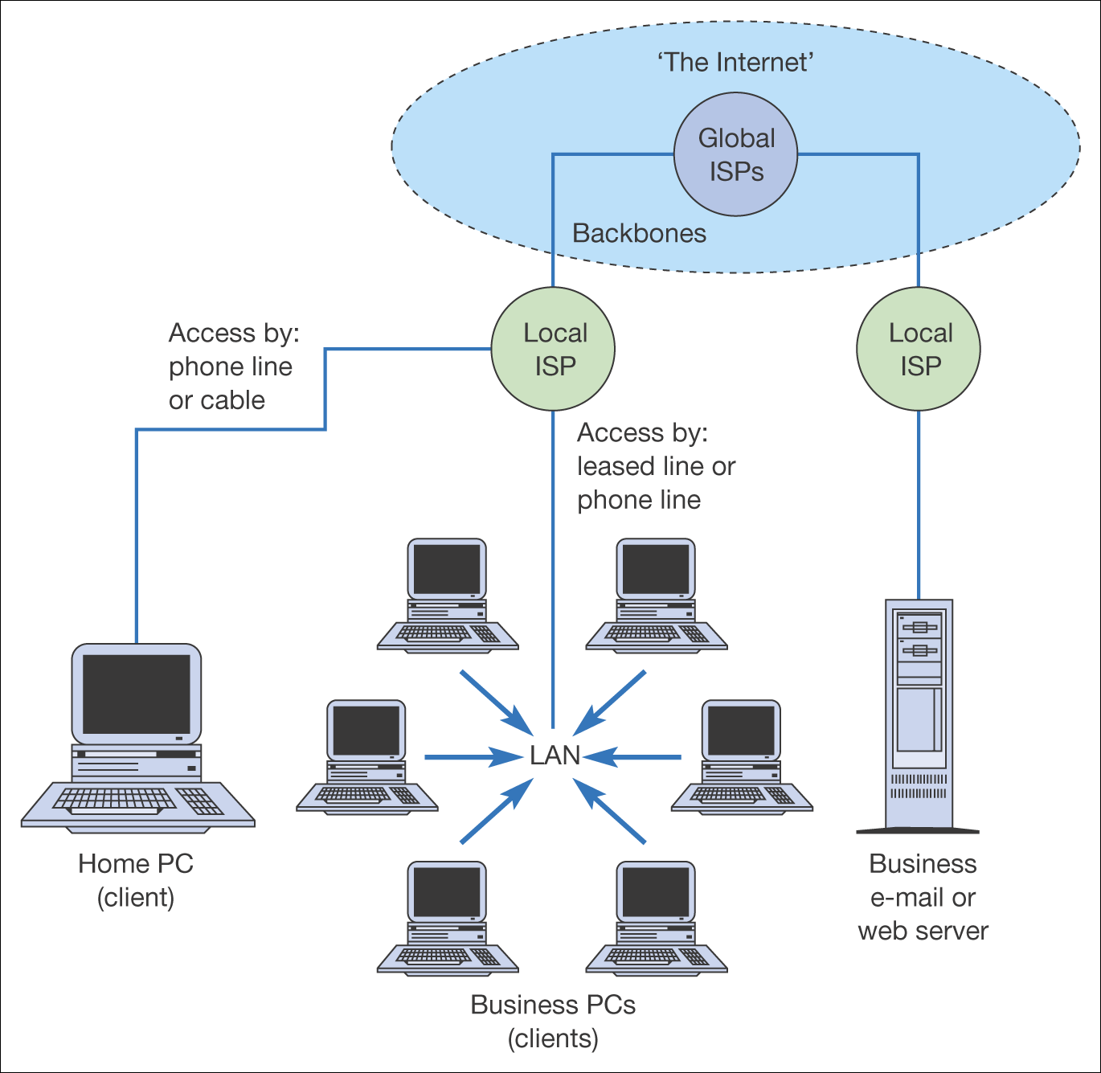
Digital Business Infrastructure
Figure 3.4 Physical and network infrastructure components of the Internet (Levels IV and III in Figure 3.3)

Slide 4
Digital Business Infrastructure
Network Infrastructure
Multimedia & Publishing Infrastructure
Messaging & Information Infrastructure
Business Service Infrastructure
Interfacing Infrastructure

Slide 5
The Internet
Extranet
Intranet
The
World
Company
Only
The
World
Suppliers,
customers,
collaborators
Suppliers,
customers,
collaborators
Digital Business Infrastructure
Relationships between Internet, Intranets and Extranets

Slide 6
Webstore (company web site)
single company’s (or individual seller’s) website where products and services are sold
may target an industry, a location, or a niche market
may belong to a manufacturer, a retailer, individuals selling from home, or to another type of business

Slide 7
Webstore (company web site)
Includes tools such as:
Electronic catalogue
Search engine that helps consumer finds products in catalogue
Electronic shopping cart for holdings items until checkout
E-auction facilities
Payment gateway
Shipment centre
Customer services

Slide 8
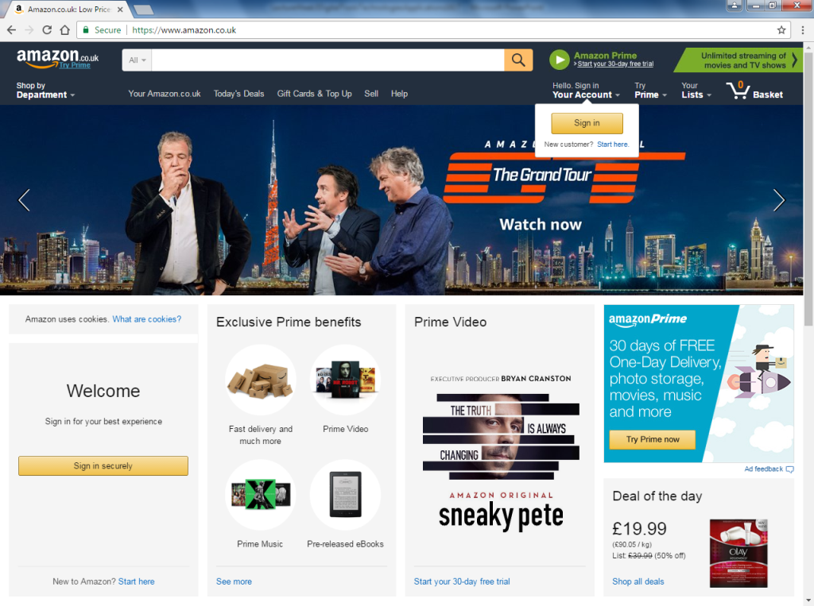
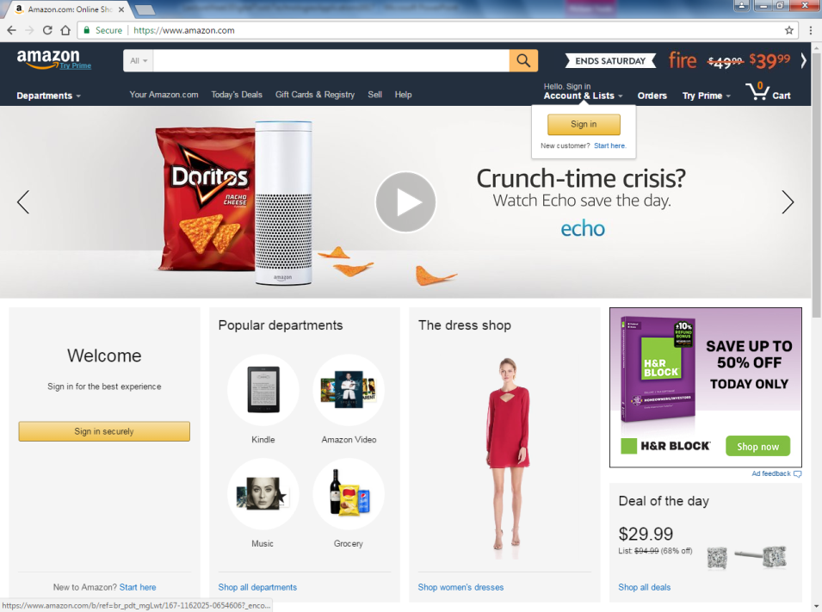
Amazon has different websites in different countries

Slide 9
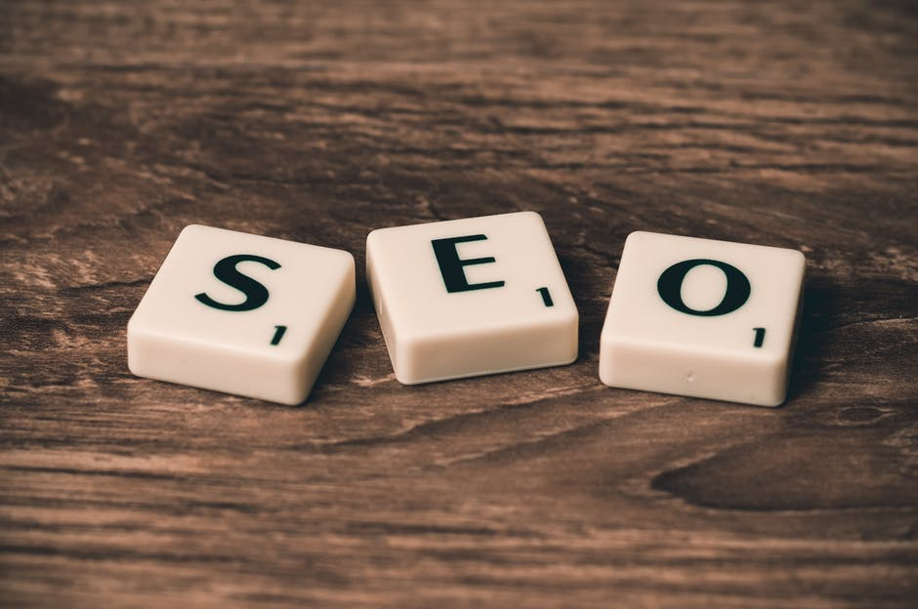
Search Engine Optimisation
Many people use search engines to find information.
Problem with search engines is that the results of a search may include thousands of products, services and company websites.
Search Engine Optimisation (SEO) is about improving the visibility of your company or brand on the results page displayed by a search engine.

Slide 10
Build content on website
Decide on keywords
Add keywords to content
Submit to search engine
Find existing ranking
Optimise pages
Analyse traffic conversion
Site Maintenance & reoptimisation
General Process of Search Engine Optimisation

Slide 11
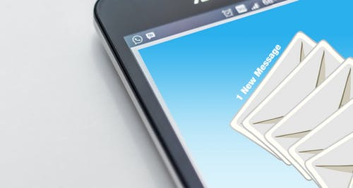
E-Mail Marketing
sending a commercial message, typically to a group of people, using email.
Usually involves direct marketing, advertisements, request for business, coupons or special offers, donations etc.
May include audio, video clips or links
Used to build brand awareness, encourage purchases and build loyalty and trust.

Slide 12
E-Mail Marketing
Advantages
Limitations
Low cost and easy to use method
Can reach large number of subscribers
Target fans of your brand
Many users check emails regularly
Can include direct link
Often treated as spam (blocked by user’s spam control software)
Users increasingly screen and blocks messages.
User uses option to unsubscribe

Slide 13
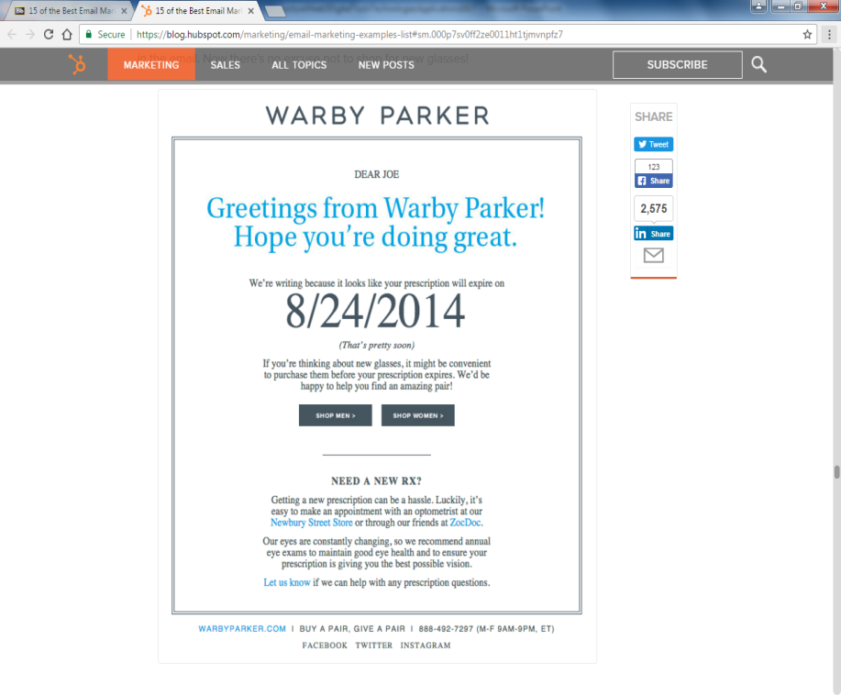
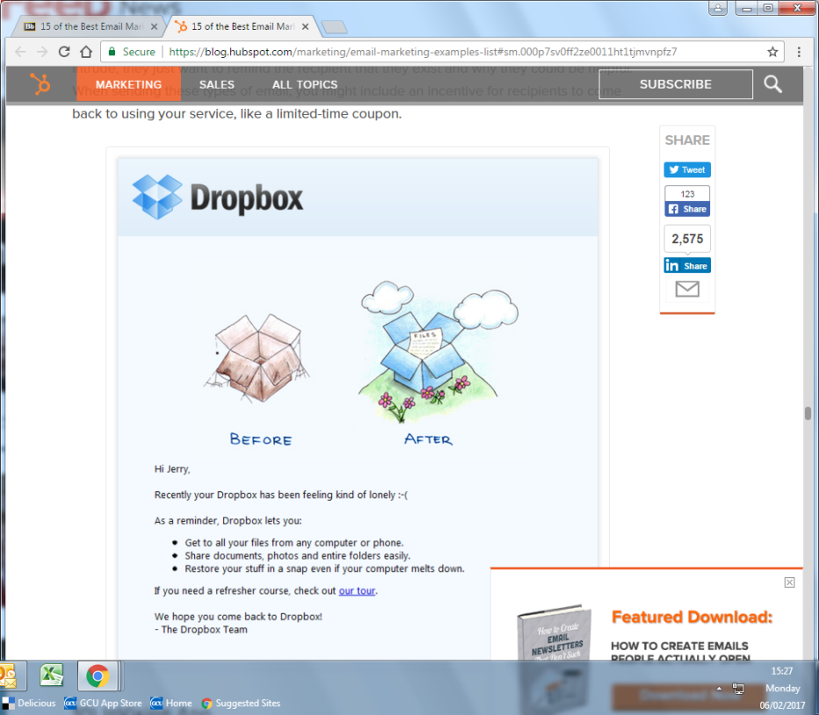
Best E-mail Marketing

Slide 14
Social Media
“Social media describes the way in which content (particularly news and opinion) has become democratized by the internet and the role people now play in creating and sharing content with them, be it textual, aural or visual. For this reason, it is interchangeably referred to as consumer- or user-generated content.”
Cook (2008), p7
Cook, N (2008), Enterprise 2.0: How Social Software will Change the Future of Work

Slide 15
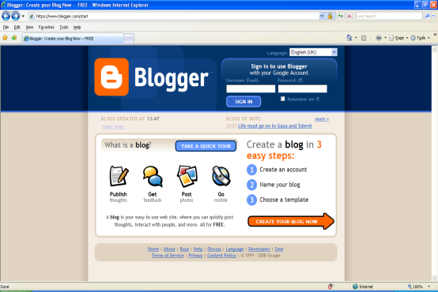
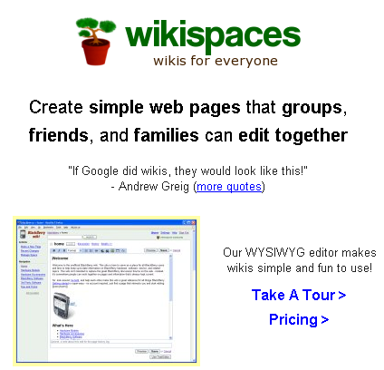
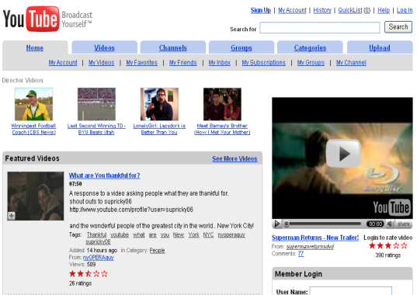
Focus of Social Media
Is on facilitating creativity, information sharing, collaboration and community amongst users

Slide 16
Social Media Features
Social
Media
Hear
See
Browse
Write &
Discuss
Collaborate
Network

Slide 17
Social Media Technologies
Social
media
Blogs
Wikis
RSS
Virtual
worlds
Social
Networking
Media
sharing
Social Bookmarking

Slide 18
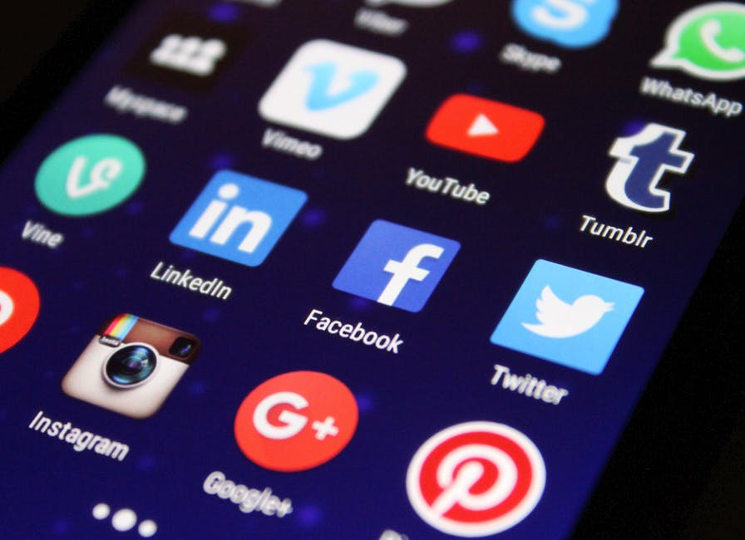
Examples of social media……………

Slide 19
Impact of social media
Participation
Community
Connectedness
Many-to-many communication
Shifting power of balance
Openness/Transparency
Disruption
Peripheral

Slide 20
Popularity of Different Social Media
By age, gender, at what time of the day? etc
The popularity of different social media platforms in different countries constantly changes. Take time to explore this website.
https://www.statista.com/statistics/282846/regular-social-networking-usage-penetration-worldwide-by-country/

Slide 21
Business Uses of Social Media:
Marketing
Advertising
Building brand awareness
Repairing brand reputation
Customer relationship management
Customer views and feedback
Community Building
Crowdsourcing
Recruitment

Slide 22
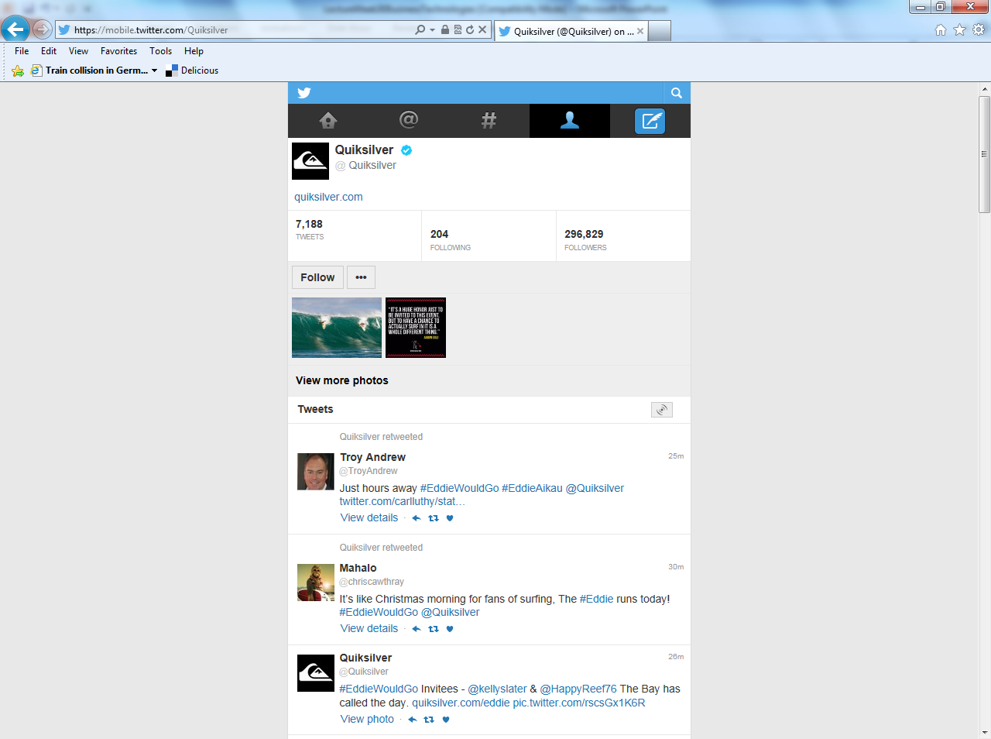
Social Commerce

Slide 23
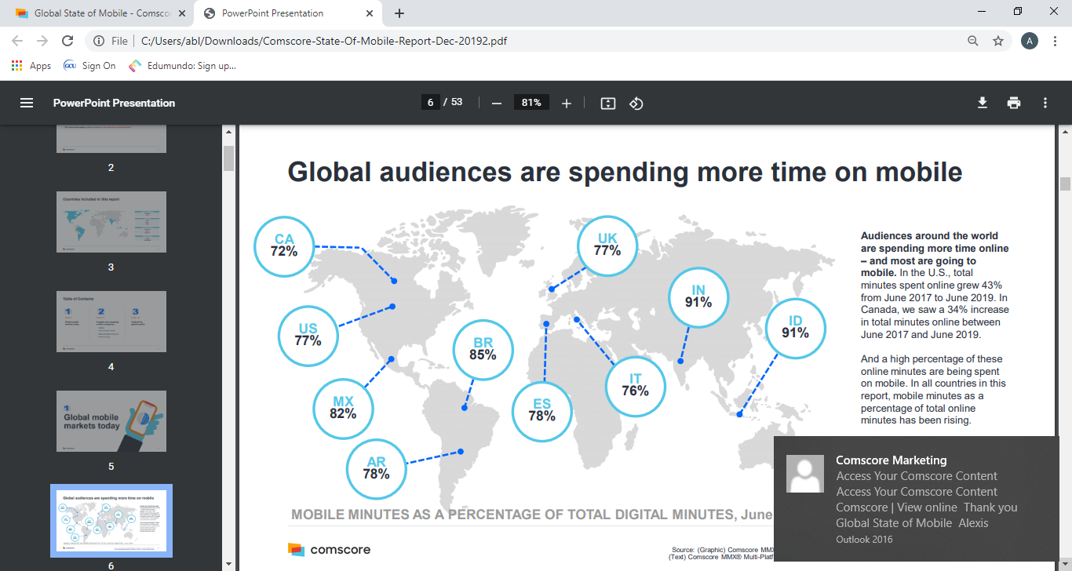
Mobile Computing

Slide 24
Mobile Devices, Software & Services
Smartphones
Tablets
Laptops
Wearable Devices
RFID
Mobile Portals and content providers
Short message service
Multimedia Messaging service
Location Based services
Voice Support services
Intelligent Personal Assistants
Mobile Apps

Slide 25
Most Popular Mobile Internet Activities

Slide 26
Benefits of Mobile
Benefits
Ubiquity
Reachability
Convenience
Interactivity
Personalisation

Slide 27
Location-based
Location-based advertising
Location-based tracking
Parcel tracking & Vehicle tracking
“66% of marketers believe location-based advertising is the ‘most exciting’ mobile opportunity according to a recent IAB UK study”

Slide 28
Business Uses of Mobile Computing
Mobile Banking and Financial Applications
Mobile Shopping
Mobile Payment
Mobile Marketing & Advertising
Consumer Services
Supporting the Workforce & Improving Internal operations
Mobile Entertainment & Gaming
Ride Sharing and Takeaways

Slide 29
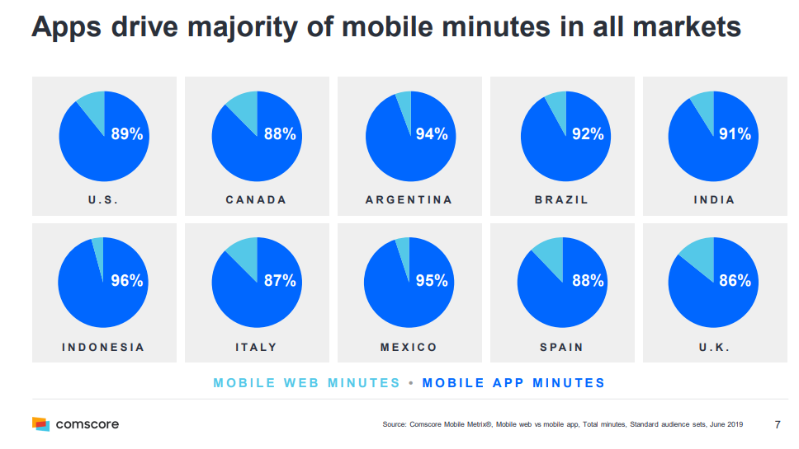

Slide 30
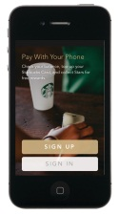
Mobile Commerce: Starbucks
Starbuck’s App pinpoints location of nearest café
Teamed up with iTunes to offer free music download whilst customer standing in queue.
Starbuck provide a Payment app once at front of queue.

Slide 31
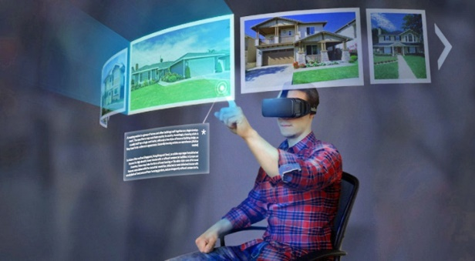
Intelligent Agents
VR is an artificial, computer-generated simulation or recreation of a real life environment or situation (immersive experience).
AR blends digital components into the real world in such a way that they enhance one another, but can also be told apart easily.

Slide 32
Virtual Reality & Augmented Reality
Examples…
customers can access product visualisation to allow them to make more informed purchasing choices
companies can use technologies for supporting store layout and planning.
or for enhancing repair and maintenance capabilities

Slide 33
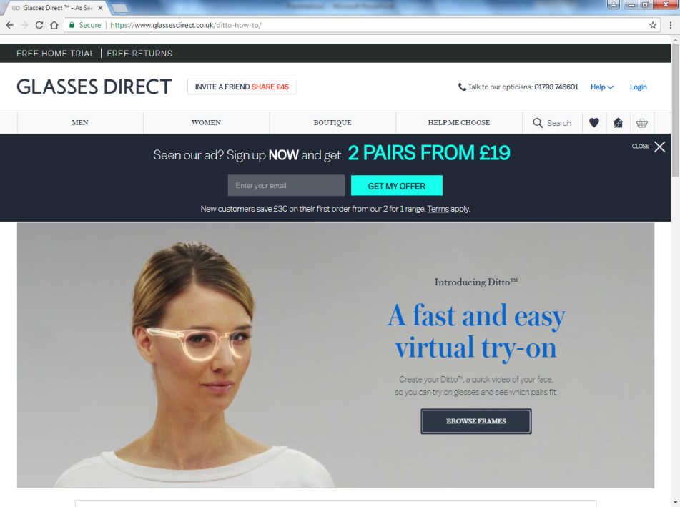
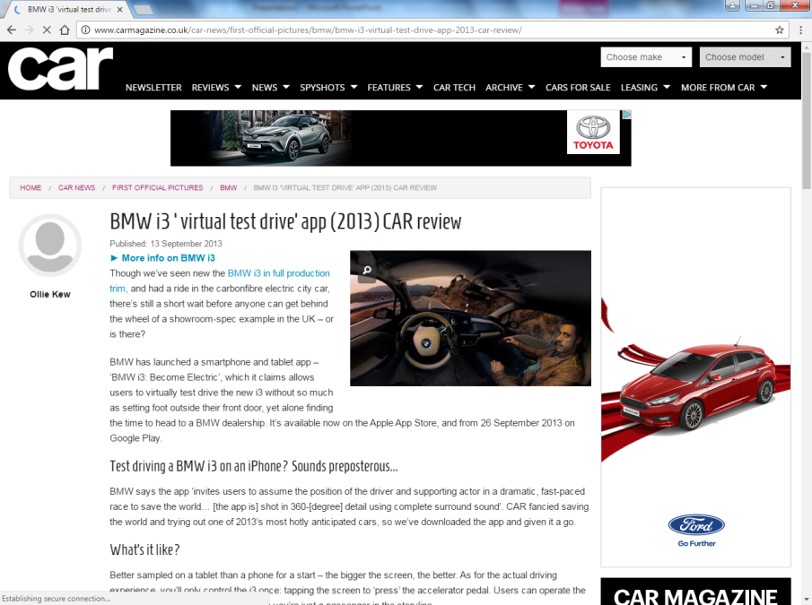
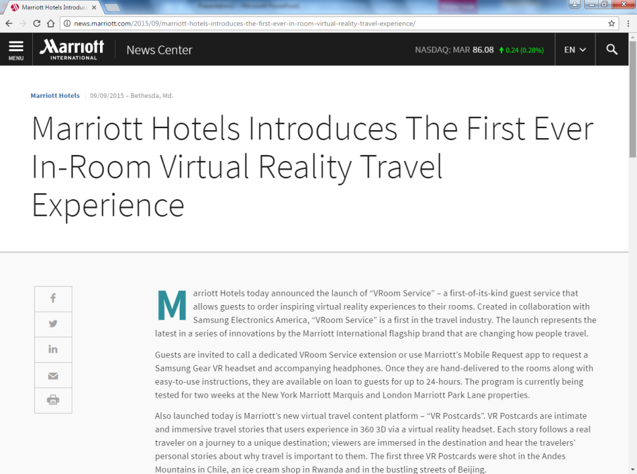

Slide 34
Intelligent & Mobile Commerce Example: Olay Skin Advisor
Mobile App (uses AI and Advanced Analytics)
Relies on machine-learning algorithms to analyse skin care needs.
Performs a facial analysis from a consumer’s no makeup selfie.
Recommends products based on personal data and best practices from skin experts.
Collects buying behaviour from consumer and uses data to predict demand for products and recommend specific products.

Slide 35
Summary
Wide range of digital business tools and technologies.
Many digital businesses have developed innovative applications.
Important to select the tool, technology and/or applications that deliver business value and meets the needs of the end consumer.

Slide 36
Additional Reading
Chaffey, D, Hemphill T & Edmundson-Bird D (2019); Digital Business and E-Commerce Management; 7th Edition; Prentice Hall – Chapter 3.
Turban, E & Outland, J (2018); Electronic Commerce 2018: A Managerial and Social Networks Perspective; 9th Edition; Pearson Education; Upper Saddle River, New Jersey – Various Chapters.

