Slide 1


Glasgow Caledonian University:
The University for the Common Good
BSc/BSc (Hons) Nursing Studies
2022 Intake

Slide 2
Glasgow Caledonian University:
The University for the Common Good
Glasgow Caledonian University is a vibrant multi-cultural university.
It is home to world leading research centres, international campuses
and partnerships around the world, as well as
the Institute for University to Business Education.
It has four academic schools…
Glasgow School for Business and Society
School of Computing, Engineering and Built Environment
School of Health and
Life Sciences
Glasgow Caledonian University London

Slide 3
Nursing Degree Programmes at GCU
BSc Nursing Studies – 3 yr degree
Adult, Child, Learning Disabilities and Mental Health
BSc Nursing Studies (Hons) – 4 yr degree
Adult, Child, Learning Disabilities and Mental Health
Please choose carefully as it is not possible to move fields once you have started on your programme
4600 hours of preparation
2300 academic hours and 2300 practice placement hours

Slide 4

BSc Entry requirements
Highers: B,B,C (including English)
Nat 5 Maths
or equivalent
BSc Hons Entry requirements
Highers: B,B,B,B (including English and Science)
Nat 5 maths
or equivalent
Also consider:
Appropriate Reference and Personal Statement
Successful assessed study within the past 5 years
Protection of Vulnerable Groups, Health Screening

Slide 5

Engagement to Develop the Programme
With students, service users/carers, service partners, colleges & supporting departments
Through World Cafes, the Involvement Group, the Development Board and subgroups, GCU Learn online site, Staff “Keep, Adapt, Remove, Add” event

Slide 6
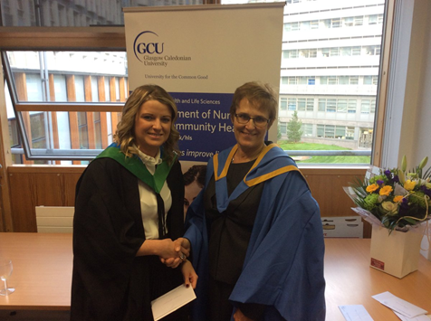
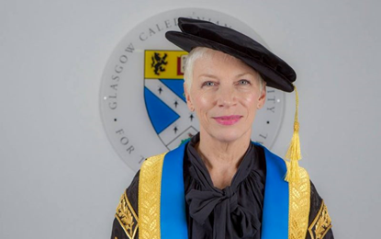
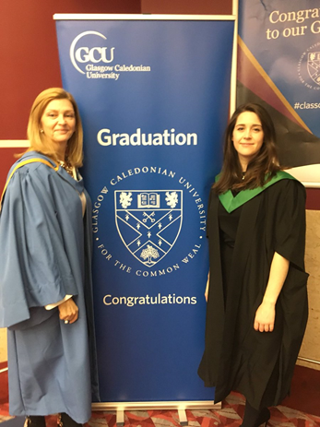


On completion:
BSc/BSc (Hons)
Nursing Studies
Registered Nurse with the Nursing and Midwifery Council (All fields)

Slide 7
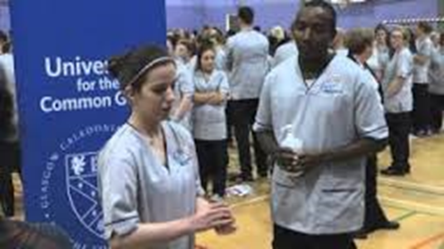

So why choose nursing at GCU?
Values based curriculum
Blended learning
Practice learning in a broad range of healthcare settings
Shared learning
Student engagement
Service user involvement
Internationalisation
Inter Professional Education
Volunteering, extra-curricular activities

Slide 8
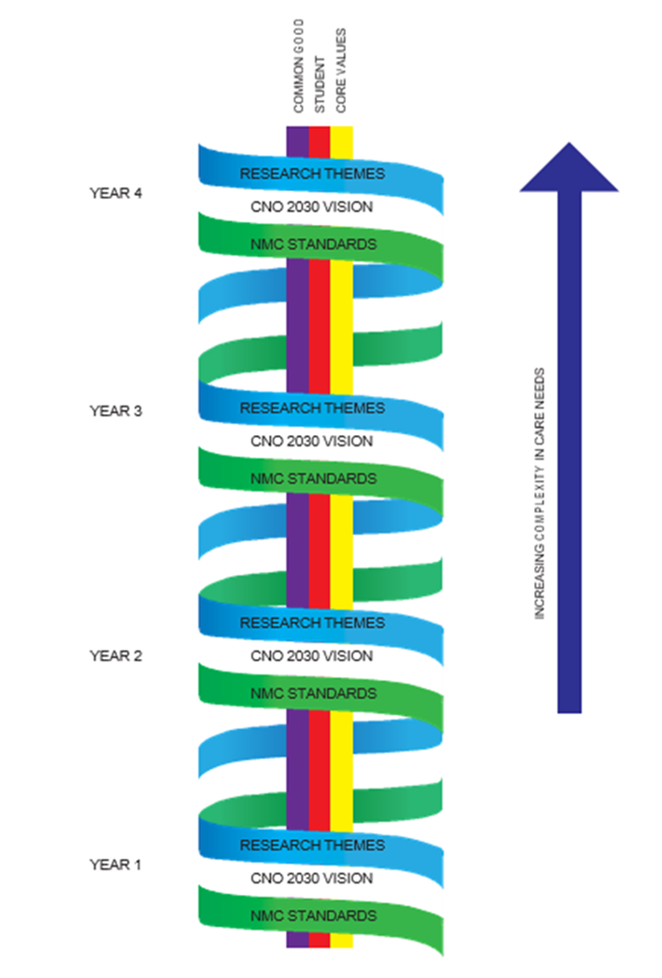
Curriculum Model
Themes:
NMC Standards
Chief Nursing Officer (CNO) 2030 Vision
GCU Centre for Living research themes and evidence-based practice
Core:
The student
Core values
GCU Common Good
Educational philosophy:
Authentic, co-produced person-centred scenarios
Increasing in complexity
Developing independence & confidence

Slide 9
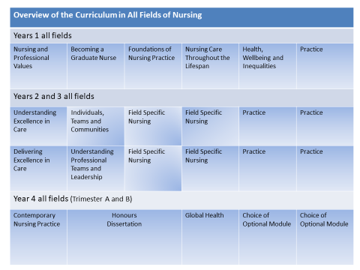

Slide 10
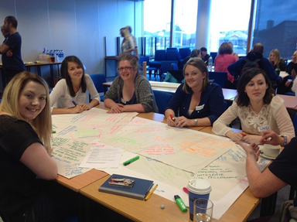
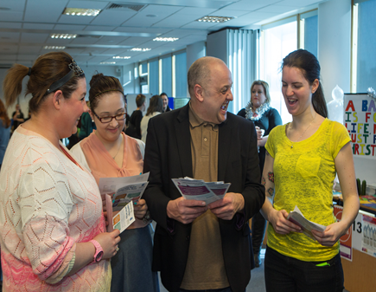
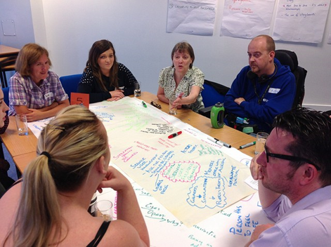
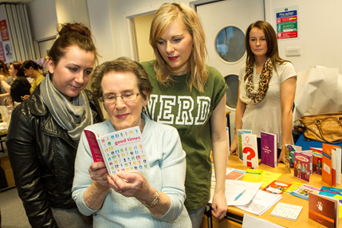
Shared Learning
Where all 4 fields of nursing come together for classes and share their learning
  Adult Learning Disabilities
  Child Mental Health
Service users and carers engagement
Student engagement

Slide 11


Interprofessional Learning
  Physiotherapists
  Occupational Therapists
  Radiographers
  Podiatrists
  Social Workers
  Dieticians
  Orthotists & Prosthetists
  Speech & Language therapists
  Paramedics

Slide 12
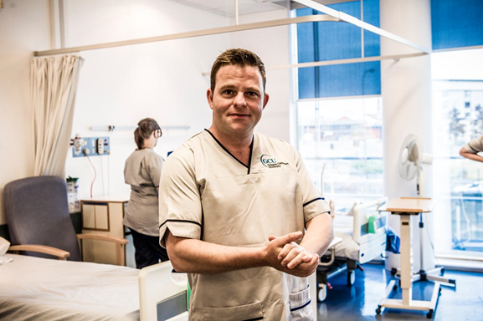
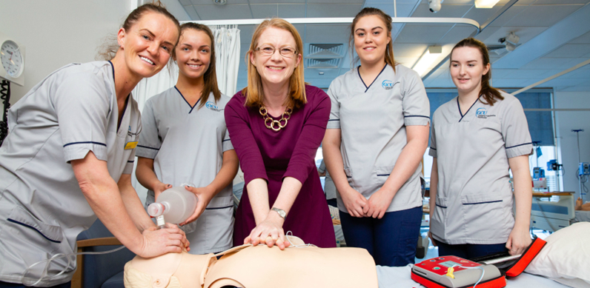
Interprofessional Simulation Centre
(Click on this Link for a Virtual Fly Through)

Slide 13
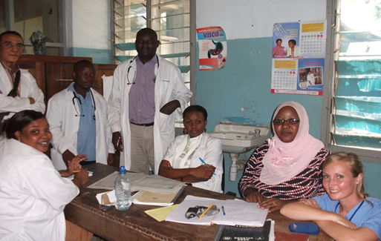
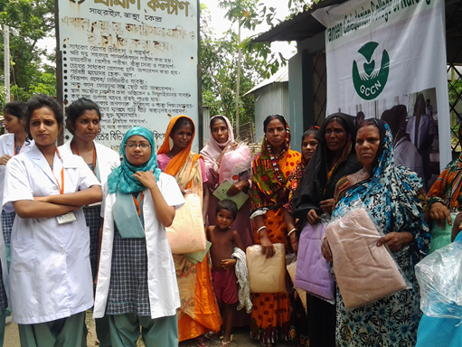
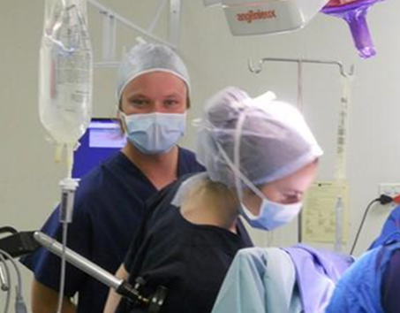
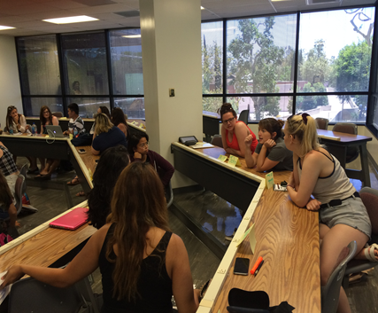
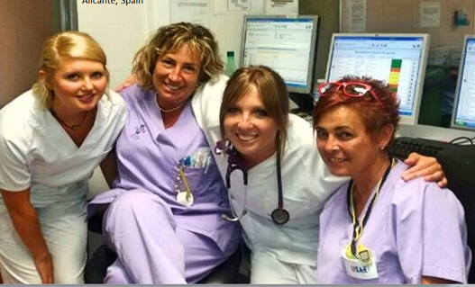
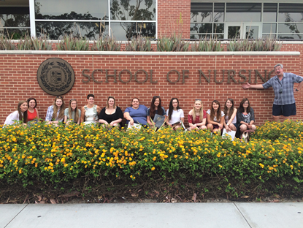
Internationalisation
Malawi
Tanzania
South Africa
Bangladesh
Nepal
Long Beach, California,
New York
Spain, Cyprus, Italy
Denmark, Sweden, Finland

Slide 14


Student Support
Student Health and Wellbeing Services
Personal Tutor/Academic Assessor
Practice Supervisors/Assessors
Level Coordinator
Administrators
Learning Development Centre
Technicians and Librarians
Student Association

Slide 15
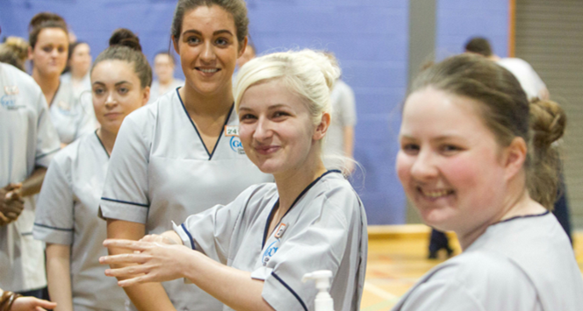
Academic Year
Trimester A – September to December
Trimester B – January to April
Trimester C – May to the end of August
Holiday dates are set and cannot be changed

Slide 16

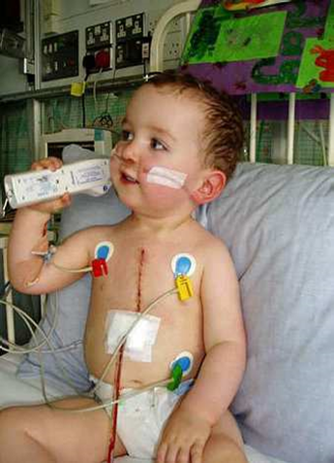
Practice Learning
50% of the programme
Time spent in practice increases each year:
14 weeks in year 1
22 weeks in year 2
27 weeks in year 3
Practice learning experiences will be in a variety of areas such as: community partnerships, the independent sector and in-patient acute services
You will be supervised in practice by Practice Supervisors/Assessors
Practice Education Facilitators (PEF)

Slide 17
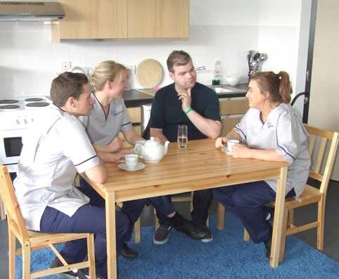
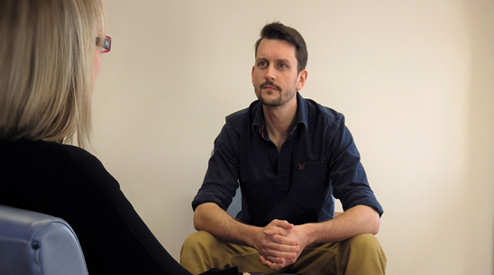
Practice Learning Experiences (PLEs)
PLEs will be across NHS GGC in a variety of settings, e.g. hospitals, residential care and in people’s own homes & communities
35 Hospitals of different types, Over 50 Health Centres and Clinics, and more than 300 GP Surgeries,
Child and LD placements may be offered across the west and other parts of Scotland
You must provide intimate care for all genders

Slide 18
Practice Learning: Travel & Shifts
Shifts vary depending on the placement: include 12 hour shifts e.g. 7am to 7pm; weekends, public holidays, some night shift; Monday to Friday 9am - 5pm
Working weekends, public holidays and nights is required to experience 24 hr service provision
Basic travel expenses included in bursary, additional monies may be claimed from SAAS if these exceed £5 per day
Part time work with set hours cannot be sustained

Slide 19
Health Screening
Independent and confidential service
You don’t have to disclose any health issues to us
We can however offer advice if required
Good Health and Character
If a student on the course is convicted of a crime this must be declared
A panel will consider the charge and any supporting evidence provided by the student
This can often result in the student being asked to leave the course

Slide 20
Protection of Vulnerable Groups (PVG)
Discuss ANY and ALL criminal charges as soon as possible, these will be thoughtfully considered on an individual basis
Failure to disclose will be considered a deliberate deception and any offer will be withdrawn
All charges will appear on enhanced disclosure, none are ever spent

Slide 21
Equality and Diversity - Health
Focus not on any disability but the individual’s capability for safe and effective practice
All nursing students are expected to participate equally in the programme and on placement to meet Nursing & Midwifery Council (NMC) outcomes
Applicants should be realistic about their capacity to provide safe and effective care

Slide 22
Additional Learning Needs
Where reasonable adjustments to support the student can be made they will be made
There are however, practical limits to these adjustments
Consider access to support that can realistically be provided in the working area, e.g. the student will be expected to read and write confidential reports without any misunderstandings

Slide 23
Course fees - 4 Nursing options to choose from
3 year ordinary degree –
BSc Nursing (Adult), BSc Nursing (Child),
BSc Nursing (Learning Disabilities) and
BSc Nursing (Mental Health)
4 Year BSc (Hons) routes for all of the above
Check eligibility for SAAS funding at their website
https://www.saas.gov.uk/full_time/nmsb/index.htm
Criteria Includes: Previous Study
Dependents
Care Experience Students
Ordinarily Resident

Slide 24
Course Fees
Home Students – £1,820 per year
(met by Student Awards Agency Scotland)
Rest of UK Students – £9,250 per year
No more than £27,750 total fees of 3 or 4 year degree
(Apply for fee and living cost support through your home
country’s Local Education Authority, not SAAS)
EU and International students – £12,250 per year
Republic of Ireland - RUK fees but can apply to SAAS for student loan to pay these. Also awarded the RUK Scholarship which refunds £2000 per year back on fees

Slide 25
Student Awards Agency Scotland Bursary
Check Eligibility with SAAS
Basic bursary, not means tested – £10,000 per year
13 instalments of about £770 every 4 weeks
Must declare any previous receipt of bursary
Not eligible for student loan
Check eligibility for Additional support – assessed by SAAS www.saas.gov.uk Telephone: 0300 555 0505

Slide 26
Additional costs for RUK, EU and International Students
Required to cover the cost of:
2 to 4 Uniforms, approximately £15 each
Occupational Health checks and vaccination set fee of £220
Membership of PVG scheme
New applications cost £59. Updates to the existing scheme £18
Invoices are issued for payment of all of the above additional costs in Trimester B (March / April) of the first year of your programme
Potential accommodation and additional travel costs during
practice education placements

Slide 27
Accommodation
Apply after May once offered a conditional or unconditional place
Caledonian Court - Friendly, multicultural atmosphere,
on-campus, city centre location
Home for 660 students - Self-contained, fully-furnished flats
for 6 to 8 people, 24 hr security
Rent of £99 - £113 per week (approx)
39 week contract includes heat, light, power, internet
Priority - under 19 & distance from home, international students,
students with recognised special needs
https://www.gcu.ac.uk/student/life/yourcampus/accommodation/universityaccommodation/

Slide 28
Applications
Follow UCAS timetable for deadlines
For questions about your application you can contact Glasgow Caledonian University central admissions department see website hlsundergraduate@gcu.ac.uk
If they can’t answer your query they will direct it to an appropriate member of School staff

Slide 29

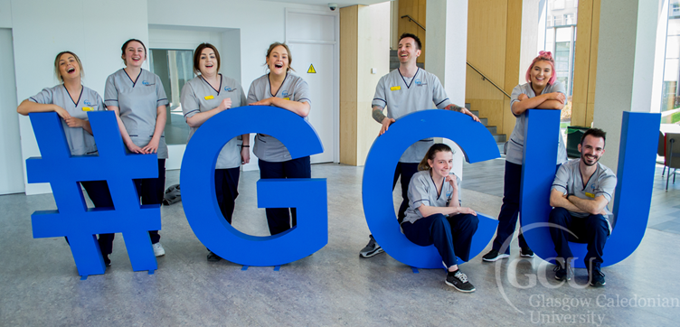
We look forward to seeing you again
Thank you for your interest in our Nursing Studies Programme here at GCU

Slide 30
Glasgow Caledonian University:
The University for the Common Good
BSc Nursing Studies/ BSc Nursing Studies (Hons)
2022 Intake
We hope this information helps you when considering your future study and where to undertake this
Please don’t hesitate to get in touch if we
can be of any more help
william.mcdonald@gcu.ac.uk

