Slide 1

Behavioural Psychology for Waste Management
Caledonian University
November 2021

Slide 2
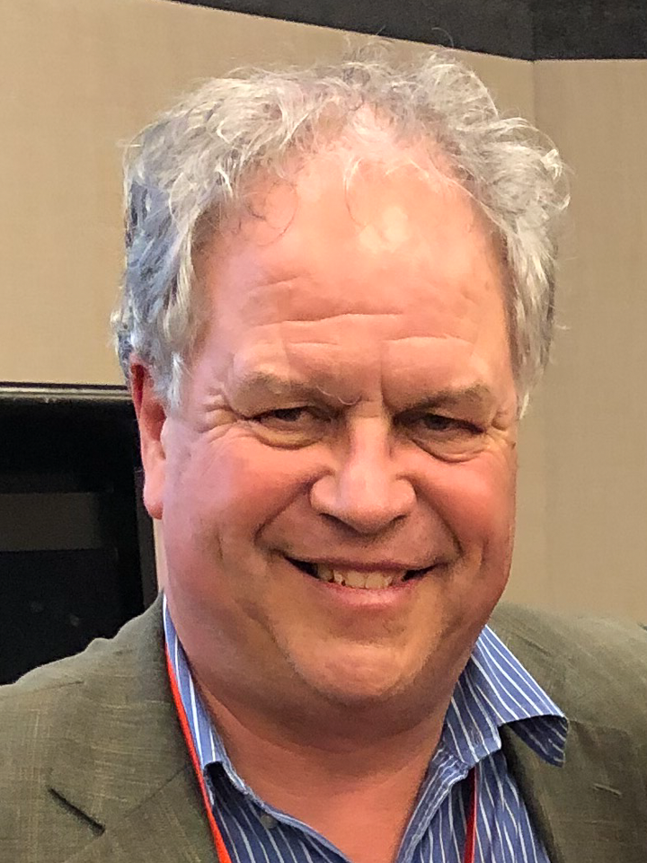
Ken Donnelly
Beyond Attitude Consulting
30 years of applying behavioural psychology to sustainability programs
International consultant
Solid Waste Manager for a local authority
Lives in Halifax, Nova Scotia, Canada

Slide 3
Doctors Washing Hands
Notes:
This example is taken from a study of health professionals in British Columbia, conducted in 2011. Researchers observed that, although health care professionals were very aware of the importance of washing their hands, only 12% were compliant with the policy. Once again, correct attitude and awareness did not translate to correct behaviour.

Slide 4
Metrics of Hand-Washing Study
2015 study at 34 US hospitals
4,000+ caregivers (2/3 were nurses)
  14 million washing hands “opportunities”
  Only 50% compliance rate
  Worse in afternoon, when compliance dropped 38% from what it was in the morning
Extrapolates to 600,000 unnecessary infections, 35,000 unnecessary deaths, and $12.5 billion in added costs in US annually

Slide 5

Attitude and
Awareness
Action

Slide 6
Intention-Action Gap
Psychologists even have a name for the phenomenon
Cannot just convince people it is a good idea and expect the behaviour will follow
Nonetheless, having the right attitude and awareness are still important

Slide 7
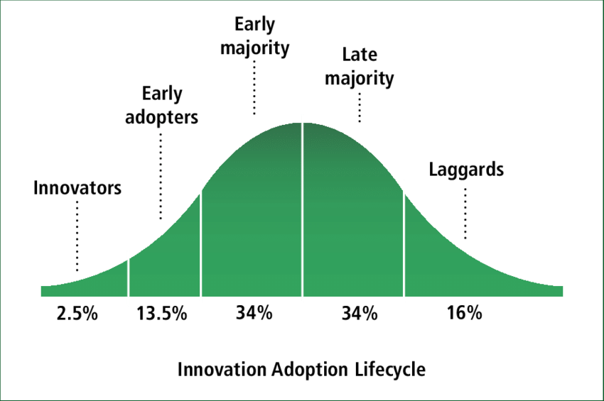

Slide 8

Behaviour Change Steps
Identify and remove barriers and promote benefits
Secure promises
Provide reminders
Develop a social norm

Slide 9
Behaviour Change Steps
Identify and remove barriers and promote benefits
Secure promises
Provide reminders
Develop a social norm

Slide 10

Barrier and Benefits Identification
Research
  Why do people litter?
  Why don’t people recycle?
Do not assume
Need to determine the actual barriers
Then remove them
Motivators are important too

Slide 11

Research Methods
Literature Reviews
  Find out best practices
Surveys
  Statistical significance
Focus Groups
  Ability to drill down
Observations

Slide 12

Barrier Removal

Slide 13

Research Methods
Literature reviews
  Share research and experiences
Surveys
Focus Groups
Observation

Slide 16
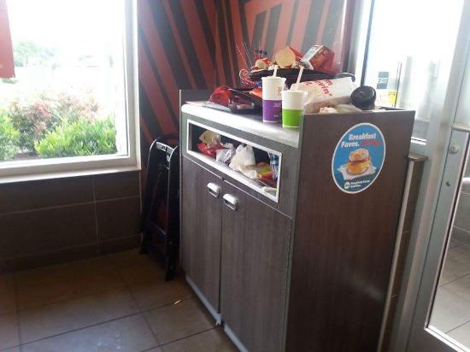
Waste Sorting Fail

Slide 17
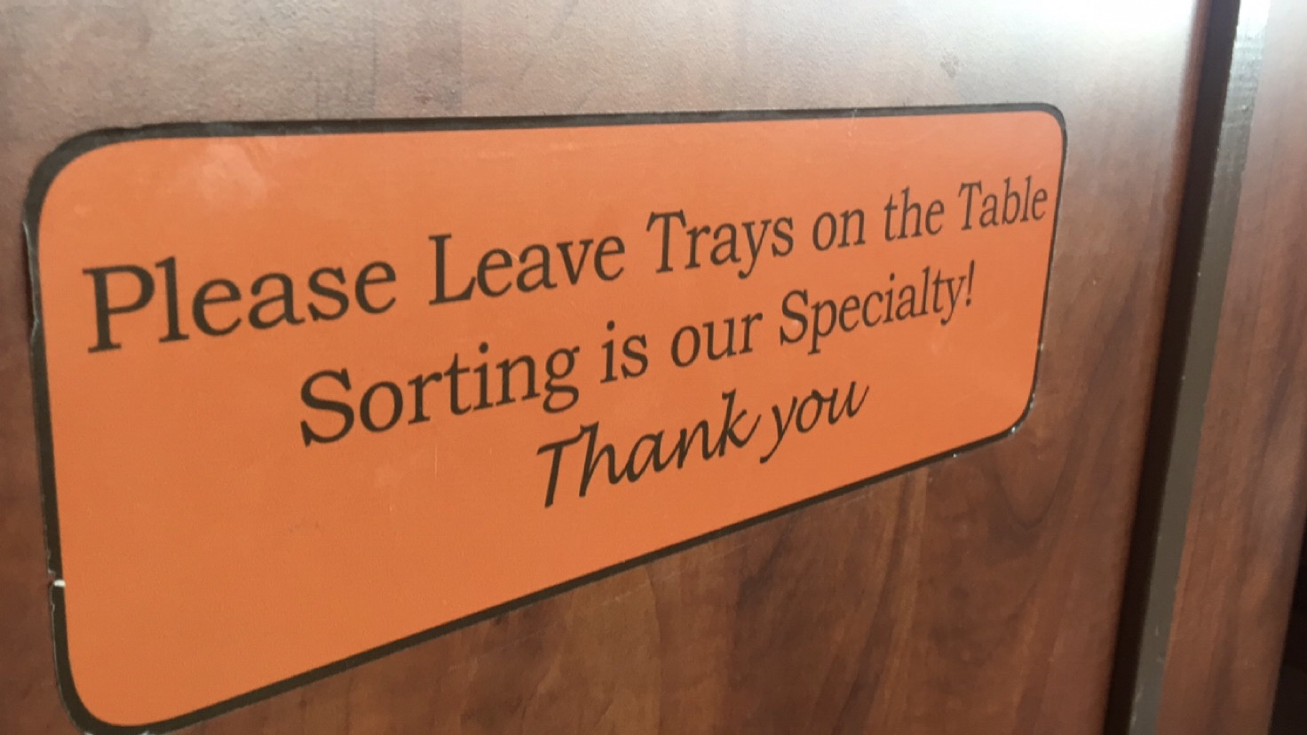
Removing Barriers

Slide 18
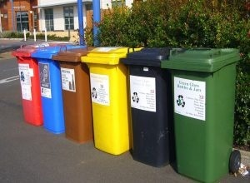
Removing Barriers
Don’t know how
Too difficult
Don’t know when
Follow up with request for commitment
Photo courtesy Resource magazine.

Slide 19
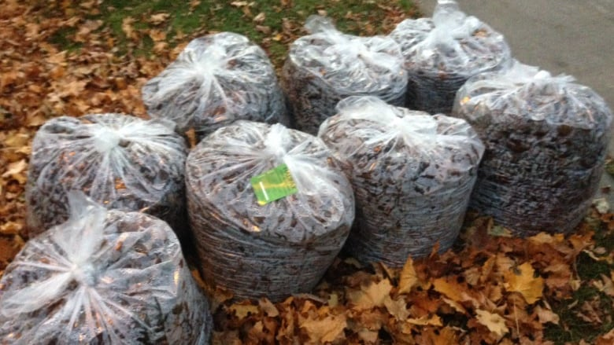
Motivators
Photo courtesy Canadian Broadcasting Corporation

Slide 20
Behaviour Change Steps
Identify and remove barriers and promote benefits
Secure promises
Provide reminders
Develop a social norm

Slide 21

The CBSM Toolbox - Commitment
People want to be seen to be consistent with what they say
Self-perception
  I am a blood donor
  I am a recycler
Change self-perception

Slide 22
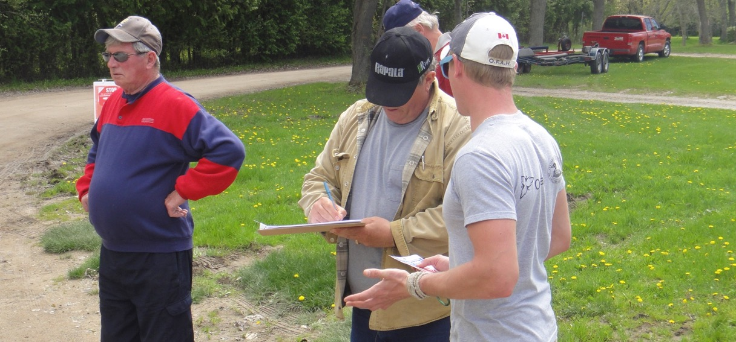
Obtain Commitments

Slide 23
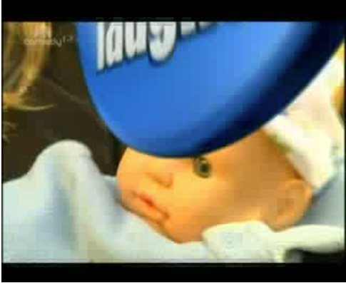
Watch My Baby?

Slide 24

Watch My Baby?

Slide 25
Behaviour Change Steps
Identify and remove barriers and promote benefits
Secure promises
Provide reminders
Develop a social norm

Slide 26
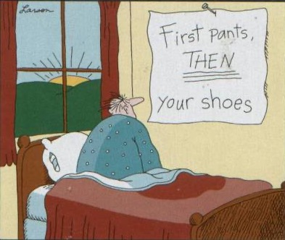
Effective Reminders
Clear and simple
In place where a decision is to be made
Provides info at right time
Is a reminder that supports other elements

Slide 27
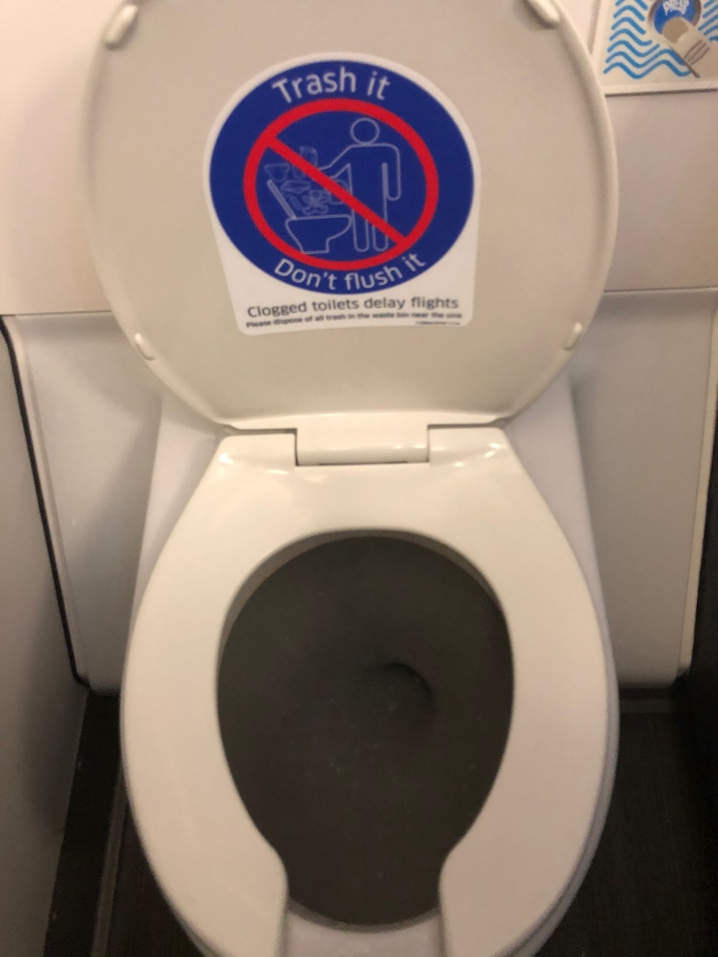
Effective Reminder

Slide 28
Behaviour Change Steps
Identify and remove barriers and promote benefits
Secure promises
Provide reminders
Develop a culture

Slide 30
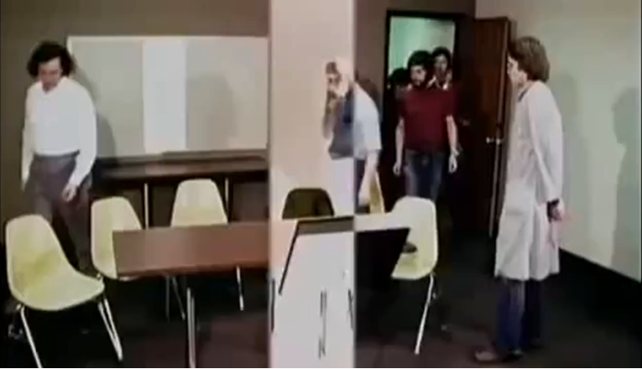
Asch Experiment
Peer pressure is a powerful force
This fascinating experiment has been conducted many times over the years

Slide 31
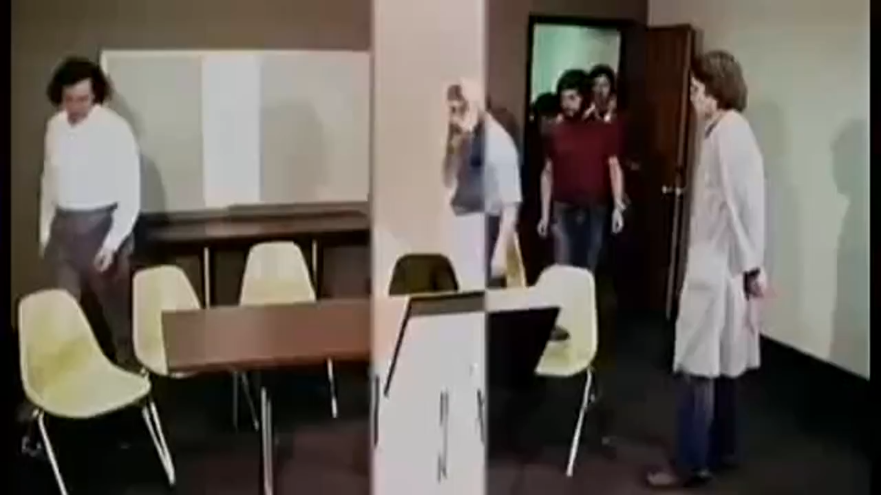
Social Norm In Action

Slide 32
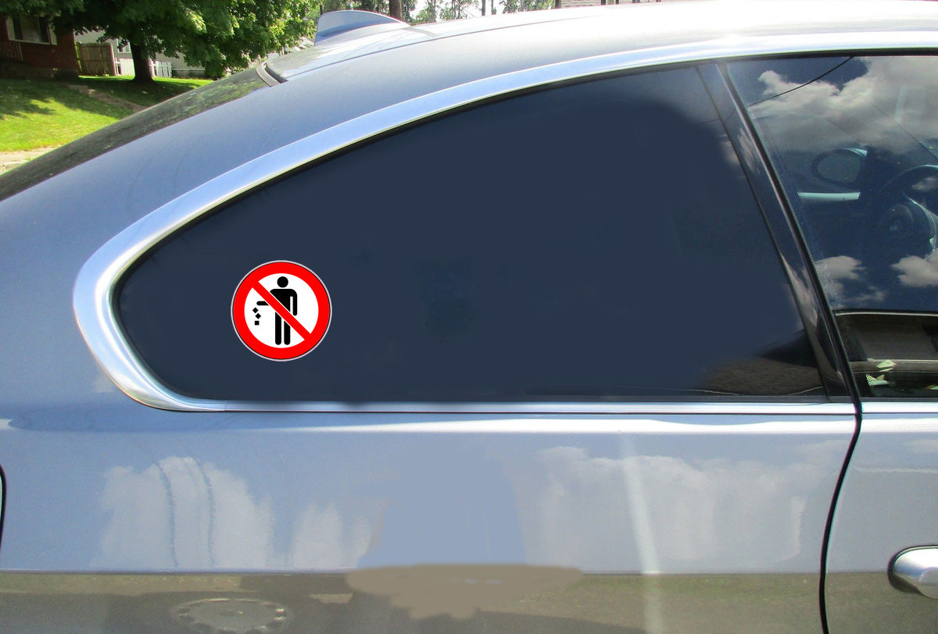
Social Norm Promotion

Slide 33
Behaviour Change Steps
Identify and remove barriers and promote benefits
Secure promises
Provide reminders
Develop a social norm

Slide 34
How many passes?

Slide 35

How many passes?

Slide 36
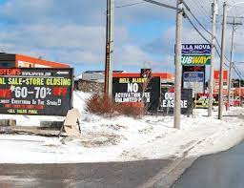
Need to stand out

Slide 37
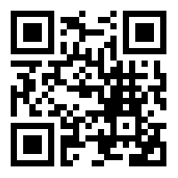
Thank You
Ken Donnelly
Beyond Attitude Consulting
ken@beyondattitude.com
(902)223-6123
www.beyondattitude.com
@beyondattitude
Facebook.com/beyondattitude

