Slide 1
Social Entrepreneurship
Dr Fiona Henderson and Melissa Mesek

Slide 2
Objectives
To learn about social innovation and, as part of this, social entrepreneurship
To review social entrepreneurship practices in Scotland
To review the differences between social enterprises and for-profit organisations re: its structure, leadership styles and culture
To consider the difficulties in managing what is an uncertain and risky process, much like it would be in for-profit contexts
To understand its relevance for your CW2 Assignment – the Digital Story

Slide 3
Social innovation (SI) - History and Definition
> Social Innovation (SI) is not a new term
> It's first usage is recorded in the late nineteenth century
> For a long time, it wasn't widely used (Ayob, Teasdale and Fagan, 2016).
> It has now found growing popularity amongst European as well as American policymakers (ibid).
Edwards-Schachter and Wallace (2017, p. 73) identified distinctive elements from a variety of discourses in order to affirm that SI is 'a collective process of learning involving the distinctive participation of civil society actors aimed to solve a societal need through change in social practices that produce change in social relationships, systems and structures, contributing to large socio-technical change.'

Slide 4
Social entrepreneurship - History and definition
Social entrepreneurs need to be seen as the agents of change (Hervieux and Voltan, 2016)
Framing SE as changing the system strikes a chord with many actors as the SE movement was born out at the beginning of a cycle of protest against capitalist systems (ibid).
Hervieux and Voltan (ibid) further remark that social entrepreneurship at its core is about finding original solutions to diverse social issues.
According to (Ridley-Duff and Bull, 2019, p. 72) it is beneficial to judge social enterprises on the scope and depth of their performance in at least one of these three areas:
1) democratic ownership and governance
2) ethical and sustainable trading practices
3) social purpose and impact

Slide 5
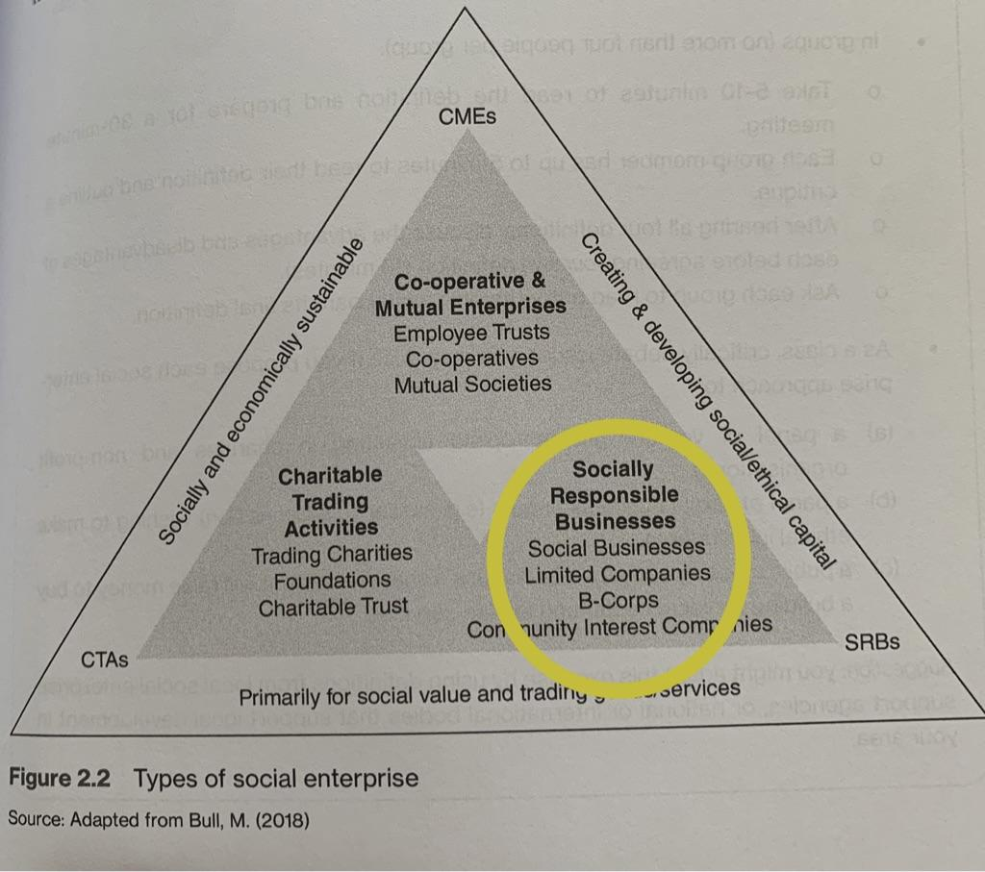
Types of Social Enterprises
Source: Adapted from M. Bull (cited in Ridley-Duff and Bull, 2019, p. 73)

Slide 6
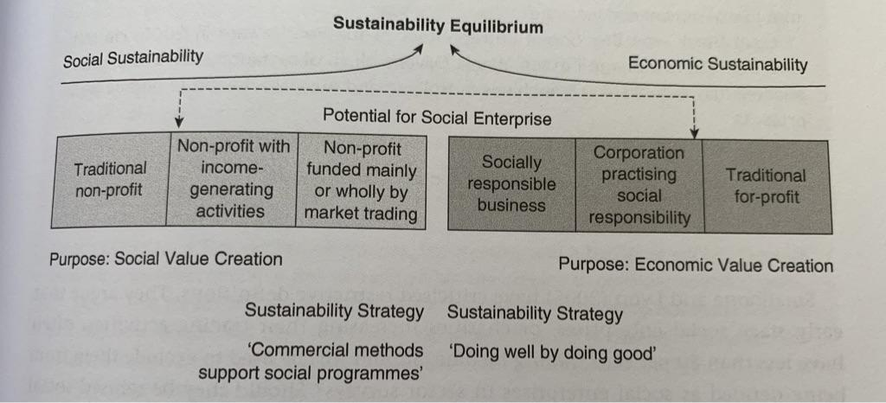
Structure of a social enterprise
Source: Adapted from Alter, K. (2007, cited in Ridley-Duff and Bull, 2019, p. 77)

Slide 7
Hybridity within social enterprises
> Hybridity or hybridisation: operating as a bridging role and across three distinct sectors: public, private and third sector
> Because of this hybridity, there often arises tensions across the senior leadership and other ethical dilemmas which the leader has to disperse
> Mongelli et al. (2019) go even further to argue that a leader should be embracing these tensions, as this can lead to innovations and can open up new possibilities.

Slide 8
Management forms in social enterprises: Unitary, Pluralist and Radical
Fox (1966) outlines three perspectives through which a social enterprise can manage their workforce: Unitary, Pluralist and Radical.
The Unitary Management Form:
> Leader will assume 'their right to manage' and takes full authority in times of crises or during challenges
> CEO or board is the sole source of authority who are also the ones to establish values, policies and practices to be followed as part of the organisational culture
> Conflict is unacceptable in this culture and will be met with disciplinary or grievances procedures in order to showcase dominance from the top tiers
> Debating forums are unlikely to be part of the culture. If it is used, it is managed by the board or the executives
> Conditions on employment or strategic management are also usually areas where no collective bargaining can be found
Source: (Ridley-Duff and Bull, 2019)

Slide 9
The Pluralist Management Form
> An organisation has different groups that have differing values, interests as well as objectives.
> This can be seen as part of debating forums during which employees can negotiate and bargain collectively, but also only to some extent.
> From this perspective, conflict cannot be avoided and therefore, in this form, we can find processes that help to resolve conflict.
> However, conflict will be rejected if the managers position is questioned. As part of this management form, joint decision-making on business matters and strategic management decisions is generally avoided (ibid).
Source: (Ridley-Duff and Bull, 2019)

Slide 10
The Radical Management Form
> Radical management form in which conflict is not only tolerated, but welcomed openly, as it is perceived to help with driving social transformation and can be the key asset to finding solutions, encouraging creativity and spurring innovation.
> The presence of open conflict marks a 'great' company (Collins, 2001, cited in Ridley-Duff and Bull, 2019, p. 311)
> Managers and/or the executive suite do not assume that they have an automatic right to manage and rather delegates workers
> One can notice that their values and attitudes as part of their organisational culture emerge over time
> Conflict is mostly managed through discussion and debate in forums which are managed democratically and mediated with conflict resolution processes only utilised if they are absolutely needed
> A consequence of the structures inherent in this management approach discussed above, their forums for debate and collective bargaining are integrated in the organisation's culture with a focus on active learning from trade unions and/or joint councils/sub-boards in the organisation
Source: (Ridley-Duff and Bull, 2019)

Slide 11
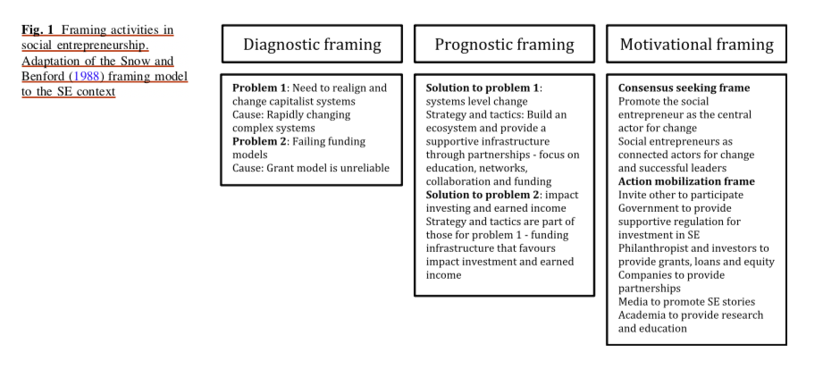
Framing of social enterprises
Source: (Hervieux and Voltan, 2018, p. 288)

Slide 12
Differences between social enterprises and for-profit organisations
Social entrepreneurs:
High levels of empathy and need for social justice
- Motivations behind creating and sustaining change
- Values more focused impact within a community
- long-term change as a time frame
- Core of business is driven by the need for social change
- Reliance on a network of stakeholders and outside resources (such as grant funding from external sources) to fulfil their promises on impacting their community or society
For-profit organisations:
Main focus on financial returns and profits
Sometimes include a corporate social responsibility (CSR) mission on the side
Senior executive team as well as a suite of managers and below those, key workers, to deliver promise to end-customer

Slide 13
Difficulties in managing sustainable social change
Search – recognizing opportunities
Selection and resource mobilization
Developing the venture
Innovation strategy
Innovative organisation/rich networking
Tidd and Bessant, 2021, p. 553-554

Slide 14
Mimicry as a form of productive resistance?
Dey and Teasdale (2015) explain that 'tactical mimicry' is a concept that has organisations which are part of the third sector label themselves as being a social enterprise in order to receive funds from the government. While tactical mimicry conforms to governmental strategies only in order to exploit them, its ultimate aim is to increase potential for collective agency outside the direct influence of power.
Dey and Teasdale (2016) maintain that tactical mimicry also implies that practitioners remain hopeful for a better world, as they are still willing to vocalise where their dislikes and pain points lie regarding the social enterprises programs and policies. Them submitting themselves to an economic rationale rather than a social one is just one of the consequences of the way that the government-led social enterprise policies and programs are offered.

Slide 15
The Real Times Study
Longitudinal study over 5 years and focused on 5 third sector organisations
Main aim was to conceptualise a third sector organisation's day-to-day reality
This research is also particularly useful as it situates these organisations within the business ecosystem that they operate in and examines them from a field-based lens as well
It is interesting for our purposes, as one can easily see how a third sector organisation works and what their challenges are, helping you to include some critical discussion into your course works.
Source: (Dey and Teasdale, 2016)

Slide 16
Relevance to CW2 – Your Digital Story
Some of the companies that were chosen by the module team (and consequently allocated to you) are social enterprises.
You will need to be able to distinguish between those two types of organizational models (social enterprise/for-profit organisation) and place your allocated company within the correct frameworks.
We included some concepts and theories for you to utilize in your CW2 Digital Story – make use of these to underpin your coursework with sufficient scientific backup.
We also included our reference list at the end of this lecture for you to follow up on the texts used.

Slide 17
Objectives
To learn about social innovation and, as part of this, social entrepreneurship
To review social entrepreneurship practices in Scotland
To review the differences between social enterprises and for-profit organisations re: its structure, leadership styles and culture
To consider the difficulties in managing what is an uncertain and risky process, much like it would be in for-profit contexts
To understand its relevance for your CW2 Assignment – the Digital Story

Slide 18
References
Ayob, N., Teasdale, S., & Fagan, K. (2016). How social innovation ‘came to be’: Tracing the evolution of a contested concept. Journal of Social Policy, 45(4), 635-653.
Boddy, D. (2011) Management. Fifth edition. Pearson Education UK.
De Bruin, A., & Teasdale, S. (Eds.). (2019). A research agenda for social entrepreneurship. Edward Elgar Publishing.
Dey, P., & Teasdale, S. (2016). The tactical mimicry of social enterprise strategies: Acting ‘as if’ in the everyday life of third sector organizations. Organization, 23(4), 485-504.
Edwards-Schachter, M., & Wallace, M. L. (2017). ‘Shaken, but not stirred’: Sixty years of defining social innovation. Technological Forecasting and Social Change, 119, pp. 64 - 79.
Hervieux, C. & Voltan, A. (2018), Framing Social Problems in Social Entrepreneurship. J Bus Ethics. 151, p.279–293.
Ridley-Duff, R. & Bull, M. (2019), Understanding Social Enterprise Theory and Practice. Third edition. London: SAGE Publications Ltd.
Tidd, J. & Bessant, J. R. (2021), Managing innovation : integrating technological, market and organizational change. Seventh edition. Chichester, West Sussex: John Wiley & Sons.

Slide 19
Further recommendations on the literature
Henderson, F., Hall, K., Mutongi, A. & Whittam, G. (2019), "Social enterprise, social innovation and self-directed care: lessons from Scotland", Social Enterprise Journal, 15(4), pp. 438-456.
Henderson, F., Reilly, C., Moyes, D. & Whittam, G. (2018), "From charity to social enterprise: the marketization of social care", International Journal of Entrepreneurial Behavior & Research, 24(3), pp. 651-666.
Marques, P., Morgan, K., & Richardson, R. (2018). Social innovation in question: The theoretical and practical implications of a contested concept. Environment and Planning C: Politics and Space, 36(3), pp. 496- 512.
Moulaert F, Mehmood A, & MacCallum D, Leubolt B. (2017), Social innovation as a trigger for transformations-the role of research. (online) Available at: https://publications.europa.eu/en/publication-detail/-/publication/a7b4de0a-1070-11e8-9253-01aa75ed71a1/language-en
Sepulveda, L. (2015), “Social enterprise–a new phenomenon in the field of economic and social welfare?”, Social Policy and Administration, 49 (7), pp. 842 - 861.

