Slide 1
GCU Mentoring Programme
Research Staff Mentoring
Dr Amy Cartwright and Karen Coyle
Notes:
Welcome to this information session for both those who are considering mentoring researchers and for researchers who are looking for a mentor. We will spend some time exploring and explaining what mentoring is in the context of this programme and how it will operate and match mentors with mentees.
There will be opportunities to ask questions and I am very happy for you to ask as we go along, either in the chat or by raising your hand.

Slide 2
Why might researchers want a mentor? What topics might be raised?
Notes:
In beginning to think about mentoring, I'd like to pose this questions just for your consideration - what might researchers want from a mentor? Think about the kinds of topics that might be raised within those conversations.

Slide 3
Typical researcher mentoring topics
Publishing and funding
Progression from early career researcher: gaining independence
Practical advice: CVs, interviews etc.
Networking
Confidence (saying no)
Work-life balance
Relationships (PI, manager, supervisor, students, senior management
Engagement, influence and impact
Research management
Notes:
An overview of typical researcher-mentoring topics:
Publishing and funding: some researchers will specify they are looking for a mentor in this area and we will use the info you provide in your online form in order to make the best match possible based on this requested area. But you may find that even if this was not the intended or initial focus, that it will be a central concern of most researchers looking to continue to pursue a research career.
Progression to independence: some researchers engaged in the mentoring programme may be considering how to make the move from ‘Early Career Researchers’ - a term that can be used to mean many different things depending on the funding/expectations/timescale it is attached to.
Maybe they are looking for more practical advice around CV advice, support for interviews etc. – a specific goal in mind and the right individual to take them through that in a focussed way, drawing on experience of similar situations.
Networking is also a typical mentoring topic. Looking to connect the person to your own network, assisting them in becoming connected to a suitable academic or non-academic network to further research or career goals.
Confidence – can be a very large hurdle, making the move from research student to independent researcher.
Work-life balance – looking to explore perhaps how to achieve a better balance between the demands of work and life balance. It might lead you to consider your role as a role model and how you manage this personally. What advice and guidance would you be able to give?
Relationships at work – the complexity of research roles and how to navigate, sharing ideas with a trusted external who understands the landscape. Things like engagement, influence and impact, reaching out with the research.
And finally – management of research – a major task and one that requires expertise and I’m sure some tips to make it all possible and still leave time to do the actual research.

Slide 4
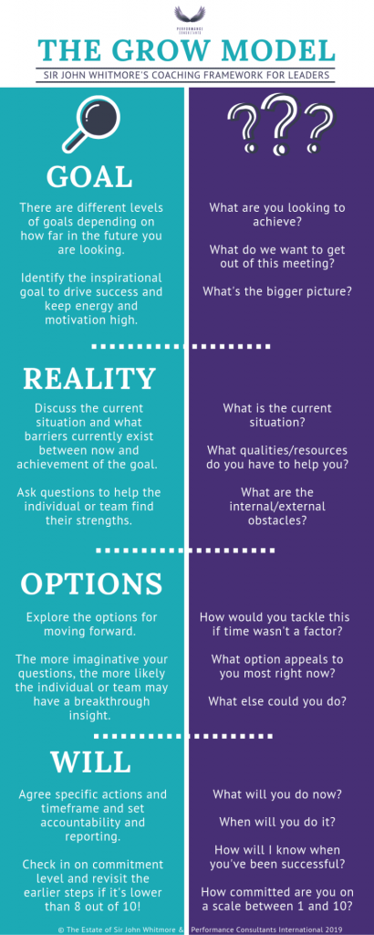
Notes:
At GCU we use the GROW model as the basis for all our mentoring schemes and it underpins Research Staff mentoring too.
It is a useful tool in opening up conversations, questions and situations – allowing a mentor to hear from the mentee about their situation rather than offer advice and opinions straight away. For a mentee, it can offer an entirely new perspective on a situation and offer space to explore new options.
This particular version I quite like as it offers some ideas on the kinds of questions mentors might pose in order to help mentees in looking at an area in a new way and find new insights.
On the Graduate School webpages you can find more information about the GROW model including some SWAY materials which you can work through in your own time https://www.gcu.ac.uk/graduateschool/researcherdevelopment/mentoring/

Slide 5
Expectations and roles
Mentors:
Be clear about the purpose
Listen
Meet regularly
Give of yourself
Be a role model
Confidentiality
Mentees:
Be very clear about expectations
Take responsibility for your goals
Be prepared to listen
Share ideas and issues
Accept constructive feedback
Accept that some things will fail in order for you to succeed
http://pcaddick.com/index.html
http://theundercoverrecruiter.com/be-great-mentor-leader/
Notes:
We will provide an example of a mentoring agreement that you may wish to consider as a starting point to your mentoring relationship, ensuring clarity for both parties and focussed discussions.
Mentoring provides the opportunity for tailored and supportive professional development, designed to meet the needs of individual researchers.
Also important to be aware of the boundaries of a mentoring partnership and be prepared as a mentor to signpost to other specialist services.

Slide 6
GCU Research Staff Mentoring Scheme Administration
Karen Coyle, Researcher Developer
The Graduate School
Notes:
I’m Karen Coyle and I’m the researcher development officer in the Graduate School. I have worked with Amy to deliver this mentoring programme with responsibility for administration and communication. If you have any queries you can contact me using the details in the final side.

Slide 7
Mentoring timeline
Recruitment:
February/March
Information session:
March
Pairing process:
March/April
Mentoring:
April – Sept/Oct
Evaluation:
October
Notes:
Here we have laid out the mentoring timeline, beginning with recruitment to the programme in February and March and today’s information session, following this will be the pairing process of mentors and mentees at the end of March and into early April, once the pairing process is completed mentoring will take place until September with evaluation in October.

Slide 8
Pairing process
Advertise programme and invite applications: https://caledonian.onlinesurveys.ac.uk/mentors-and-mentees-form
Pairing process: Use Jisc Survey tool and pair mentors and mentees based on the information provided
Useful resources as a guide to mentoring: https://www.gcu.ac.uk/graduateschool/researcherdevelopment/mentoring/
Notes:
For the pairing process we have invited potential mentors and mentees to complete a secure online application form using the Jisc Online Surveys tool. The questions in the application include information about school, department or research unit, research interests and methodology and publishing records. The application also asks why participants want to join the programme and what they hope to gain from taking part listing different examples depending on whether they are applying as a mentor or mentee. We also added a question on emotionally demanding research and whether that’s something applicants could give support or would want support in.
Once the deadline has passed Amy and I will use the detailed answers received to pair mentors and mentees as suitably as possible based on their mutual interests and aspirations for taking part, once the pairs have been agreed with both parties we will facilitate introductions and each person will receive a mentoring agreement.
We will continue to add useful resources on our webpage highlighted here and I will also send the mentoring agreement and other materials via email. If anyone has any useful materials that they have used for mentoring in the past and want to share please send them to me.

Slide 9
What next?
Deadline to apply will be Friday 25 March
Pairing process will take place
Mentors and mentees will be introduced and mentoring agreements sent
One-to-one meetings
Monitoring and evaluation
Notes:
The deadline for people to complete the application form will be Friday 25th March. After that the pairing process will take place.
Once the pairs have been agreed mentors and mentees will be introduced to one another via email.
Mentoring will proceed in the form of confidential meetings over six months, while we won’t be hugely prescriptive - the timings and content will be for you to design and plan together, focussing on objectives you set, we can provide a suggested framework and topics to anyone who wishes.
We will be in contact regularly to hear about your experience, we will check in after the first month via email and hope to hold an in person catch up after three months. At the end of the process we will host informal voluntary focus groups and send you an anonymous evaluation survey.

Slide 10
Any Questions?

Slide 11
amy.cartwright@gcu.ac.uk karen.coyle@gcu.ac.uk
Researcher Development Concordat: https://researcherdevelopmentconcordat.ac.uk/

