Slide 1
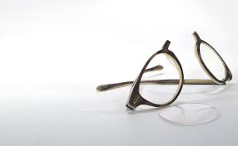
Falls & Vision:
More than meets the eye!
Dawn Skelton
Prof. Ageing and Health
Co-Lead: Ageing Well Research Group

Slide 2
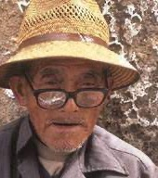
This afternoon…
How big a problem are falls?
How is vision implicated in falls?
Can we prevent falls?
Can we prevent falls in people with visual impairment?
Take action
Resources available

Slide 3
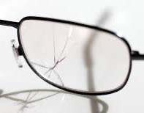
How big a problem are falls?

Slide 4
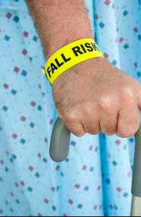
Falls in Scotland
868,512 people aged >65
294,194 are fallers
16,549 admissions to hospital
30% have a hip fracture
Average length of stay
  Faller – 19 days
  Fracture – 29 days
39% not discharged to their own home
Craig et al. Scott Med J. 2013

Slide 5
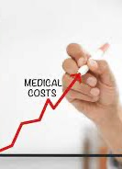
Costs of falls
Costs (2010/2011):
  Cost per person falling £1720
  For those needing medical assistance £8600
  Hip fracture admission £39,490
  In total falls and fractures cost over £470 million a year, with the majority of the costs (45%) being for long term care.
Craig et al. Scott Med J. 2013

Slide 6
Covid-19 and social restrictions
Large decline in physical activity
  Active travel to work, incidental activity (to and from shops etc.), leisure and sport activity
Loneliness and reduced social support
Access to healthcare
  Exacerbation of long-term conditions
  Lack of early diagnosis so symptoms worse
  Falls exercise services paused
Mental health
  Anxiety, depression, OCD, PTSD….
Falls & Frailty
De Biase. Skelton et al. Age Ageing 2020; https://www.physoc.org/policy/covid19resilience/; https://www.gov.uk/government/publications/covid-19-wider-impacts-on-people-aged-65-and-over
© Dawn SKELTON

Slide 7
The cost of reduced incidental activity
26%
18%
Deconditioning is the syndrome of physical, psychological and functional decline that occurs as a result of prolonged inactivity and associated loss of muscle strength
Deconditioning can occur at any age, but amongst older adults can occur more rapidly (symptoms experienced within one week), be more severe, and be extremely challenging to reverse
are unable to walk as far as before
feel less steady on their feet
average duration of strength and balance activity decreased from 126 to 77 minutes per week (in March to May 2020 compared to the corresponding period in 2019)
Increase of > 250,000 falls (110,000 people)
Costing >£211 million per year over next 2.5 years
Pangioti, M et al. (2019) BMJ; https://www.physoc.org/policy/covid19resilience/; https://www.gov.uk/government/publications/covid-19-wider-impacts-on-people-aged-65-and-over; https://www.ageuk.org.uk/latest-press/articles/2020/10/age-uk--research-into-the-effects-of-the-pandemic-on-the-older-populations-health/
© Dawn SKELTON

Slide 8
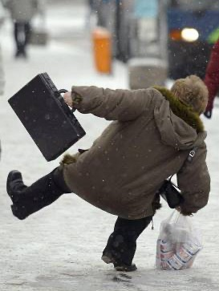
Trippers or fallers?
When intrinsic abilities to remain upright cannot cope with extrinsic risk factors
Nervous system, reaction times and gait speed slows
Balance and strength deteriorates

Slide 9
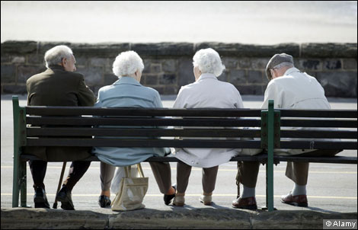

Sedentary behaviour health risks
In older adults (>60 years old), sedentary behaviour is significantly associated with:
Higher plasma glucose
Higher BMI and waist:hip ratio
Higher cholesterol
Reduced muscle strength
Reduced bone density
Increased frailty
Increased falls
Those with highest quartile of sedentary behaviour had a 26% higher risk of falling relative to the lowest quartile
Copeland, Dogra (2017) Brit J Sports Med, Gennuso (2013) Med Sci Sports Exerc.; Skelton (2001) Age Ageing; Chastin (2014) Bone; Rosenberg (2021) JAGS
Notes:
Plasma glucose and BMI (Gennuso et al)
Muscle strength and bone density (Skelton et al; Chastin et al)
Pain (WHO)

Slide 10
How is vision implicated in falls?
There are over 400 risk factors for falls in the literature
History of falls is the biggest risk factor
Poor gait and balance are the next most predictive risk factors
Being female and older
History of Stroke, Parkinson’s Disease, Epilepsy and Dementia
Vision impairment
Deandrea et al. Epidemiology. 2010

Slide 11
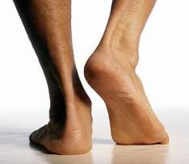
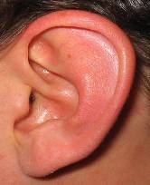

Stability and Balance
Input for balance
  Visual iformation
  Vestibular information
  Proprioceptive information
All decline with age
All components of postural sway
Postural sway increases by
20 -70% with impaired vision

Slide 12
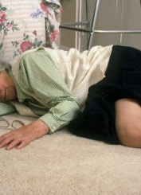
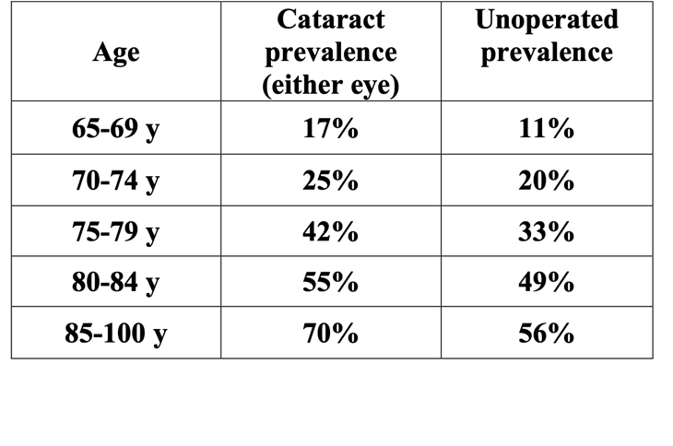
Visual Impairment and Falls
80% of VI people are aged over 65
Rate of falls in older people with VI is 1.7 times higher
Hip fractures in older people with VI are 1.3-1.9 times higher
Legood et al. 2002; Squirell and Kenny 2005; Minassian et al 2000

Slide 13

BSc Dissertation – Welsh 2011
N=67 (33 VIP, 34 normally sighted) aged 70-96 years attending GCU low vision clinic
 | VIP | Normal
Fall in last year | 38% | 18%
Fall requiring medical treatment | 44% | 25%
Multiple falls | 69% | 43%
Visual field defect within 20 deg of fixation in those who fell | All | None

Slide 14
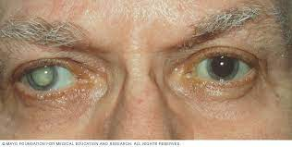
Unilateral vs bilateral VI and falls
1972 people aged 60+ 6 year follow up after visual acuity screening, Singapore
the majority of VI was correctable (unoperated cataract and under corrected refractive error)
baseline bilateral (OR 1.79), moderate-severe VI in one eye and mild VI in the other (OR 1.58) but not unilateral VI conferred a greater likelihood of incident fall
Unilateral mild VI (OR 2.34) and any form of bilateral VI (OR 2.46 to 4.32) increased the odds of recurrent falls
Even mild unilateral VI conferred substantially higher odds of recurring falls
VI caused by correctable (OR 2.02) and uncorrectable (OR 3.09) eye conditions were both associated with greater odds of incident frequent falls
Gupta et al. BJO 2022

Slide 15
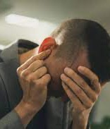

Dual sensory loss and where you live
166 people 65+ with and without VI. Age matched case control study
Increased risk of experiencing a fall with reduced visual function (OR 3.49
Specifically impaired stereoacuity worse than 85” of arc (OR 3.4) and reduced (by 0.15 log unit) high spatial frequency CS (18 cpd) (OR 1.40)
If also have a hearing impairment then OR 3.18
The risk decreases with living in a less deprived area (OR 0.74), or socialising more out of the home (OR 0.75)
Mehta et al. BMC Geriatr 2022

Slide 16
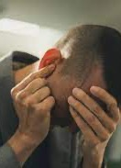
Dual Sensory Loss
7,623 Chinese adults aged 45+
7 year follow up on falls
Vision Loss leading to falls OR 1.30
Hearing Loss leading to falls OR 1.50
Dual Sensory Loss leading to falls OR 2.06
50, 986 European adults aged 50+
3 year follow up on falls
Subjective vision impairment OR 1.19
Subjective Dual Sensory impairment OR 1.33
Zhou et al. Front Med 2022;
Ogliari et al. Eur Geriatr Med 2021

Slide 17
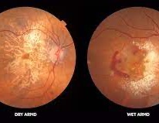
Fear of falling with AMD
133 Australian people, 77 with AMD and 56 without
Concern about falling scores higher in AMD
Greater concern seen in those with reduced contrast sensitivity
White et al. Opthalmic Physiol Opt 2021

Slide 18
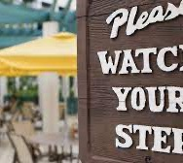
Missing that step
  Loss of central vision
  Loss of peripheral vision / reduced visual field
  Patchy vision
  Poor visual acuity
  Poor contrast sensitivity
  Loss of colour awareness
  Loss of depth perception
  Discomfort in bright light or glare
  Poor light dark adaptation
  Or combinations of the above
Lord et al. 2007, Freeman et al. 2007

Slide 19
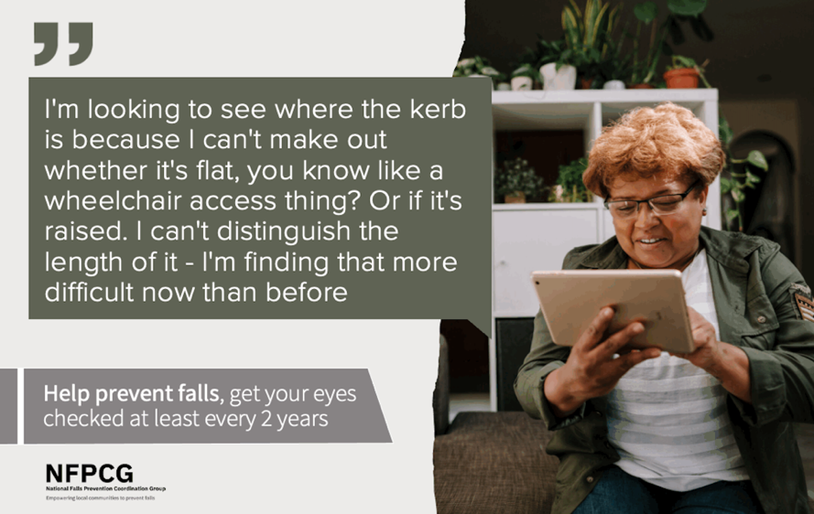

Slide 20
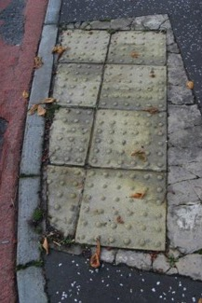
Knowing where to cross
Many older people without visual impairment avoid walking on these as they lead to balance problems with sore feet
Are the right ones used in the right places?
A visual jumble to work out
Upsets people balance

Slide 21
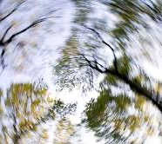
Dizziness
Issues with vestibular-ocular reflex seen in people with dual sensory loss
Visual migraines
New glasses prescription

Slide 22
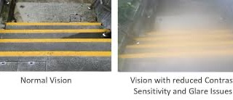
Ramp or steps?
How deep?
Any obstacles in the way?
Need at least 50% contrast difference to provide adequate visual information for safer stair ambulation
Bjelica et al. Appl Ergon 2021

Slide 23
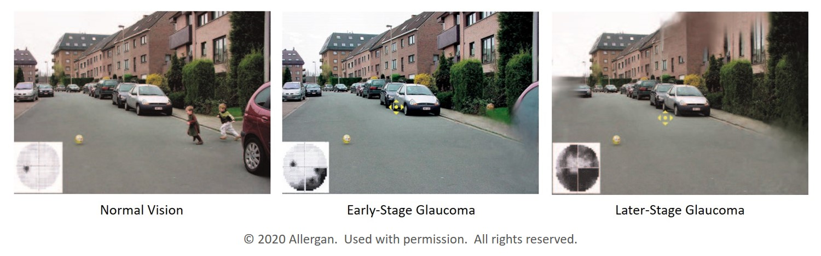
Jumping or being scared and reacting inappropriately when things come from behind them
Greater binocular field loss = greater postural sway = greater risk of falls
Colman et al. 2007

Slide 24

Difficulty judging obstacles
Difficulty distinguishing shadows from steps
Don’t see changes in surfaces (=balance challenges) ahead

Slide 25
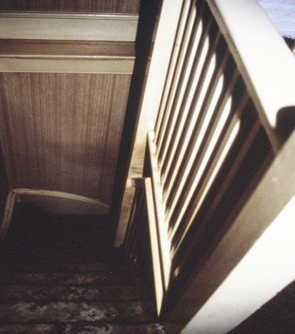
Poor lighting
Confusing patterns on carpet
No handrail

Slide 26
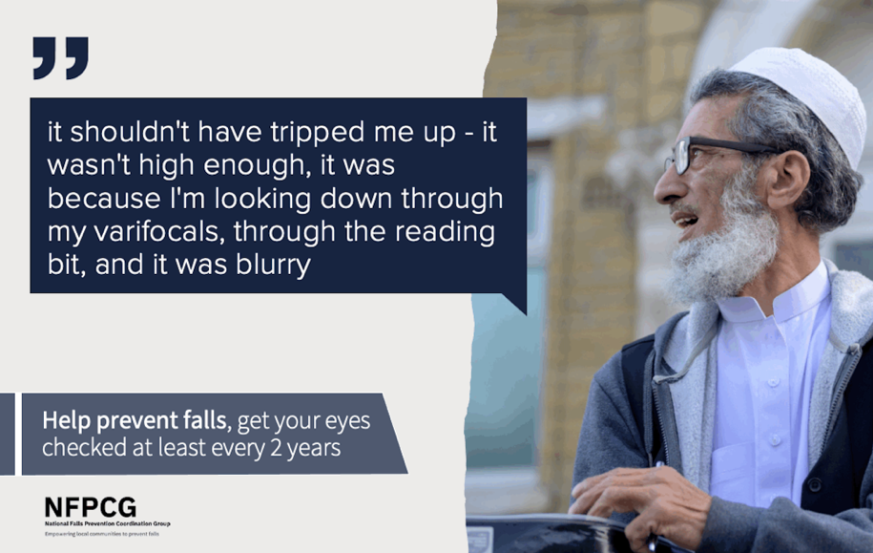

Slide 27
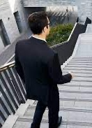
Multi-focal and Bi-focal glasses
Can impair contrast sensitivity and depth perception
Loss of acuity in the lower peripheral visual field
Protective responses, such as grabbing a rail, may also be hindered by the peripheral prismatic effect
total direct medical costs related to falls associated with multi-focal spectacles are estimated to be approximately $11 billion annually in the United States
Lord et al. 2000 Camb Univ Press; Chang J Refract Surg 2021

Slide 28
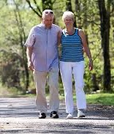
Physical activity in those with glaucoma
Objective physical activity monitoring and falls calendars for patients with Glaucoma diagnosis
multiple fallers had greater annual declines (per year) in daily active bouts, daily active minutes (-17 min/day), compared to non-fallers
Specifically reduced activity between 5-8pm
E, Mihailovic et al. Eclin Med 2021

Slide 29
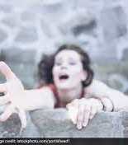
Fear = restriction in activity
If you can’t see what you are going to fall over?
Avoid busy places
Avoid going out as getting or when dark
Avoid places with perceived uneven surfaces
Take shorter steps and stare at the floor
Sit down too early and miss the seat
Furniture walk

Slide 30
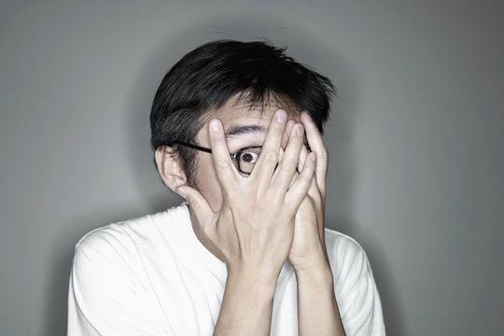
BSc Dissertation – Welsh 2011
N=67 (33 VIP, 34 normally sighted) aged 70-96 years
 | VIP | Normal
Fear of falling affects daily tasks such as shopping | 24% | 11%
Within those who were fearful:
38% VIP had had a fall compared to 25% with normal vision
62% of VIP avoided activity due to fear of falling despite having no falls in the last year

Slide 31
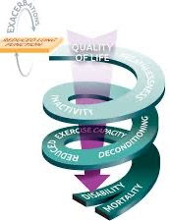
Spiral of inactivity
Less movement
Loss of strength and power
Loss of stamina and balance
Walking capacity reduces
Stiffness and Pain
Low mood
More falls

Slide 32
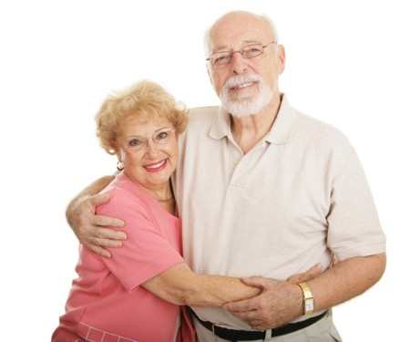
Views about falls
Older people with visual impairment and carers
‘I think it's, you know, that where the pavements are breaking up, and sometimes I'm really afraid of it’
’rugs in the house, tripping over rugs and things like that, the carpet, when you've got a divider between rooms’
‘You spill something on the floor in the kitchen, you don’t know where and by the time you’ve found it, you’ve slipped’
’Going down the stairs and it's the last step…the stair carpet was the same colour as the hall carpet, so it all just merged in, and it disappeared completely. It was a horrible feeling’
Brundle, Skelton et al. Health Expect. 2015

Slide 33
Views about falls
Older people with visual impairment and carers
‘My biggest advantage is knowledge of a place, cognitive mapping, that’s my biggest advantage. But it can also mean that you lead to making mistakes because you’re anticipating something and it’s changed’
‘I never saw the thing, and I tripped over one of them signs on the pavement’
‘Some of the shops insist they put all their wares outside all over the pavements. . . oh they’re a pain’
Brundle, Skelton et al. Health Expect. 2015

Slide 34
Can we prevent falls?

Slide 35
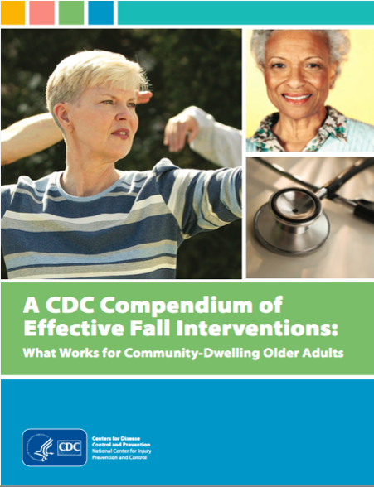
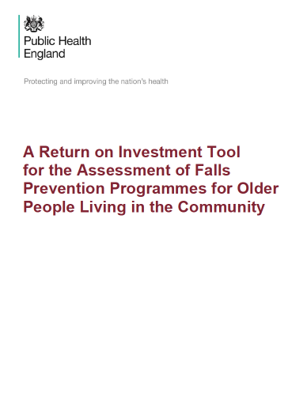
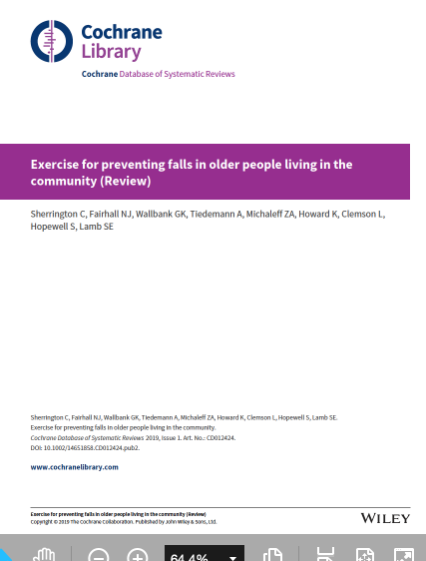
What works to reduce falls?

Slide 36


Multifactorial Interventions for reducing falls
Multifactorial assessment with multidisciplinary intervention
  23% ↓ in rate of falls
  No difference in the number of people who fall, hospital admissions or medical attention
  Possible ⇣ in fall related fractures
  Most evidence for home hazard assessment and behavioural interventions, medication review and action, group and home-based strength and balance exercise
  Exercise interventions alone were as effective as multifactorial interventions
Hopewell. Cochrane Library 2018; Gillespie. Cochrane Library 2012

Slide 37
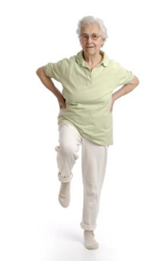
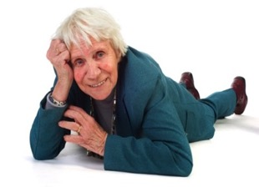
Exercise interventions for reducing falls
Exercise for preventing falls in older people living in the community
reduces rate of falls by 23% (RaR 0.77)
reduces the number of people experiencing one or more falls by 15% (RR 0.85)
  (both falls outcomes irrespective of high or lower risk of falls at baseline)
may reduce fall related fractures (RR 0.73)
may reduce falls requiring medical attention (RR 0.61)
© Dawn SKELTON
Sherrington et al. Cochrane Review 2019

Slide 38
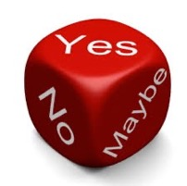
Sherrington et al. Cochrane Review 2019
The devil is in the detail
Not all falls prevention exercise programs work
@GCUResearch @LaterLifeTrain @ScotPARC

Slide 39
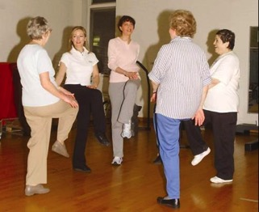
The evidence….. What works best?
Functional balance and strength
  Highly challenging balance training + progressive strength training
Frequency 3 x per week for ≥ 2 hours total
Duration ≥ 6 months
= Dose ≥ 50 hours
These types of exercise also reduce fear of falling
No evidence to support physical activity (eg. walking, dance) or resistance training alone
© Dawn SKELTON
Sherrington et al., JAGS 2008, NSWPHB 2011, BJSM 2016;
Cochrane Review 2019; Kendrick Cochrane Review FoF 2014; World Falls Guidelines, Age Ageing 2022

Slide 40
BUT - Not all physical activity is the same…
Not all PA improves strength or balance
Not all PA that DOES improve strength and balance REDUCES falls
Some PA increases risk of falls in frailer older people
  Brisk walking
  Cycling
  Sporting activities
UK Chief Medical Officers' Physical Activity Guidelines 2019
Skelton & Mavroeidi, JFSF 2019

Slide 41
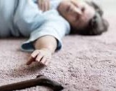
Can we prevent falls in people with visual impairment?
Visual impairment increases with age, especially for women¹
Age Related Macular Degeneration (ARMD) 53%, Cataract 36%, Glaucoma 12%²
88% people with cataract and ARMD were not in touch with any hospital eye services²
Evans et al, MRC trial, BJO 2002 ¹and BJO 2004²

Slide 42
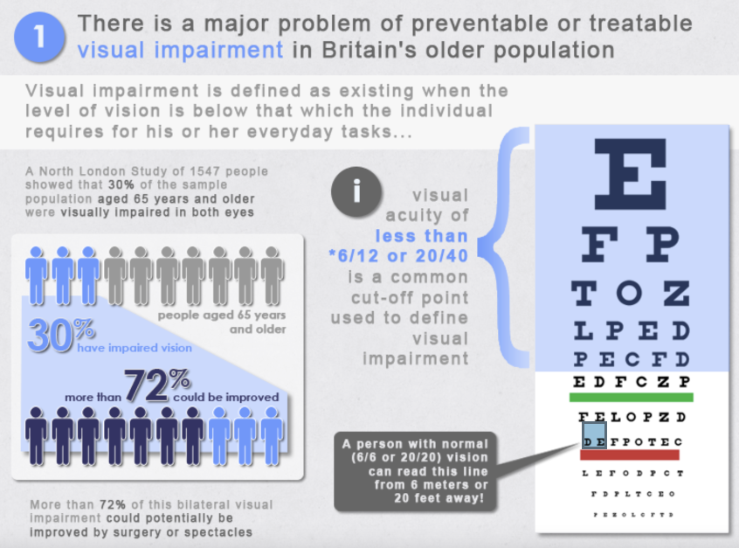

Slide 43
Take action - Guidelines
What do guidelines say?
  NICE Falls Guidelines 2013
    Ensure that a multifactorial assessment includes vision impairment
    Vision assessment and referral (as an intervention)
    NO EVIDENCE FOR VISION CORRECTION ON ITS OWN
Scoping study of UK falls clinics found that only 55% assessed vision
Lamb et al. 2007

Slide 44
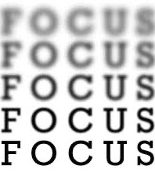


In a Falls Clinic
Example 4 Questions (NHS GGC) and recommendation to see optometrist if No to anything of these
  Are you able to read small print, bills, medicines?
  Can you recognise faces?
  Do you overfill cups when pouring?
  Do you have difficulty judging steps, stairs, kerbs?

Slide 45
BSc Dissertation – Welsh 2011
N=67 (33 VIP, 34 normally sighted) aged 70-96 years
Question | VIP’s Score | Controls Score
Reading | 1.54 ±0.96 | 4.23 ± 0.74 *
Recognising faces | 1.00 ±0.85 | 3.77 ± 0.96 *
Pouring | 3.15 ±1.47 | 4.62 ± 0.66 *
Steps/ kerbs | 2.69 ±1.21 | 4.38 ± 0.87 *
* P=<0.0001
These 4 questions easily differentiate those with significant visual impairment
Appropriate for referral/recommendation
BUT do people come? Do they perceive this as an expense they can’t afford?

Slide 46
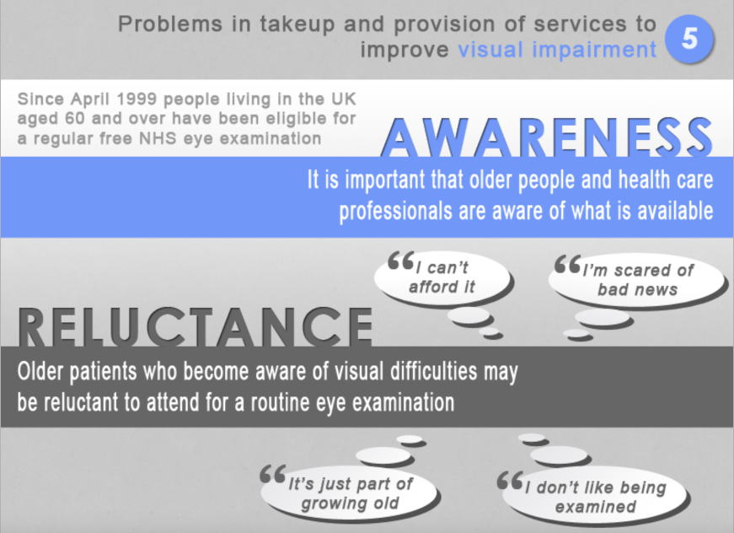

Slide 47
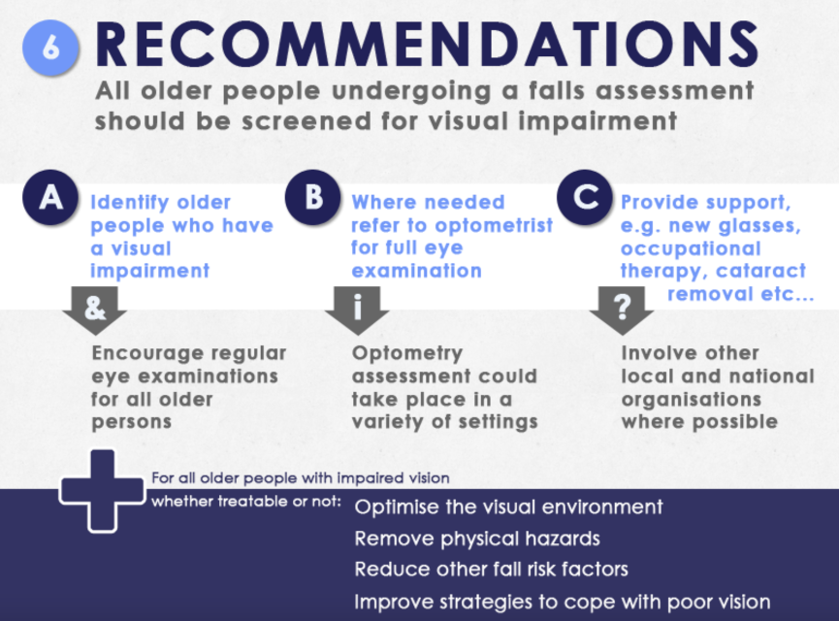

Slide 48

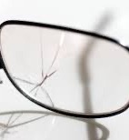
Take action - Guidelines
WORLD Falls Guidelines 2022
  Enquire about vision impairment as part of a multifactorial falls risk assessment, measure visual acuity and examine for other visual impairments such as hemianopia and neglect where appropriate
  Interventions include:
    Cataract Surgery
    Single lens glasses instead of multi-focal lenses if prone to trips
    Advice to avoid multifocal lenses when outdoors
    Advice on short term falls risk with new prescriptions and lenses
Montero-Odasso et al. Age ageing 2022

Slide 49
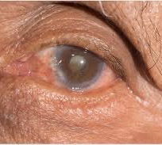
Cataract Surgery expedited
1st eye surgery
Showed 34% reduction in rate of falls
Reduction in rate of fractures
2nd eye surgery
Showed non-significant 32% reduction in rate of falls
RCT - 306 women 70+ yrs
1st eye cataract surgery expedited
(approx 4 weeks or routine 12 months wait)
RCT - 239 women 70+ yrs
2nd eye cataract surgery expedited
Harwood et al. BJO 2005; Foss et al. Age Ageing 2006

Slide 50
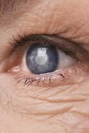
Cataract Surgery 1st and 2nd eye
24 month follow up of 409 people aged 65+
Fall incidence
  Prior to surgery 1.17 per year
  After 1st eye surgery 0.81 per year
  After 2nd eye surgery 0.41 per year
First eye surgery substantially improves vision in older people with cataract, but second eye surgery is required to minimise fall incidence.
Keay et al. Med J Aust 2022

Slide 51
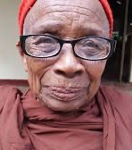
New glasses?
616 people aged 70+ randomised to usual care or vision assessment by optometrist
Intervention group
  New glasses (92 people)
  Home visit with OT (24 people)
  Glaucoma Management (17 people)
  Cataract Surgery (15 people)
Significantly increased falls and fractures in the intervention group!
Older people have difficulty adjusting to sudden change in vision
Prescription of new lenses should involve careful instruction in their use
Cumming et al. JAGS 2007

Slide 52
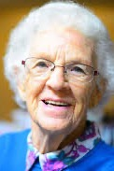
Changing multifocals back to single lens glasses?
Can this reduce falls?
YES - by around 40% in people who regularly took part in outside activities.
BUT - In frailer people, who spent more time inside, no significant difference was seen in falls inside and a significant increase was seen in falls outside.
Haran MJ et al. BMJ 2010

Slide 53
Vision intervention as a component in a multi-component falls intervention
First study to look at 3 components of a MF intervention individually and together
1090 people aged 70+
RCT - Home hazard management, vision improvement and group based exercise (individually and a mix – 8 groups)
The number of people needed to be treated to prevent one fall a year ranged from 32 for home hazard management to 7 for all three interventions combined.
Fall reduction: Group exercises ✓ [rate ratio 0.82, p=0.02] Home hazard X Vision assessment X
All three ✓ ✓ [rate ratio 0.67. P=0.004]
Day et al. BMJ 2006

Slide 54
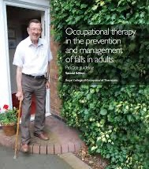
Intervention for VIP older people
391 people aged 75+, visual acuity 6/24 or worse, RCT, one year follow up
Intervention groups
  Home safety assessment and modification by OT
  Exercise programme prescribed by a physiotherapist (Otago) and Vit D
  Social visits
Fewer falls in OT group (RR 0.59)
No change in falls in home-based exercise group
Adherence poor for unsupervised exercise
VIP Study
Campbell et al. BMJ 2005; La Grow et al. Inj Prev 2006

Slide 55
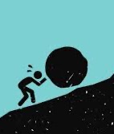
Challenges
VIP Study
OT Recommendations
  Characteristics of individual service user
  Cost and size of changes
  Challenges with systems for provision (HP)
  Lack of knowledge about visual impairment (HP)
Exercise engagement
  Confusion, boredom, anxiety, low mood, physical problems and lack of motivation at home
  Remembering/seeing/hearing what to do
  Lack of support
Campbell et al. BMJ 2005; La Grow et al. Inj Prev 2006

Slide 56

Facilitators
OT recommendations
  Highlighting relevance to individual circumstances
  Importance of shared decision making
  Chance to weigh up pros and cons
  Information and carer support useful
Exercise engagement
  Empathetic communication is helpful
  Reinforcement and encouragement
  Integration of exercise with enjoyable activities
  Alternative media
VIP Study
Campbell et al. BMJ 2005; La Grow et al. Inj Prev 2006

Slide 57
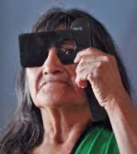
VIP2UK
Feasibility Study where OT delivers the exercise and the OT intervention
Peer mentors to support and exercises (Otago) given in variety of formats (DVD, audio, large print)
Learned lessons on adherence to exercise from Campbells Study
Focus groups and interviews
RCT into 3 arms as per Campbell
100% partially or fully adhered to home safety intervention
86.7% reported average 3 x week exercise (higher than original VIP study)
‘You might fall while you're doing your exercises’
Waterman, Skelton et al. Trials 2016

Slide 58
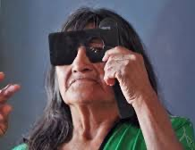
Lessons learned in VIP2UK
VIP not too keen on Peer Mentors visiting them at home (prefer calls)
Outcome measures need to be done by interview (not paperwork)
Generally not comfortable in exercising at home unless someone is around (still fearful that activity increases risk)
Too many home exercises so few done
Seem to have swapped general physical activity for the exercises (compensation)
Did not increase walking activity
Waterman, Skelton et al. Trials 2016

Slide 59

Barriers to home safety interventions
Being old /not identifying
Highlights vulnerability
Lack of support to implement
No perceived / don’t believe at risk
No strangers in home
Perceived threat to independence
Professionals lack visual impairment awareness
Resistance to change
Too much of an effort
Waterman, Skelton et al. Trials. 2016

Slide 60

Barriers to home exercise interventions
Already do enough exercise
Believe too old to exercise
Multiple impairments
Just not interested
Lack of alternative formats or support to remember
Laziness
Threat to independence
Time consuming
Fearful
Waterman, Skelton et al. Trials. 2016

Slide 61
Enablers to home safety interventions
Minimise risks within limits of acceptability
Reasons for modifications & benefits are understood
Retaining independence
Seeing peers have done something similar
Trial and demonstrate
Changes suggested rather than forced
Confidence
Explain what needs changing sensitively
Waterman, Skelton et al. Trials. 2016

Slide 62
Enablers to home exercise interventions
Demonstrate each exercise
Feeling safe to exercise
Health conditions understood/ accommodated
Incorporate with activities enjoyed and into everyday life
Individually tailored
Understand procedure/ purpose
Build up gradually
Provide continued support
See a benefit
Have a go attitude
Waterman, Skelton et al. Trials. 2016

Slide 63


Feasibility Study to adapt an evidence based group exercise programme for use with visually impaired older people for falls prevention
64 people aged 60+ who attend low vision clinics or members of vision charities
RCT usual care vs FaME exercise
12 week group exercise sessions (1 hr) and home based exercise (2hrs)
Adams, Skelton et al. BMC Geriatrics 2018

Slide 64
Views about group exercise
Older people with visual impairment
‘It’s soulless when you are doing that in the house on your own because there’s a fun element in the class, and there’s a bit of banter’
‘So I decided to go to this study and see if it helped me to… for the muscle part. You know, to build muscle. And it did actually give me a lot more confidence’
‘Yes [I found the homework book beneficial]. I mean, it’s sensible to say use this when you put your toast on […] I liked the prompts.”
‘Where using the escalators I’m probably more confident than I was’
De Jong, Skelton et al. Disabil Rehab 2019

Slide 65
Views about group exercise
Postural Stability Instructors
‘I felt the clients coped with it absolutely amazing, obviously there is a few differences depending on illnesses etc., but that is in sighted people as well, so I couldn’t see any reason why those people couldn’t be in a mainstream group, I would not segregate them’
‘I think the first few sessions I was terrified I was patronising them, can you do this, can you do that? These people might be visually impaired but they are not daft’
‘Sometimes in mainstream I can sit or stand quite quiet and they continue the exercise, but with the visually impaired you do scenarios, like we are going to step over this puddle, where in mainstream, you can just say once’
De Jong, Skelton et al. Disabil Rehab 2019

Slide 66

Adaptations to FaME delivery
Adaptations to include:
Descriptive commentary
Use of personal names
Voice recognition
Hands on
Big gestures
Room layout and anchor point
De Jong, Skelton et al. Disabil Rehab 2019

Slide 67

First steps
Are they keeping glasses clean?
Are they wearing the right prescription?
Ensure they come for their regular check ups
Improve your communication with local falls services

Slide 68

They may need?
Referral or recommendation to a Falls Clinic
A home hazard assessment and discussion about coping behaviours with an Occupational Therapist

Slide 69



They may need?
Better lighting
Reveal edge of steps
Remove glare
Contrast made clear
Carpets removed/changed
Can they access care and repair?
An OT can refer for adaptations to be made to a persons’ home at no / reduced cost

Slide 70

They may need?
Cataract Surgery
Glaucoma management
Referral or recommendation to a Vision Charity (eg. Visibility) for support

Slide 71
Resources
Info on local Falls Services
Info on Visibility Scotland
Royal College of Optometrists
Royal College of Opthalmologists
VISIBLE
Posters from NFPCG
Deconditioning leaflets in easy read
Links to guidance and further reading

Slide 72


Community Falls Prevention Programme
Phone: 0141 427 8311
E-mail: gg.fallsadmin@nhs.net
https://www.nhsggc.scot/download/community-falls-prevention-programme/
Telephone triage
Visit within 5 working days
Multi factorial Screen
Tailored action plan
Triggered referrals
Leaflets

Slide 73

Patient Support Services funded by NHS GGC
  Gartnavel General Hospital (Room 8)
  0141 332 4632
Making the most of your vision
Reading and navigation
Technology and assistive apps
Benefits and entitlements
Emotional support and much more

Slide 74



Royal College of Optometrists
Falls Checklist
The Ageing Eye: Vision and Falls Course
https://www.college-optometrists.org/category-landing-pages/falls/focus-on-falls

Slide 75

Recommendations for identifying patients at high risk of falls include:
asking about fall history for those at risk
promoting more regular eye exams with smaller prescription changes
suggesting earlier first eye cataract surgery
advising patients about spectacle magnification effects on gait
proposing either an additional intermediate add multifocal or distance single vision spectacles to active long-term multifocal wearers
and referring low vision patients for home hazard modification using the College’s falls team directory.

Slide 76


System and Assurance Framework for Eye-health (SAFE)
The Clinical Council for Eye Health Commissioning (CCEHC) England
And for Scotland - https://www.isdscotland.org/health-topics/eye-care/general-ophthalmic-services/

Slide 77



VISIBILE Resources
https://healthinnovationnetwork.com/visible/?cn-reloaded=1

Slide 78


NFPCG Posters

Slide 79





NFPCG Deconditioning Resource Suite https://www.bgs.org.uk/resources/deconditioning-information-for-providers-of-services-for-older-people-and-the-public
Launched 19th April 2022

Slide 80

What can you do better tomorrow?
Be aware
Put posters up
Print out info on local falls services
Watch people walk in
Ask about falls
Promote physical activity
Refer / recommend to attend Falls Clinic
Refer / recommend to do strength and balance exercise
THANK YOU
dawn.skelton@gcu.ac.uk

