Slide 1
Referencing/Cite Them Right for beginners
Referencing/Cite Them Right for Beginners
Sir Alex Ferguson Library

Slide 2
Aims of the session
Aims of the session
By the end of this session, you'll be able to:
Recognise the importance of referencing
Find the information you need for a reference
Recognise the referencing style you need for your assignments
Access Cite Them Right to find examples of your referencing style

Slide 3
What is referencing?
What is referencing?
Referencing is the process of acknowledging any work you have used in your assignments.
It is a key component of academic writing. You are required to reference all your assignments at GCU.

Slide 4
Why do we reference?
Why do we reference?
We reference for many reasons:
It shows the evidence for your ideas.
It shows that you have done research.
It allows the reader to find the sources you have used.
It helps you avoid academic misconduct or plagiarism.

Slide 5
What is plagiarism?
What is plagiarism?
Plagiarism is using someone else's work as your own without crediting them.
It can be deliberate or accidental – both are taken seriously by GCU.
Referencing and note-taking will help you to avoid plagiarism.

Slide 6
When do I need to reference?
When do I need to reference?
You need to reference when you:
Directly quote or use the exact words from a source
Put ideas from a source into your own words (paraphrasing)
Use someone else's work to support your ideas

Slide 7
What types of sources need a reference?
What types of source need a reference?
You need to reference any source you use in your assignments.
This includes:
Books
Journal articles
Reports
Statistics
Online resources
All of the sources you use in your work need to be referenced.

Slide 8
What information do I need for a reference?
What information do I need for a reference?
All references will need the same general pieces of information. Find this information for every source you use.
Author – who created the source?
Year – when was the source created?
Title – what is the name of the source?
Publication details – where can you find the source?
Once you have this information, you can create a reference. You write this information in a specific order/format (also called a style).

Slide 9
Where do I find information about a source?
Where do I find information about a source?
Depending on the source, the information you need is in different places:
Books: front cover, first page of the book
Journal articles: first page, across the top or bottom of the page
If you find the source through our Discover search, the Discover page will also have the information you need.

Slide 10
Parts of a reference
Parts of a reference
A reference is always made up of two parts:
The in-text citation in the body/text of your essay. This includes the author’s surname, the year and (if using a direct quote or paraphrasing) the page number.
The full reference in your reference list at the end of your work.

Slide 11
What referencing style do I need to use?
What referencing style do I need to use?
Different referencing styles have different requirements.
Many assignments at GCU will use the style Cite Them Right Harvard, but different courses will use different styles.
Always check your module handbook or ask your tutor if you are unsure.

Slide 12
Harvard referencing styles
Harvard referencing styles
There are lots of referencing styles called Harvard. Different journals and academics use different versions of Harvard.
We use the Cite Them Right Harvard style at GCU.
You don’t need to memorise this style - use our Cite Them Right platform to find the correct information.

Slide 13
Cite Them Right
Cite Them Right
Cite Them Right is an online platform which includes all the information you need about many styles used at GCU.
It has a Tutorial which you can work through in your own time. This covers the basics of referencing.
Cite Them Right has detailed examples of references for many information sources.

Slide 14
Open Cite Them Right
Open Cite Them Right
Open your Internet browser (Google Chrome, Microsoft Edge). Type ‘gcu library’ into the search bar and select the top result. This is the Library homepage.
On the left-hand menu, select ‘Online Resources’, then choose ‘Database A-Z’.
Click 'C'. Scroll down to the result called Cite Them Right. Click ‘Available Online’.

Slide 15
Cite Them Right – access the tutorial
Cite Them Right – access the tutorial

Slide 16
Cite Them Right – find your style
Cite Them Right – find your style

Slide 17
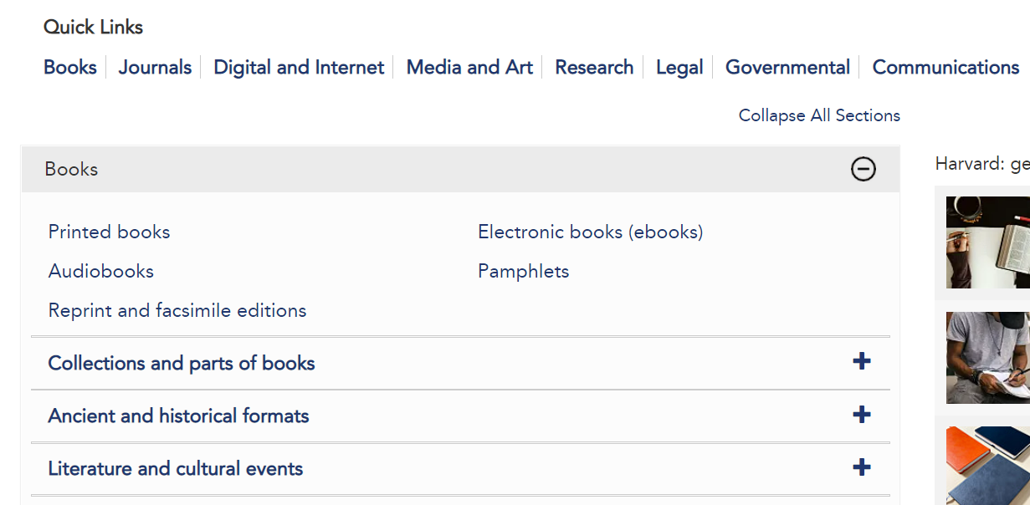
Cite Them Right – choose a source type
Cite Them Right – choose a source type

Slide 18
CTR Harvard - Example book reference
Example book reference
In-text citation: (Cottrell, 2019, p.20)
Full reference:
Cottrell, S. (2019) The study skills handbook. 5th edn. London: Red Globe Press.
Year of publication
Author’s surname, initial
Title of book
Edition
Place of publication
Publisher

Slide 19
CTR Harvard - Example article reference
Example article reference
In-text citation: (Bose, 2020, p.68)
Full reference:
Bose, M. (2020) ‘Public leadership in a public sector’, Journal of Leadership Studies, 14(1), pp.66-73.
Author’s surname, initial
Year of publication
Title of article
Volume and issue number
Title of journal
Page numbers

Slide 20
Reference list
Reference list
Your reference list goes at the end of your assignment and should include everything you have read.
If you’re using Cite Them Right Harvard, the list should be arranged alphabetically by the first author’s surname. If you’re using a different style, check the Cite Them Right website for advice.

Slide 21
Multiple authors
Multiple authors
Q: If the source has lots of authors, do I list them all?
- 1 to 3 authors – list them all.
- If your source has four or more authors, use the first author’s name and then the phrase ‘et al’. Use this phrase in your citation and the full reference list.
Example:
In a review of the literature (Norrie et al., 2012)…
Norrie, C. et al. (2012) 'Doing it differently? A review of literature on teaching reflective practice across health and social care professions', Reflective Practice, 13(4), pp. 565–578.

Slide 22
Individual vs group authors
Individual vs group authors
Q: What if there isn’t an individual author?
- If a group or organisation created your source, list them as the author.
Example:
According to recent figures (Scottish Government, 2022)…
Scottish Government (2022) The Scottish Health Survey: 2021 edition. Available at: https://www.gov.scot/publications/scottish-health-survey-2021-volume-1-main-report/ (Accessed: 11 November 2022).

Slide 23
Further help
Further help
Our Referencing and Plagiarism guide includes these links and support.
Referencing and Plagiarism guide
We have a short online video which covers the basics of the Cite Them Right platform.
Link to video (4 minutes)
The University has more support around academic integrity, including a GCU Learn module where you can learn and test your knowledge.
Academic Integrity

Slide 24
Aims of the session (recap)
Aims of the session (recap)
By the end of this session, you'll be able to:
Recognise the importance of referencing
Find the information you need for a reference
Recognise the referencing style you need for your assignments
Access Cite Them Right to find examples of your referencing style

